Slide 1
RegEx and CFGs
CSPC 105
Automata Theory and Formal Languages
Introduction to Context-Free Grammar
L.P.Facun

Slide 2
In Context-Free Grammars (CFGs), we define language using rules (specifically `production rules`)
CSPC 105
Louis Philippe Facun
Notes:
Regular expressions are basically another notation for defining Languages.
-previously english

Slide 3
Formally, CFGs consists of 4-tuples: G = {N, T, P, S}
N – non terminal symbols (variables)
T – terminal symbols (usually from alphabets)
P – production rules (in form of A -> b)
S – start symbol (one from non terminal symbols)
CSPC 105
Louis Philippe Facun
Notes:
Regular expressions are basically another notation for defining Languages.
-previously english

Slide 4
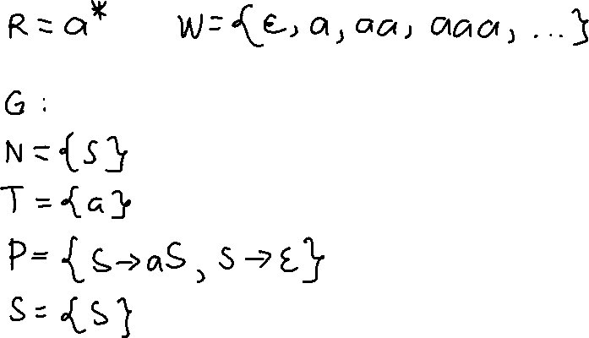
Ex. 1 (Constructing CFG from RegEx)
CSPC 105
Louis Philippe Facun
Notes:
Regular expressions are basically another notation for defining Languages.
-previously english

Slide 5
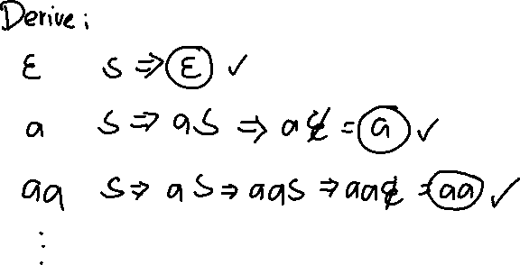
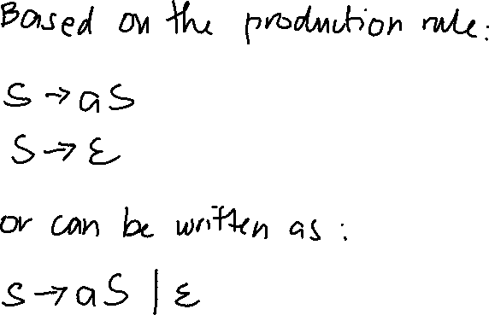
Ex. 1 (Constructing CFG from RegEx)
CSPC 105
Louis Philippe Facun
Notes:
Regular expressions are basically another notation for defining Languages.
-previously english

Slide 6
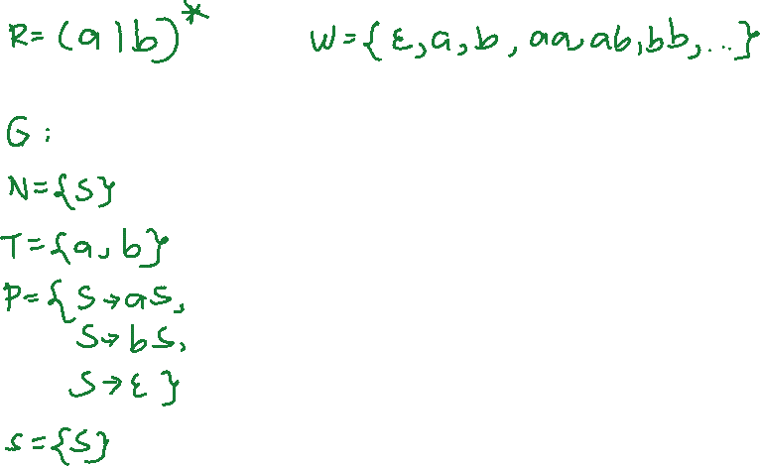
Ex. 2 (Constructing CFG from RegEx)
CSPC 105
Louis Philippe Facun
Notes:
Regular expressions are basically another notation for defining Languages.
-previously english

Slide 7
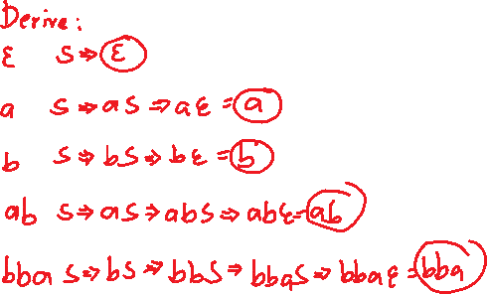

Ex. 2 (Constructing CFG from RegEx)
CSPC 105
Louis Philippe Facun
Notes:
Regular expressions are basically another notation for defining Languages.
-previously english

Slide 8
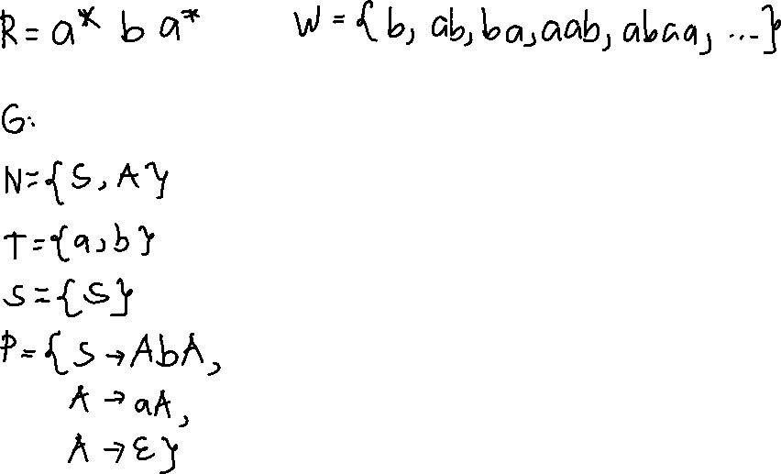
Ex. 3 (Constructing CFG from RegEx)
CSPC 105
Louis Philippe Facun
Notes:
Regular expressions are basically another notation for defining Languages.
-previously english

Slide 9
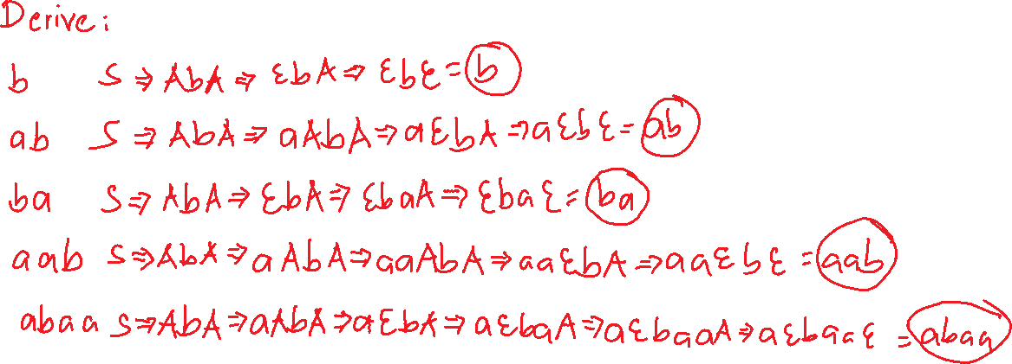
Ex. 3 (Constructing CFG from RegEx)
CSPC 105
Louis Philippe Facun
Notes:
Regular expressions are basically another notation for defining Languages.
-previously english

Slide 10
Questions?
Louis Philippe Facun

