Slide 1
Introduction
CSPC 105
Automata Theory and Formal Languages
Review on Relations and Graphs
L.P.Facun

Slide 2
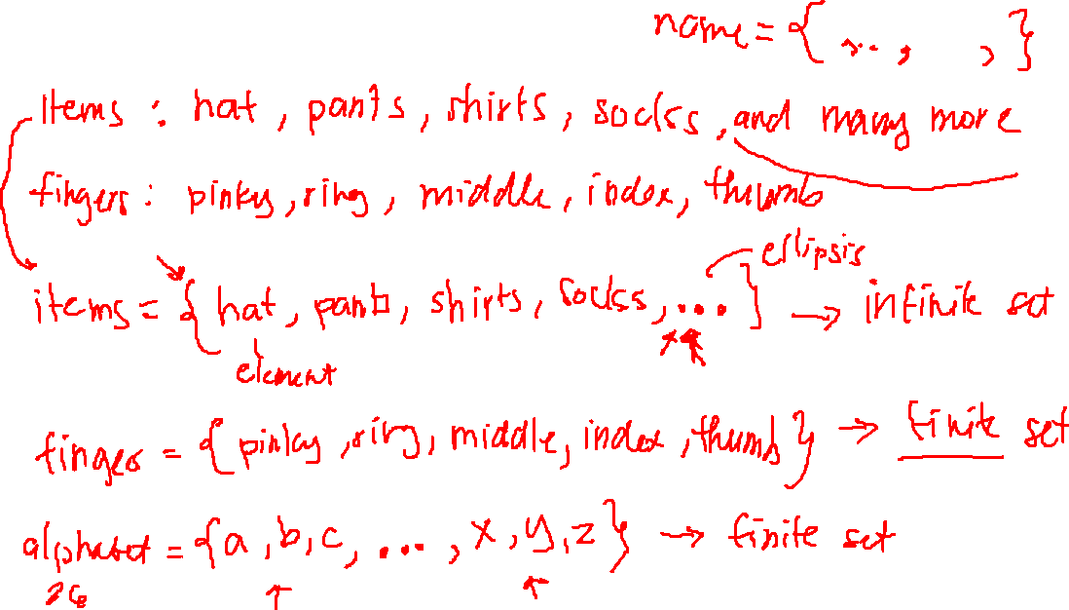
Sets: collection of things
CSPC 105
Louis Philippe Facun

Slide 3
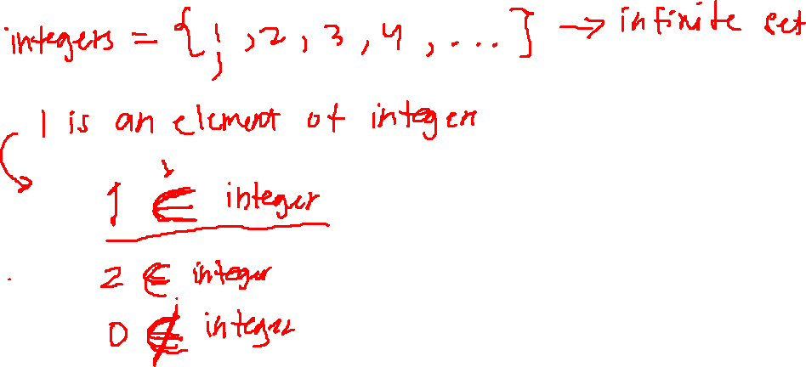
Sets: collection of things
CSPC 105
Louis Philippe Facun

Slide 4
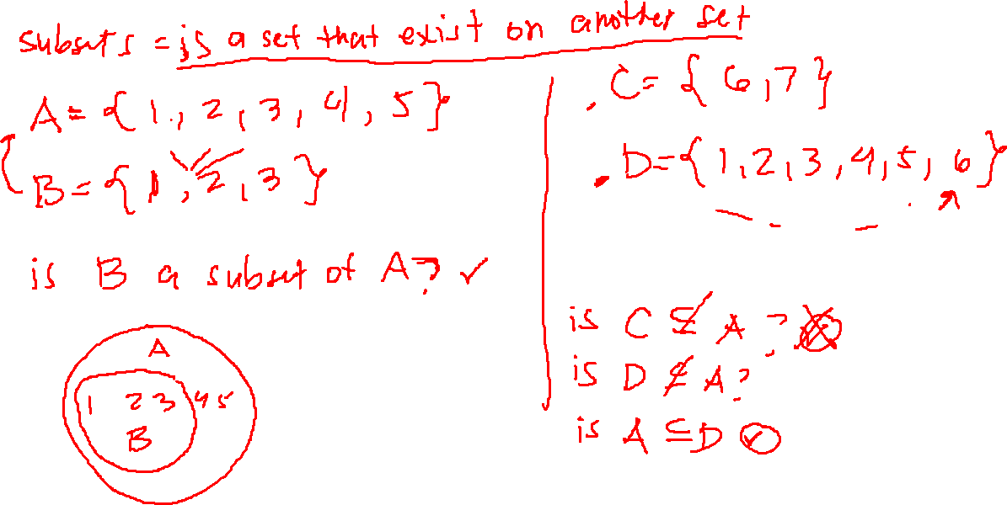
Sets: collection of things
CSPC 105
Louis Philippe Facun

Slide 5
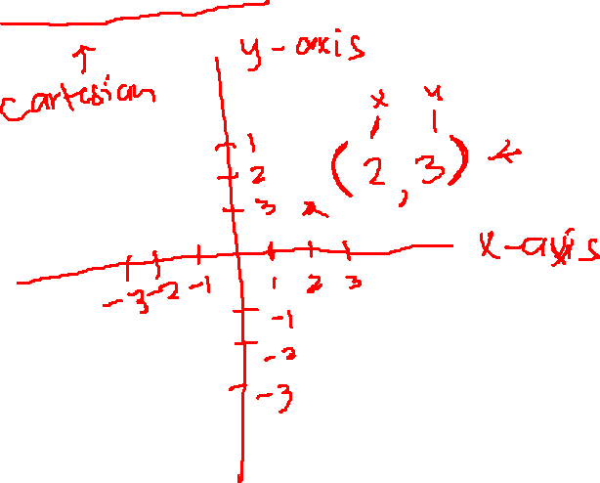
Rectangular coordinate system
CSPC 105
Louis Philippe Facun

Slide 6
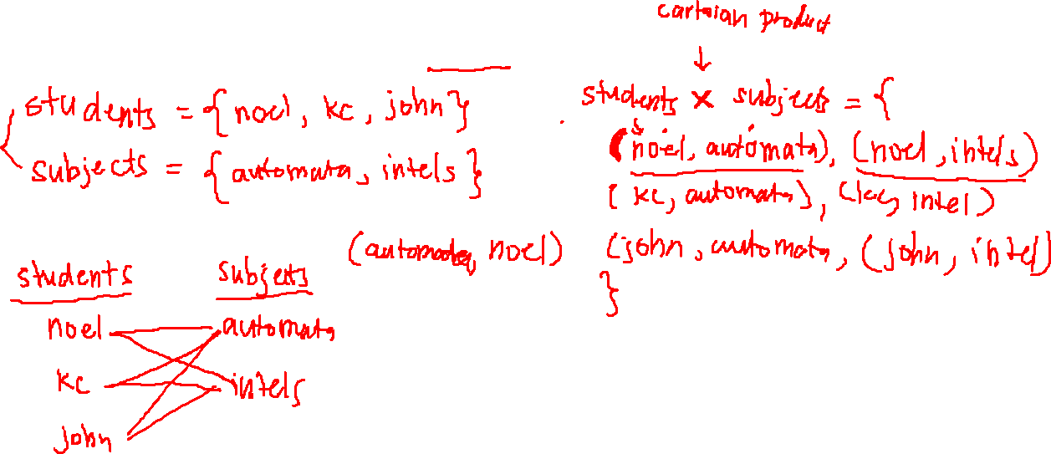
Cartesian product of sets
CSPC 105
Louis Philippe Facun

Slide 7
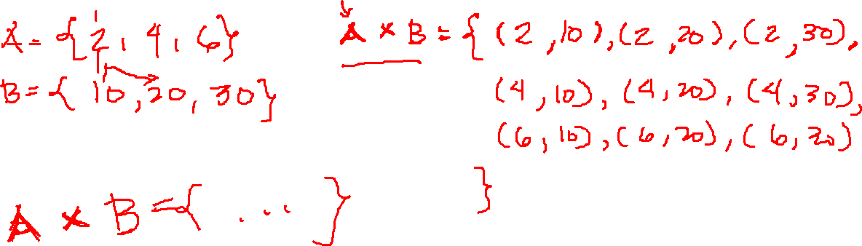
Cartesian product of sets
CSPC 105
Louis Philippe Facun

Slide 8
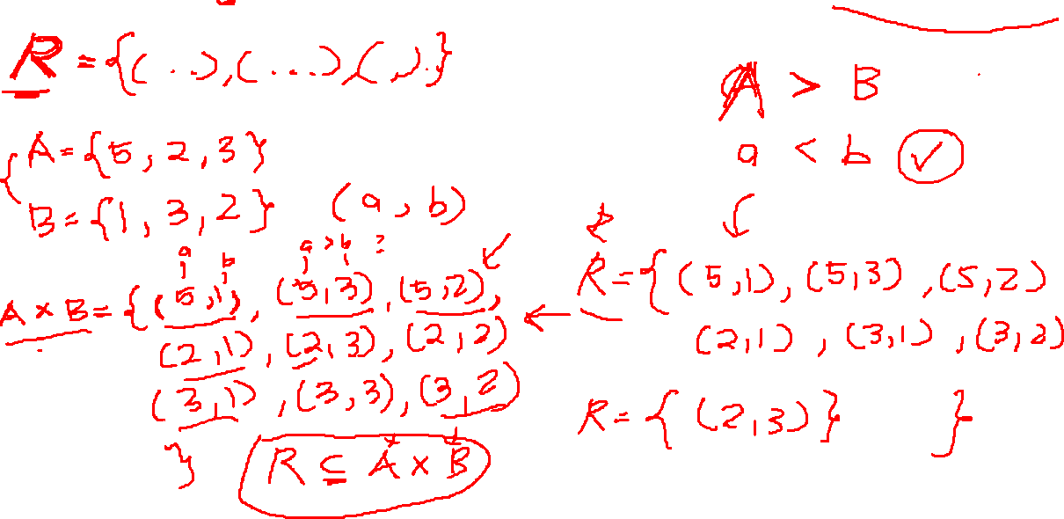
Relation: set of ordered pairs that satisfy a relationship
CSPC 105
Louis Philippe Facun

Slide 9
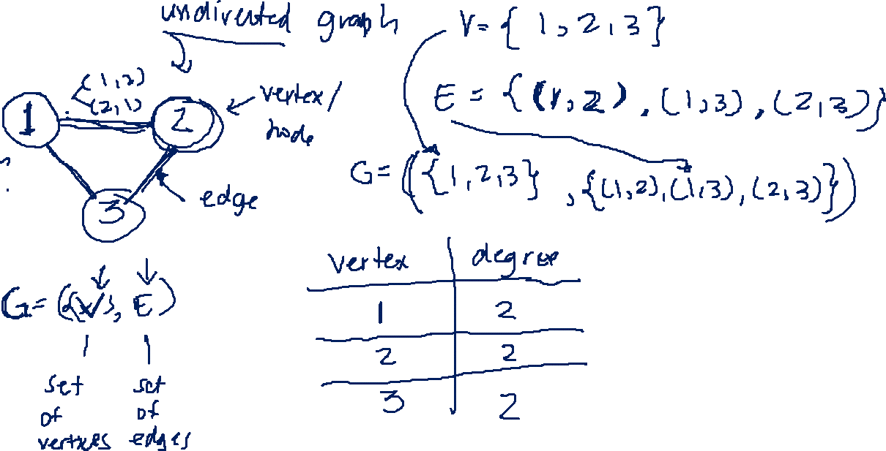
Graph
CSPC 105
Louis Philippe Facun

Slide 10
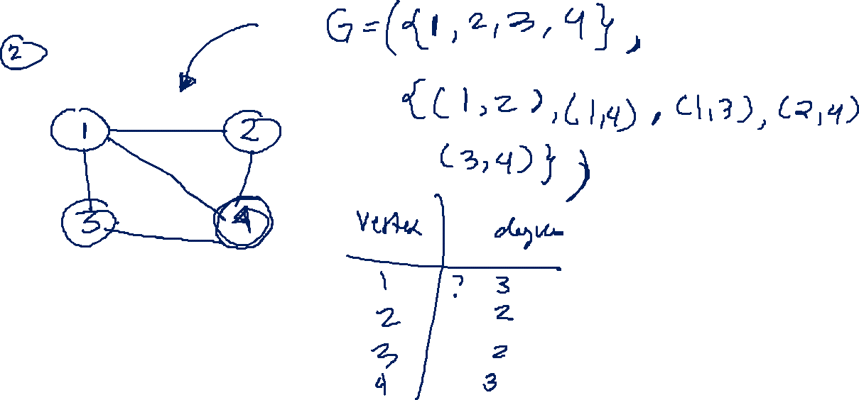
Graph
CSPC 105
Louis Philippe Facun

Slide 11
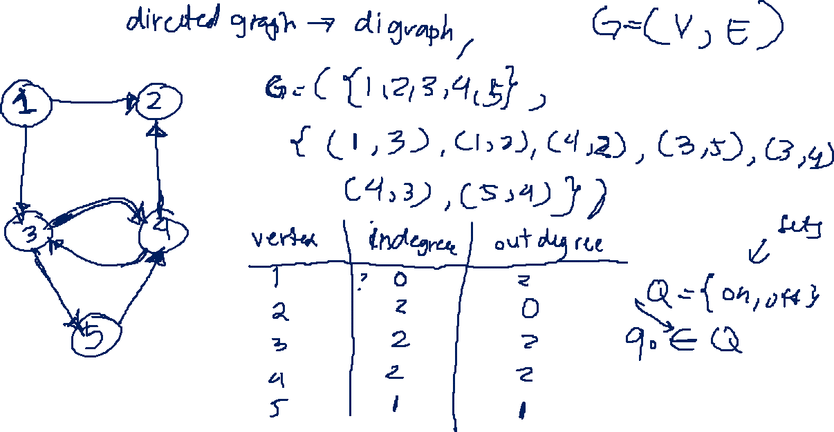
Graph
CSPC 105
Louis Philippe Facun

Slide 12
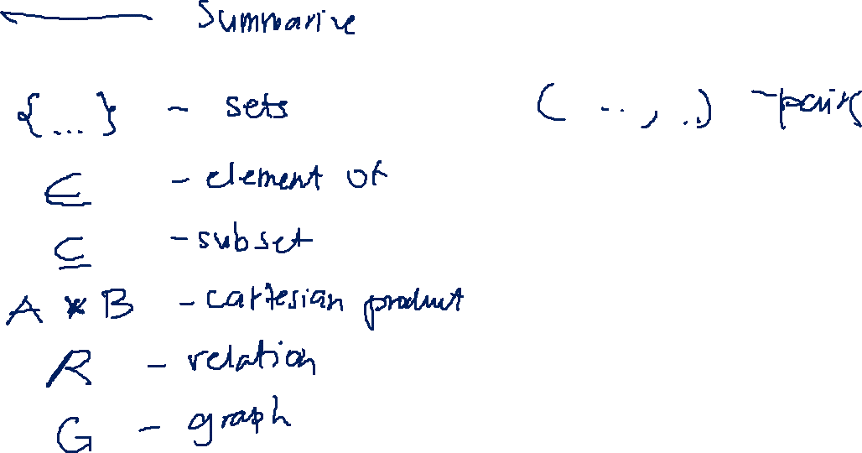
Activity!
CSPC 105
Louis Philippe Facun

