Slide 1
RegEx and CFGs
CSPC 105
Automata Theory and Formal Languages
Finite Automata and RegEx Equivalence
L.P.Facun

Slide 2
For every automaton there is RegEx that defines its language. (Converting RegEx to DFA)
Also, for every RegEx, there is automaton that accepts the language that RegEx represents. (Converting DFA to RegEx)
CSPC 105
Louis Philippe Facun

Slide 3
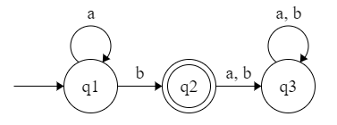
RegEx to DFA (1)
Example strings:
a
aab
aaab
aaaab
aaaaab
a*b
CSPC 105
Louis Philippe Facun

Slide 4
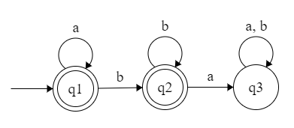
RegEx to DFA (2)
Example strings:
a
ab
aab
abb
aaabbb
a*b*
CSPC 105
Louis Philippe Facun

Slide 5
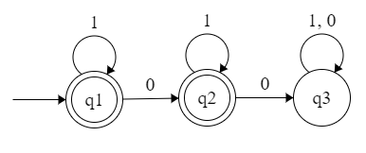
RegEx to DFA (3)
Example strings:
0
01
10
101
1101111
1*01*
CSPC 105
Louis Philippe Facun

Slide 6
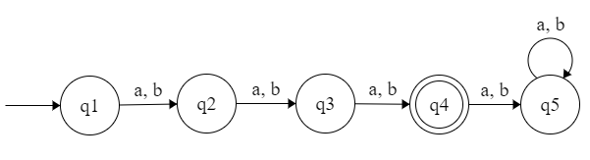
RegEx to DFA (4)
Example
strings:
aaa
aab
abb
bbb
bba
(a|b)(b|a)(a|b)
CSPC 105
Louis Philippe Facun

Slide 7
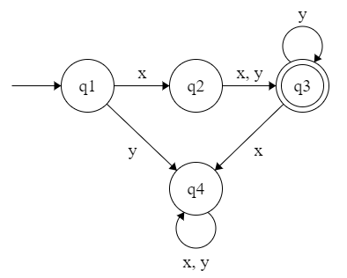
RegEx to DFA (5)
Example strings:
xy
xx
xyy
xxyyyy
xxyyyyy
x(y|x)y*
CSPC 105
Louis Philippe Facun

Slide 8
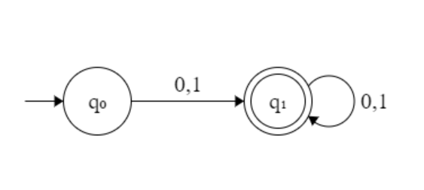
DFA to RegEx (1)
Example strings:
0
1
010
01010101
01010101011111
(0|1)(0|1)*
CSPC 105
Louis Philippe Facun

Slide 9
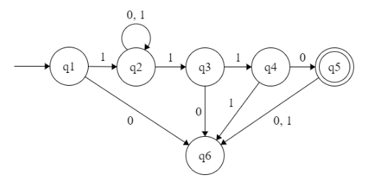
DFA to RegEx (2)
Example strings:
1110
10110
11110
1000110
10101010110
1(0|1)*110
CSPC 105
Louis Philippe Facun

Slide 10
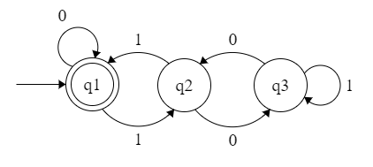
DFA to RegEx (3)
Example strings:
0
00
000
0000
00000
0*
CSPC 105
Louis Philippe Facun

Slide 11
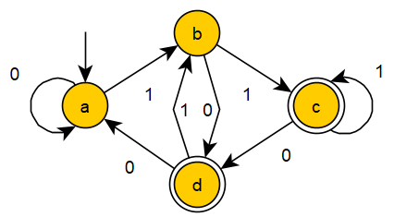
DFA to RegEx (4)
CSPC 105
Louis Philippe Facun

Slide 12
Questions?
Louis Philippe Facun

