Slide 1
RegEx and CFGs
CSPC 105
Automata Theory and Formal Languages
Regular Expressions – Activity Answer
L.P.Facun

Slide 2
DETERMINE IF A GIVEN STRING IS VALID OR NOT FROM A GIVEN REGULAR EXPRESSION
CSPC 105
Louis Philippe Facun

Slide 3
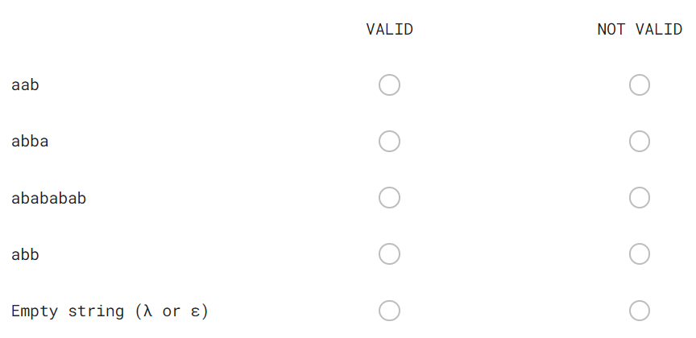
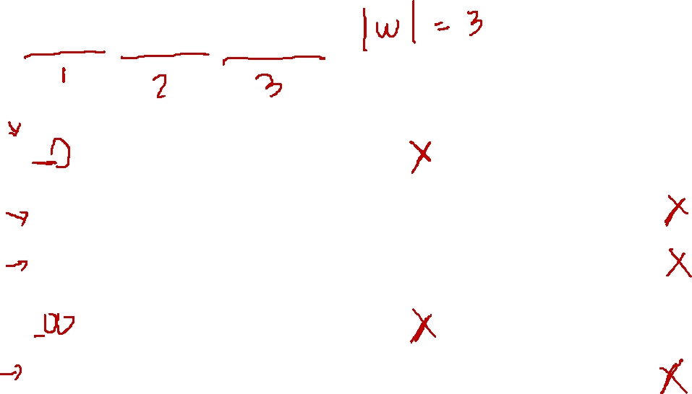
(a|b)(b|a)(a|b)
CSPC 105
Louis Philippe Facun

Slide 4
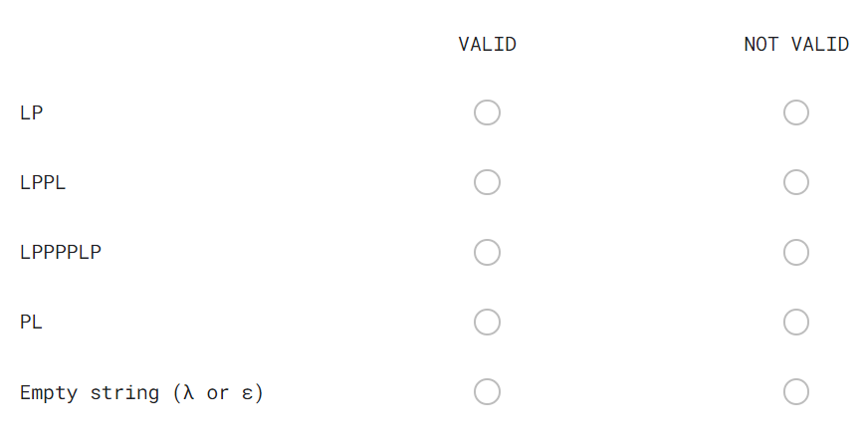
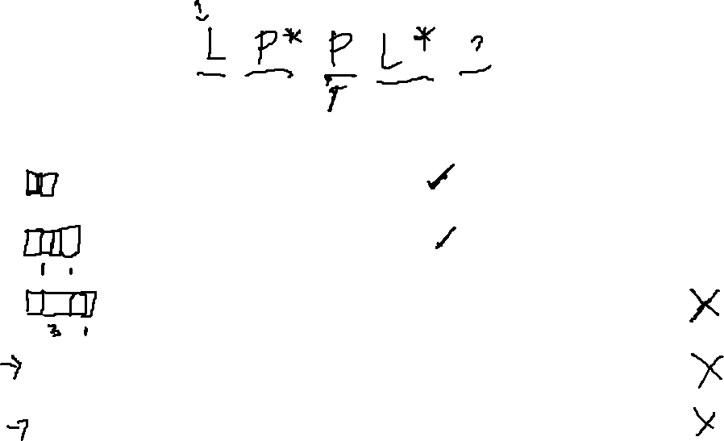
LP*PL*
CSPC 105
Louis Philippe Facun

Slide 5
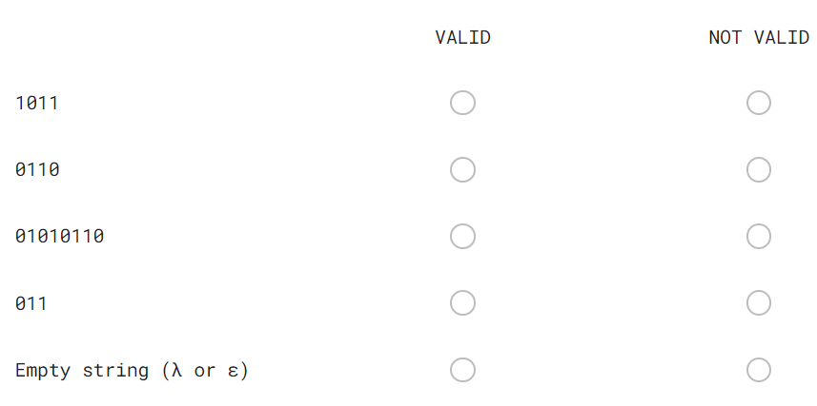
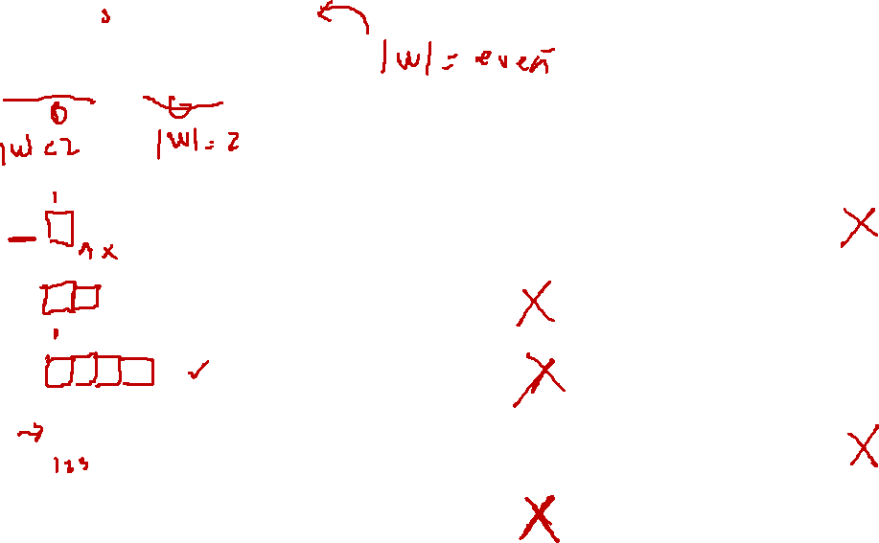
(01)*(10)*
CSPC 105
Louis Philippe Facun

Slide 6
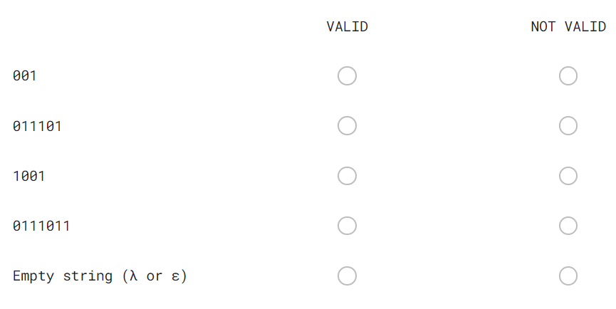
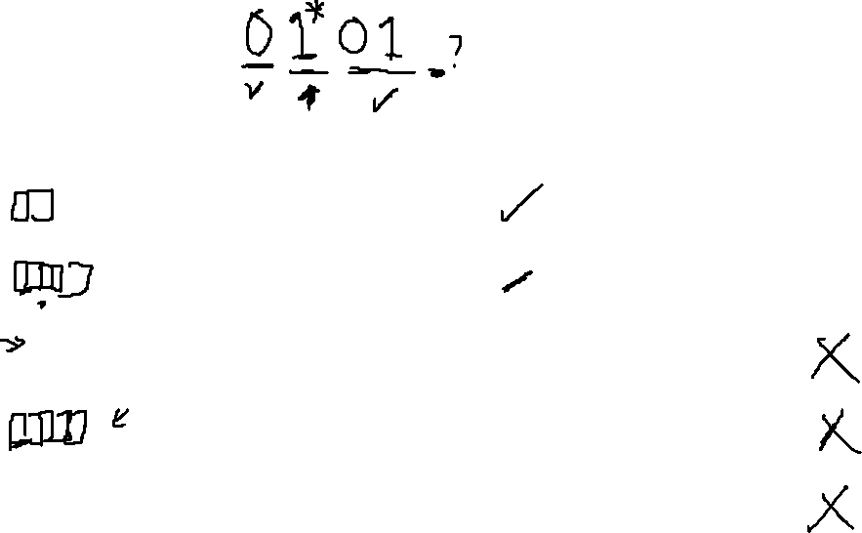
(01*)01
CSPC 105
Louis Philippe Facun

Slide 7
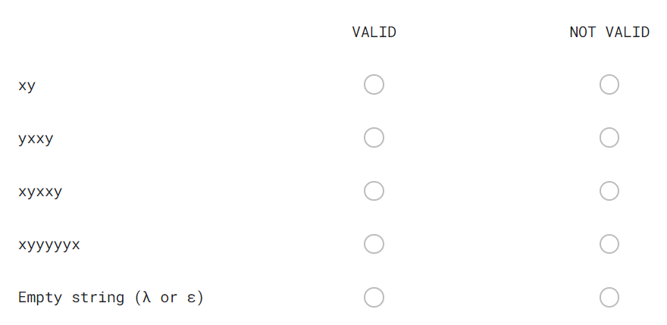
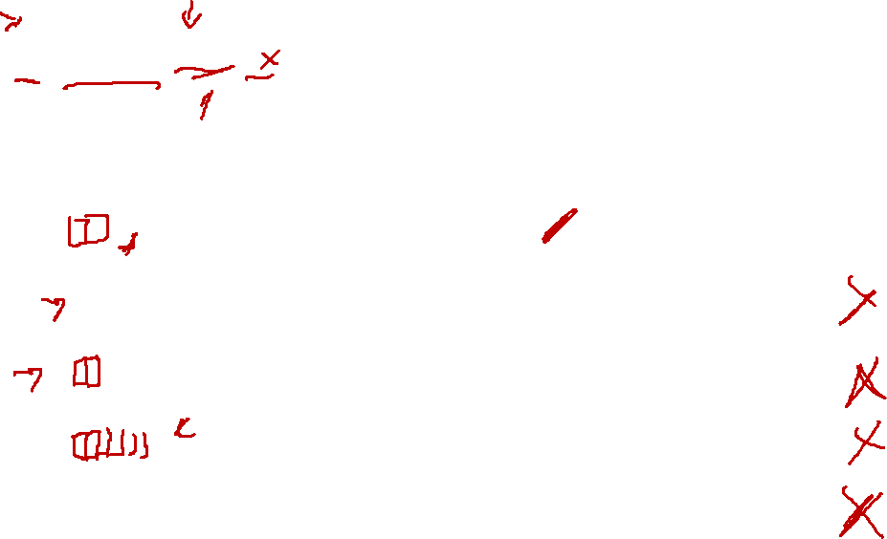
x(y|x)y*
CSPC 105
Louis Philippe Facun

Slide 8
WRITE THE REGULAR EXPRESSION OF A GIVEN DESCRIPTIVE LANGUAGE DEFINITION
CSPC 105
Louis Philippe Facun

Slide 9
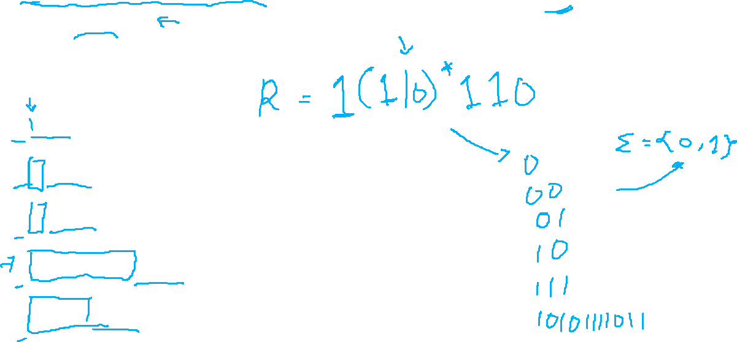
Set of all strings that starts with `1` and ends in `110`.
Example:
1110
10110
11110
10101010110
11111110
CSPC 105
Louis Philippe Facun

Slide 10
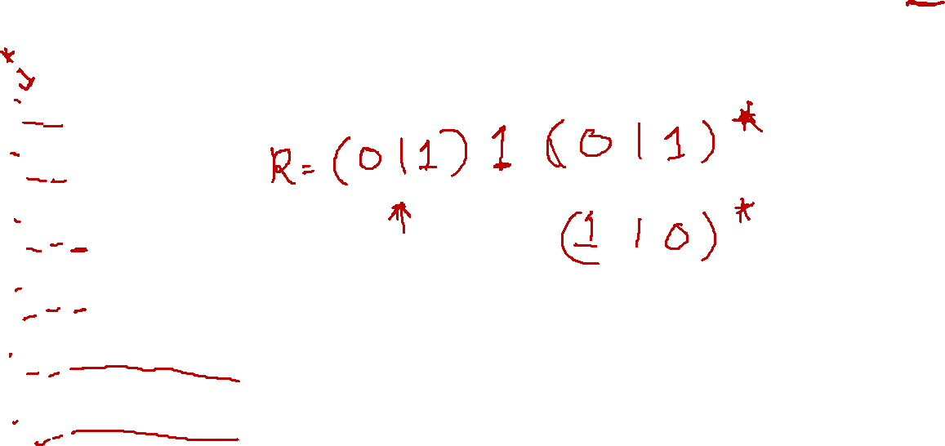
Set of all strings that the 2nd character is `1`.
Example:
01
11
110
011
0111010101
1100000000
CSPC 105
Louis Philippe Facun

Slide 11
Questions?
Louis Philippe Facun

