Slide 1
RegEx and CFGs
CSPC 105
Automata Theory and Formal Languages
Regular Expressions
L.P.Facun

Slide 2
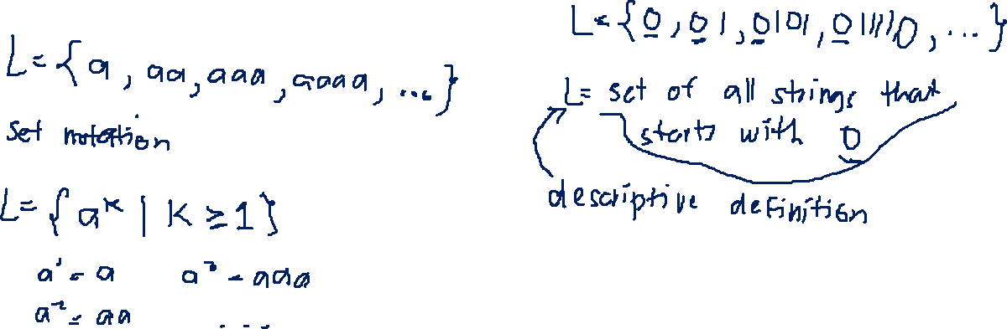
Regular Expressions or (RegEx)
Pattern used to match a string
CSPC 105
Louis Philippe Facun

Slide 3
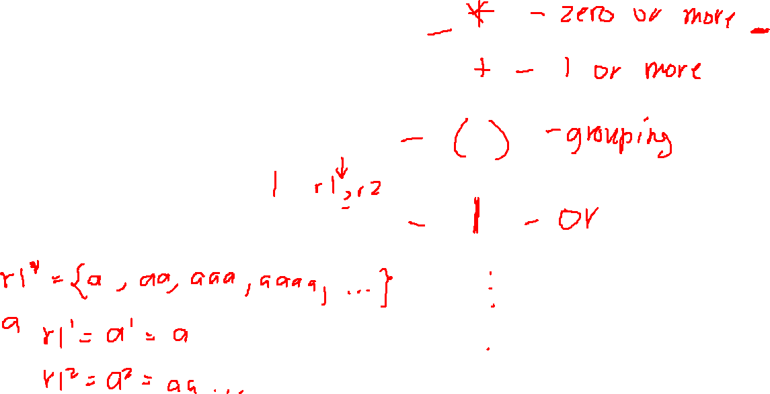
Operators
If r1 and r2 are regexs, then:
r1r2 : concatenation
r1|r2 : OR operator
r1* : closure (Kleene Star)
CSPC 105
Louis Philippe Facun

Slide 4
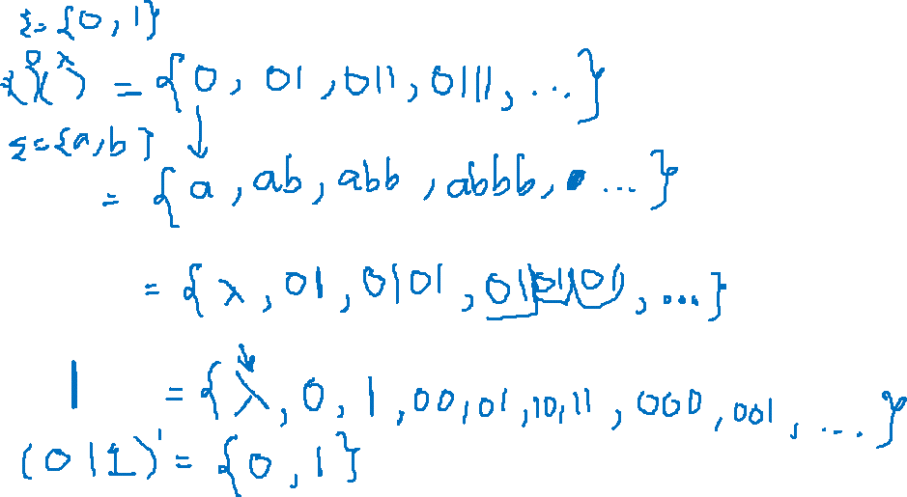
Examples
01*
ab*
(01)*
(0,1)*
CSPC 105
Louis Philippe Facun

Slide 5
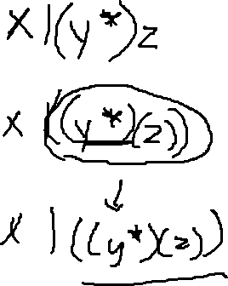
Operators Precedence
Kleene star
Concatenation
OR
x|y*z
CSPC 105
Louis Philippe Facun

Slide 6
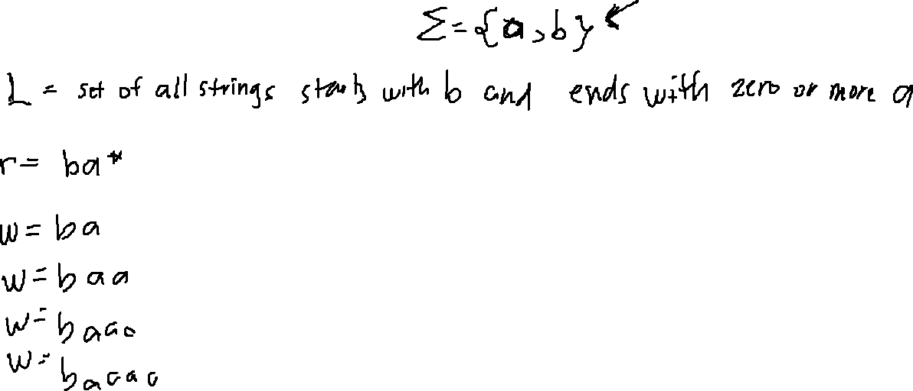
More examples
CSPC 105
Louis Philippe Facun

Slide 7
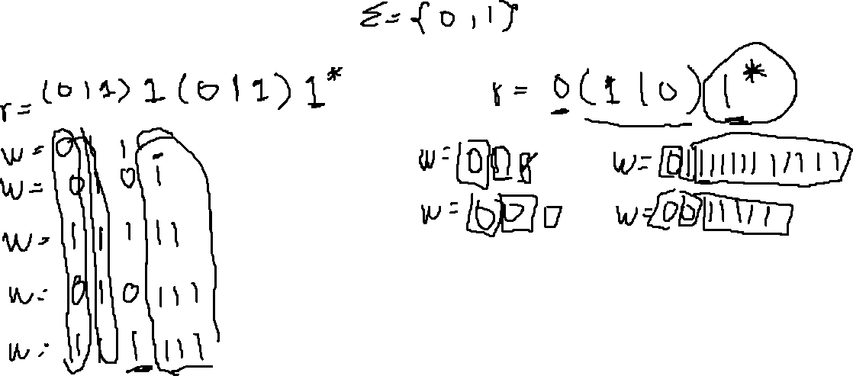
More examples
CSPC 105
Louis Philippe Facun

Slide 8
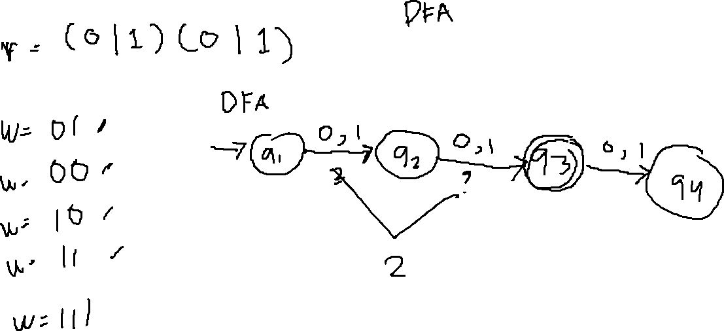
More examples
CSPC 105
Louis Philippe Facun

Slide 9
Questions?
Louis Philippe Facun

