Slide 1
Introduction
CSPC 105
Automata Theory and Formal Languages
Review on Relations and Graphs
L.P.Facun

Slide 2
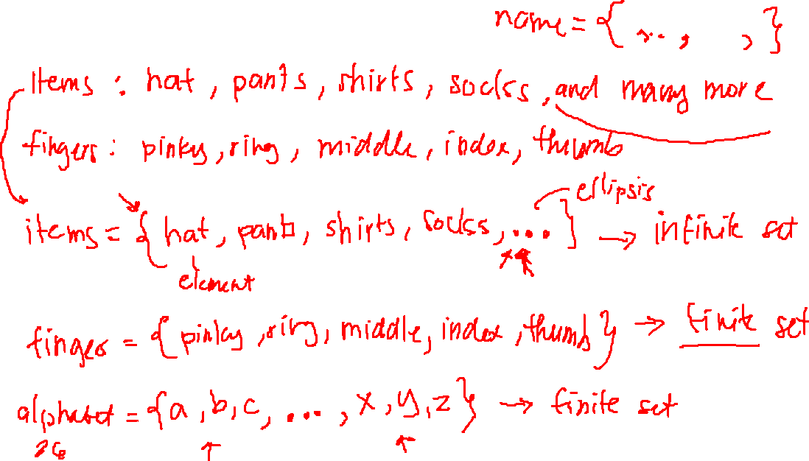
Sets: collection of things
CSPC 105
Louis Philippe Facun
Notes:
-Examples of sets
-element of
-subset of
-equality

Slide 3
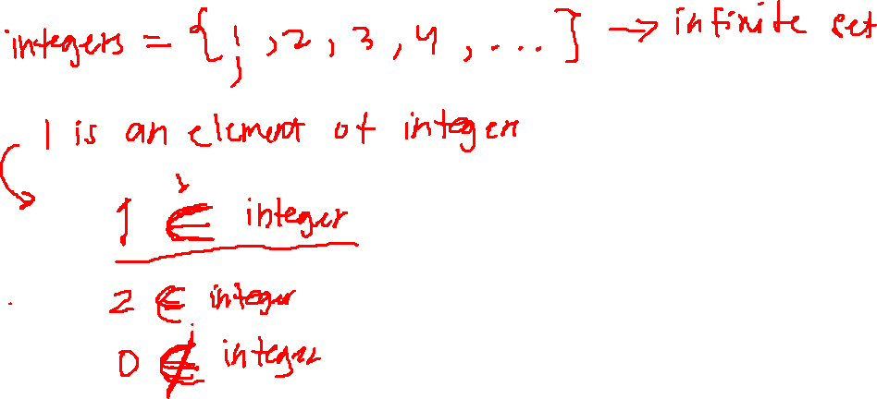
Sets: collection of things
CSPC 105
Louis Philippe Facun
Notes:
-Examples of sets
-element of
-subset of
-equality

Slide 4
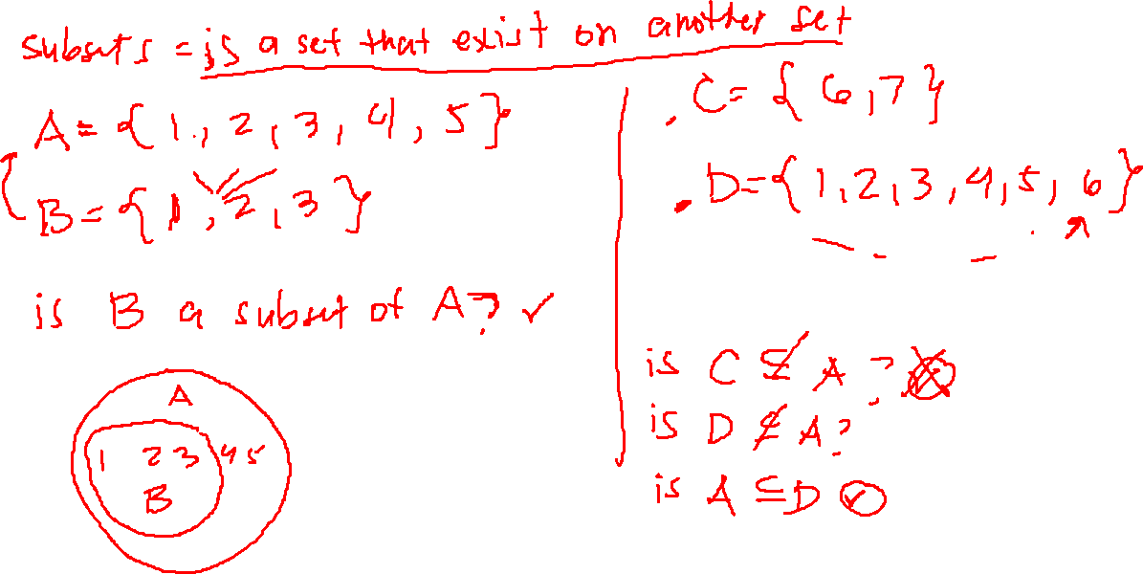
Sets: collection of things
CSPC 105
Louis Philippe Facun
Notes:
-Examples of sets
-part of sets
Words
Numerical
Infinite set
Finite set
-element of
More Notation
-subset of

Slide 5
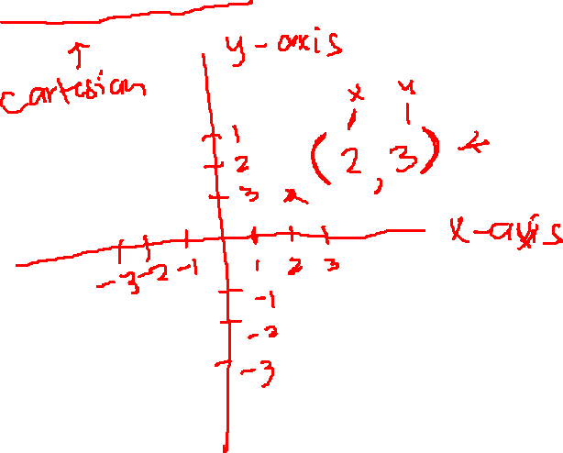
Rectangular coordinate system
CSPC 105
Louis Philippe Facun
Notes:
-draw horizontal and vertical axis as x and y
-define pair()
-define (2, 1) point
AKA: Cartesian coordinate system

Slide 6
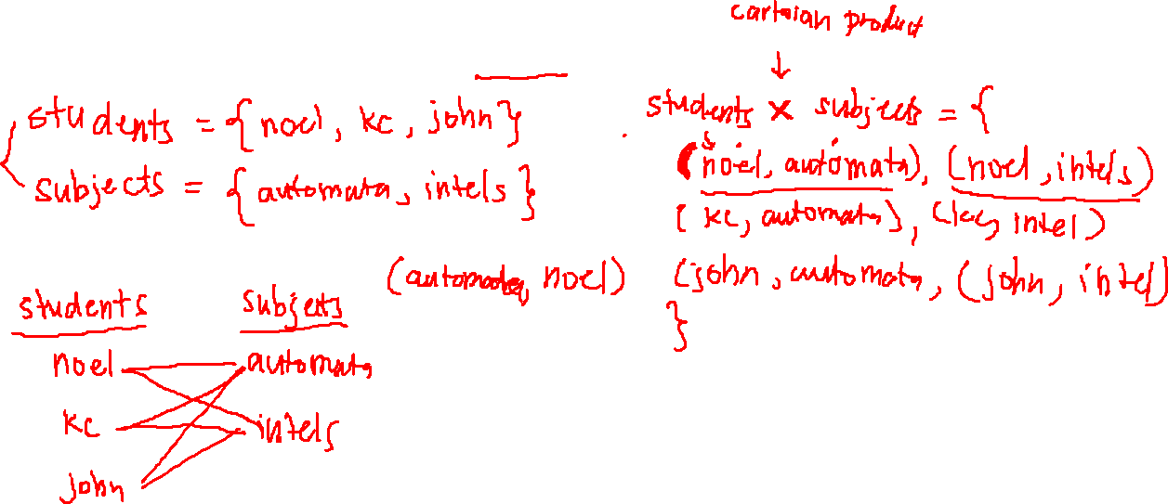
Cartesian product of sets
CSPC 105
Louis Philippe Facun
Notes:
Word example:
Set students = { pick sa google meet }
Set subjects = { automata, intel sys , hci }
Number example:
Set A = {2, 4, 6 }
Set B = {10, 20, 30}
Draw diagram left and right
Discuss the ordered pair, order matters
ASK STUDENT

Slide 7
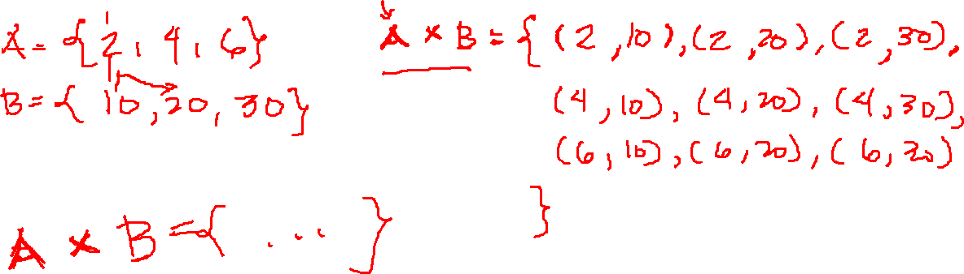
Cartesian product of sets
CSPC 105
Louis Philippe Facun
Notes:
Word example:
Set students = { pick sa google meet }
Set subjects = { automata, intel sys , hci }
Number example:
Set A = {2, 4, 6 }
Set B = {10, 20, 30}
Draw diagram left and right
Discuss the ordered pair, order matters
ASK STUDENT

Slide 8
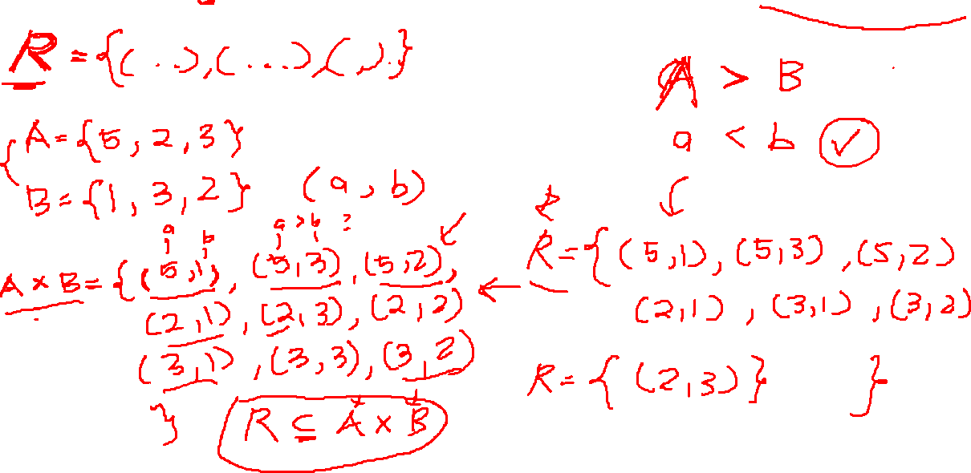
Relation: set of ordered pairs that satisfy a relationship
CSPC 105
Louis Philippe Facun
Notes:
Relation is a set of (ordered) pairs satisfying relationship
-define two sets
Relationship:
x is related to y
X is greater than y
X is less than y
X is multiple of y
Draw big circle AxB inside is RELATION

Slide 9
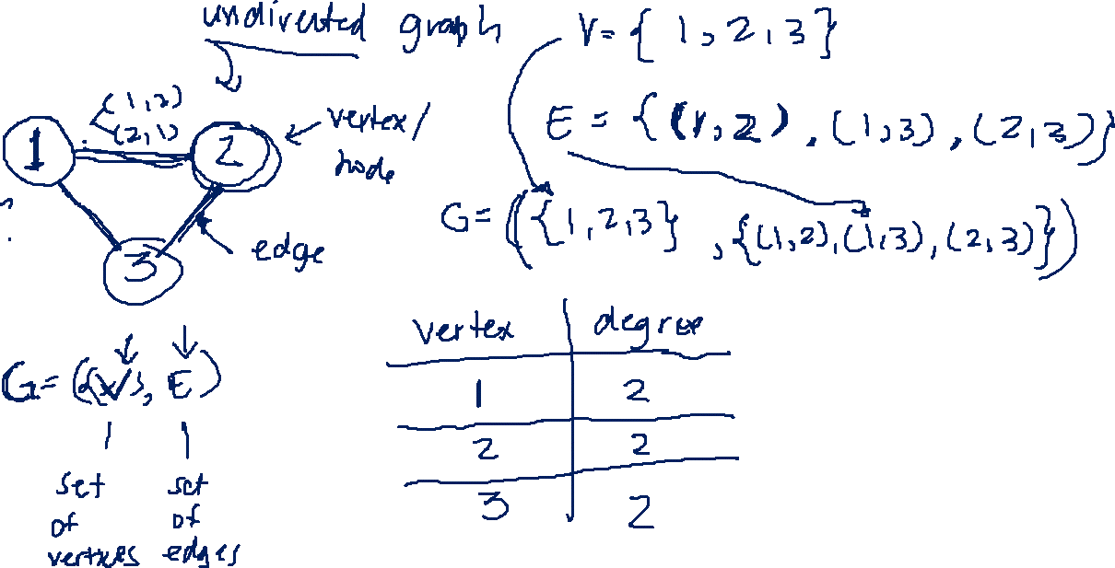
Graph
CSPC 105
Louis Philippe Facun
Notes:
Undirected graph
-formal definition
-G =(V, E) vertex/nodes, edges/lines
-Degree
Directed graph
-indegree
-outdegree

Slide 10
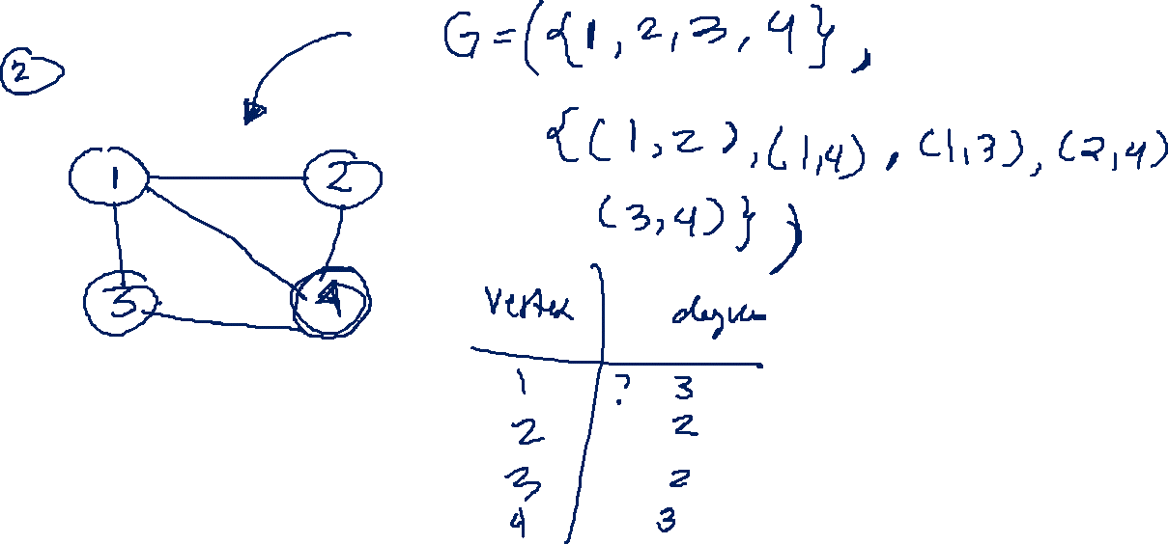
Graph
CSPC 105
Louis Philippe Facun
Notes:
Undirected graph
-formal definition
-G =(V, E) vertex/nodes, edges/lines
-Degree
Directed graph
-indegree
-outdegree

Slide 11
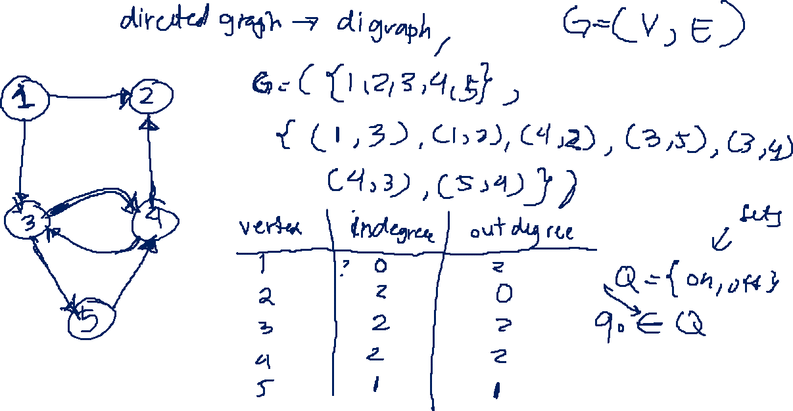
Graph
CSPC 105
Louis Philippe Facun
Notes:
Undirected graph
-formal definition
-G =(V, E) vertex/nodes, edges/lines
-Degree
Directed graph
-indegree
-outdegree

Slide 12
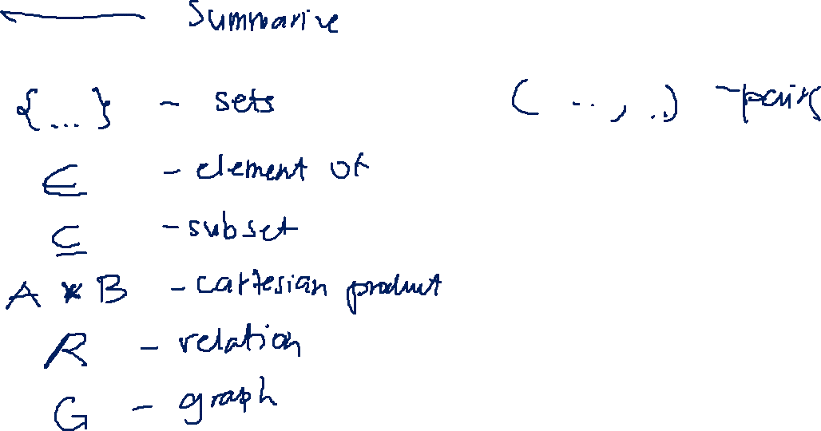
Activity!
CSPC 105
Louis Philippe Facun
Notes:
Relation is a set of pairs satisfying relationship
-define two sets
-

