Slide 1
RegEx and CFGs
CSPC 105
Automata Theory and Formal Languages
Derivation Trees, Parsing and Ambiguity
L.P.Facun

Slide 2
Instead of manually writing derivation, we can also visualize or represent it using a derivation tree.
CSPC 105
Louis Philippe Facun

Slide 3
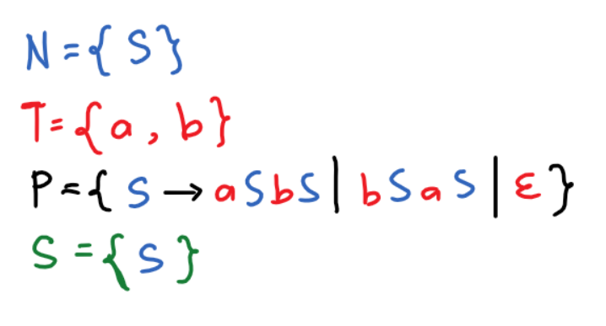
CFG 1
L = {equal number of a and b}
CSPC 105
Louis Philippe Facun

Slide 4
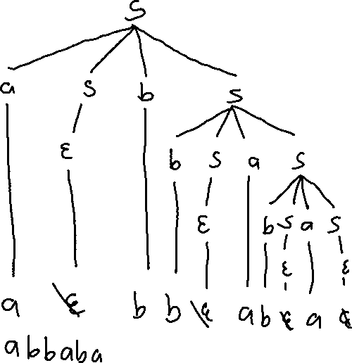
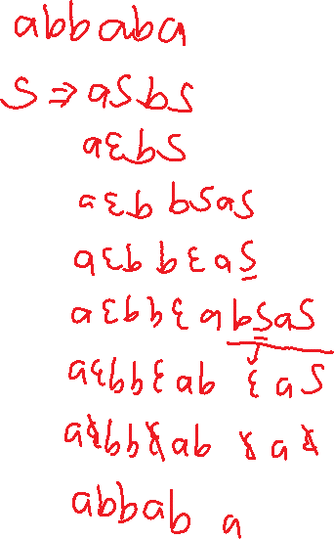
Ex. 1
CSPC 105
Louis Philippe Facun

Slide 5
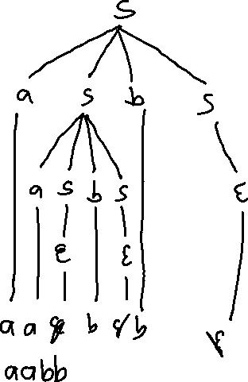
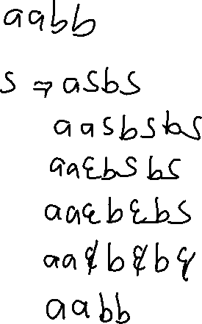
Ex. 2
CSPC 105
Louis Philippe Facun

Slide 6
Ex. 2
CSPC 105
Louis Philippe Facun

Slide 7
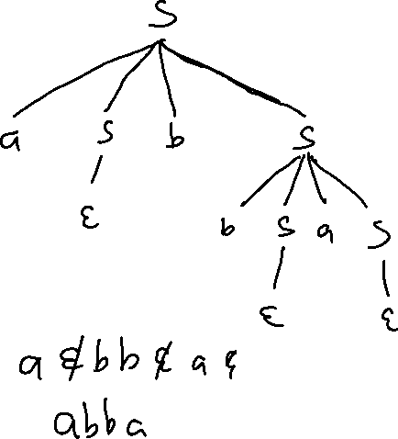
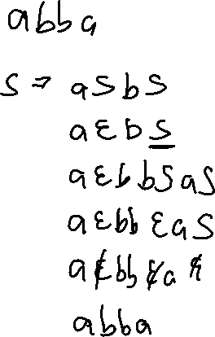
Ex. 3
CSPC 105
Louis Philippe Facun

Slide 8
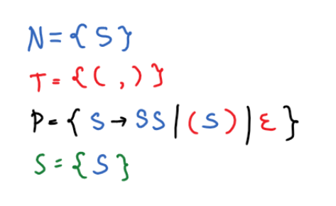
CFG 2
L = {balanced open and close parenthesis}
CSPC 105
Louis Philippe Facun

Slide 9
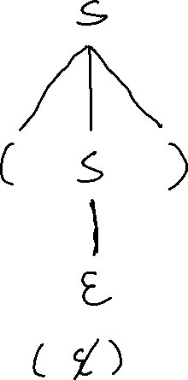
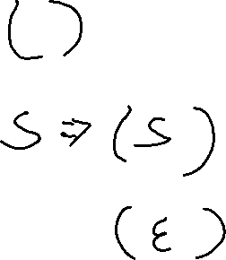
Ex. 1
CSPC 105
Louis Philippe Facun

Slide 10
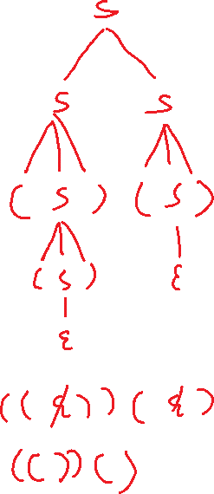
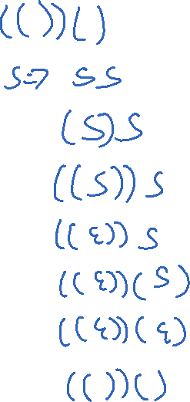
Ex. 2
CSPC 105
Louis Philippe Facun

Slide 11
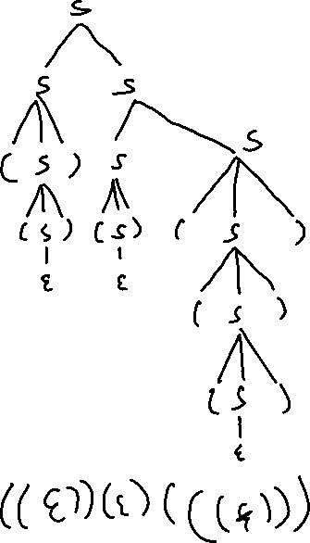
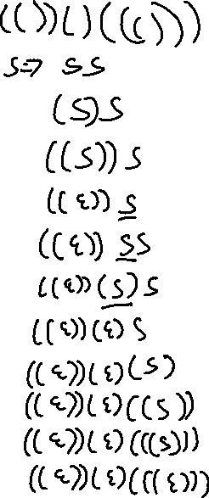
Ex. 3
CSPC 105
Louis Philippe Facun

Slide 12
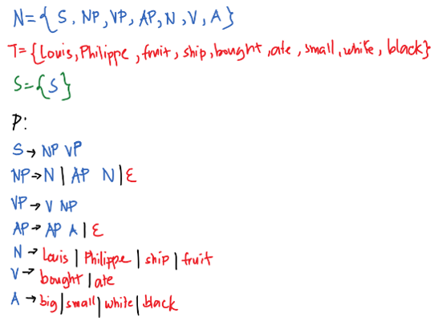
CFG 3
L = {basic valid English sentence structure}
CSPC 105
Louis Philippe Facun

Slide 13
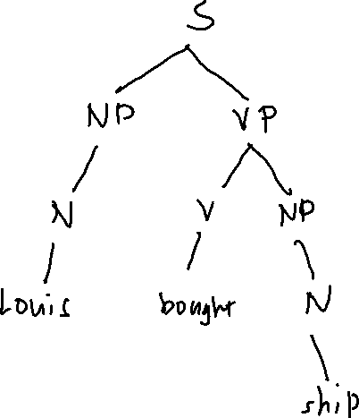
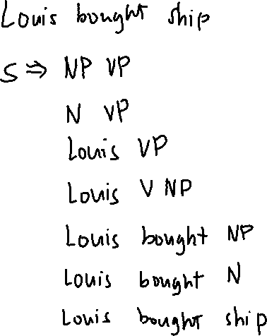
Ex. 1
CSPC 105
Louis Philippe Facun

Slide 14
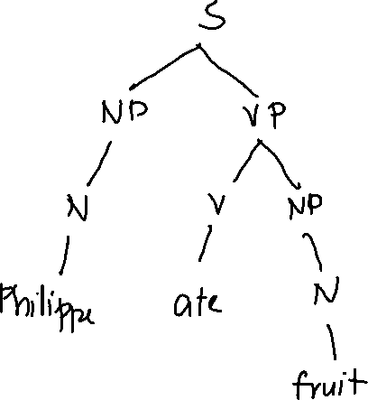
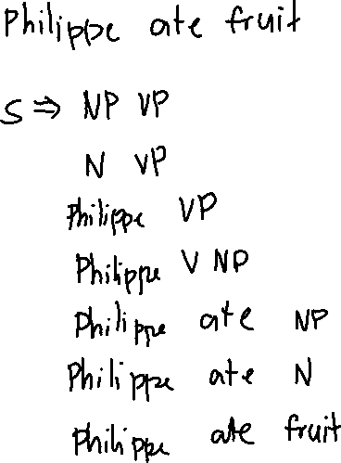
Ex. 2
CSPC 105
Louis Philippe Facun

Slide 15
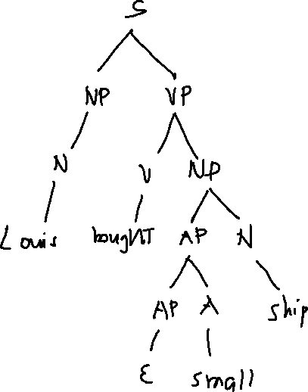
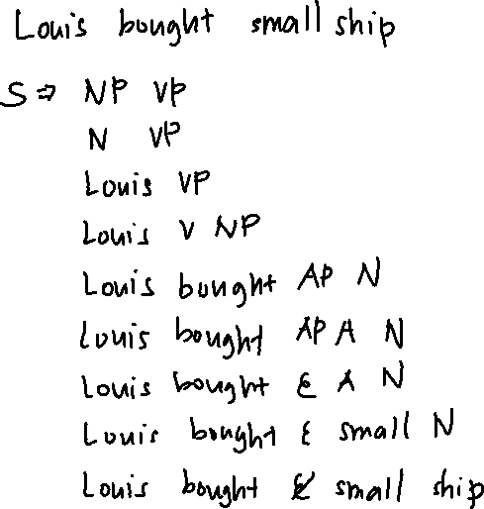
Ex. 3
CSPC 105
Louis Philippe Facun

Slide 16
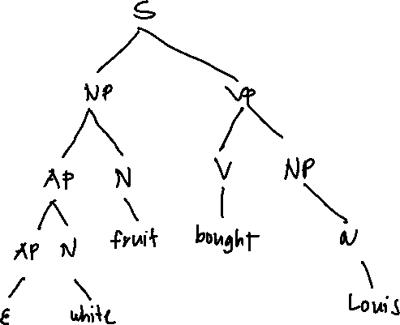
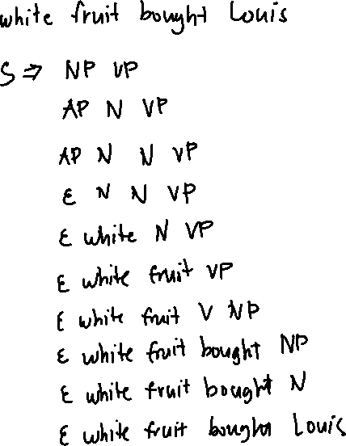
Ex. 4
CSPC 105
Louis Philippe Facun

Slide 17
When there is more than 1 possible derivation on a 1 string it’s called ambiguous.
CSPC 105
Louis Philippe Facun

Slide 18
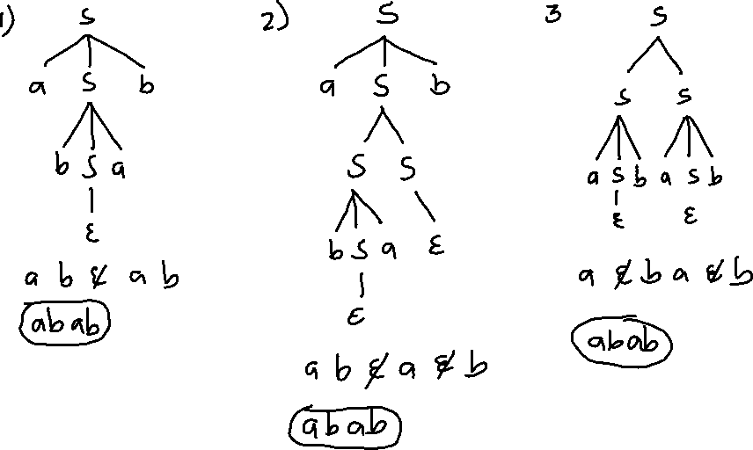


Ex. 1
CSPC 105
Louis Philippe Facun

Slide 19
Questions?
Louis Philippe Facun

