Slide 1
Introduction
CSPE 102
Intelligent Systems
Overview of Artificial Intelligence
L.P.Facun

Slide 2
What is “intelligence”?
Someone’s intelligence is their ability to understand and learn things.
Intelligence is the ability to think and understand instead of doing things by instinct or automatically.
Can computers think, or can be intelligent?
CSPE 102
Louis Philippe Facun

Slide 3
What is “Artificial Intelligence”?
A way of making computers, a software or computer-controlled robot think intelligently.
AI is accomplished on how humans learn, decide, work while trying to solve a problem.
Can machines think? Answer: unclear (not a yes or not a no)
CSPE 102
Louis Philippe Facun

Slide 4
Goals of Artificial Intelligence
Implement human intelligence in machines.
Make machines answer problems and do things that would require intelligence done by humans.
CSPE 102
Louis Philippe Facun

Slide 5
Disciplines Important to AI
Computer Science
Psychology
Artificial Intelligence
Neuroscience
Biology
Mathematics
Philosophy
CSPE 102
Louis Philippe Facun

Slide 6

Disciplines Important to AI
Computer Science
Foundation of computer systems are built using algorithms.
CSPE 102
Louis Philippe Facun

Slide 7
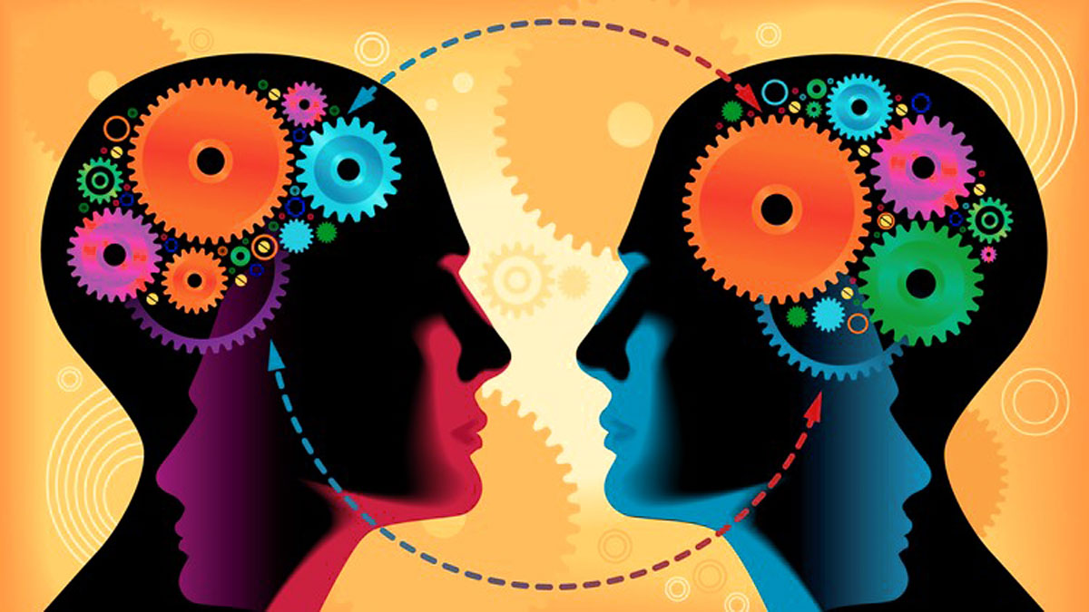
Disciplines Important to AI
Psychology
Since AI mimics on how human think, it is important to understand on how people behave and perceive and on how human process information and represent knowledge.
CSPE 102
Louis Philippe Facun

Slide 8
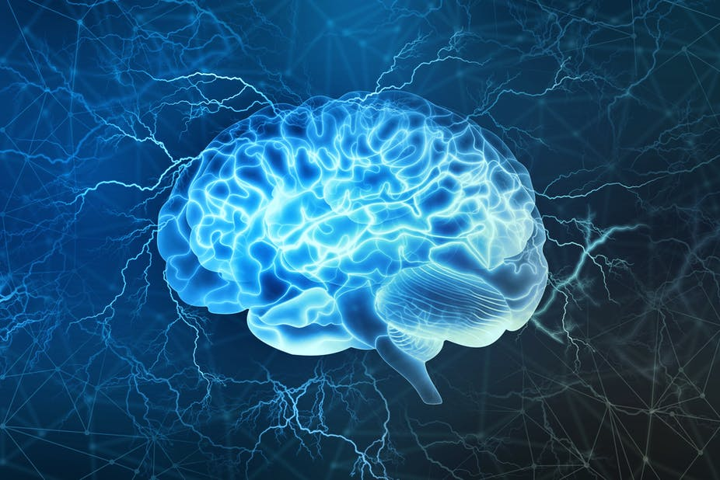
Disciplines Important to AI
Neuroscience
Helps in emulating human intelligence and is used to build neural networks that mimics brain structure.
CSPE 102
Louis Philippe Facun

Slide 9
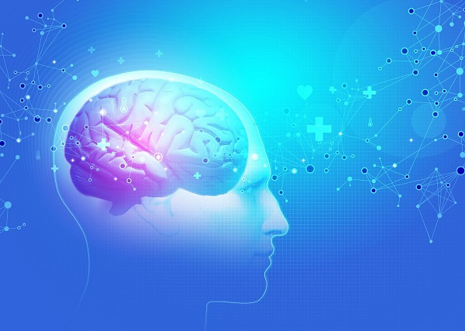
Disciplines Important to AI
Biology
Often used as an inspiration to AI because it aims to create approximative models of human brain.
CSPE 102
Louis Philippe Facun

Slide 10

Disciplines Important to AI
Mathematics
Fundamental topics in math such as linear algebra, calculus, probability, and optimization are important in AI.
CSPE 102
Louis Philippe Facun

Slide 11
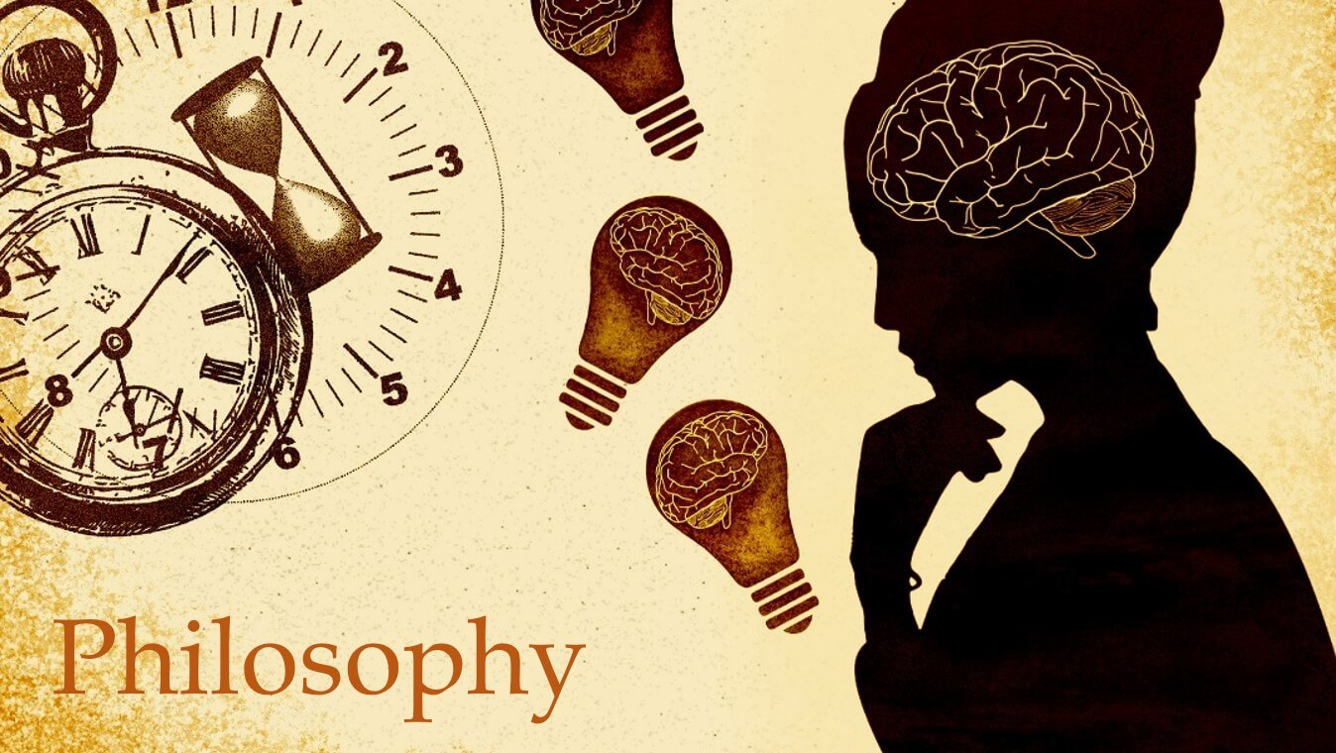
Disciplines Important to AI
Philosophy
The concept of logic, methods of reasoning, language and foundation of learning are essential in stablishing on how the computers will rationalize.
CSPE 102
Louis Philippe Facun

Slide 12
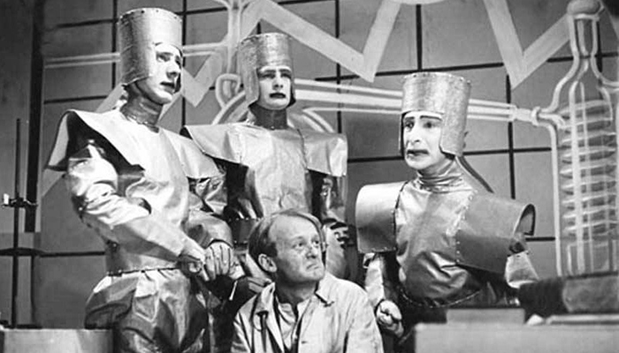
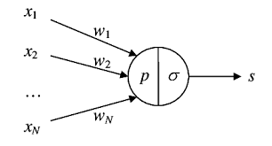
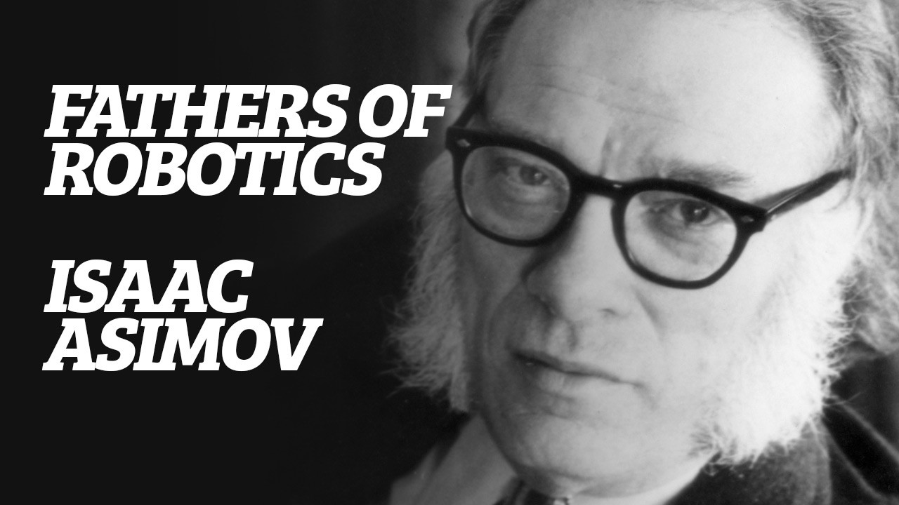
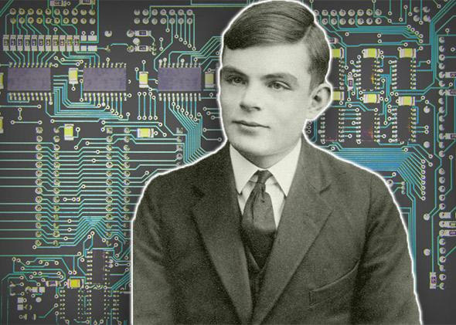
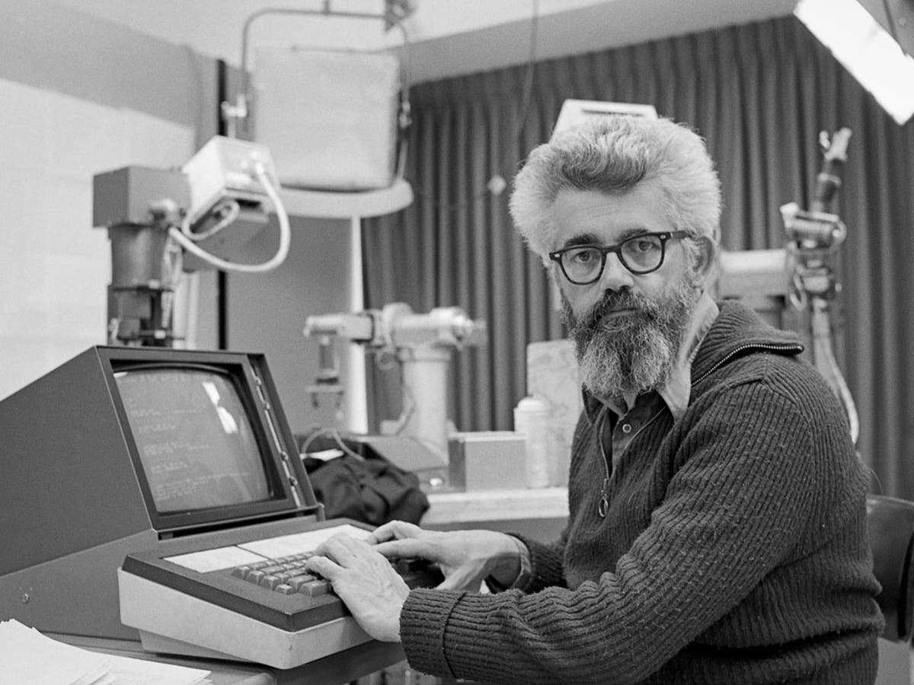
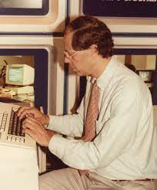
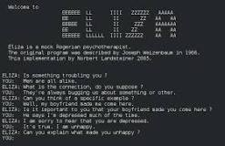

Milestones in AI
1923
1943
1945
1950
Rossum's Universal Robots
Foundation of Artificial Neural Networks
Coined the term “Robotics”
Turing Test
1956
1958
1964
1965
Coined the term “Artificial Intelligence”
LISP programming language for AI
Algebra world problem solver
First chatbot “ELIZA”
CSPE 102
Louis Philippe Facun

Slide 13
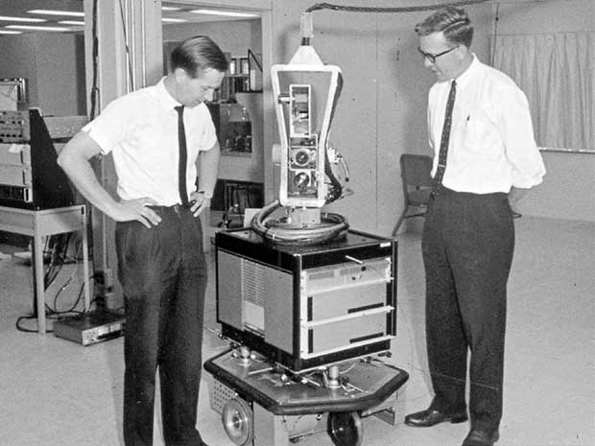
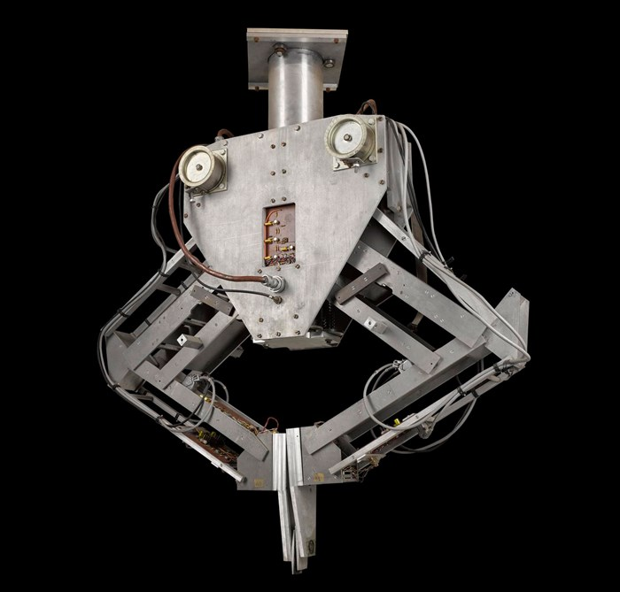
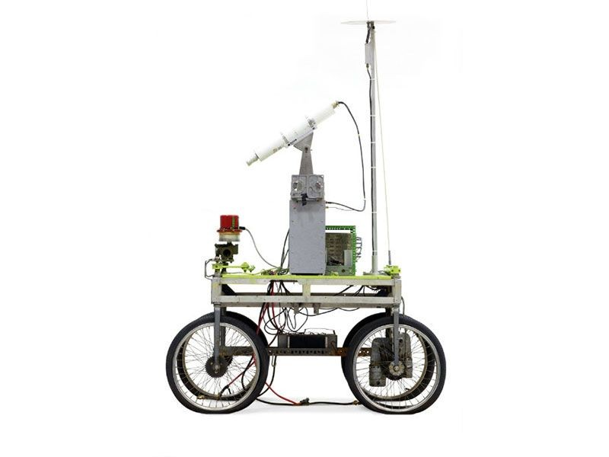
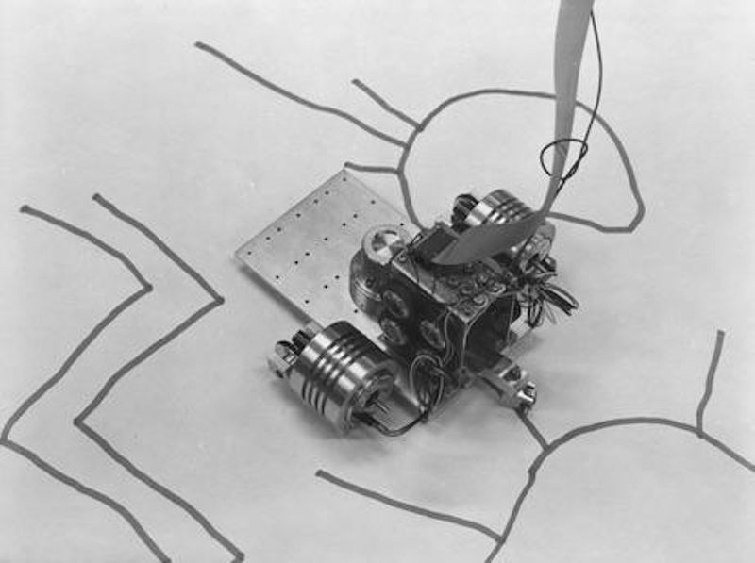
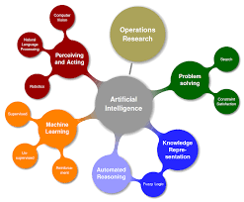
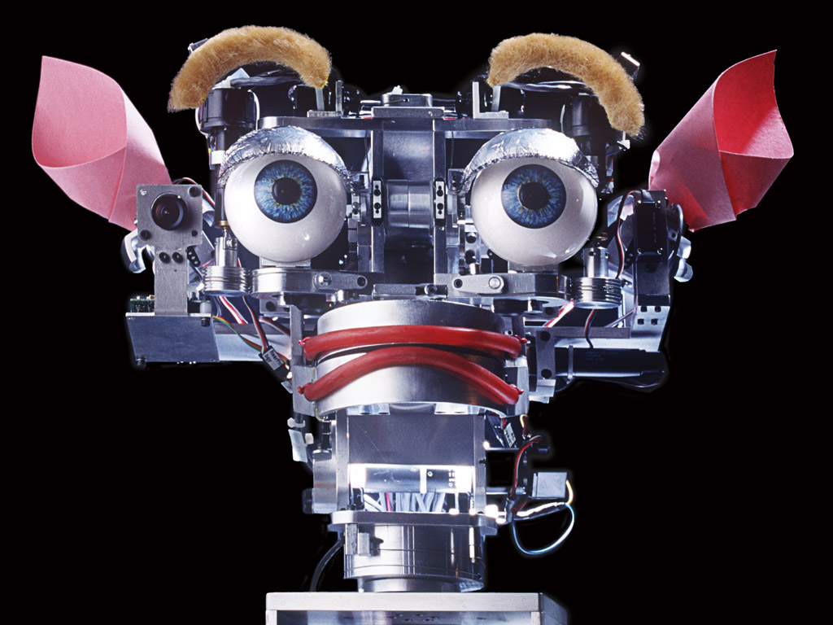
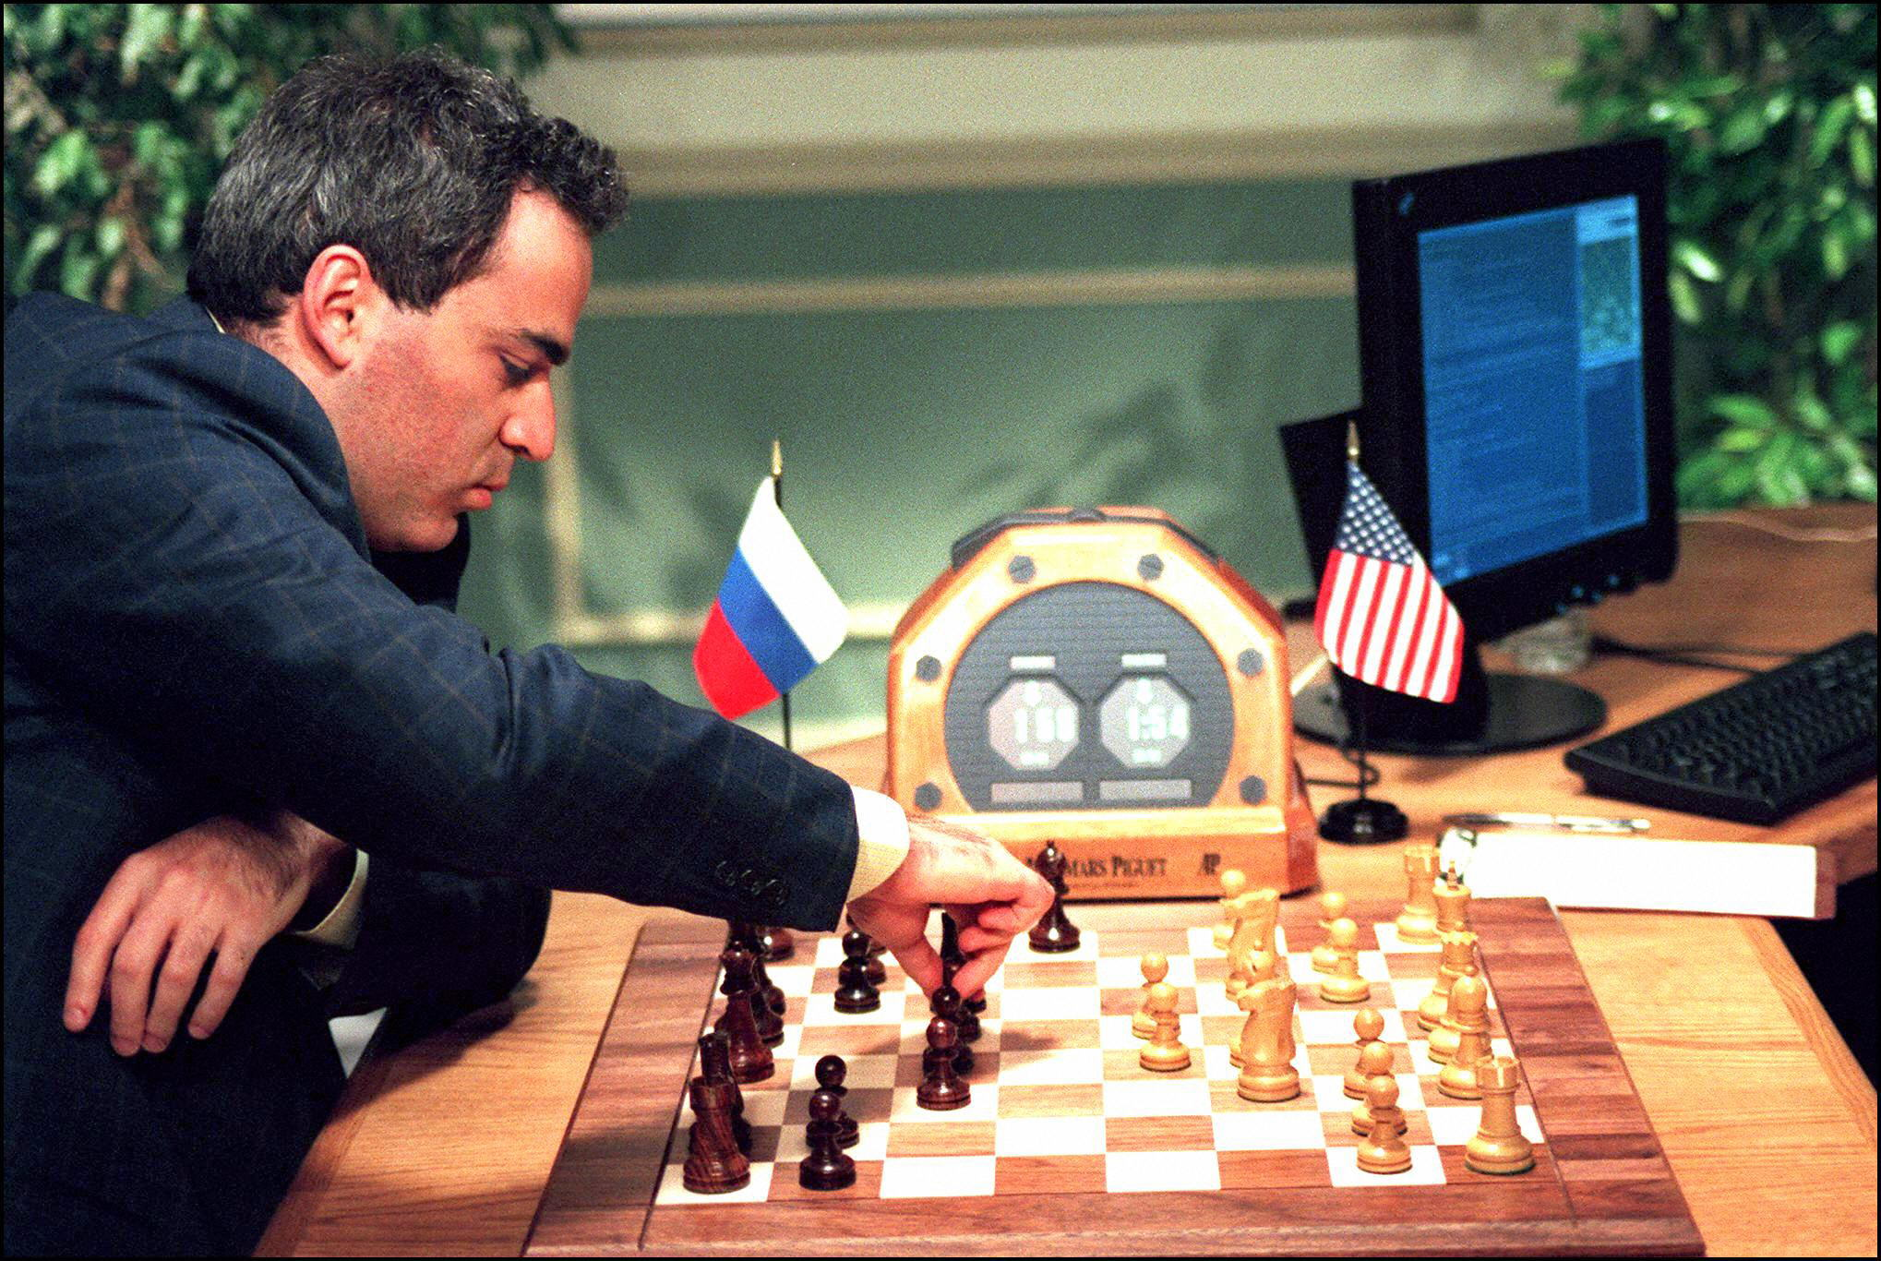
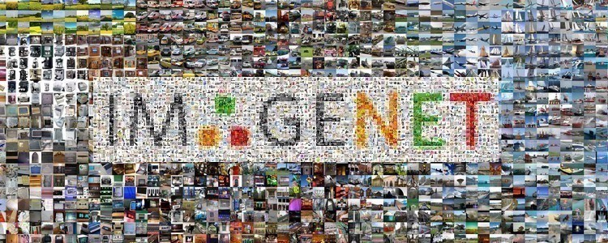
Milestones in AI
1969
1973
1979
1985
First mobile robot “Shakey”
First computer-controlled, autonomous vehicle “Stanford Cart”
Art making AI “AARON”
First robot with vision and hand “Freddy”
1990
1997
2000
2007
Major advances in all areas of AI
“Deep Blue Chess Program” beats world chess champion
First social robot “Kismet”
ImageNet for object recognition
CSPE 102
Louis Philippe Facun

Slide 14
What can AI do today
Robotic vehicles: self-driving cars, self-driving drones, planes etc.
Legged locomotion: BigDog, Spot, Atlas etc. by BostonDynamics
Autonomous planning and scheduling: NASA’s Mars rovers, Uber, Google Maps
Machine translation: language translation in over 100 languages
Speech recognition: Alex, Siri, Cortana, and Google Assistant
Recommendations: Amazon, Facebook, Netflix, YouTube
Game Playing: Chess (Deep Blue), Dota 2 (OpenAI), Go (AlpaGO)
CSPE 102
Louis Philippe Facun

Slide 15
What can AI do today
Image understanding: Image captioning
Computer vision: face detection & recognition, image classification, object detection
Medicine: disease diagnosis (COVID-19, Cancer, Alzheimer’s)
Climate science: detailed information about weather events
CSPE 102
Louis Philippe Facun

Slide 16
Risks of AI
Lethal autonomous weapons: e.g. homing missiles, killer drones
Surveillance and persuasion: e.g. cctv, social media
Biased decision making: e.g. loan applications biased race, gender, etc.
Employment/Jobs: replacing of standard worker
Safety-critical applications: self-driving cars (fatal accidents)
Cybersecurity: ai-powered malicious cyberattacks: blackmail, phishing
Super AI: robots dominating humans in the future?
CSPE 102
Louis Philippe Facun

Slide 17
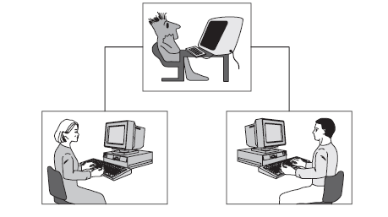
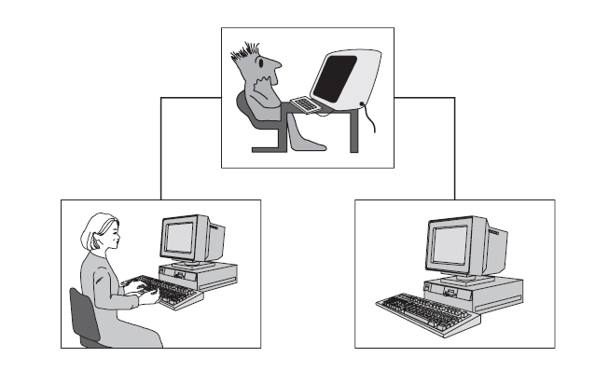
Turing Test
First phase
Second phase
CSPE 102
Louis Philippe Facun

Slide 18
Assignment
Watch this two videos about “Chinese Room Argument and Experiment”:
https://youtu.be/htrsnpwzhmI?t=29
https://www.youtube.com/watch?v=D0MD4sRHj1M
Briefly explain the:
Process of the Experiment.
Conclusion/Argument of the Experiment.
CSPE 102
Louis Philippe Facun

