Slide 1
Overview of Intelligent Systems
CSPE 102
Louis Philippe Facun
lpfacun@dmmmsu.edu.ph
http://facebook.com/louispbfacun

Slide 2
system
Notes:
Ask

Slide 3
module 1
module 2
system
module 3
...

Slide 4
module 1
module 2
system
module 3
...

Slide 5
module 1
module 2
system
goal
module 3
...

Slide 6
module 1
module 2
system
goal
module 3
...

Slide 7
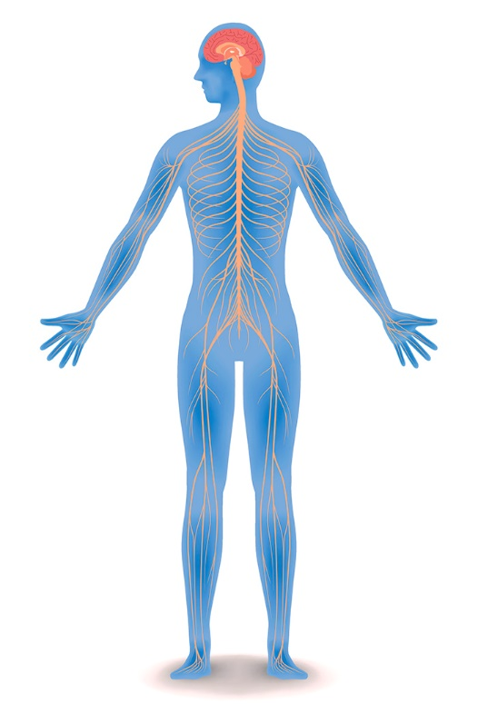
??
??
??
…
nervous
system
Notes:
Example

Slide 8
brain
nerves
spinal cord
…
nervous
system
Notes:
Example

Slide 9
module 1
module 2
system
module 3
...

Slide 10
module 1
module 2
system
module 3
...

Slide 11
module 1
module 2
nervous system
module 3
...

Slide 12
module 1
module 2
nervous system
module 3
...

Slide 13
module 1
module 2
nervous system
module 3
...

Slide 14
brain
nerves
nervous system
spinal cord
...

Slide 15
brain
nerves
nervous system
goal
spinal cord
...

Slide 16
brain
nerves
helps all the parts of the body to communicate with each other
nervous system
spinal cord
...

Slide 17
intelligent system

Slide 18
module 1
module 2
intelligent system
module 3
...

Slide 19
biological
module 1
module 2
intelligent system
module 3
...
cognitive

Slide 20
biological
module 1
module 2
intelligent system
module 3
...
cognitive

Slide 21
biological and cognitive processes

Slide 22

Notes:
A child does not hold hot objects once they experienced that by holding them, it may bring pain. In analogy, intelligent systems also learn by example or by experience.

Slide 23
input →
child
→ output

Slide 24
input →
child
→ output
pain experience
removing the hand

Slide 25
intelligent
system
input →
→ output

Slide 26
intelligent
system
input →
→ output
data (experience)
decision

Slide 27
Lazada
Facebook
YouTube

Slide 28
Lazada
Facebook
YouTube

Slide 29
lazada’s
intelligent
system
input →
→ output
Notes:
Ask their experience

Slide 30
lazada’s
intelligent
system
input →
→ output
you, clicking/liking that item

Slide 31
lazada’s
intelligent
system
input →
→ output
you, clicking/liking that item
recommend similar item

Slide 32
Lazada
Facebook
YouTube

Slide 33
facebook’s
intelligent
system
input →
→ output

Slide 34
facebook’s
intelligent
system
input →
→ output
you, reacting that post

Slide 35
facebook’s
intelligent
system
input →
→ output
you, reacting that post
recommend similar post

Slide 36
Lazada
Facebook
YouTube

Slide 37
youtube’s
intelligent
system
input →
→ output

Slide 38
youtube’s
intelligent
system
input →
→ output
you, watching that video

Slide 39
youtube’s
intelligent
system
input →
→ output
you, watching that video
recommend similar video

Slide 40
Lazada
Facebook
YouTube
recommender
systems
Notes:
The government is not spying on you, it is just that these platforms are using intelligent systems. The system is learning based on your data to have a knowledge that you are interested in the cellphone or pop music.

Slide 41
module 1
module 2
intelligent system
module 3
...

Slide 42
module 1
module 2
intelligent system
module 3
...

Slide 43
module 1
module 2
recommender
system
module 3
...

Slide 44
module 1
module 2
recommender
system
module 3
...

Slide 45
module 1
module 2
recommender
system
module 3
...

Slide 46
data collection
algorithm
recommender
system
model
...

Slide 47
data collection
algorithm
recommender
system
goal
model
...

Slide 48
data collection
algorithm
recommender
system
Recommend something that users will probably like
model
...

Slide 49
challenges

Slide 50
uncertainty
dynamic world
time-consuming computation
mapping

Slide 51
uncertainty
dynamic world
time-consuming computation
mapping
Notes:
: Physical sensors/effectors provide limited, noisy, and inaccurate information/action. Therefore, any actions the system takes may be incorrect both due to noise in the sensors and due to the limitations in executing those actions.

Slide 52

reality
actual
Notes:
: Physical sensors/effectors provide limited, noisy, and inaccurate information/action. Therefore, any actions the system takes may be incorrect both due to noise in the sensors and due to the limitations in executing those actions.

Slide 53
uncertainty
dynamic world
time-consuming computation
mapping
Notes:
The physical world changes continuously, requiring that decisions be made at fast time scales to accommodate for the changes in the environment.

Slide 54
uncertainty
dynamic world
time-consuming computation
mapping
Notes:
Time-consuming computation: Searching for the optimal path to a goal requires an extensive search through a very large state space, which is computationally expensive. The drawback of spending too much time on computation is that the world may change in the meantime, thus rendering the computed plan obsolete

Slide 55
uncertainty
dynamic world
time-consuming computation
mapping
Notes:
Mapping: A lot of information is lost in the transformation from the 3D world to the 2D world. Computer vision must deal with challenges including changes in perspective, lighting, and scale; background clutter or motion; and grouping items with intra/inter-class variatio

Slide 56
Questions?
Slide/lectures and modules/notes will be uploaded here:
https://github.com/louisfacun/teaching/tree/master/cspe102/2022

