Slide 1
Introduction
CSPE 102
Intelligent Systems
Applications of Intelligent Systems
L.P.Facun

Slide 2
Introduction
Intelligent Assistants
Healthcare
Smart Cars and Drones
Robotics
Social Media Feeds
Music and Media Streaming Services
Online Ads Network
Security and Surveillance
CSPE 102
Louis Philippe Facun
Notes:
Intelligent systems play an important role in shaping our daily lives and future. We may not be aware of it, but it has been affecting our decisions and lifestyles every day. This lesson focuses on the different examples of intelligent systems and how these technologies are being applied.

Slide 3
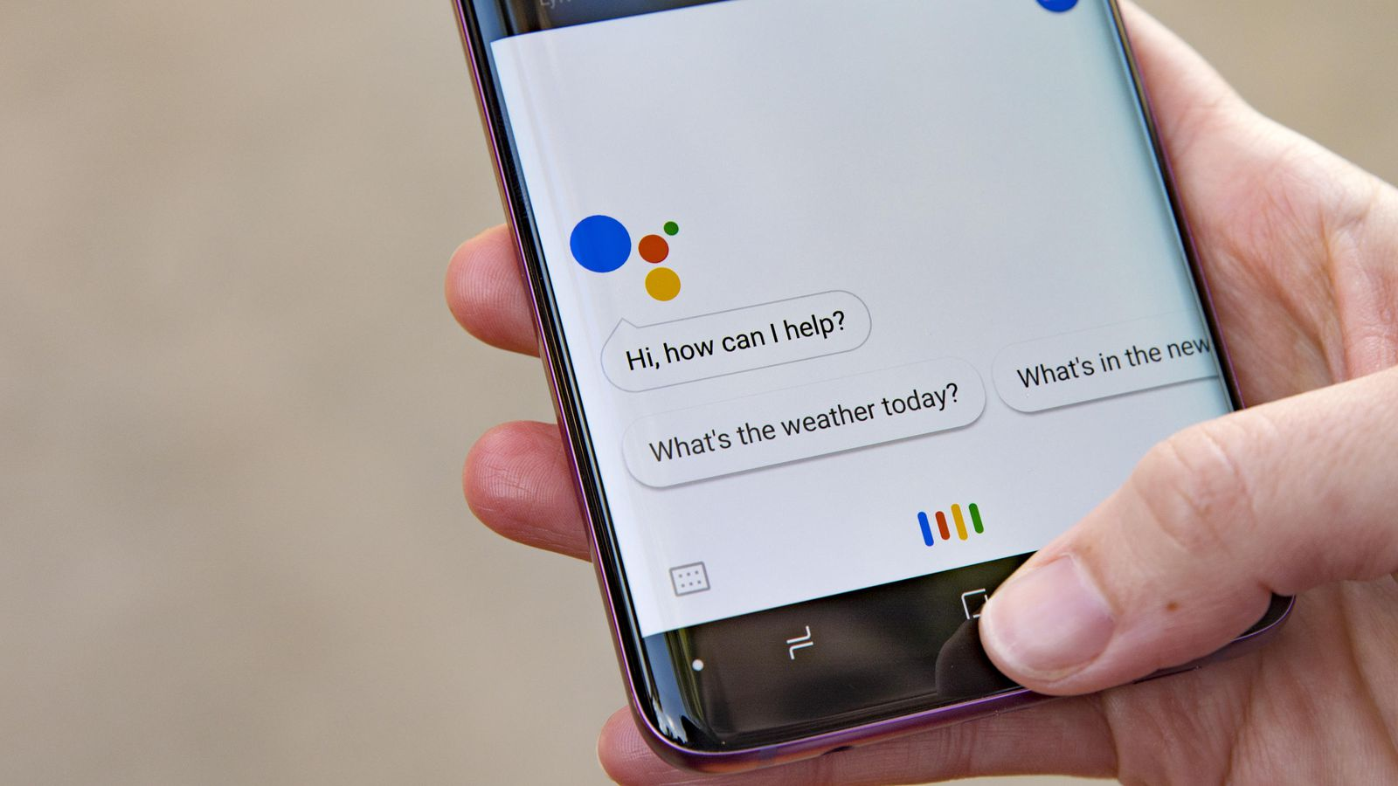
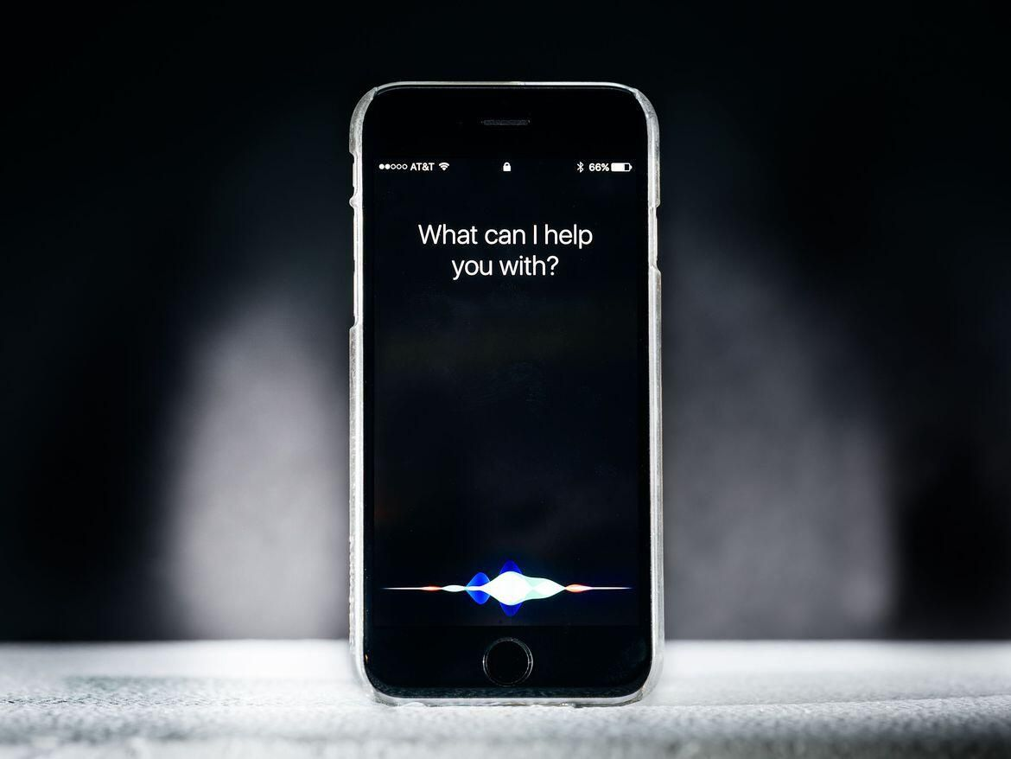
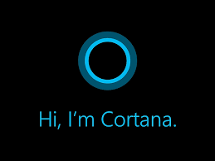
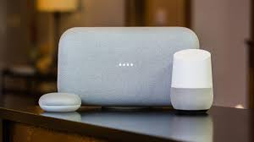
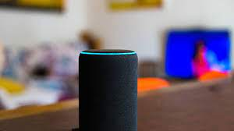
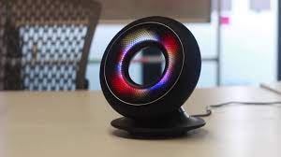
Intelligent Assistants
Google Assistant
Siri
Cortana
Google Home
Amazon Alexa
Olly
CSPE 102
Louis Philippe Facun
Notes:
Intelligent personal assistants can provide services and perform tasks based on user input and awareness. These applications can access online resources such as weather, location, contacts, and many more. In our smartphones, the most common intelligent assistants are Google Assistant, Siri, and Cortana. They usually accept commands as either text or audio inputs. In smart homes, some employ Amazon, Alexa or Google Home. Recently, a similar assistant called was designed to have an evolving personality. Olly can understand a user’s facial expressions, voice inflections, and verbal patterns to proactively start conversations and make pertinent suggestions.

Slide 4
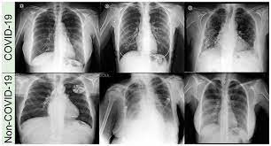

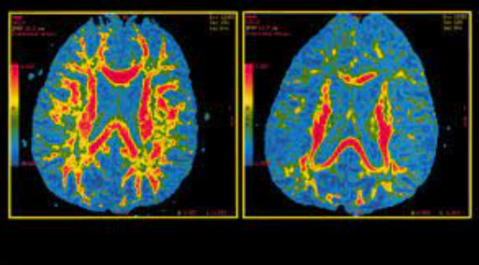
Healthcare
COVID-19 Diagnosis using Chest X-ray
Alzheimer’s Disease Detection
CSPE 102
Louis Philippe Facun
Notes:
With the introduction of AI-powered machines, it’s become a bit easier to detect disease and diagnosis. Moreover, it’s also playing a significant role in making the treatment and management processes more simplified. As a result, hospitals and healthcare centers are fast embracing AI-enabled technologies to facilitate everything from research to the detection of diseases.
AI-enabled virtual assistants are reducing unnecessary hospital visits and giving nurses 20% of their time back in the process; workflow assistants are helping doctors free up 17% of their schedules; pharmaceutical companies are researching life-saving medicines in a fraction of the time and cost it traditionally takes, and AI is even being used to help bring healthcare to underdeveloped nations. Some intelligent systems help pathologists analyze tissue samples and make more accurate diagnoses. The aim is to not only improve diagnostic accuracy, but also treatment. The Pager app allows any user to chat with a nurse via text 24/7, talk to a doctor via video chat and have prescriptions filled as needed.
Using technology based on convolutional neural networks, Atomwise's algorithms can "extract insights from millions of experimental affinity measures and thousands of protein structures to predict the binding of small molecules to proteins."

Slide 5
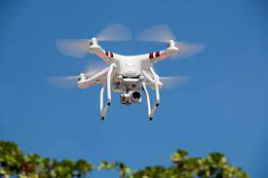
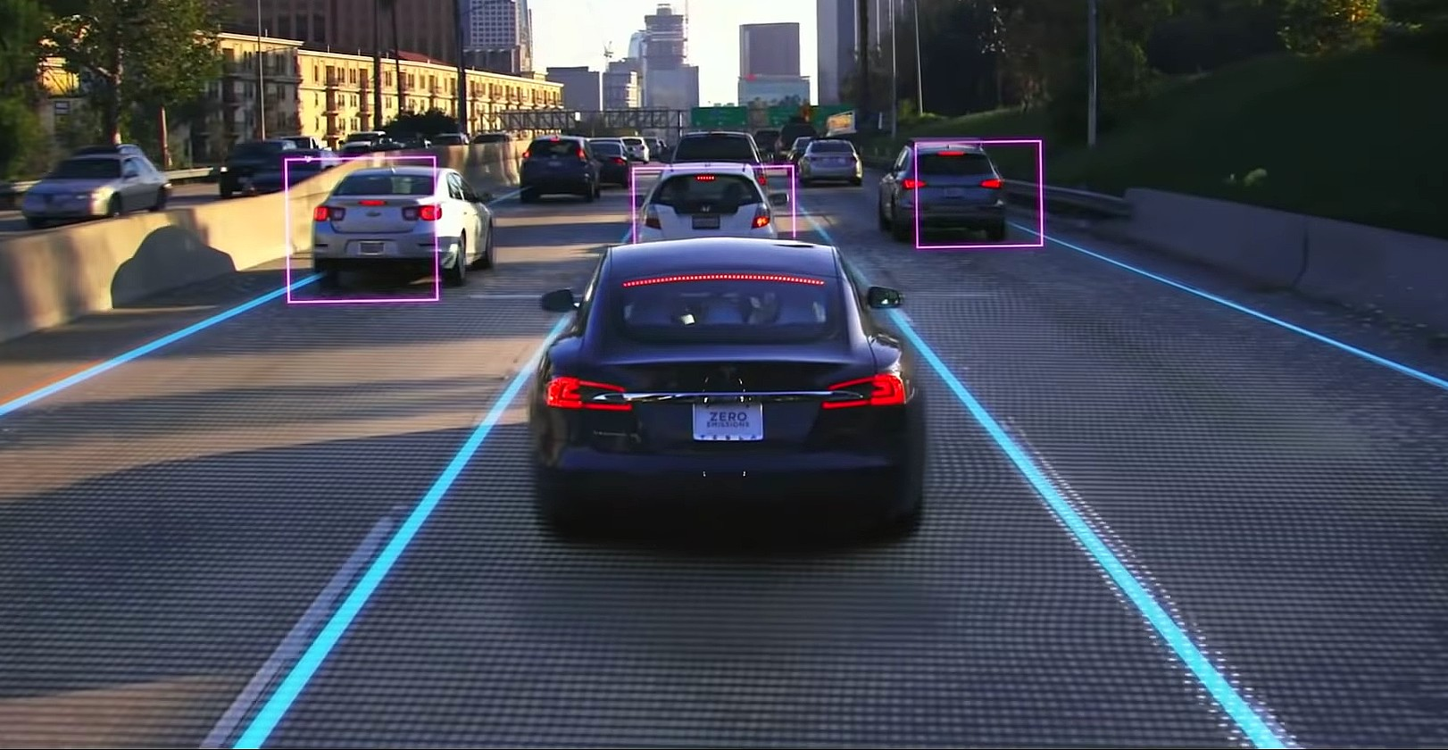
Smart Cars and Drones
Tesla’s Autopilot
AI-Powered Drones
CSPE 102
Louis Philippe Facun
Notes:
Intelligent systems are a computer-based approach to decision-making. Notably, they are used in autonomous transportation systems and interact with the world in a way that helps humans get from point A to point B safely. Transportation companies like Tesla have made so much progress that we already have a fleet of semi-automatic cars on the road.
0:32
This Is What Tesla's Autopilot Sees On The Road
https://www.youtube.com/watch?v=fKXztwtXaGo
AI-powered drone fights off tornadoes
https://www.youtube.com/watch?v=R1S5BnKgJxs

Slide 6
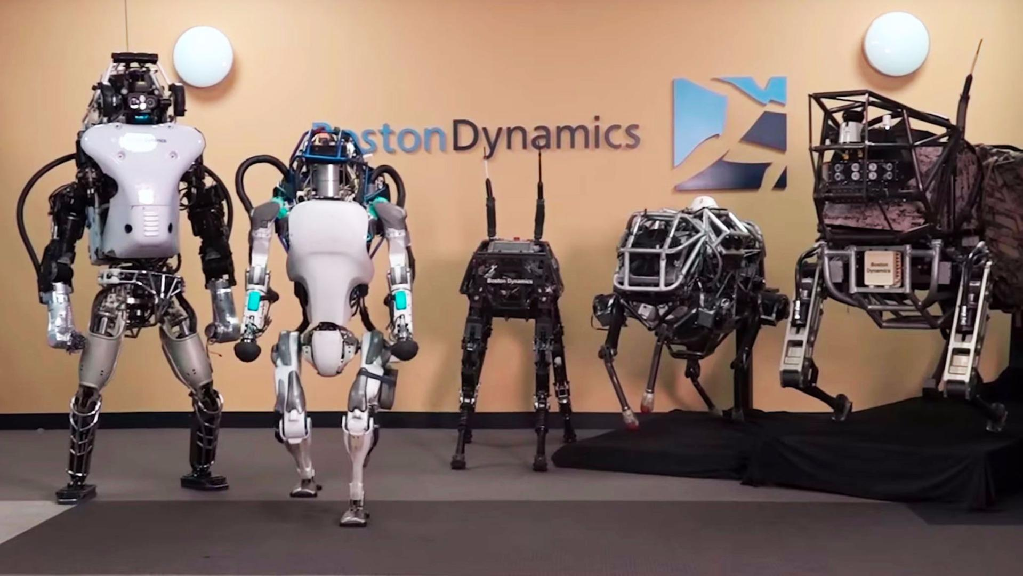
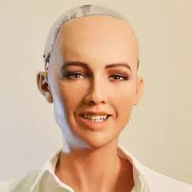
Robotics
Agile Robots (Boston Dynamics)
Sophia (Humanoid Robot)
CSPE 102
Louis Philippe Facun
Notes:
AI-powered robots are capable of solving problems and "thinking" in a limited capacity even without natural general intelligence. Smart homes usually employ robotic vacuums that can scan the room size and remember the most efficient routes for cleaning. We also have humanoid robots, one of the most prominent that exists is Sophia, which can have immediate applications as media personalities in movies and TV shows, entertainment animatronics in museums and theme parks, and for university research and medical training applications.
Spot's Got an Arm!
https://www.youtube.com/watch?v=6Zbhvaac68Y
Atlas | Partners in Parkour
https://www.youtube.com/watch?v=tF4DML7FIWk
Introducing Stretch | Boston Dynamics
https://www.youtube.com/watch?v=yYUuWWnfRsk

Slide 7

Social Media Feeds
Top 12 Most Popular Social Media Sites In 2022
CSPE 102
Louis Philippe Facun
Notes:
If you are using social media, most of your decisions are being impacted by artificial intelligence. From the feeds that you see in your timeline to the notifications that you receive from these apps, everything is curated by AI. AI takes all your past behavior, web searches, interactions, and everything else that you do when you are on these websites and tailors the experience just for you. The sole purpose of AI here is to make the apps so addictive that you come back to them again and again, and I am ready to place a bet that AI is winning this war against you.

Slide 8

Music and Media Streaming Services
10 Best Music Streaming Services Sites 2022
CSPE 102
Louis Philippe Facun
Notes:
Another great example of how AI impacts our lives are the music and media streaming services that we are using daily. These systems can recommend songs and videos based on your taste.

Slide 9

Online Ads Network
CSPE 102
Louis Philippe Facun
Notes:
One of the biggest users of artificial intelligence is the online ad industry which uses AI to not only track user statistics but also serves our ads based on those statistics. Without AI, the online ad industry will just fail as it would show random ads to users with no connection to their preferences whatsoever. AI has become so successful in determining our interests and serving us ads that the global digital ad industry has crossed 250 billion US dollars with the industry projected to cross the 300 billion mark in 2019. So next time when you are going online and see ads or product recommendations, know that AI is impacting your life.

Slide 10
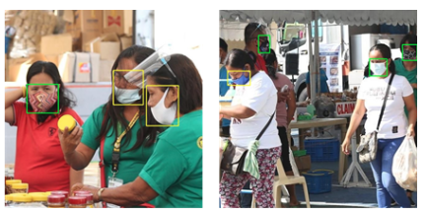
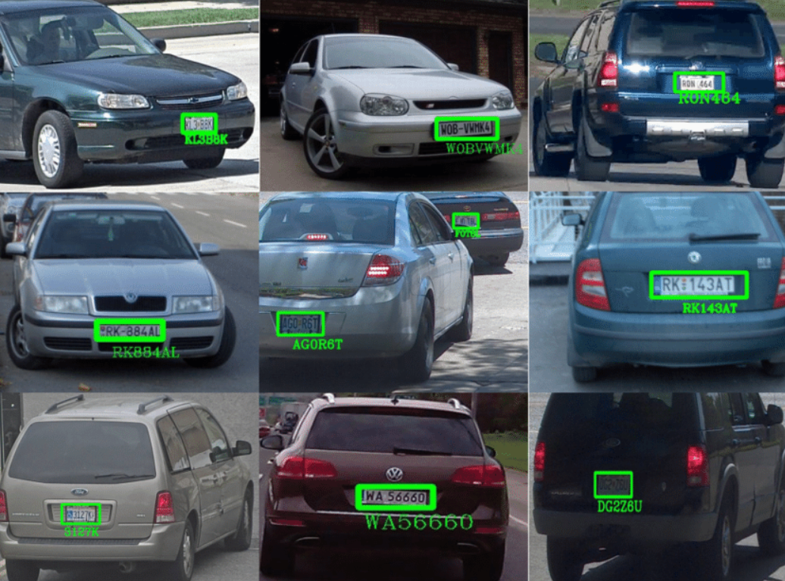
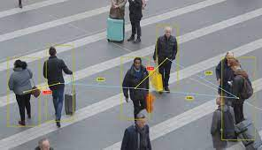
Security and Surveillance
Wearing of Face Mask Detection
License Plate Recognition
Social Distancing Detector
CSPE 102
Louis Philippe Facun
Notes:
While we can all debate the ethics of using a broad surveillance system, there’s no denying the fact that it is being used and AI is playing a big part in that. Humans can't keep monitoring multiple monitors with feeds from hundreds if not thousands of cameras at the same time.
Think
Whether we are using our smartphones, surfing the internet, buying products online, using navigation, wasting time on social media, or listening to songs on our favorite music streaming service, AI is impacting our choices in one way or another.

Slide 11
Intelligent Assistants
“Hi assistant, open calculator”
Steps to process the command:
1. Wakeword detection
Audio
“Hi assistant”?
2. Speech recognition
Audio
“open calculator”
3. Intent recognition
“open calculator”
open?
music?
time?
alarm?
weather?
4. Execute intent
Open calculator software
CSPE 102
Louis Philippe Facun
Notes:
Intelligent personal assistants can provide services and perform tasks based on user input and awareness. These applications can access online resources such as weather, location, contacts, and many more. In our smartphones, the most common intelligent assistants are Google Assistant, Siri, and Cortana. They usually accept commands as either text or audio inputs. In smart homes, some employ Amazon, Alexa or Google Home. Recently, a similar assistant called Olly was designed to have an evolving personality. Olly can understand a user’s facial expressions, voice inflections, and verbal patterns to proactively start conversations and make pertinent suggestions.

Slide 12
Questions?
CSPE 102
Louis Philippe Facun

