Slide 1
Introduction
CSPC 105
Automata Theory and Formal Languages
Alphabets, Strings and Languages
L.P.Facun

Slide 2
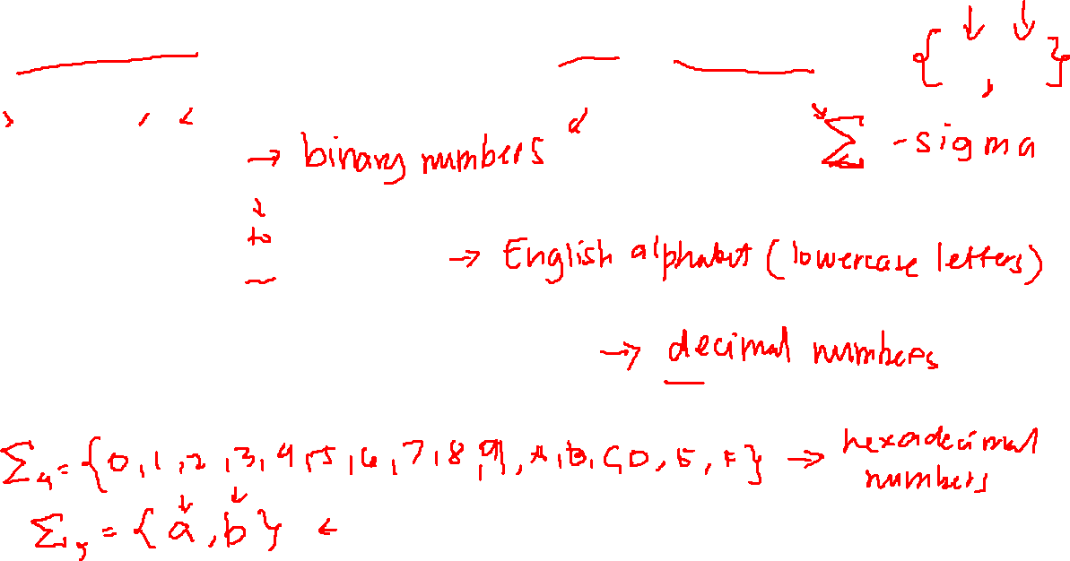
Alphabets: non-empty finite set of symbols
Σ₁= {0, 1}
Σ₂= {a, b, c, ... , x, y, z}
Σ₃= {0, 1, 2, 3, 4, 5, 6, 7, 8, 9}
CSPC 105
Louis Philippe Facun
Notes:
An alphabet is any non-empty finite set of symbols.
The elements of the alphabet are called symbols of the alphabet.
We use the symbol sigma, Σ, to denote an alphabet or we will use upper case letters in this lesson to denote an alphabet.

Slide 3
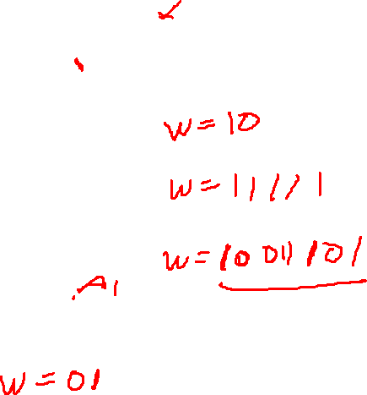
String: finite sequence of symbols from an alphabet
Σ= {0, 1}
w = 0
w = 1
w = 00
CSPC 105
Louis Philippe Facun
Notes:
A string (w) over an alphabet is a finite sequence of symbols from the given alphabet. Symbols per string w are written not separately by commas.

Slide 4
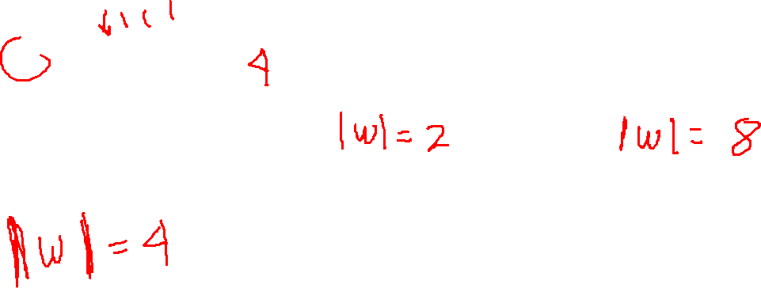
Length of string / cardinality
w = abcd
|w| = 4
w = 01
w = automata
CSPC 105
Louis Philippe Facun
Notes:
The length of string w denoted by |w| is the number of symbols composing the string.

Slide 5
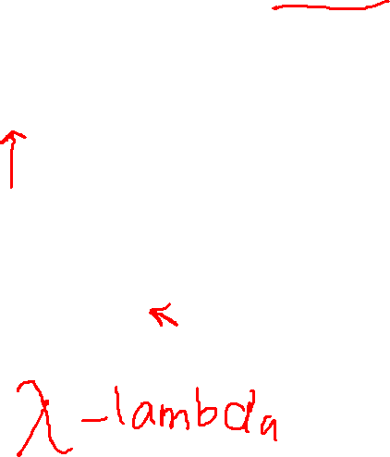
Null string or empty string
w =
w = λ
|λ| = 0
CSPC 105
Louis Philippe Facun
Notes:
The string of length 0 is called an empty or null string and is denoted with a symbol λ (lembda).
Thus, |λ|=0

Slide 6
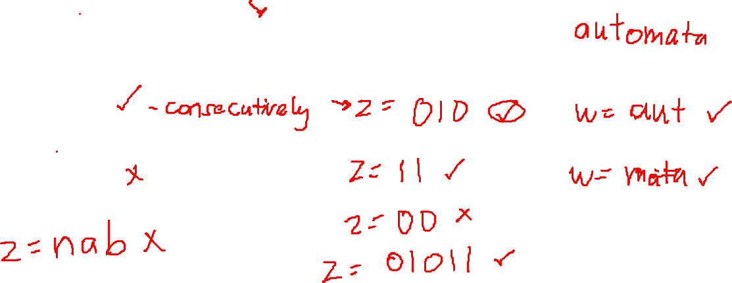
Substring
w = banana
z = ana
z = anb
w = 01011
w = c
CSPC 105
Louis Philippe Facun
Notes:
String z is a substring of w if z appears consecutively in w.
In example 4, z is a substring of w since the symbols in ‘ana’ is found consecutively in ‘banana.’

Slide 7
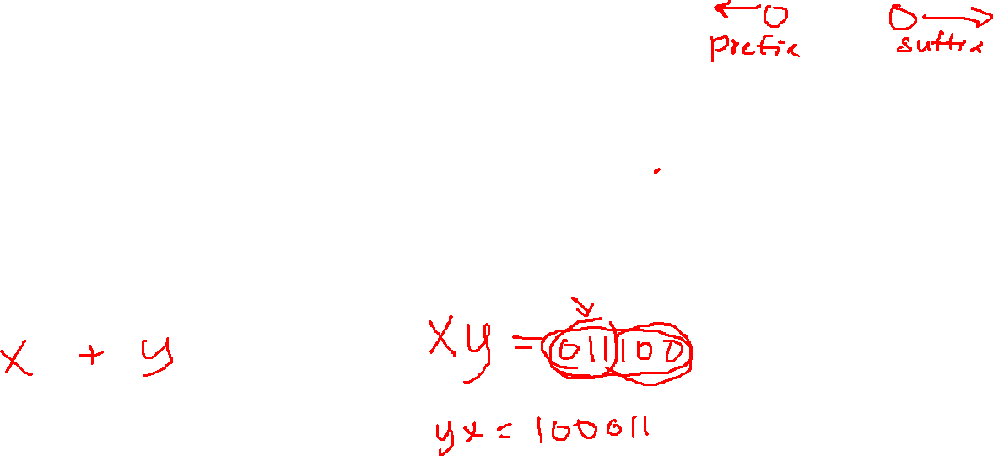
Concatenation: combine two string
x is x₁, x₂, x₃, … , x_{m}
y is y₁, y₂, y₃, … , y_{n}
x₁x₂x₃…y₁y₂y₃…y_{n}
x = 011
y = 100
CSPC 105
Louis Philippe Facun
Notes:
he concatenation of strings x with length m and y with length n is the sequence of symbols formed by appending y to the end of x.
(write Z = 011100)
Prefix
suffixs

Slide 8
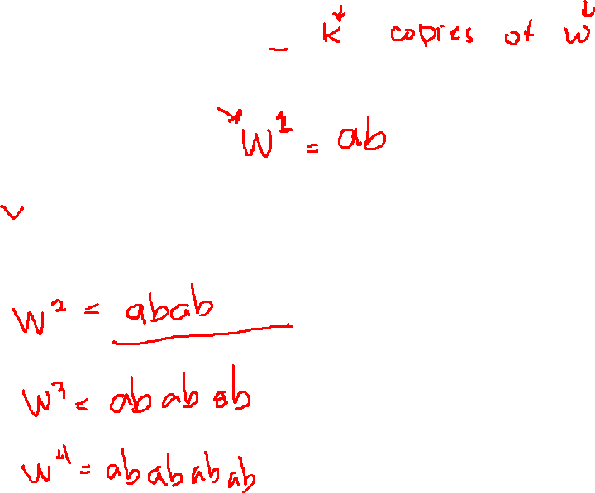
w^{k} copies
w = ab
w¹ = ab
CSPC 105
Louis Philippe Facun
Notes:
wk means k copies of w or the number of times (k) a string (w) is repeated.
Write w2-5

Slide 9
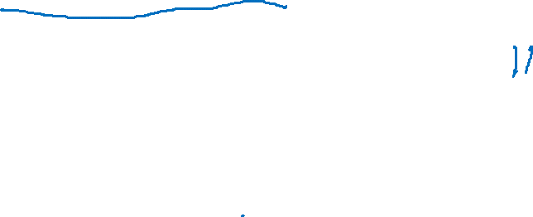
Language (L): set of all possible strings from an alphabet, given a condition
Σ = {0, 1} - no two consecutive 1’s
L = { λ , 0, 1, 00, 01, 10, 000, 001, 010, 100, 101, 0000, 0001, 0010,
0100, 0101, 1000, 1001, 1010, . . . }
CSPC 105
Louis Philippe Facun
Notes:
Notice that there are no two consecutive 1’s in each string element in the language

Slide 10
Language (L): set of all possible strings from an alphabet, given a condition
Σ = {0, 1} - no two consecutive 1’s
L = { λ , 0, 1, 00, 01, 10, 000, 001, 010, 100, 101, 0000, 0001, 0010,
0100, 0101, 1000, 1001, 1010, . . . }
CSPC 105
Louis Philippe Facun
Notes:
Notice that there are no two consecutive 1’s in each string element in the language

Slide 11
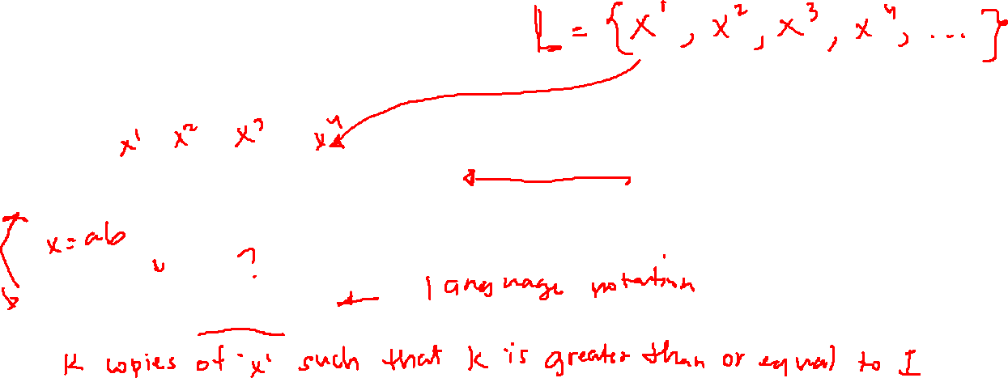
Language notation
Σ = {x, y}
L₁= {x, xx, xxx, xxxx,…}
L₁= {x^{k} | k ≥ 1}
CSPC 105
Louis Philippe Facun
Notes:
A language notation represents the characteristics of a given language using some symbols and rules.
k copies of x such that k is greater than or equal to 1.”
X is not variable, it is a symbol `mismo` give example number as a symbol

Slide 12
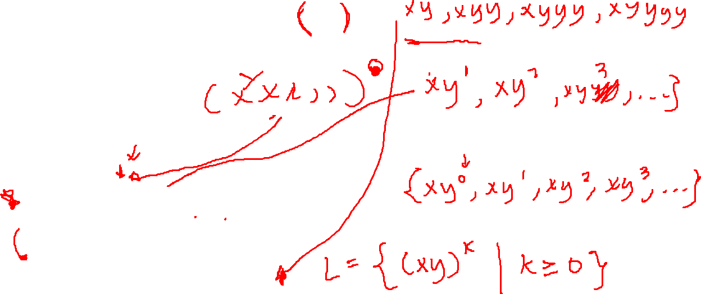

Language notation
Σ = {x, y}
If L₂= {λ, xy, xyxy, xyxyxy,…}
L₂= {(xy)^{k} | k ≥ 0}
CSPC 105
Louis Philippe Facun
Notes:
k copies of x such that k is greater than or equal to 1.”

Slide 13
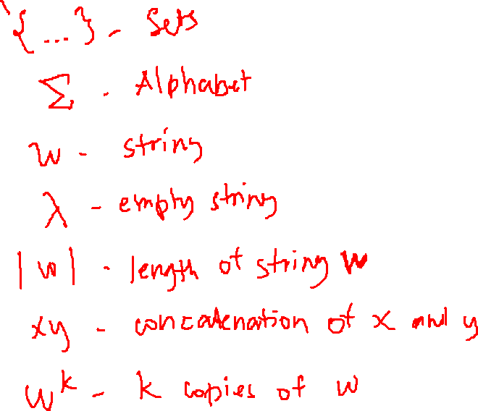
Questions?
CSPC 105
Louis Philippe Facun
Notes:
k copies of x such that k is greater than or equal to 1.”

