Slide 1
Introduction
CSPE 102
Intelligent Systems
Overview of Artificial Intelligence
L.P.Facun

Slide 2
What is “intelligence”?
Someone’s intelligence is their ability to understand and learn things.
Intelligence is the ability to think and understand instead of doing things by instinct or automatically.
Can computers think, or can be intelligent?
CSPE 102
Louis Philippe Facun
Notes:
[Ask them, what is “intelligence] to them?
[Give them 5 minutes to think]
[Choose volunteer, if none pick to the list]
[1]
First def, intel. is a quality possessed by humans.
[2]
Second def, not specific if someone or something can think and understand.

Slide 3
What is “Artificial Intelligence”?
A way of making computers, a software or computer-controlled robot think intelligently.
AI is accomplished on how humans learn, decide, work while trying to solve a problem.
Can machines think? Answer: unclear (not a yes or not a no)
CSPE 102
Louis Philippe Facun
Notes:
[3]
-Different person approaches an encountered problems.
-We all can think, learn and understand: tho, abilities are not same.

Slide 4
Goals of Artificial Intelligence
Implement human intelligence in machines.
Make machines answer problems and do things that would require intelligence done by humans.
CSPE 102
Louis Philippe Facun
Notes:
[E.g. nagpopogram]
[E.g]

Slide 5
Disciplines Important to AI
Computer Science
Psychology
Artificial Intelligence
Neuroscience
Biology
Mathematics
Philosophy
CSPE 102
Louis Philippe Facun

Slide 6

Disciplines Important to AI
Computer Science
Foundation of computer systems are built using algorithms.
CSPE 102
Louis Philippe Facun

Slide 7
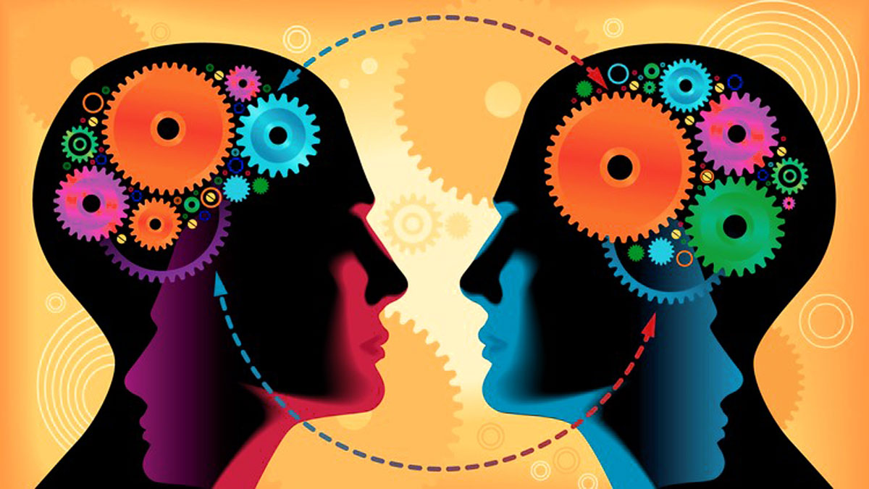
Disciplines Important to AI
Psychology
Since AI mimics on how human think, it is important to understand on how people behave and perceive and on how human process information and represent knowledge.
CSPE 102
Louis Philippe Facun

Slide 8
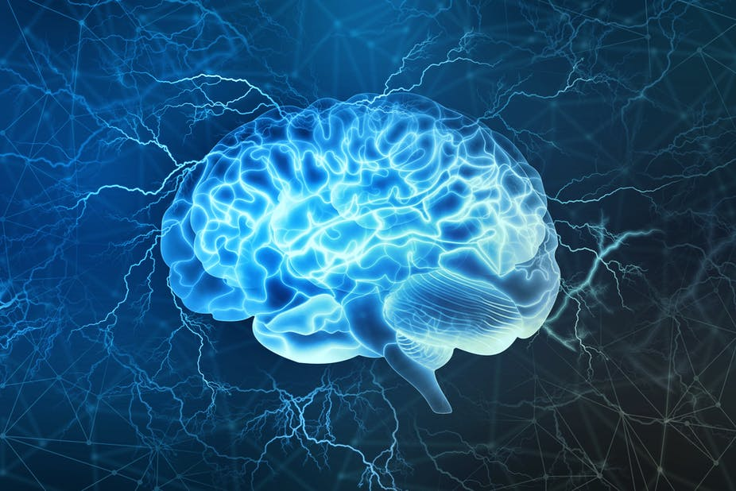
Disciplines Important to AI
Neuroscience
Helps in emulating human intelligence and is used to build neural networks that mimics brain structure.
CSPE 102
Louis Philippe Facun

Slide 9
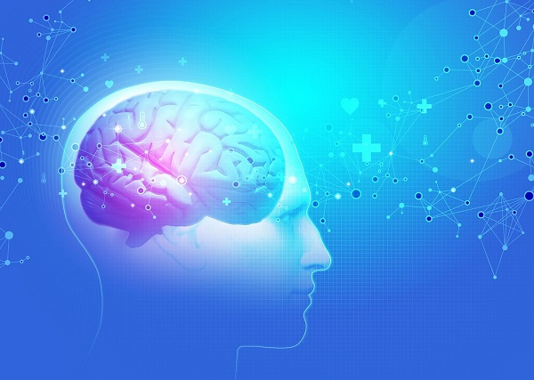
Disciplines Important to AI
Biology
Often used as an inspiration to AI because it aims to create approximative models of human brain.
CSPE 102
Louis Philippe Facun

Slide 10

Disciplines Important to AI
Mathematics
Fundamental topics in math such as linear algebra, calculus, probability, and optimization are important in AI.
CSPE 102
Louis Philippe Facun

Slide 11
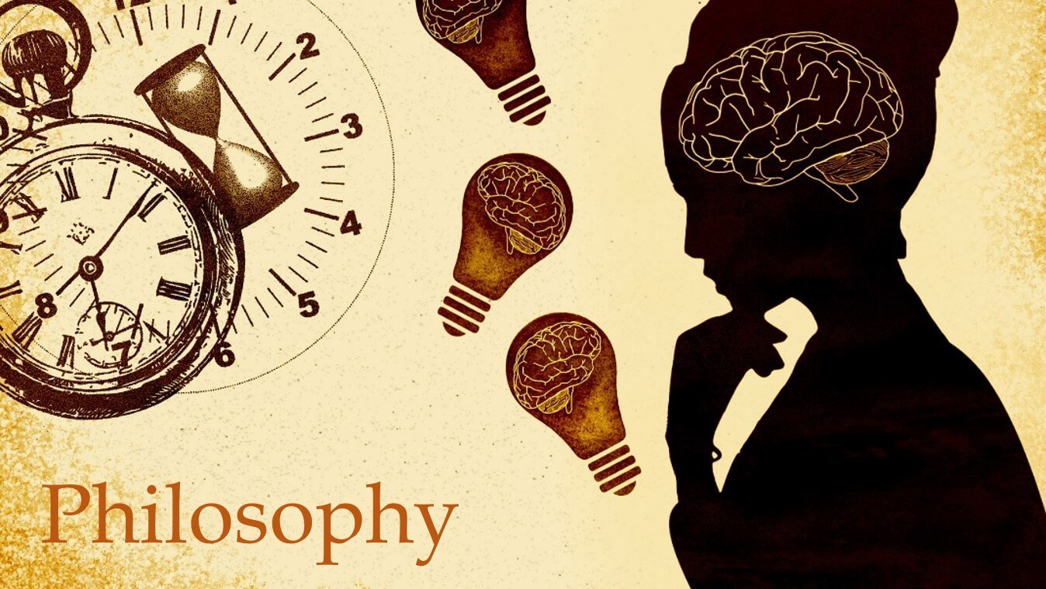
Disciplines Important to AI
Philosophy
The concept of logic, methods of reasoning, language and foundation of learning are essential in stablishing on how the computers will rationalize.
CSPE 102
Louis Philippe Facun

Slide 12
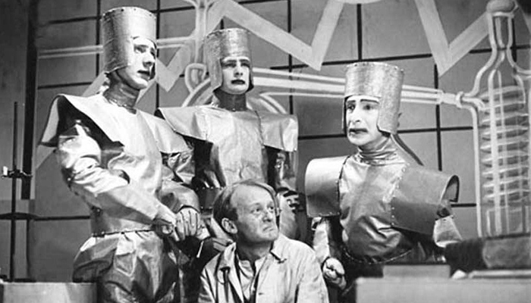
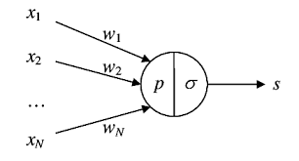
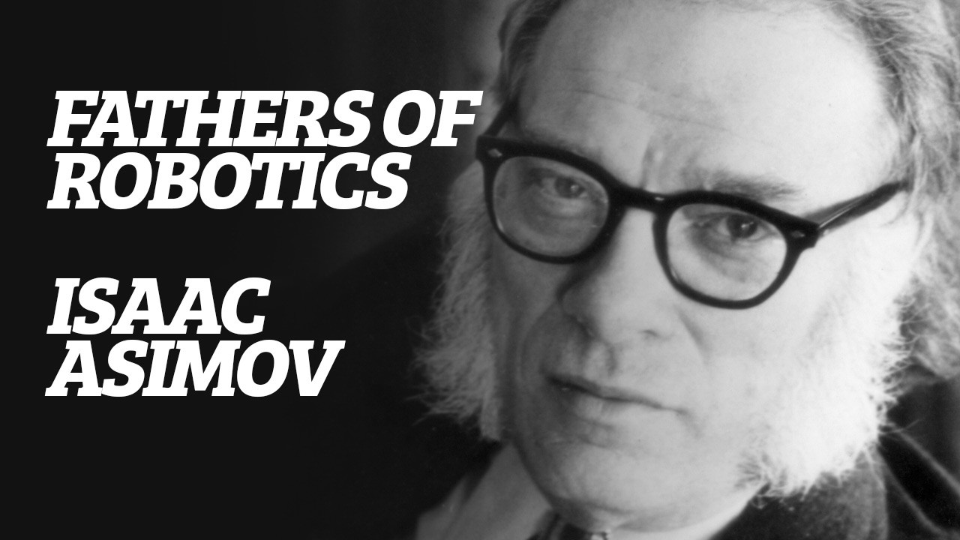
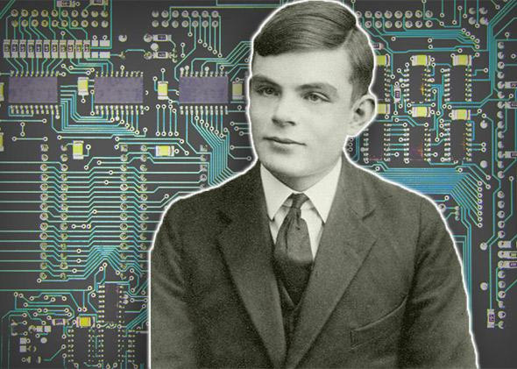
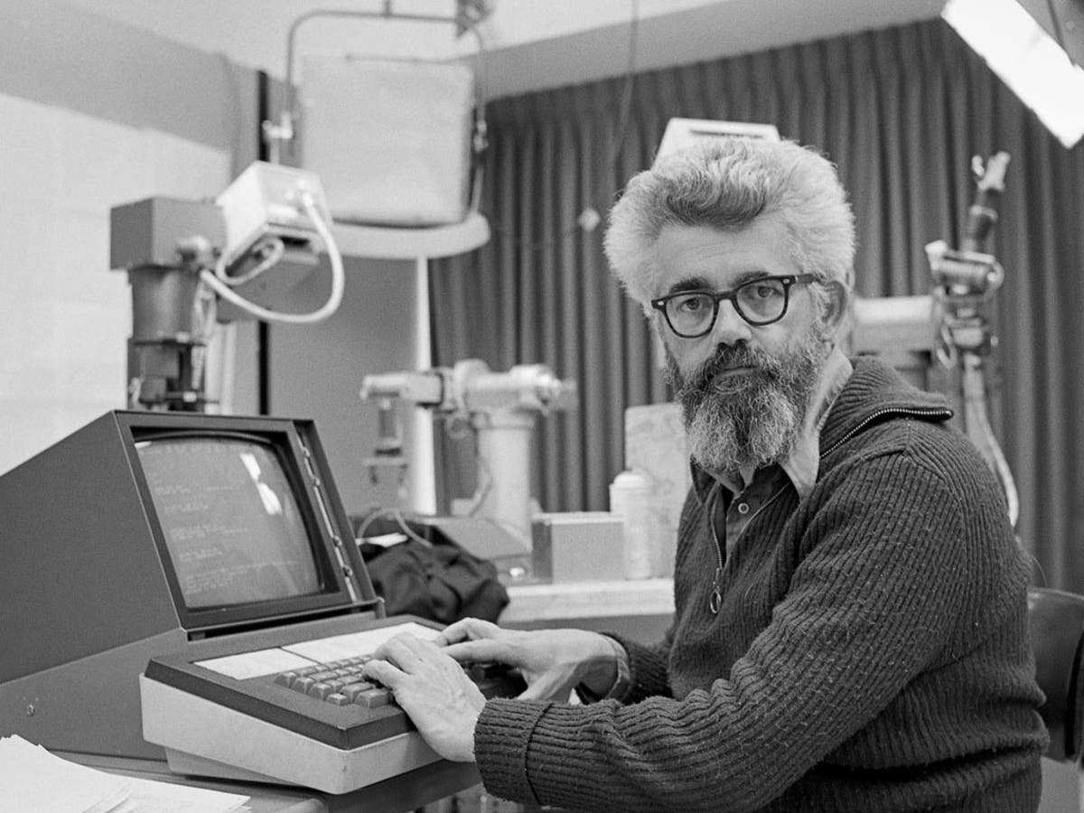
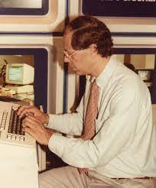
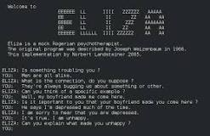

Milestones in AI
1923
1943
1945
1950
Rossum's Universal Robots
Foundation of Artificial Neural Networks
Coined the term “Robotics”
Turing Test
1956
1958
1964
1965
Coined the term “Artificial Intelligence”
LISP programming language for AI
Algebra world problem solver
First chatbot “ELIZA”
CSPE 102
Louis Philippe Facun
Notes:
1923 Karel Čapek’s play named “Rossum's Universal Robots” (RUR) opens in London, first use of the word "robot" in English.
1943 Foundations for neural networks laid.
1945 Isaac Asimov, a Columbia University alumni, coined the term Robotics.
1950 Alan Turing introduced Turing Test for evaluation of intelligence and published Computing Machinery and Intelligence. Claude Shannon published Detailed Analysis of Chess Playing as a search.
1956 John McCarthy coined the term Artificial Intelligence. Demonstration of the first running AI program at Carnegie Mellon University.
1958 John McCarthy invents LISP programming language for AI.
1964 Danny Bobrow's dissertation at MIT showed that computers can understand natural language well enough to solve algebra word problems correctly.
1965 Joseph Weizenbaum at MIT built ELIZA, an interactive problem that carries on a dialogue in English

Slide 13
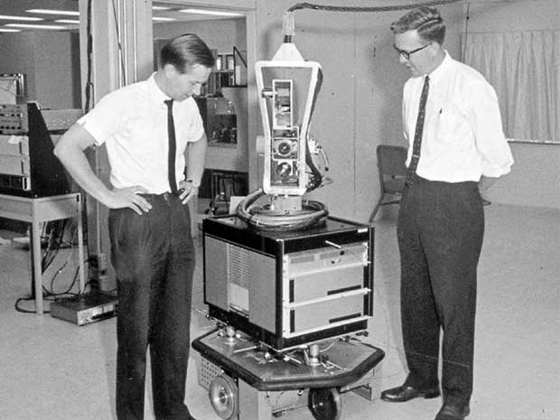
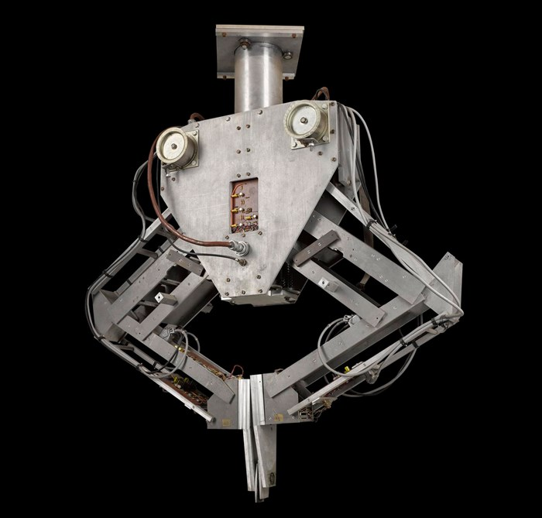
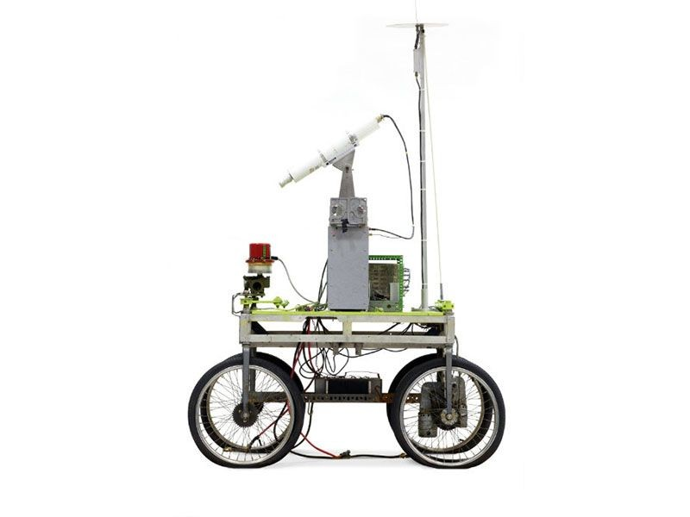
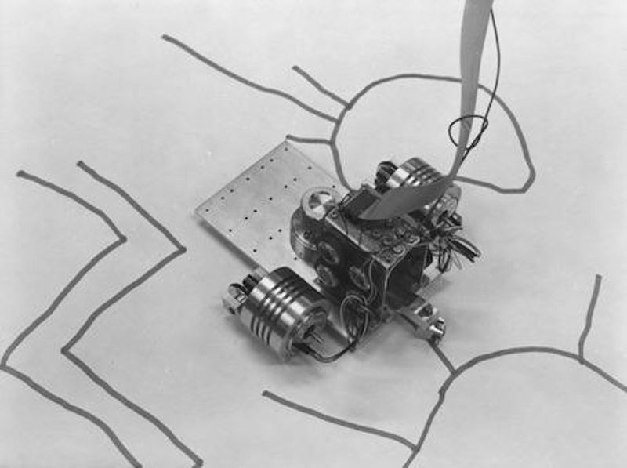
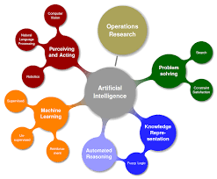
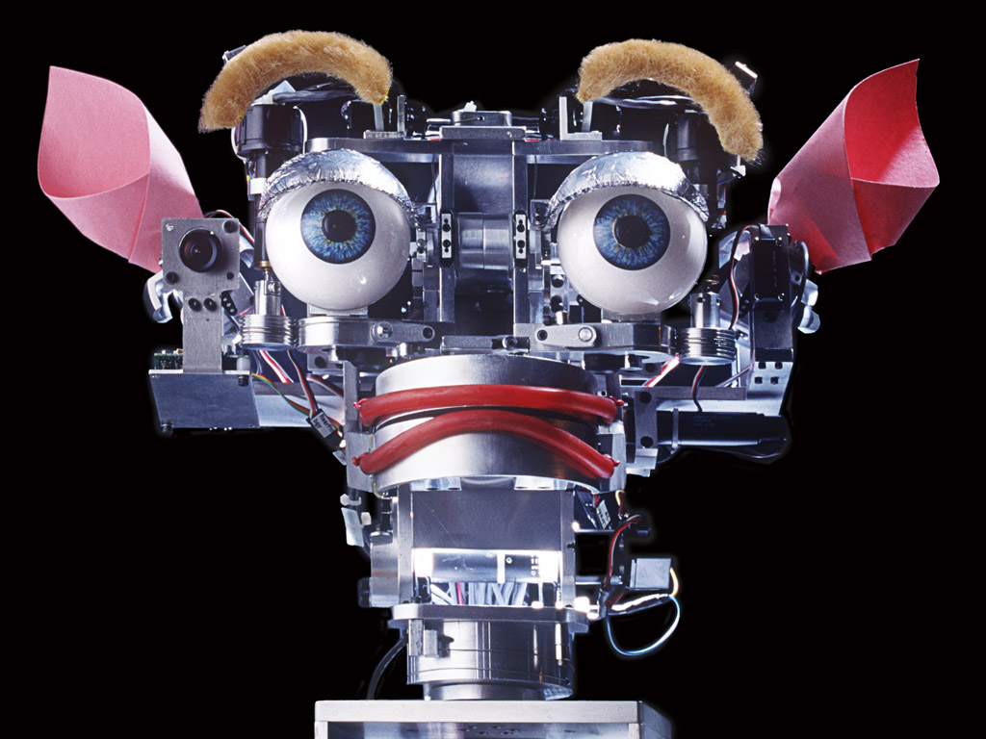
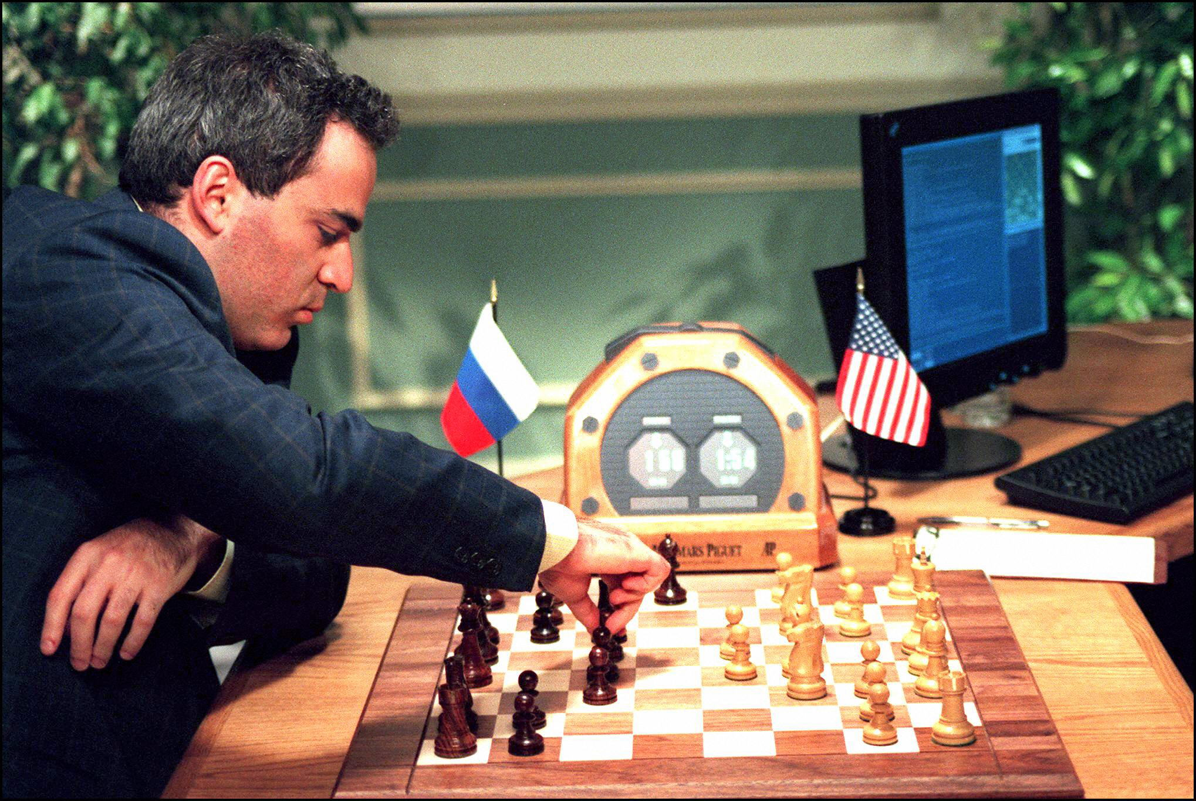

Milestones in AI
1969
1973
1979
1985
First mobile robot “Shakey”
First computer-controlled, autonomous vehicle “Stanford Cart”
Art making AI “AARON”
First robot with vision and hand “Freddy”
1990
1997
2000
2007
Major advances in all areas of AI
“Deep Blue Chess Program” beats world chess champion
First social robot “Kismet”
ImageNet for object recognition
CSPE 102
Louis Philippe Facun
Notes:
1969 Scientists at Stanford Research Institute Developed Shakey, a robot, equipped with locomotion, perception, and problem solving.
1973 The Assembly Robotics group at Edinburgh University built Freddy, the Famous Scottish Robot, capable of using vision to locate and assemble models.
1979 The first computer-controlled autonomous vehicle, Stanford Cart, was built.
1985 Harold Cohen created and demonstrated the drawing program, Aaron.
1990 Major advances in all areas of AI:
• Significant demonstrations in machine learning
• Case-based reasoning
• Multi-agent planning
• Scheduling
• Data mining, Web Crawler
• Natural language understanding and translation
• Vision, Virtual Reality
• Games
1997 The Deep Blue Chess Program beats the then world chess champion, Garry Kasparov.
2000 Interactive robot pets become commercially available. MIT displays Kismet, a robot with a face that expresses emotions. The robot Nomad explores remote regions of Antarctica and locates meteorites.
2007 ImageNet, a large database of annotated images designed to aid in visual object recognition software research.

Slide 14
What can AI do today
Robotic vehicles: self-driving cars, self-driving drones, planes etc.
Legged locomotion: BigDog, Spot, Atlas etc. by BostonDynamics
Autonomous planning and scheduling: NASA’s Mars rovers, Uber, Google Maps
Machine translation: language translation in over 100 languages
Speech recognition: Alex, Siri, Cortana, and Google Assistant
Recommendations: Amazon, Facebook, Netflix, YouTube
Game Playing: Chess (Deep Blue), Dota 2 (OpenAI), Go (AlpaGO)
CSPE 102
Louis Philippe Facun

Slide 15
What can AI do today
Image understanding: Image captioning
Computer vision: face detection & recognition, image classification, object detection
Medicine: disease diagnosis (COVID-19, Cancer, Alzheimer’s)
Climate science: detailed information about weather events
CSPE 102
Louis Philippe Facun

Slide 16
Risks of AI
Lethal autonomous weapons: e.g. homing missiles, killer drones
Surveillance and persuasion: e.g. cctv, social media
Biased decision making: e.g. loan applications biased race, gender, etc.
Employment/Jobs: replacing of standard worker
Safety-critical applications: self-driving cars (fatal accidents)
Cybersecurity: ai-powered malicious cyberattacks: blackmail, phishing
Super AI: robots dominating humans in the future?
CSPE 102
Louis Philippe Facun

Slide 17
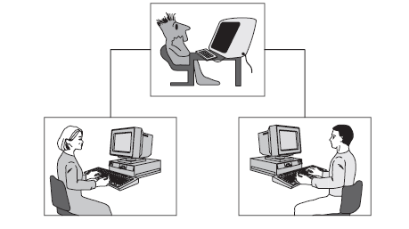
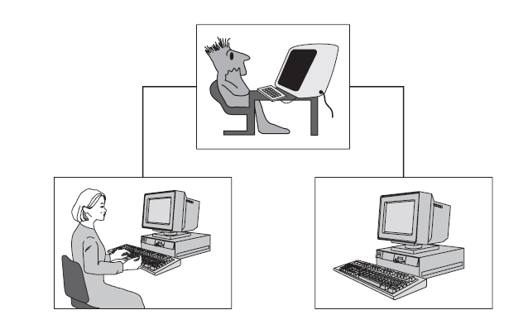
Turing Test
First phase
Second phase
CSPE 102
Louis Philippe Facun
Notes:
[ developed to determine or test if machine is truly intelligent ]

Slide 18
Assignment
Watch this two videos about “Chinese Room Argument and Experiment”:
https://youtu.be/htrsnpwzhmI?t=29
https://www.youtube.com/watch?v=D0MD4sRHj1M
Briefly explain the:
Process of the Experiment.
Conclusion/Argument of the Experiment.
CSPE 102
Louis Philippe Facun

