Slide 1

CMPS ……… PROJECT
TEAM HOMIES

Slide 2
DESCRIPTION OF BUSINESS
<describe what type of products or services are aimed to be delivered.>
Business operations:
Employees work on their respective projects
Projects are requests from clients
Projects have certain budget to implement
Clients pay certain amount for their project completion
Employees in the project have certain roles
Employees also have their own salaries
Business requirements:
Client information
Project requests from Client
Employees with certain roles
Payment to all the employees
Employees information and their dependents

Slide 3
REFERENTIAL-RELATIONS
FOREIGN TABLE (REFERENCING TABLE) | FOREIGN KEY | REFERENCED TABLE | PRIMARY KEY
ROLES | NONE | NONE | Role_Id
EMPLOYEE | Role_Id | ROLES | Employee_Id
SUPERVISOR | Employee_Id, Supervisor_Id | EMPLOYEE | Employee_Id
DEPENDENT | Employee_Id | EMPLOYEE | D_Id
PAYMENTTOEMPLOYEES | Employee_Id | EMPLOYEE | Payment_Id
BANKINFO | Employee_Id | EMPLOYEE | Employee_Id
PROJECT | Client_Id | CLIENT | Project_Id
CLIENT | Project_Id | PROJECT | Client_Id
PAYMENTFROMCLIENT | Project_Id, Client_Id | PROJECT,CLIENT | Payment_Id
EMPLOYEE_PROJECT | Employee_Id, Project_Id | PROJECT,EMPLOYEE | Id

Slide 4
ER-Diagram
Dependent
(1,1)
Project
PaymentFromClient
Dependent of
(1:n)
EmployeeProject
(2,N)
(1,1)
PaymentToEmployees
works on
(1,1)
(0,N)
(1,N)
(1:n)
Employee
(m:n)
(1,1)
proposes
makes
(1:n)
receives
(1,N)
(1:1)
(1,1)
(1,1)
(1,1)
(1,N)
(1,1)
(0,N)
(0,1)
has
(1:1)
has
Client
(1,1)
(1,N)
Supervision
Roles
BankInfo
(1:n)

Slide 5
ER-Diagram
D_Id
FirstName
MiddleName
LastName
Phone_number
Date_Started
Total_Budget
Client_Id
Project_Id
Joined_on
Email
Dependent
Email
Project_Name
Date_Completed
Realtionship
Client_Id
Amount_Paid
address
Employee_Id
Project_Id
(1,1)
Project
Budget
age
PaymentFromClient
Id
Project_Id
Payment_Id
lastname
Dependent of
(1:n)
EmployeeProject
(2,N)
(1,1)
Amount_remaining
PaymentToEmployees
firstname
Salary
Employee_Id
works on
(1,1)
Role_Id
(0,N)
(1,N)
(1,1)
(1:n)
Employee
(m:n)
End_Date
proposes
makes
(1:n)
receives
(1,N)
Employee_Id
Start_Date
(1:1)
Payment_Id
(1,1)
(1,1)
(1,1)
(1,N)
Employee_Id
PayPeriod_Startdate
(1,1)
(0,N)
(0,1)
has
(1:1)
has
Client
Amount
(1,1)
Project_Id
(1,N)
Client_Id
Email
Status
Supervision
Roles
BankInfo
FirstName
PhoneNumber
(1:n)
Role_Name
BankAccountNumber
Role_Name
Employee_Id
Address
Role_Id
BankName
MiddleName
Employee_Id
LastName

Slide 6
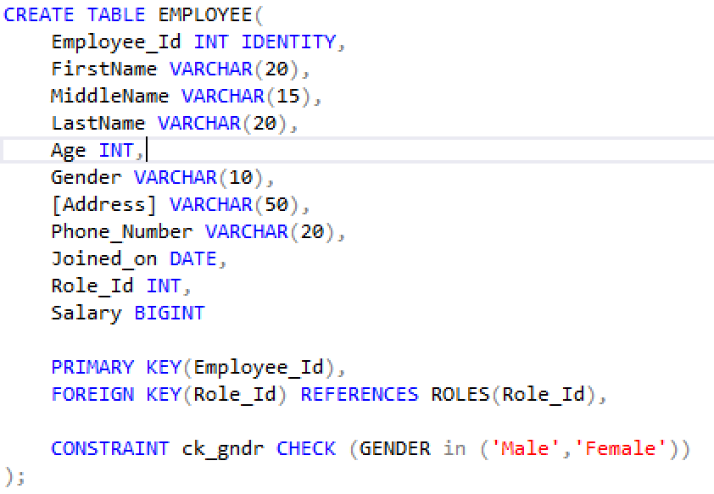
DDL QUERIES
Q1: CREATE TABLE
Here, We have created a table Employee

Slide 7
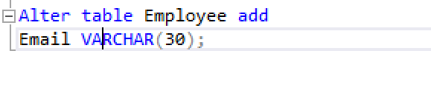

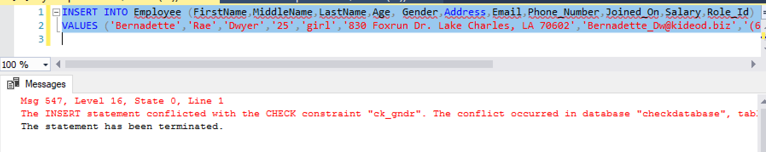
Q2: Alter table
Adding email to Employee table with alter
Implementing constraint ck_gender
Q3: Check Query

Slide 8
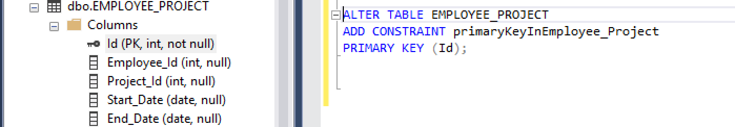
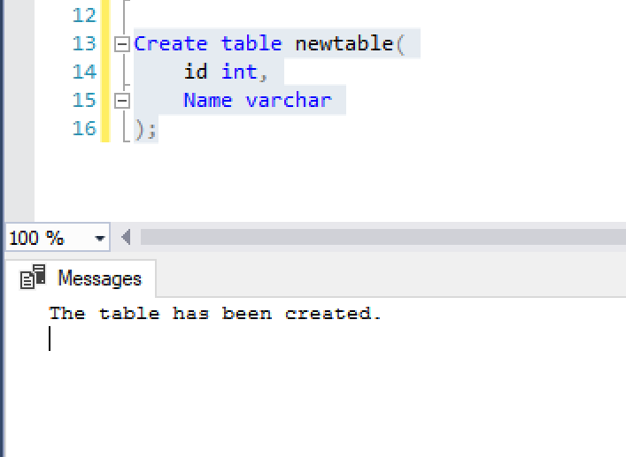
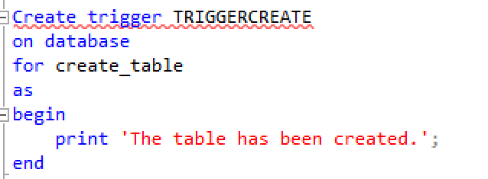
Q4: Add constraints to table
Adding constraint primary key to Employee_Project table
Q5: Trigger
Creating trigger for whenever a table is created

Slide 9
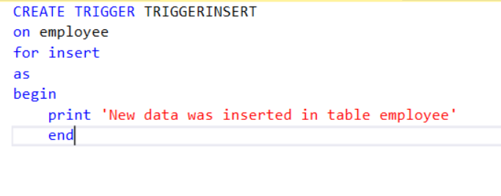
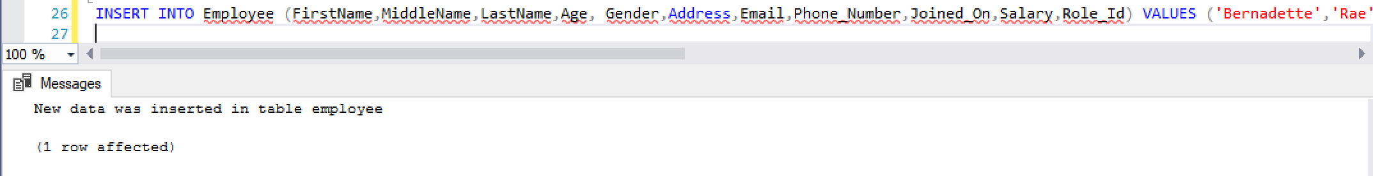
DML QUERIES
Creating a trigger for whenever a new data is inserted into table Employee
Q1: Trigger test query:

Slide 10
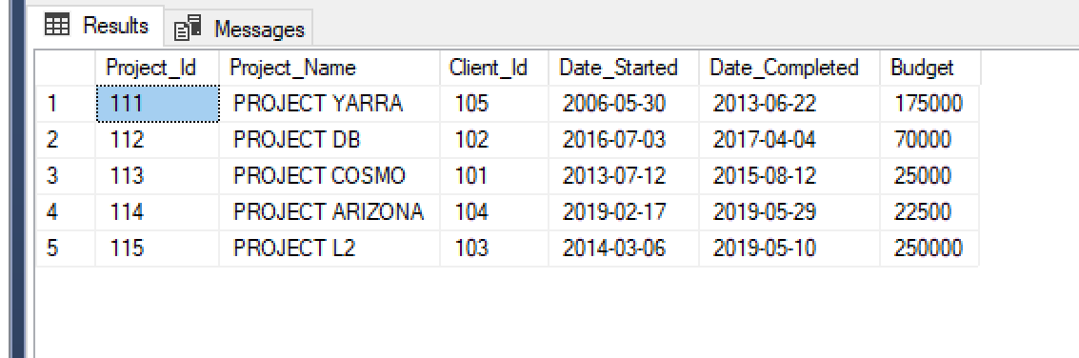
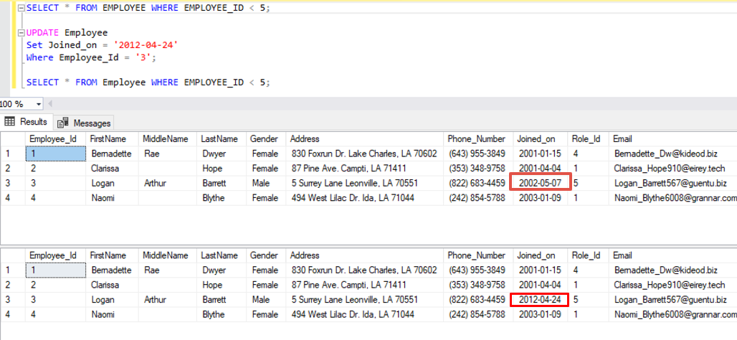
Inserting data and its result
Q2: Insert data
Q3: Update data
Updating joined on date of employee no. 3

Slide 11
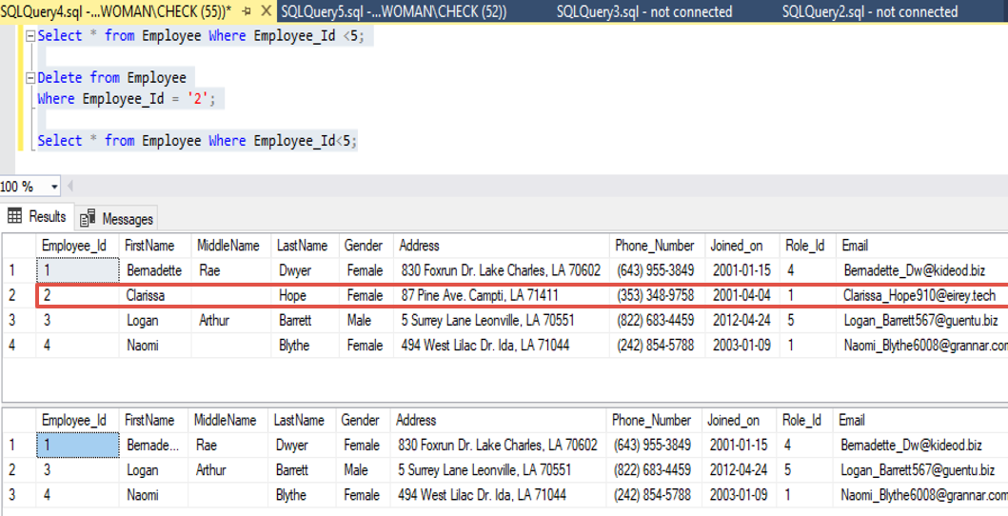
Q4: Delete data
Deleting employee_id 2

Slide 12
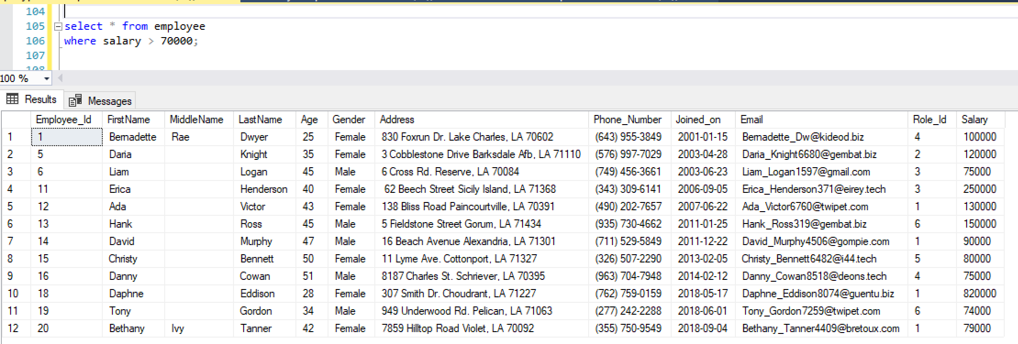
Q5: Query Data:
Query to get a list of employee whose salary is more than 70,000

Slide 13
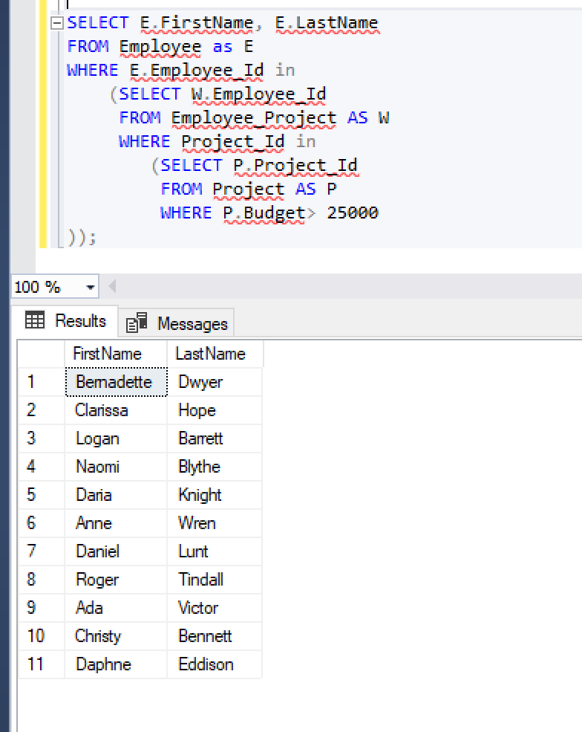

Q6: Query data with subquery in where clause
Employee-table Schema
EmployeeProject –table Schema
Project-table Schema
Query to return name of employees who works on projects whose budge is more than 25000

Slide 14
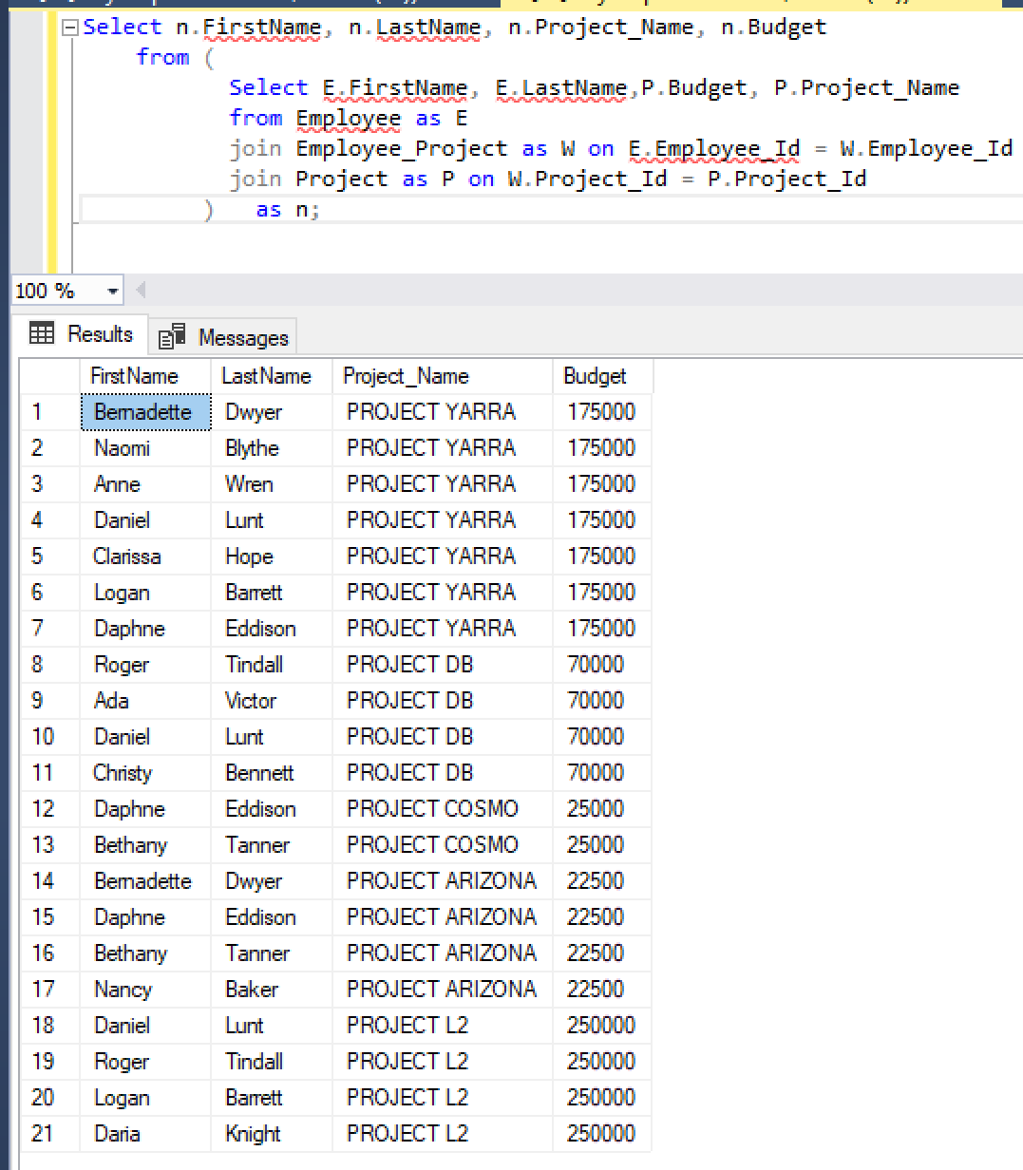
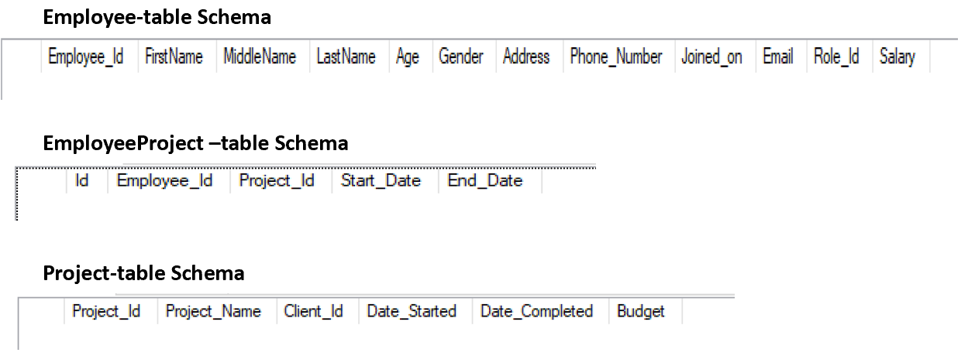
Q7: Query data with subquery in from clause:
Query to return name of employees, the project they are working on and the budget of the project for all the projects they are working on.

Slide 15
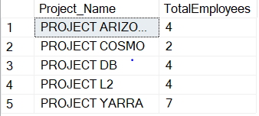
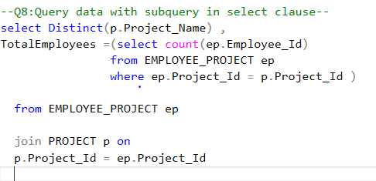
Q: Query data with subquery in select clause:
Query to give distinct project names and the number of employees working on it

Slide 16

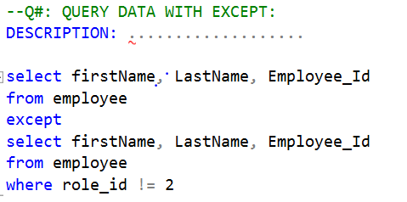
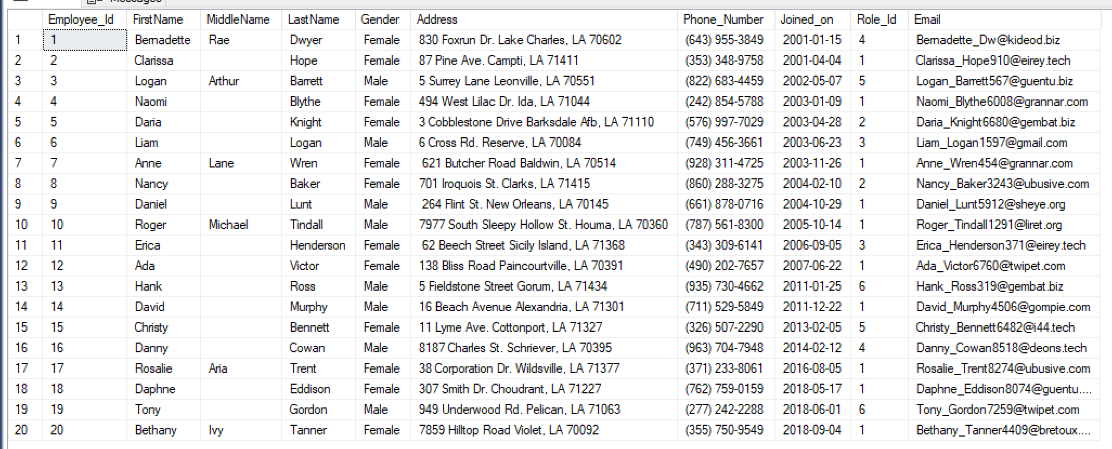
Q: Query data with except: Returns data whose role id is 2
Query to return name of employees excluding those whose role id is not 2 , which is name of employees whose role id is 2

Slide 17
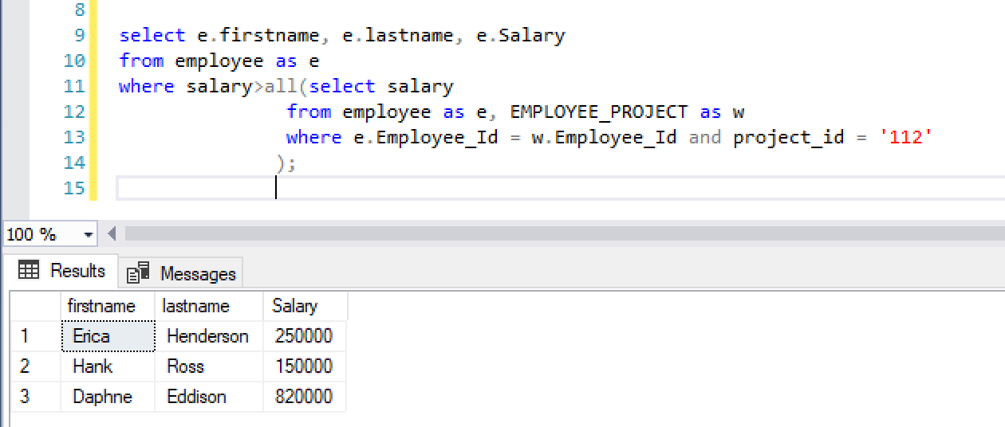
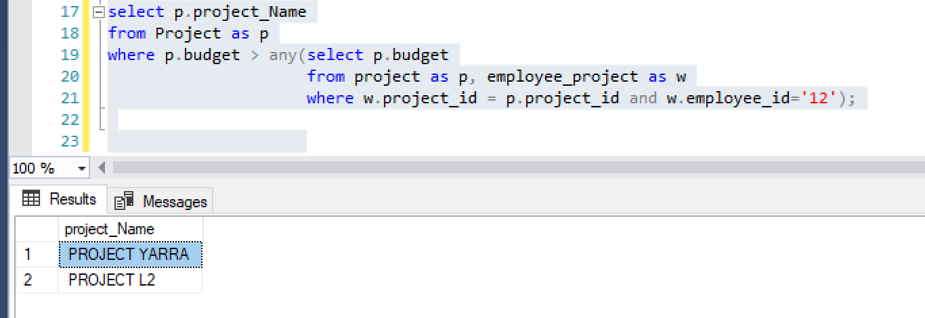
Q: Query data with any/some/all
[All] Query to return names and salary of employees whose salary is greater than all the salaries of employees working on project 112
[Any] Query to return all project names whose budget is more than all the projects that is worked on by employee no 12

Slide 18
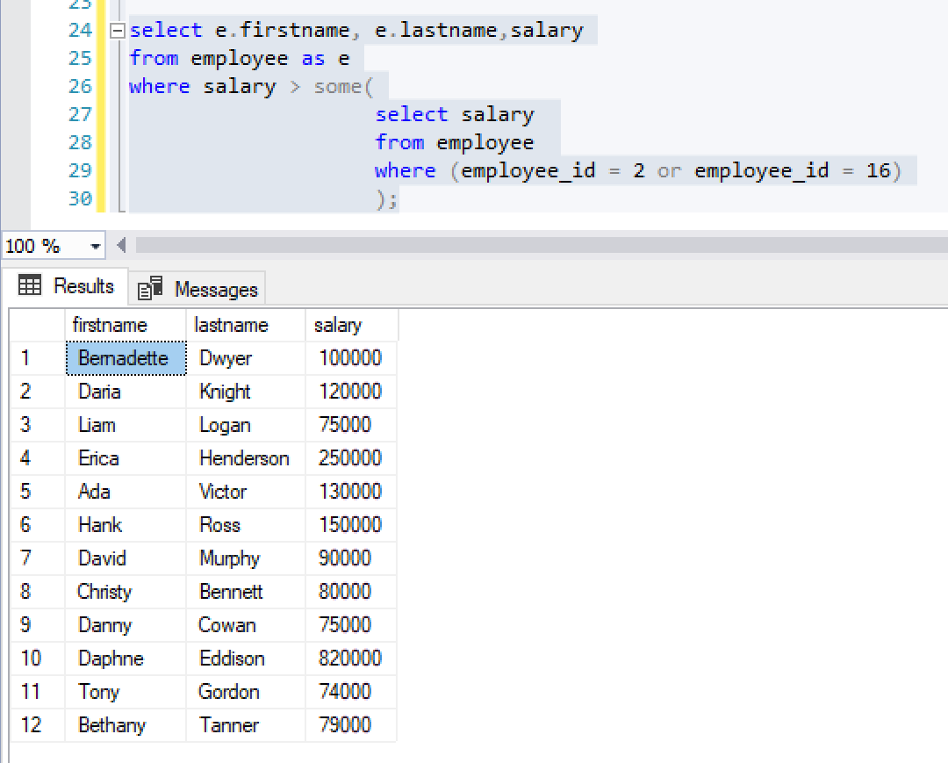
[Some] Query to return name and salary of employees whose salary is greater than employee id no 2 or employee id no 16.

Slide 19
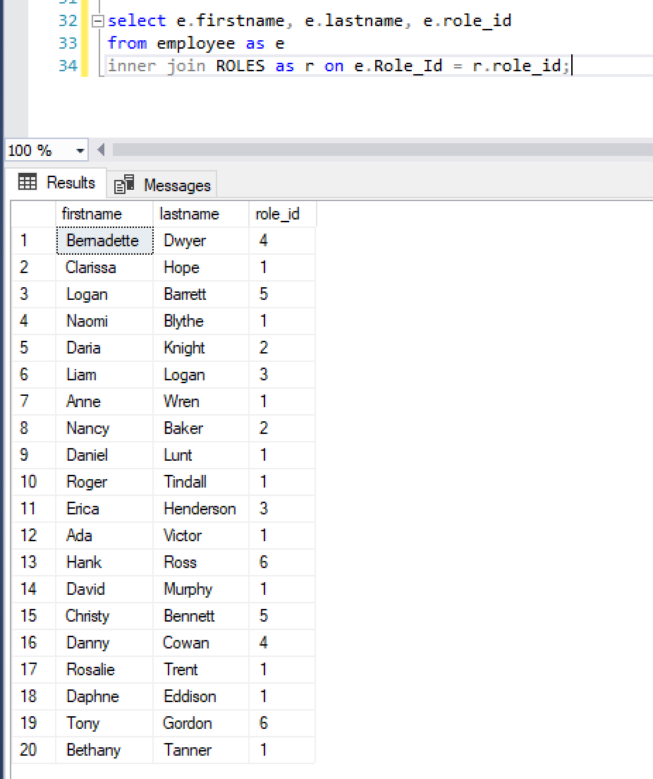
Q: Inner join
Inner joining table employee and roles

Slide 20
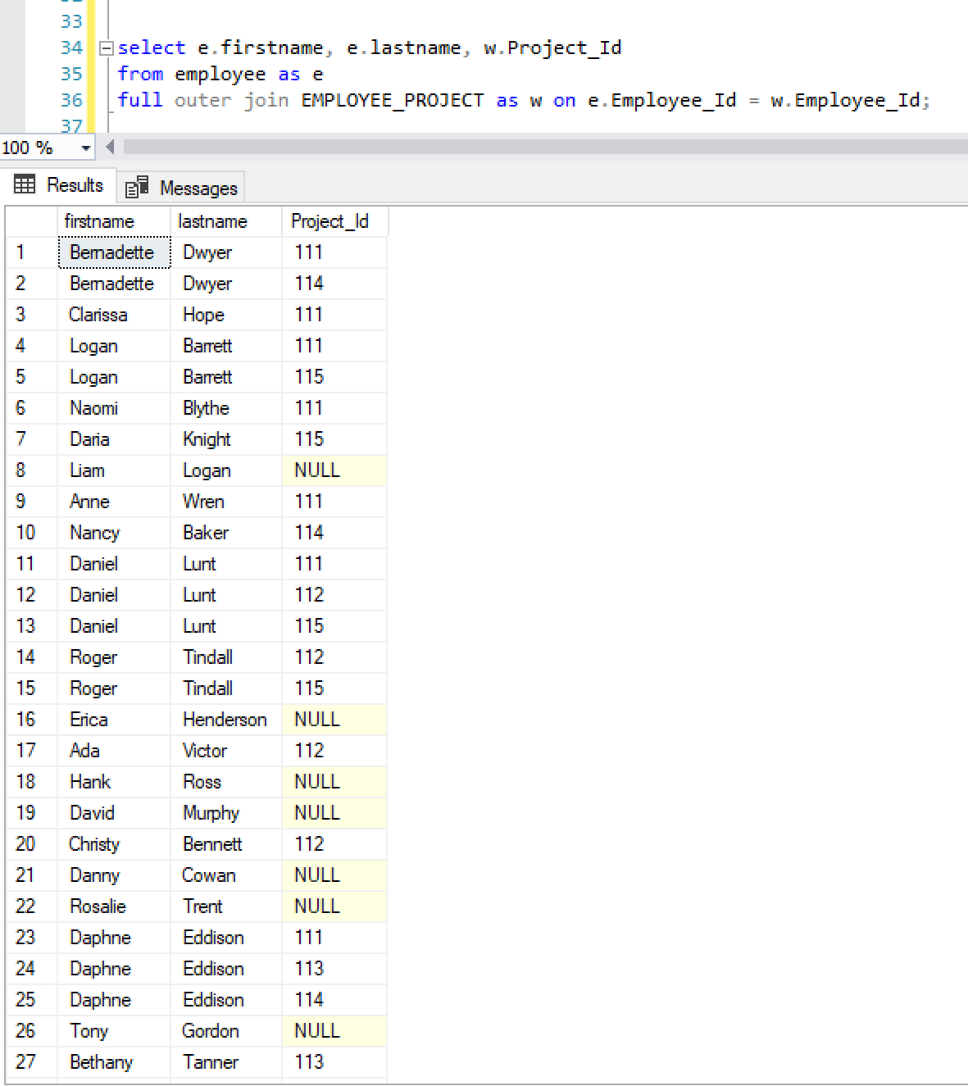
Q:Full outer join
Query for full outer join of employee and employee_project table.

Slide 21
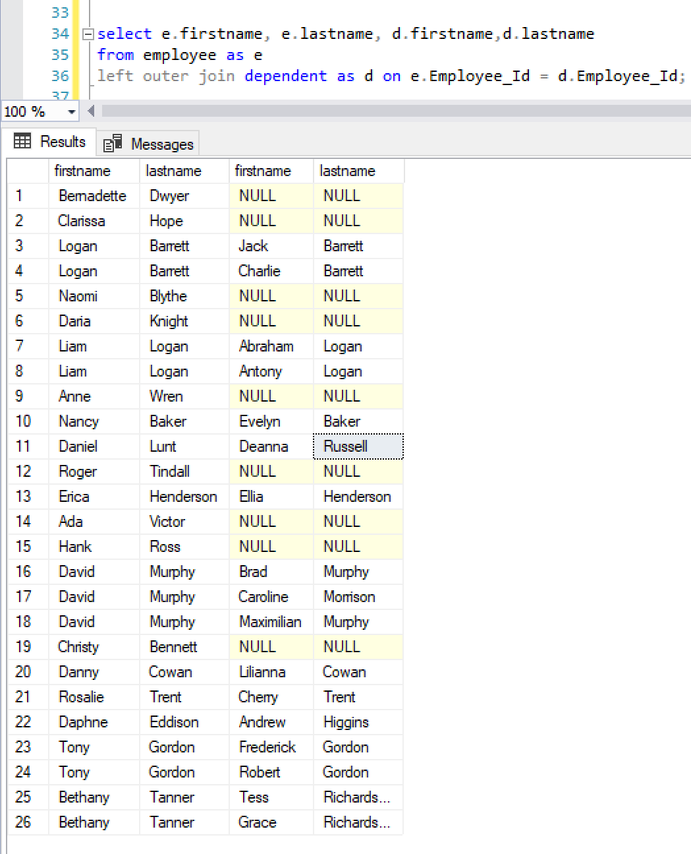
Q: Left Outer join
Query for left outer join employee and dependent table

Slide 22
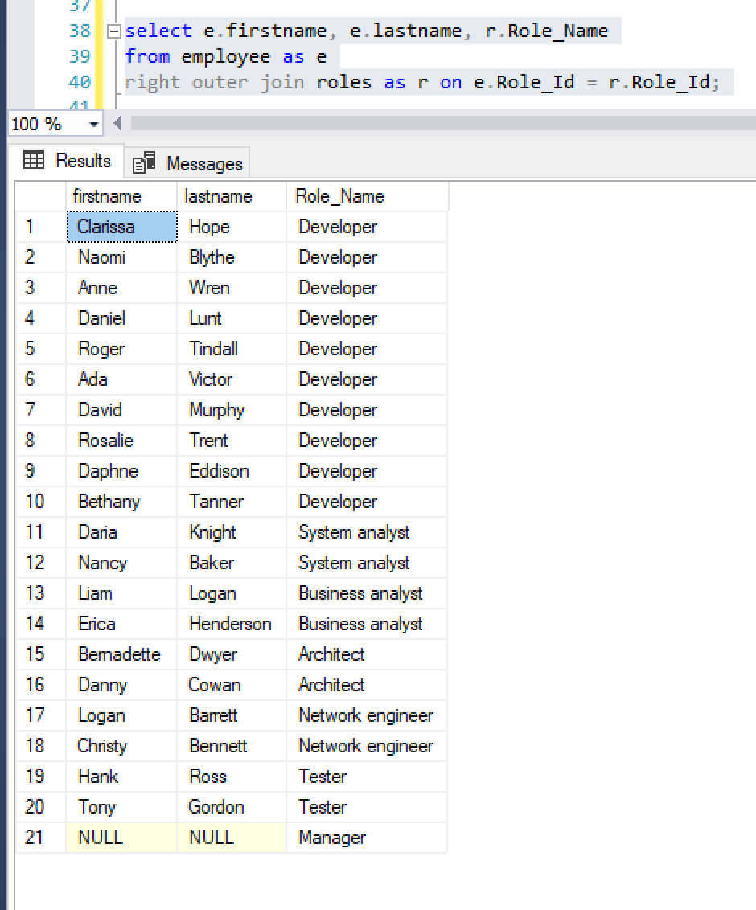
Q: Right outer join
Query for right outer join of employee and roles tables

Slide 23
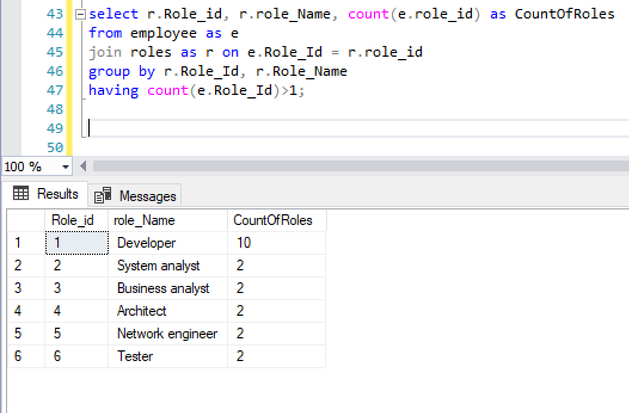
Q: Aggregation-join-query with group by and having
Query to get role name and the count of employees working in that role if more than one employee is working in that role.

Slide 24
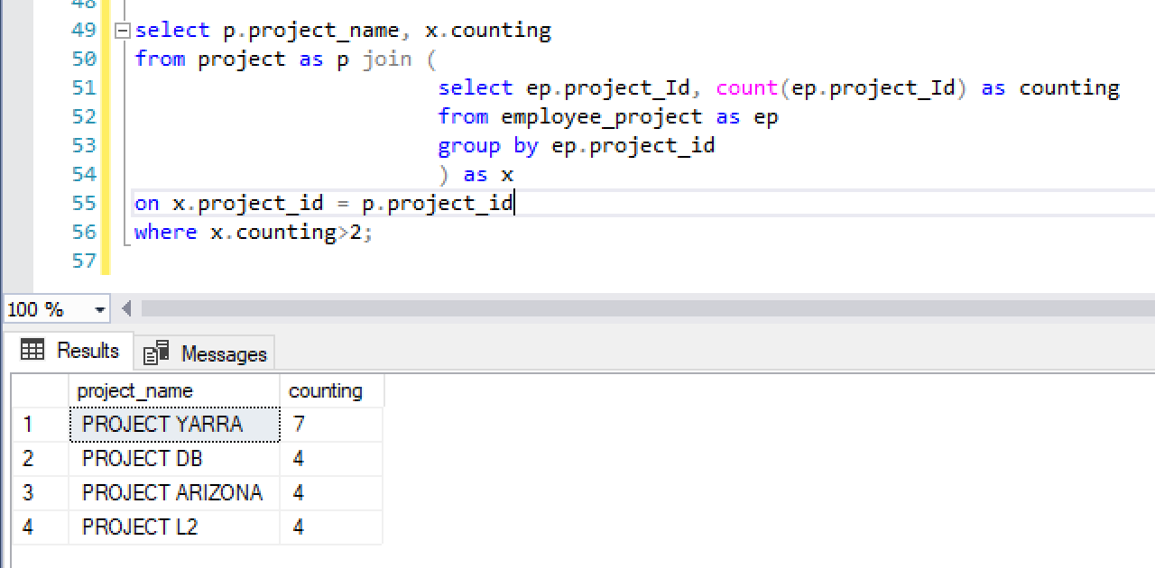
Q: Aggregation-join-query with subquery
Query to get project name and no of employees working on it if more than two employees are working on it

Slide 25
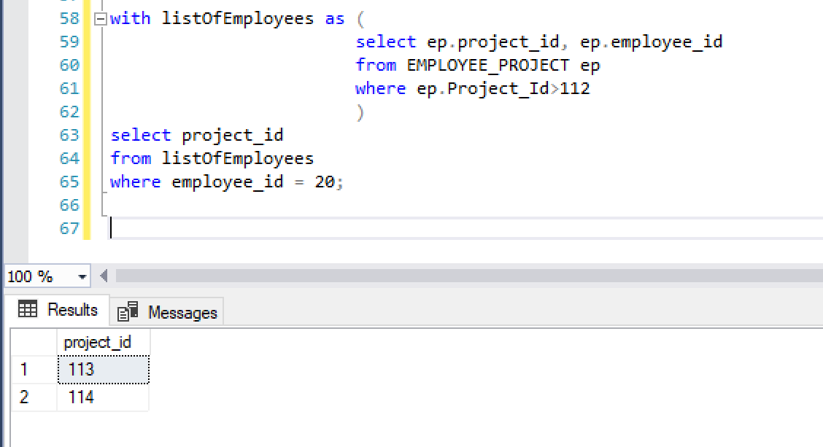
Q14
Query to make a temporary table using with that has project_id greater than 112 and then querying that table to get id of projecs worked on by employee id no 20

Slide 26
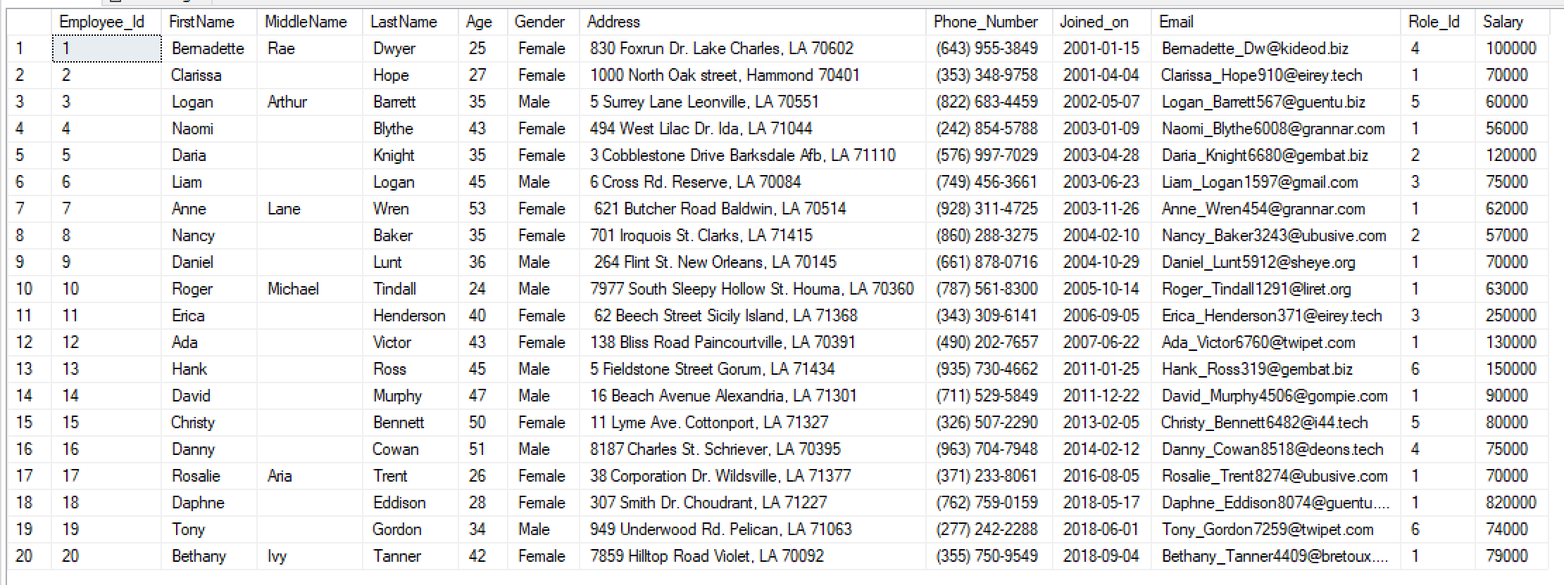
Employee

Slide 27
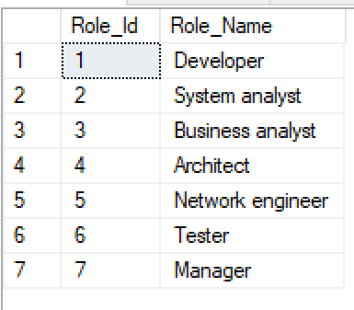
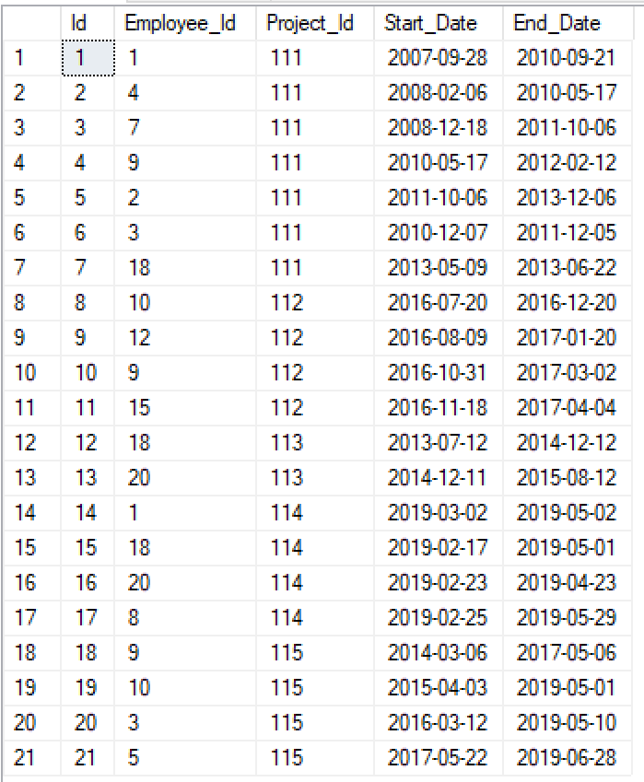
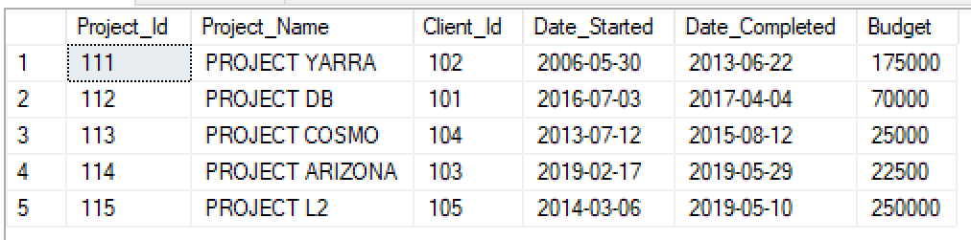
Roles
Employee_Project
Project

Slide 28
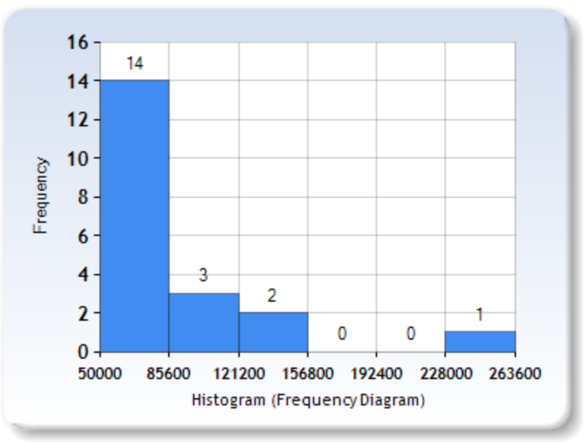
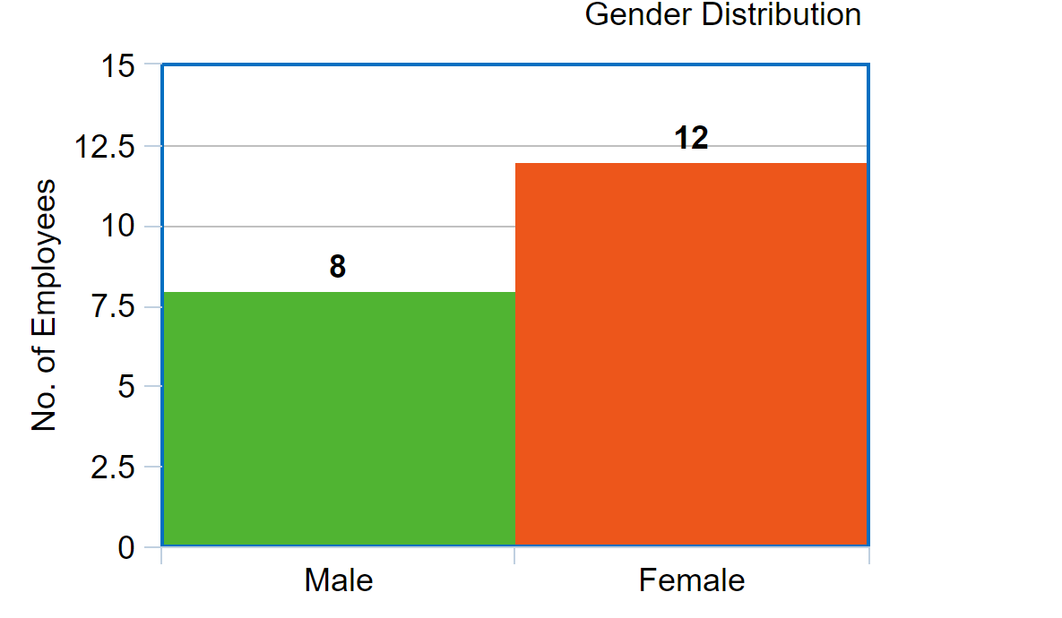
ANALYSIS OF DATA
Gender distribution among Employees
Salary distribution among Employees

Slide 29
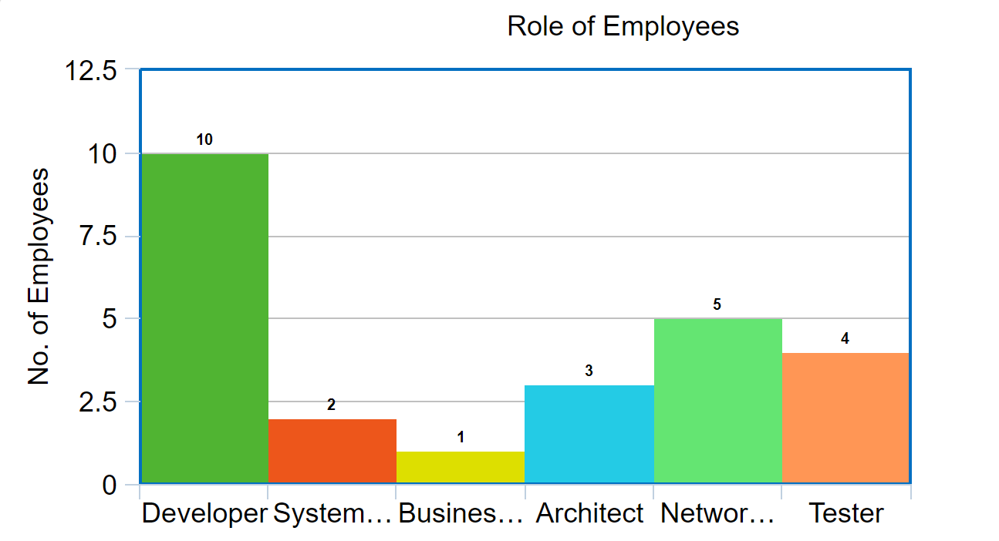
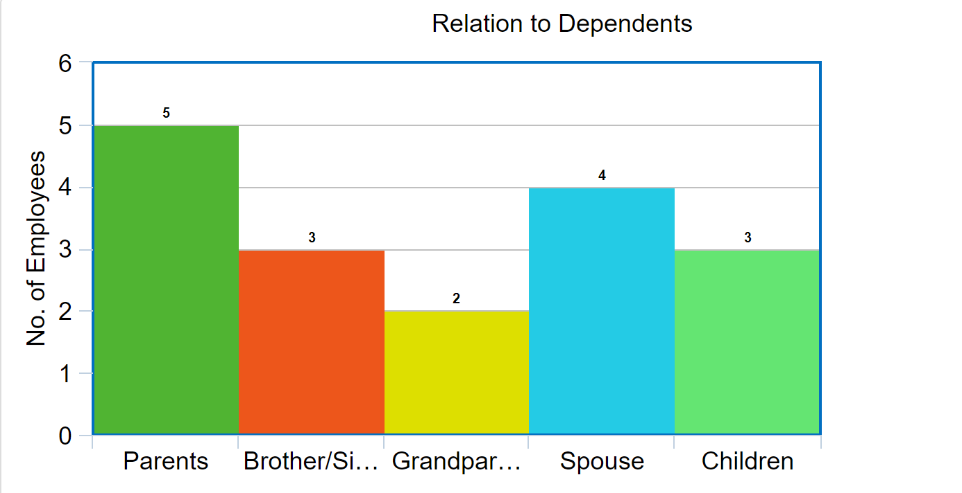
Role of Employees
Relation to Dependents

Slide 30
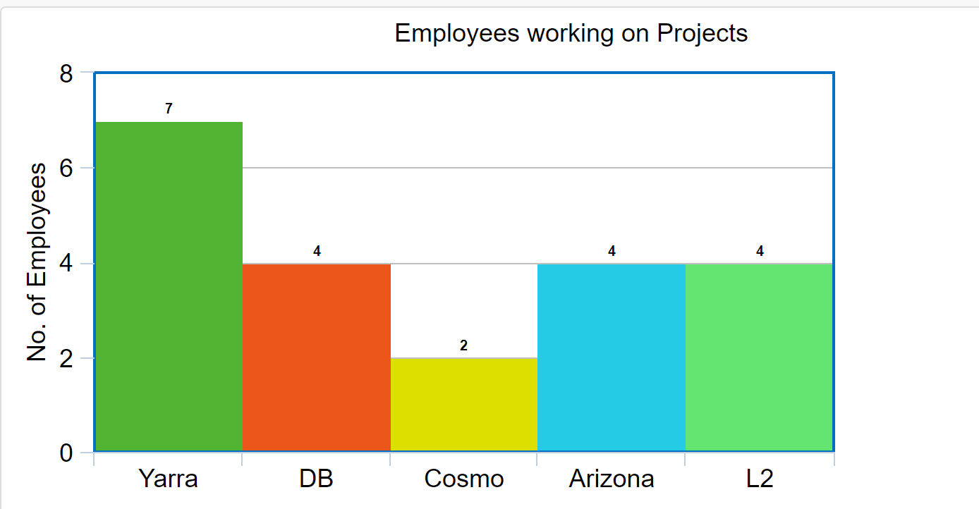
Employees working on Projects

Slide 31
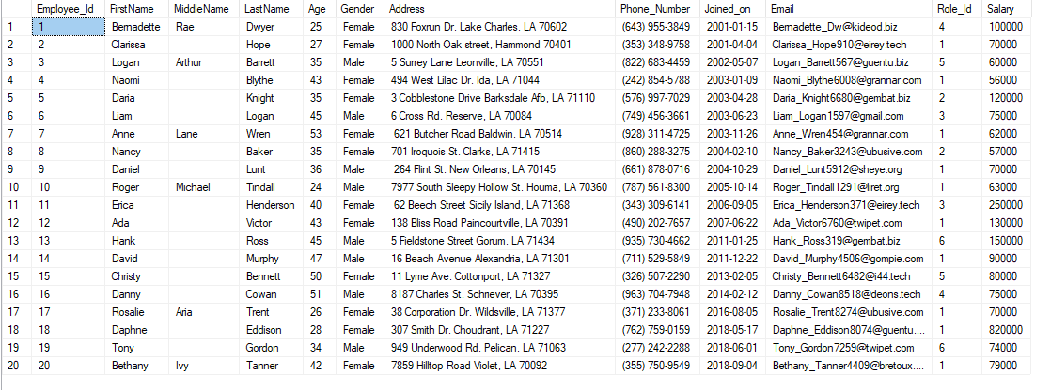
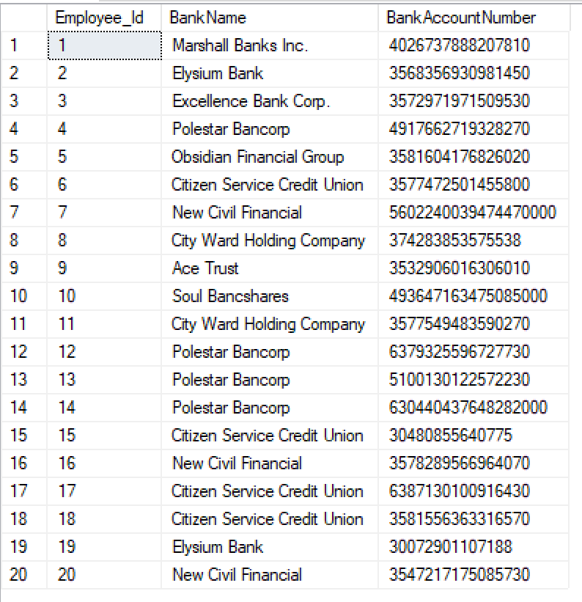
ANALYSIS OF DATA
Employee and BankInfo (1:1)

Slide 32
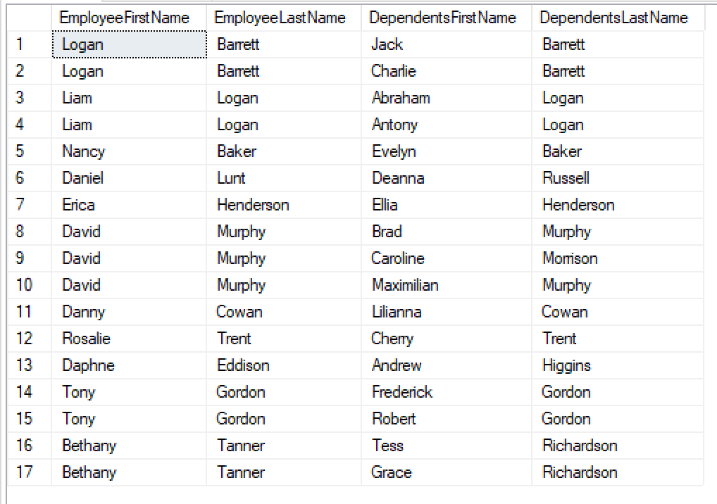
Employee and Dependents(1:n)

Slide 33
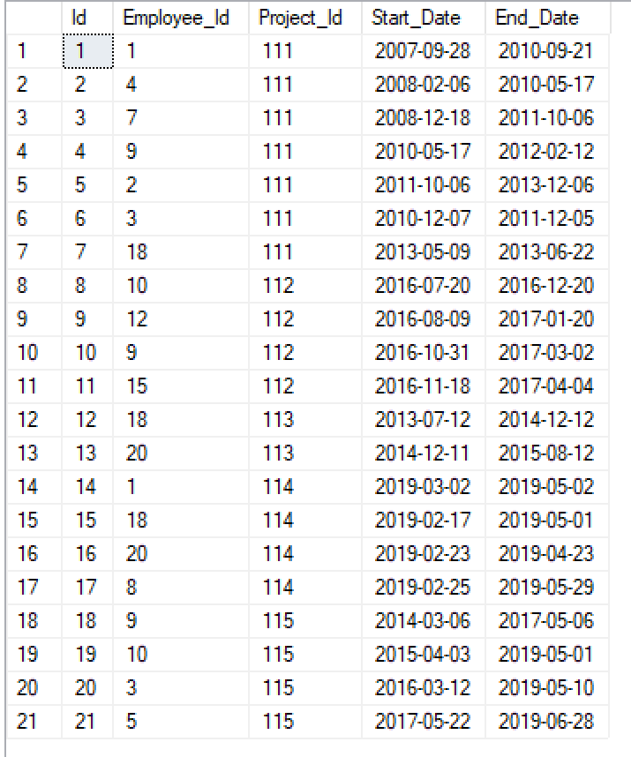
Employee and Employee_Project(m:n)

Slide 34
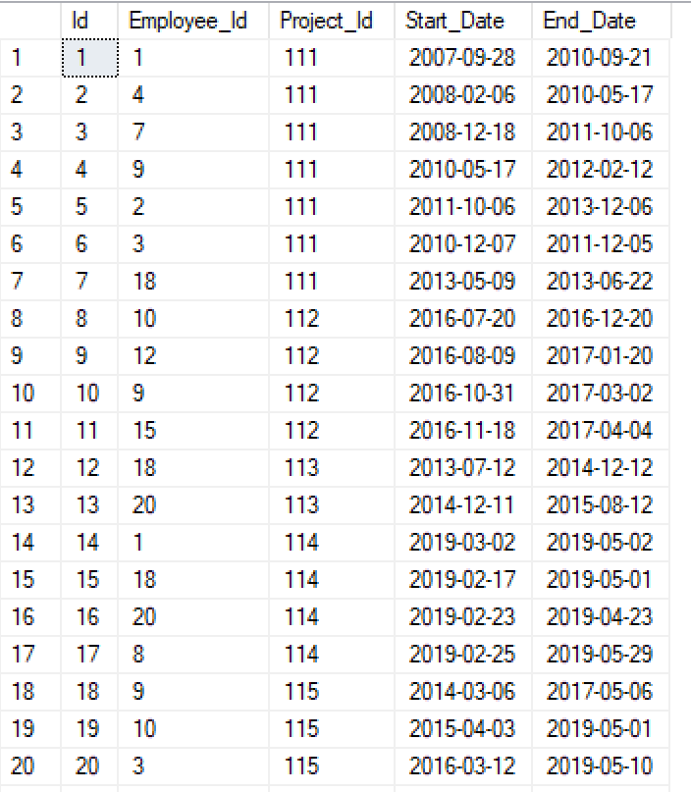
Employee—(1,N)--Employee_project --(2,N)--Project
Here, every employee in the table works on atleast one to many no of projects
Each project is worked by atleast 2 employees to n number of employees

Slide 35
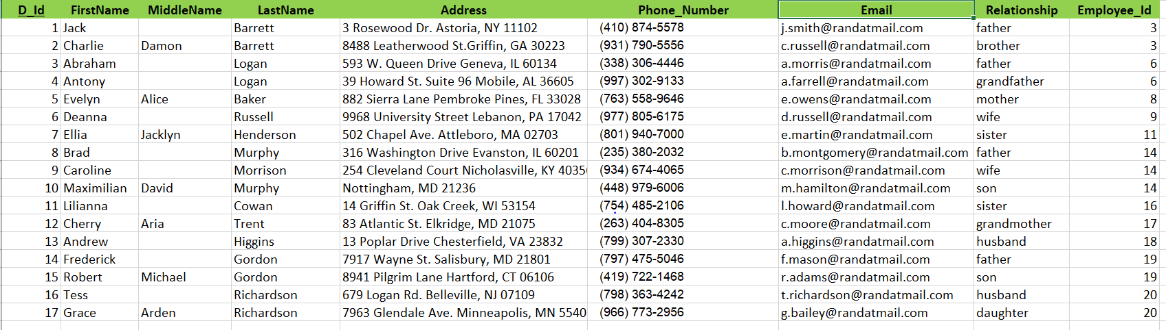
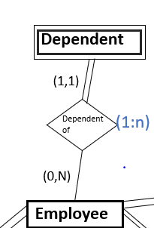
Analysis- <Provide some samples that show how weak entity, binary and ternary relations are implemented in the data.>
Here, the Dependent table shows the weak entity relations. The Dependent table doesn’t have it’s own primary attribute. It depends upon Employee table.

Slide 36
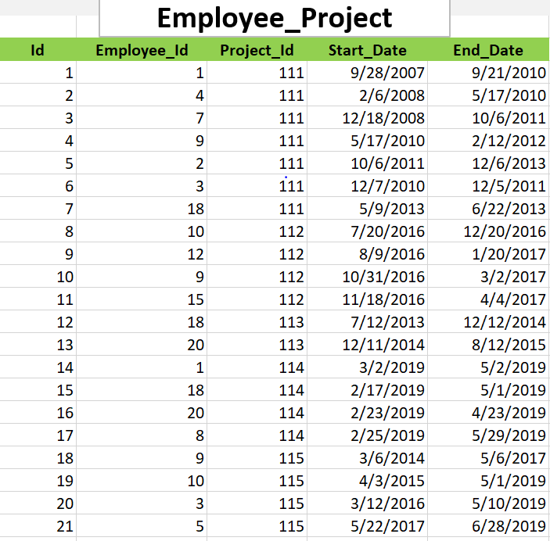
Analysis- Binary relation
Employee
2,N
works on
1,N m:n
Project
Employee and project have binary relationship

Slide 37
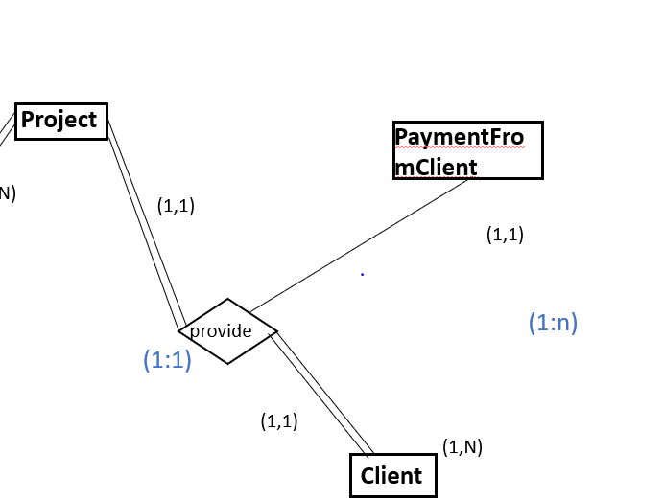
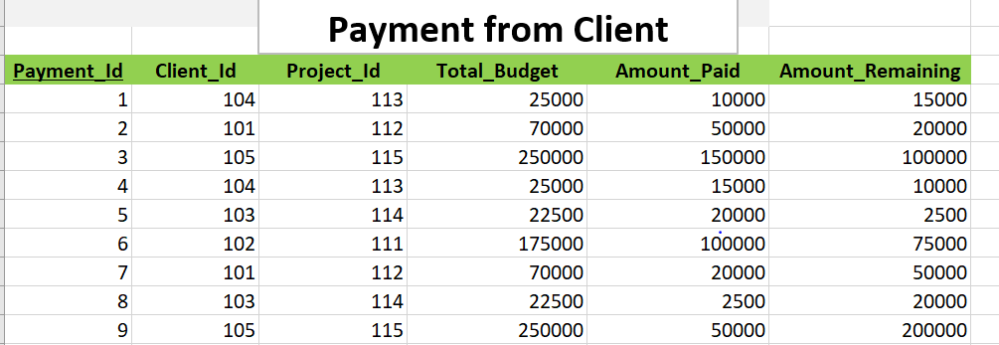
Analysis- Ternary Relationship
Here project is provided by client, payment is provided by client to project, and payment is made by client to fulfill the project budget

Slide 38
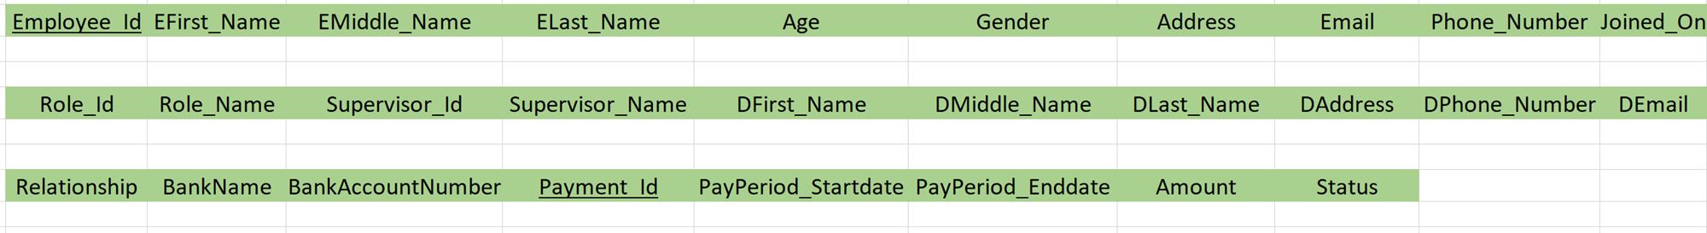
ANALYSIS OF DATA(Normalizing to 2NF and 3 NF)
Before normalizing (Table 1:) Primary Keys: Employee_Id, Payment_Id

Slide 39
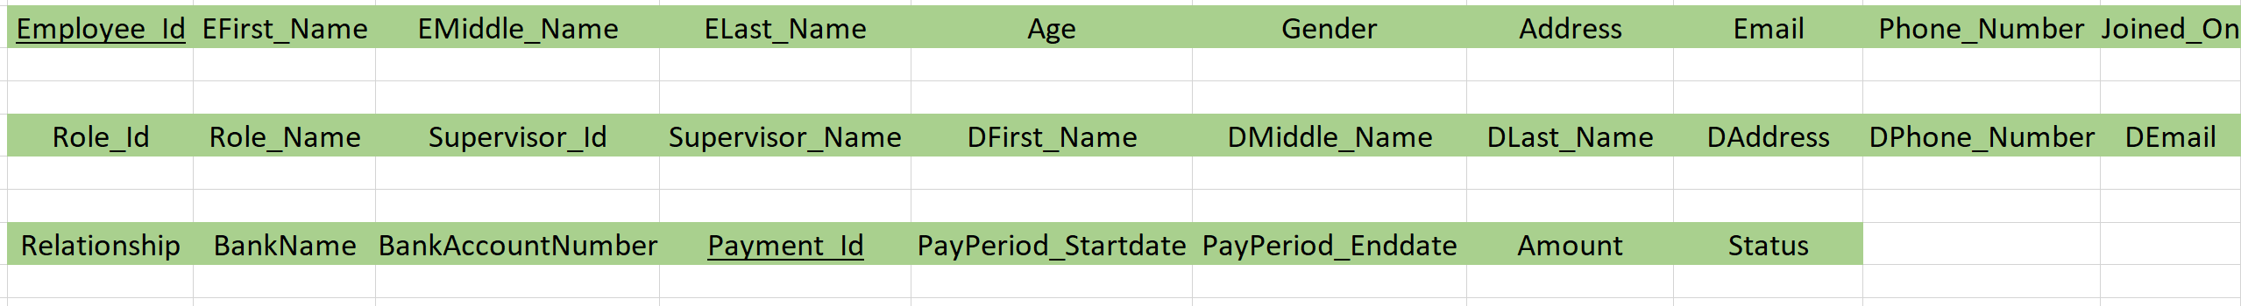
TABLE-1(changing to 2nd normal form)
PrimaryKey
FD1
Partially dependent on Employee_Id
FD2
Partially dependent on Payment_Id
TABLE-1A(2nd Normal Form)
PrimaryKey
TABLE-1B (2nd Normal Form)

Slide 40

FD1
TABLE-1A
FD4
FD2
TABLE-1A-1 (3rd Normal Form)
FD3
TABLE-1A-2 (3rd Normal Form)
TABLE-1A-3 (3rd Normal Form)
TABLE-1A-4 (3rd Normal Form)

Slide 41
TABLE-1B
TABLE-1B-1 (3rd Normal Form)
TABLE-1B-2 (3rd Normal Form)

Slide 42
ANALYSIS OF DATA
< Provide some sample tuples of your database to discuss possible anomaly issues related to data insertion, update, delete anomalies existing in your database. If does not exist, then add some sample tuples to your tables in your database so that an insertion, an update, and a delete anomaly exist.>
Update
Delete and
Insert Anomalies

Slide 43



Insert Anomaly- Here, If we try to insert 2 more dependents of an employee_id 3 we have to insert first and last name and email of employees too in addition to names of dependents
But if you separate the tables employee and dependent, you don’t have to write down email, first name and last name of employee twice. That is Employee Table
Dependents Table

Slide 44
Delete Anomaly- Here, If we try to delete two dependents of employee_id 3, we have to delete other tuples that follows it, hence the loss of data like email, first and last name, and employee_id 3 itself. Update Anomaly- Also, if we try to update a employee_id lets say 3’s name to something else we have to update that name in all repeated tuples in dependents_employee table.
To fix this anomaly, we have to make separate table such that we don’t have to loose data while deleting and update every tuple while updating as shown in the example below-
Now if you delete two dependents of employee_id 3, firstname, lastname, email and employee_id 3 remains intact in other table that is employee table
If the table is separate you can update the name in employee table at one place only.
Dependents Table
Employee Table

Slide 45


ANALYSIS OF DATA <Propose remedies with some examples for anomalies existing in the database.>
To get rid of the anomalies, we separate the tables as employee and the project table. For ex-
Here if you insert new employees that work on project_id 111

