Slide 1
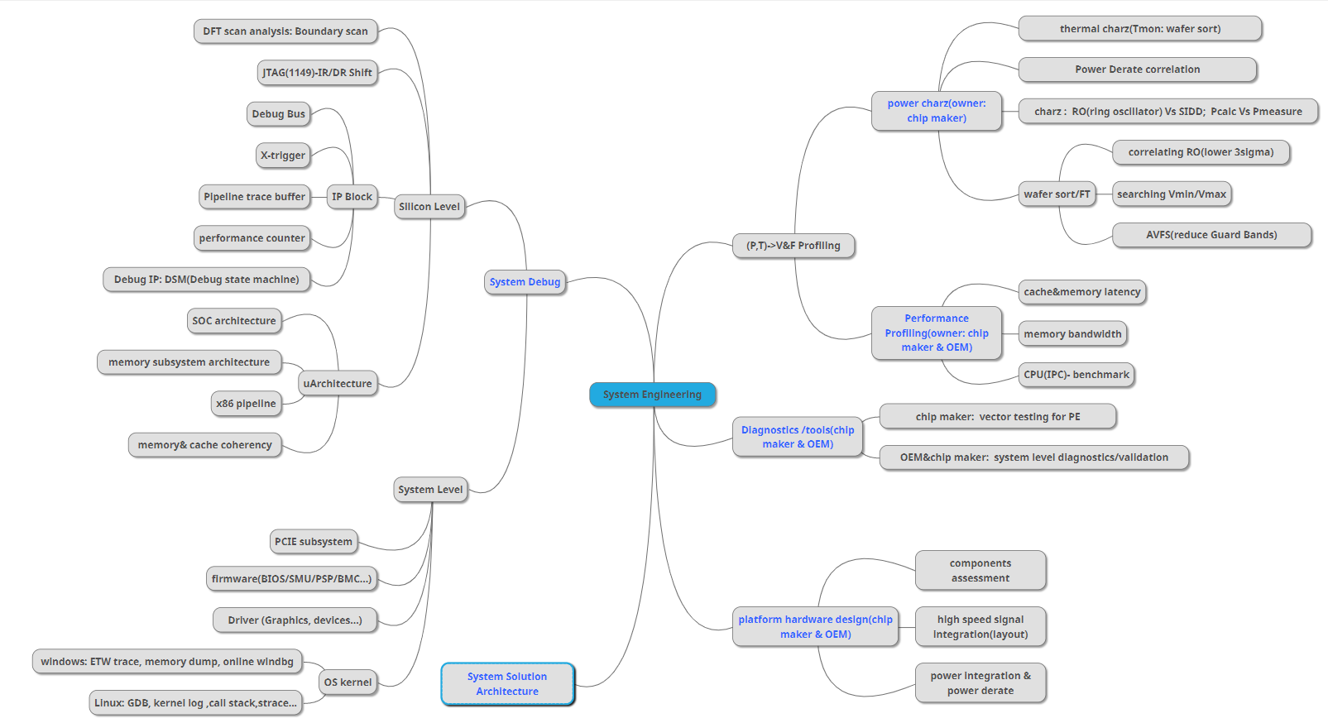
Knowledge Tree
https://app.mindmup.com/map/_free/2019/07/0ed1d6c0a20511e983baef8c2c492558

