Slide 1
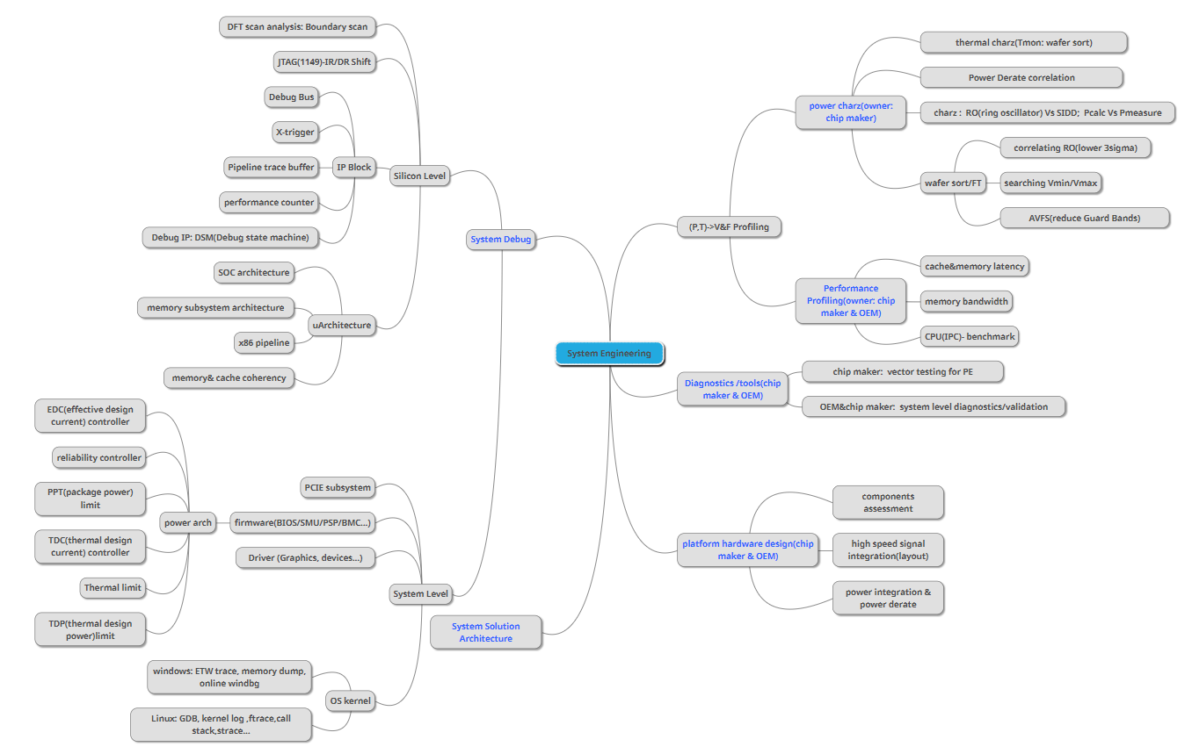
Knowledge Tree
https://app.mindmup.com/map/_free/2019/07/6fb37590b01311e9965265413d5f1884

Slide 2
EDC controller flow diagram
start
Reset EDC Freq limit to Fmax
Run CLK Freq arbiter
Reduce EDC Freq Limit
Calculate IddMax
IddMax>EDC limit
Y
N
Change CLK F/V
END

Slide 3
Linux architecture-outline
2.RunTime
Exception handler
Init/main.c : trap_init(); init_IRQ()
-arch/arm/kernel/traps.c
-arch/arm/kernel/irq.c
Exception Categories
-undefined instruction
-instruction prefetch abort
-data access abort
-interrupt
-swi(software wait instruction)
Interrupt handler architecture
-irq_desc structure (include/linux/irq.h)
-irq_chip(include/linux/irq.h)
-irqaction structure (include/linux/interrupt.h)
Interrupt work flow
CPU ack to execute vector_irq->
call asm_do_IRQ from vector_irq->
asm_do_IRQ call irq_desc.handle_irq->
handle.irq call chip.functions to do with hardware->handle.IRQ screen action table for every handler function’s implementation
Applications
FileSystem
Library(glibc…)
kernel last action: launch init (init/main.c)->/sbin/init
Kernel-syscall
kernel
Driver(open/read/write/ioctl…)
Character device
Block device
Boot parameters
Network device
Bootloader
Firmware (optional)
ASIC/SOC
1.Boot

Slide 4
Linux architecture-Bootloader
Kernel-syscall
kernel
Driver(open/read/write/ioctl…)
Bootloader dispatch parameters to Kernel through Tagged list
-include/asm/setup.h
Struct tag_header {
u32 size;
u32 tag;
};
Struct tag{
struct tag_header hdr;
union {
struct tag_core core;
struct tag_mem32 mem;
struct tag_videotext videotext;
struct tag_ramdisk ramdisk;
struct tag_initrd initrd;
struct tag_serialnr serialnr;
struct tag_revision revision;
struct tag_videolfb videolfb;
struct tag_cmdline cmdline;
// any specific
}u;
};
Boot parameters
Set ATAG_CORE
Params =(struct tag*) 0x30000000; //address for example
Params->hdr.tag=ATAG_CORE;
Params->hdr.size=tag_size(tag_core);
Params->u.core.flags=0;
Params->u.core.pagesize=0;
Params->u.core.rootdev=0;
Params=tag_next(params);
#define tag_next(t) ((struct tag*)((u32*)(t)+(t)->hdr.size))
Set ATAG_MEM
Params->hdr.tag=ATAG_MEM;
Params->hdr.size=tag_size(tag_mem32);
Params->u.mem.start=0x30000000;
Params->u.mem.size=0x4000000;
Params=tag_next(params);
Set ATAG_CMDLINE
Char *p=“root=/dev/mtdblock 2 init=/linuxrc console=ttySAC0”; //for example
Params->hdr.tag=ATAG_CMDLINE;
Params->hdr.size=(sizeof(struct tag_header)+strlen(p)+1+4)>>2;
Strcpy(params->u.cmdline.cmdline,p);
Params=tag_next(params);
//dispatch to kernel for first root file system, first executed program, console target…
Set ATAG_NONE as the end
Params->hdr.tag=ATAG_NONE;
Params->hdr.size=0;
Bootloader

Slide 5
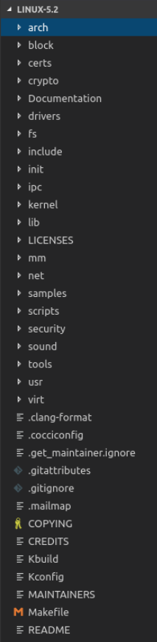
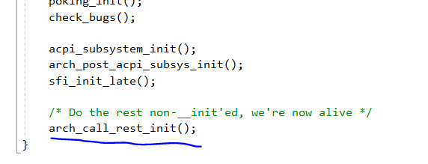
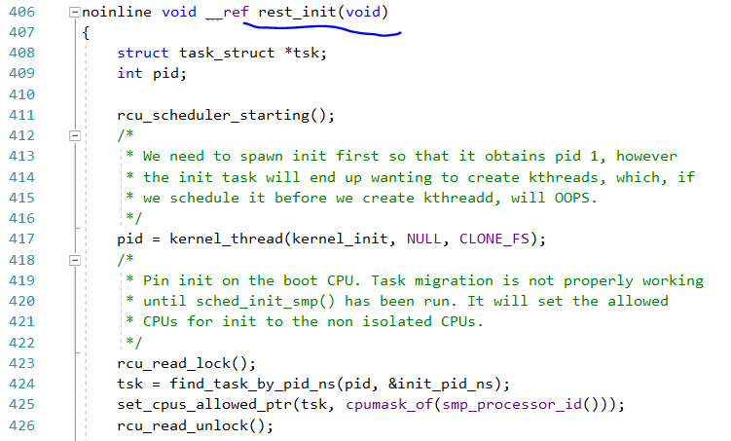
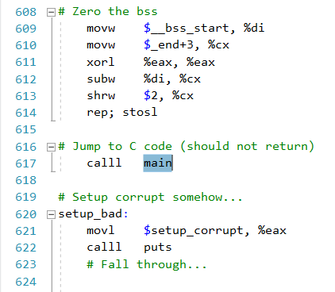
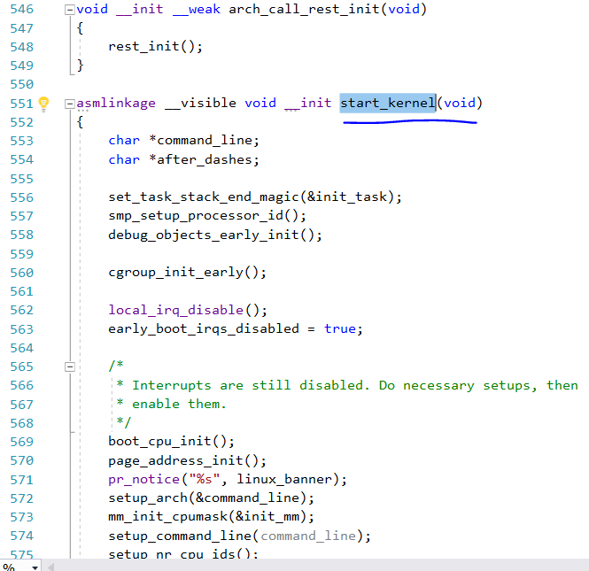
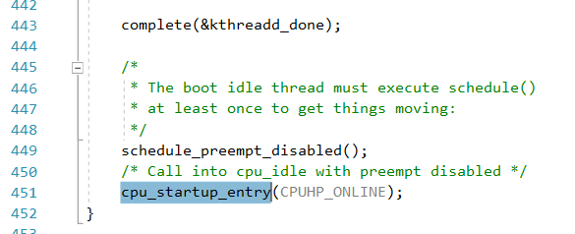
Linux architecture-kernel
Kernel Debug Skills
Kernel log/system log analysis (/var/log)
Compile kernel to add KGDB patch, enable remote host debug kernel
Oops call stack trace
Kernel Kconfig Analysis
$make config
$make menuconfig
$make xconfig
Snapshots- TBC
Kernel Bootup Procedure
Phase 1: Assembly Language: /arch/x86/boot/header.s
Phase 2: invoke function “start_kernel()” in /init/main.c
Kernel Bootup Procedure
Phase 3: last function invoke “rest_init()” in function “start_kernel()”
- call root file system

Slide 6
Linux architecture-File System
FileSystem
Library(glibc…)
File Hierarchy Standard
/
|- /bin (cmd: cat,chgrp,chmod,cp,ls,sh,kill,mount,umount,mkdir,mknod,[,test)
|- /sbin (cmd: shutdown, reboot, fdisk, fsck)
|- /dev (mknod created device file)
|- /etc (configure file- folder: opt/X11/sgml/xml; files: export;fstab(FS mounted by “mount –a”);mtab(already mounted FS) ;ftpusers; group; inittab(init’s configure file);ld.so.conf;passwd)
|- /lib (shared lib & driver)
|- /home (user folder)
|- /root (root folder)
|- /usr (shared-read-only data, folder: bin/include/lib/local/sbin/share/X11R6/games/src)
|- /var (variable data)
|- /proc (virtual FS, dynamic created by kernel)
|- /mnt (mount pointer)
|_ /tmp
Linux File attribution
File type:
normal file(“-”)
folder file (“d”)
character device file(“c”)
block device file(“b”)
FIFO(“p”) : pipe between process
socket(“s”)
linker(“l”)
Cmd “ls –lih” list file attributions as below
228883 - rwx r-- r-- 2 root root 6 Jul 20 2019 readme.txt
inode type auth: owner group others hardlink# owner grp size time name
Kernel-syscall
kernel
Driver(open/read/write/ioctl…)

Slide 7
Linux architecture-File System
FileSystem
Library(glibc…)
Create File System
Create “executable commands” in folder “/bin & /sbin”
-Install busybox & glibc to create executable cmds (http://www.busybox.net)
2. Store library files in folder “/lib”
-gcc library (xxx.so xxx.o xxx.a xxx.la gconv folder ldscripts folder other folders/files)
3.Create device node in folder “/dev”
-create necessary device node
$mkdir –p /dev
$cd /dev
$sudo mknod console c 5 1
$sudo mknod null c 1 3
$sudo mknod ttySAC0 c 204 64
$sudo mknod mtdblock0 b 31 0
$sudo mknod mtdblock1 b 31 1
$sudo mknod mtdblock2 b 31 2
-review registered device to create other corresponding device files
$cat /proc/devices
$sudo mknod xxx
4.Store configure files in folder “ /etc”
-create /etc/inittab
$ vim inittab
#/etc/inittab
::sysinit:/etc/init.d/rcS
ttySAC0::askfirst:-/bin/sh
::ctrlaltdel:/sbin/reboot
::shutdown:/bin/umount –a –r
-create /etc/init.d/rcS
$vim rcS
#!/bin/sh
Ifconfig eth0 192.168.1.17
mount –a
$ chmod +x /etc/init.d/rcS s
Kernel-syscall
kernel
Driver(open/read/write/ioctl…)
4.Store configure files in folder “ /etc”
-create /etc/fstab
$ vim fstab
#device mount-point type options dump fsck order
proc /proc proc defaults 0 0
tmpfs /tmp tmpfs defaults 0 0
device: to be mounted device, such as /dev/hda2, /dev/mtdblock1…….
type: file system type. such as proc, jffs2, yaffs, ext2, nfs. auto: detect file system type
options
-auto/noauto: run “mount –a” to mount it automatically
-user: other users can mount it
/nouser: only root can mount it
-exec/noexec: allowed to run executable program on it
-Ro: read-only
-rw: read/write
-sync/async: sync data to physical device when modify file
-defaults: combinations- rw.suid,dev,exec,auto,nouser,async …
dump/fsck
dump program- backup purpose
fsck order- disk check order

