Slide 1
CS252
Graduate Computer Architecture
Lecture 18:
ILP and Dynamic Execution #3: Examples (Pentium III, Pentium 4, IBM AS/400)
April 4, 2001
Prof. David A. Patterson
Computer Science 252
Spring 2001

Slide 2
Review: Dynamic Branch Prediction
Prediction becoming important part of scalar execution
Branch History Table: 2 bits for loop accuracy
Correlation: Recently executed branches correlated with next branch.
  Either different branches
  Or different executions of same branches
Tournament Predictor: more resources to competitive solutions and pick between them
Branch Target Buffer: include branch address & prediction
Predicated Execution can reduce number of branches, number of mispredicted branches
Return address stack for prediction of indirect jump

Slide 3
Review: Limits of ILP
1985-2000: 1000X performance
  Moore’s Law transistors/chip => Moore’s Law for Performance/MPU
Hennessy: industry been following a roadmap of ideas known in 1985 to exploit Instruction Level Parallelism to get 1.55X/year
  Caches, Pipelining, Superscalar, Branch Prediction, Out-of-order execution, …
ILP limits: To make performance progress in future need to have explicit parallelism from programmer vs. implicit parallelism of ILP exploited by compiler, HW?
  Otherwise drop to old rate of 1.3X per year?
  Less because of processor-memory performance gap?
Impact on you: if you care about performance,
better think about explicitly parallel algorithms
vs. rely on ILP?

Slide 4
Dynamic Scheduling in P6
(Pentium Pro, II, III)
Q: How pipeline 1 to 17 byte 80x86 instructions?
P6 doesn’t pipeline 80x86 instructions
P6 decode unit translates the Intel instructions into 72-bit micro-operations (~ MIPS)
Sends micro-operations to reorder buffer & reservation stations
Many instructions translate to 1 to 4 micro-operations
Complex 80x86 instructions are executed by a conventional microprogram (8K x 72 bits) that issues long sequences of micro-operations
14 clocks in total pipeline (~ 3 state machines)

Slide 5
Dynamic Scheduling in P6
Parameter 80x86 microops
Max. instructions issued/clock 3 6
Max. instr. complete exec./clock 5
Max. instr. commited/clock 3
Window (Instrs in reorder buffer) 40
Number of reservations stations 20
Number of rename registers 40
No. integer functional units (FUs) 2
No. floating point FUs 1
No. SIMD Fl. Pt. FUs 1
No. memory Fus 1 load + 1 store

Slide 6
P6 Pipeline
14 clocks in total (~3 state machines)
8 stages are used for in-order instruction fetch, decode, and issue
  Takes 1 clock cycle to determine length of 80x86 instructions + 2 more to create the micro-operations (uops)
3 stages are used for out-of-order execution in one of 5 separate functional units
3 stages are used for instruction commit
Reserv.
Station
Execu-
tion
units
(5)
Reorder
Buffer
Gradu-
ation
3 uops
/clk
Instr
Fetch
16B
/clk
16B
Instr
Decode
3 Instr
/clk
6 uops
Renaming
3 uops
/clk

Slide 7
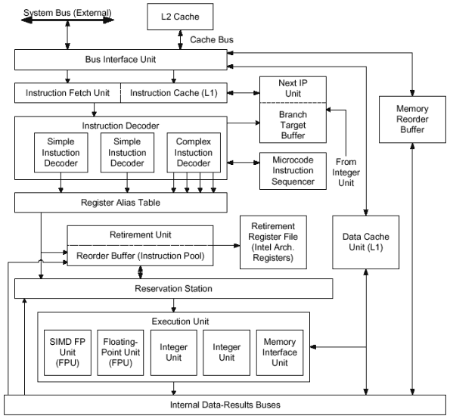
P6 Block Diagram
IP = PC
From: http://www.digit-life.com/articles/pentium4/

Slide 8
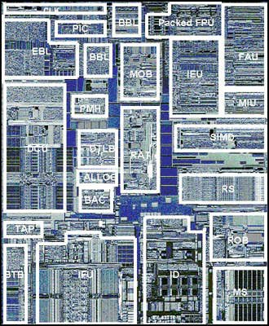
Pentium III Die Photo
EBL/BBL - Bus logic, Front, Back
MOB - Memory Order Buffer
Packed FPU - MMX Fl. Pt. (SSE)
IEU - Integer Execution Unit
FAU - Fl. Pt. Arithmetic Unit
MIU - Memory Interface Unit
DCU - Data Cache Unit
PMH - Page Miss Handler
DTLB - Data TLB
BAC - Branch Address Calculator
RAT - Register Alias Table
SIMD - Packed Fl. Pt.
RS - Reservation Station
BTB - Branch Target Buffer
IFU - Instruction Fetch Unit (+I$)
ID - Instruction Decode
ROB - Reorder Buffer
MS - Micro-instruction Sequencer
1st Pentium III, Katmai: 9.5 M transistors, 12.3 * 10.4 mm in 0.25-mi. with 5 layers of aluminum
Notes:
From http://www.tomshardware.com/cpu/99q3/990810/
Statistics
0.25 micron 5-layer metal CMOS process technology
9.5M transistors
10.2 x 12.1 mm die size (excluding the etch ring)
3-way superscalar out-of-order execution micro-architecture
70 new streaming SIMD instructions:
Comprehensive set of new SIMD-FP instruction set
Additional SIMD-integer MMX Technology instructions
New memory streaming instructions (for FP & integer data types)
Bottom left quadrant
Logic for the front-end of the pipeline resides here.
IFU
Instruction Fetch Unit. Instruction fetch logic and a 16K Byte 4-way set-associative level one
instruction cache resides in this block. Instruction data from the IFU is then forwarded to the ID.
BTB
Branch Target Buffer. This block is responsible for dynamic branch prediction based on the
history of past branch decisions paths.
BAC
Branch Address Calculator. Static branch prediction is performed here to handle the BTB miss
case.
TAP
Testability Access Port. Various testability and debug mechanisms reside within this block.
Bottom right quadrant
Instruction decode, scheduling, dispatch, and retirement functionality is contained within this
quadrant.
ID
Instruction Decoder. This unit is capable of decoding up to 3 instructions per cycle.
MS
Micro-instruction Sequencer. This holds the microcode ROM and sequencer for more complex
instruction flows. The microcode update functionality is also located here.
RS
Reservation Station. Micro-instructions and source data are held here for scheduling and dispatch
to the execution ports. Dispatch can happen out-of-order and is dependent on source data
availability and an available execution port.
ROB
Re-Order Buffer. This supports a 40-entry physical register file that holds temporary write-back
results that can complete out of order. These results are then committed to a separate
architectural register file during in-order retirement.
Top right quadrant
This primarily consists of the execution datapath for the Pentium® III processor.
SIMD
SIMD integer execution unit for MMX Technology instructions.
MIU
Memory Interface Unit. This is responsible for data conversion and formatting for floating point
data types.
IEU
Integer Execution Unit. This is responsible for ALU functionality of scalar integer instructions.
Address calculations for memory referencing instructions are also performed here along with
target address calculations for jump related instructions.
FAU
Floating point Arithmetic Unit. This performs floating point related calculations for both existing
scalar instructions along with support for some of the new SIMD-FP instructions.
PFAU
Packed Floating point Arithmetic Unit. This contains arithmetic execution data-path functionality
for SIMD-FP specific instructions.
Top left quadrant
Functionality in this quadrant is split into assorted functions including bus interface related
functionality, data cache access, and allocation.
ALLOC
Allocator. Allocation of various resources such as ROB, MOB, and RS entries is performed here
prior to micro-instruction dispatch by the RS.
RAT
Register Alias Table. During resource allocation the renaming of logical to physical registers is
performed here.
MOB
Memory Order Buffer. Acts as a separate schedule and dispatch engine for data loads and
stores. Also temporarily holds the state of outstanding loads and stores from dispatch until
completion.
DTLB
Data Translation Look-aside Buffer. Performs the translation from linear addresses to physical
address required for support of virtual memory.
PMH
Page Miss Handler. Hardware engine for performing a page table walk in the event of a TLB
miss.
DCU
Data Cache Unit. Contains the non-blocking 16K Byte 4-way set-associative level one data cache
along with associated fill and write back buffering.
BBL
Back-side Bus Logic. Logic for interface to the back-side bus for accesses to the external unified
level two processor cache.
EBL
External Bus Logic. Logic for interface to the external front-side bus.
PIC
Programmable Interrupt Controller. Local interrupt controller logic for multi-processor interrupt
distribution and boot-up communication.

Slide 9
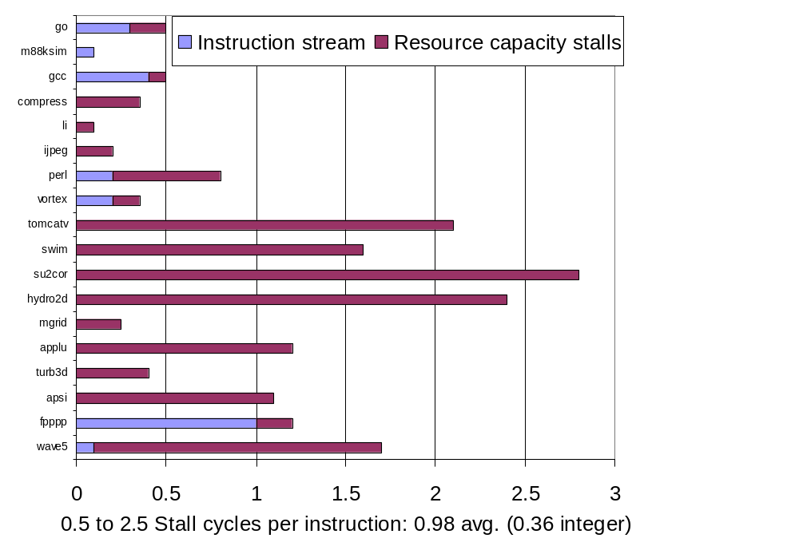
P6 Performance: Stalls at decode stage
I$ misses or lack of RS/Reorder buf. entry

Slide 10
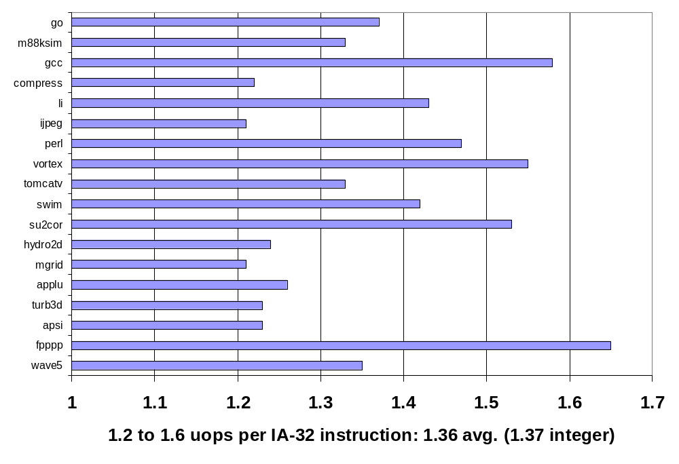
P6 Performance: uops/x86 instr
200 MHz, 8KI$/8KD$/256KL2$, 66 MHz bus

Slide 11
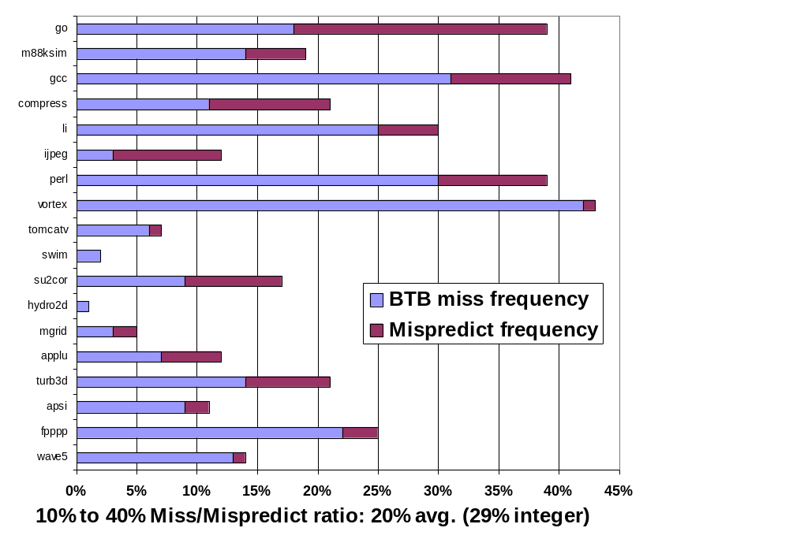
P6 Performance: Branch Mispredict Rate

Slide 12
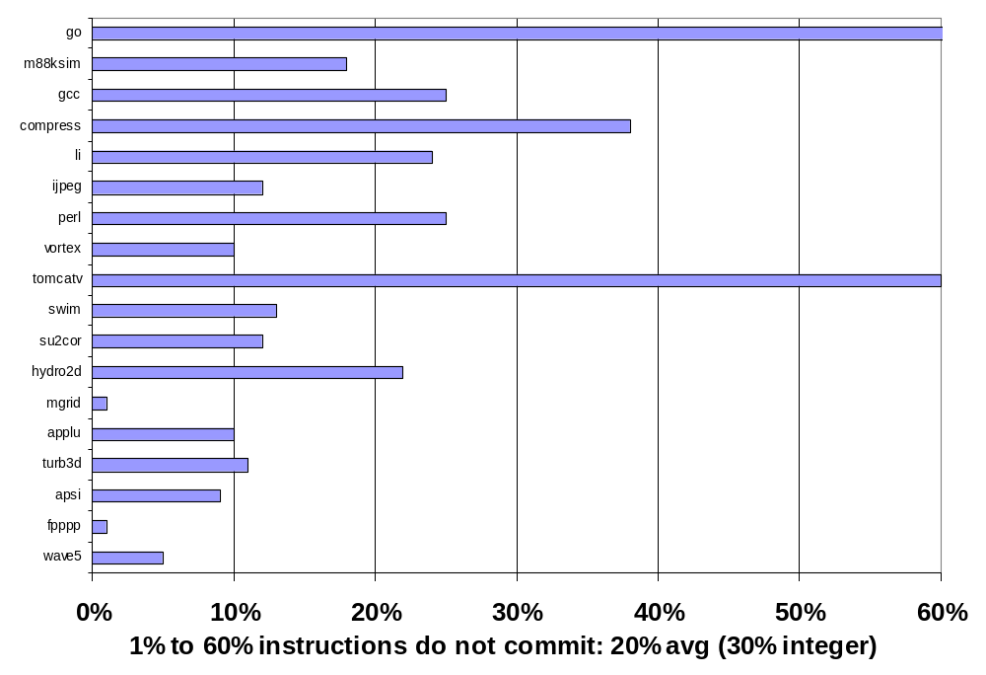
P6 Performance: Speculation rate
(% instructions issued that do not commit)

Slide 13
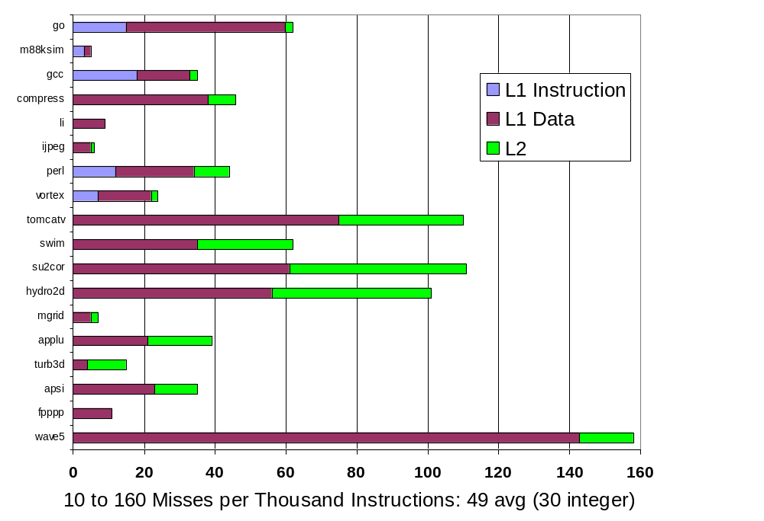
P6 Performance: Cache Misses/1k instr

Slide 14
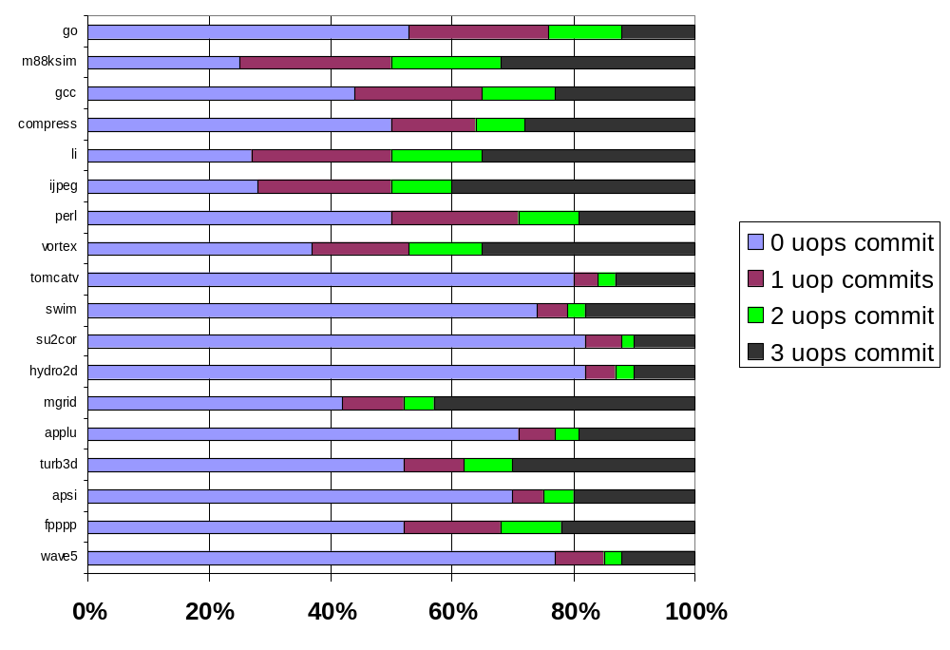
P6 Performance: uops commit/clock
Average
0: 55%
1: 13%
2: 8%
3: 23%
Integer
0: 40%
1: 21%
2: 12%
3: 27%

Slide 15
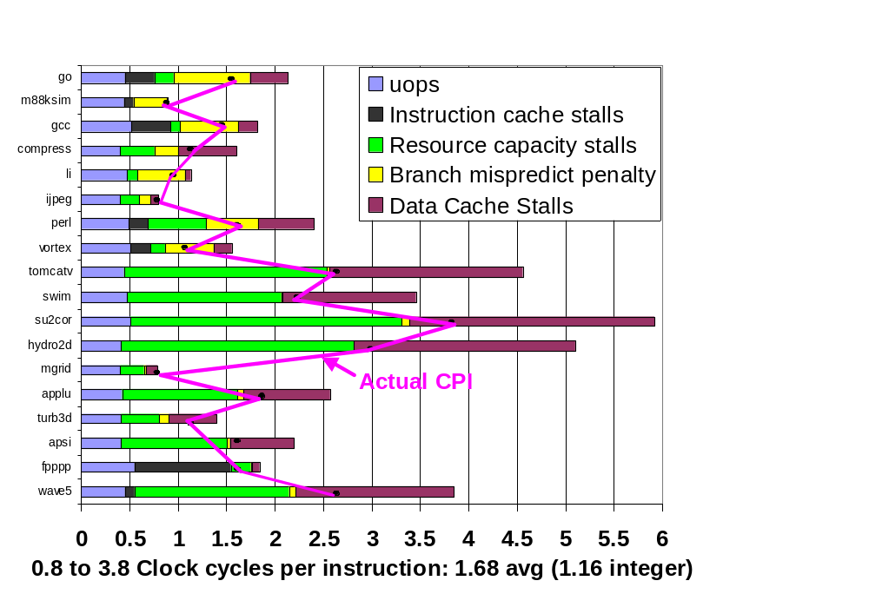
P6 Dynamic Benefit?
Sum of parts CPI vs. Actual CPI
Ratio of sum of parts vs. actual CPI:
1.38X avg.
(1.29X integer)

Slide 16
Administratrivia
3rd (last) Homework on Ch 3 due Saturday
3rd project meetings 4/11
Quiz #2 4/18 310 Soda at 5:30

Slide 17
AMD Althon
Similar to P6 microarchitecture
(Pentium III), but more resources
Transistors: PIII 24M v. Althon 37M
Die Size: 106 mm² v. 117 mm²
Power: 30W v. 76W
Cache: 16K/16K/256K v. 64K/64K/256K
Window size: 40 vs. 72 uops
Rename registers: 40 v. 36 int +36 Fl. Pt.
BTB: 512 x 2 v. 4096 x 2
Pipeline: 10-12 stages v. 9-11 stages
Clock rate: 1.0 GHz v. 1.2 GHz
Memory bandwidth: 1.06 GB/s v. 2.12 GB/s

Slide 18
Pentium 4
Still translate from 80x86 to micro-ops
P4 has better branch predictor, more FUs
Instruction Cache holds micro-operations vs. 80x86 instructions
  no decode stages of 80x86 on cache hit
  called “trace cache” (TC)
Faster memory bus: 400 MHz v. 133 MHz
Caches
  Pentium III: L1I 16KB, L1D 16KB, L2 256 KB
  Pentium 4: L1I 12K uops, L1D 8 KB, L2 256 KB
  Block size: PIII 32B v. P4 128B; 128 v. 256 bits/clock
Clock rates:
  Pentium III 1 GHz v. Pentium IV 1.5 GHz
  14 stage pipeline vs. 24 stage pipeline

Slide 19
Pentium 4 features
Multimedia instructions 128 bits wide vs. 64 bits wide => 144 new instructions
  When used by programs??
  Faster Floating Point: execute 2 64-bit Fl. Pt. Per clock
  Memory FU: 1 128-bit load, 1 128-store /clock to MMX regs
Using RAMBUS DRAM
  Bandwidth faster, latency same as SDRAM
  Cost 2X-3X vs. SDRAM
ALUs operate at 2X clock rate for many ops
Pipeline doesn’t stall at this clock rate: uops replay
Rename registers: 40 vs. 128; Window: 40 v. 126
BTB: 512 vs. 4096 entries (Intel: 1/3 improvement)

Slide 20
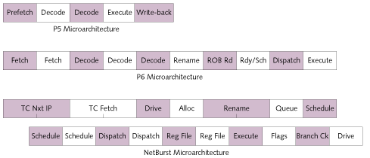
Pentium, Pentium Pro, Pentium 4 Pipeline
Pentium (P5) = 5 stages
Pentium Pro, II, III (P6) = 10 stages (1 cycle ex)
Pentium 4 (NetBurst) = 20 stages (no decode)
From “Pentium 4 (Partially) Previewed,” Microprocessor Report, 8/28/00

Slide 21
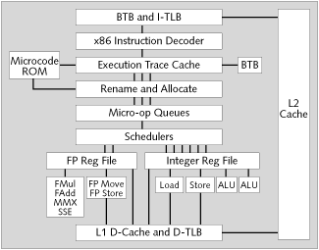
Block Diagram of Pentium 4 Microarchitecture
BTB = Branch Target Buffer (branch predictor)
I-TLB = Instruction TLB, Trace Cache = Instruction cache
RF = Register File; AGU = Address Generation Unit
"Double pumped ALU" means ALU clock rate 2X => 2X ALU F.U.s
From “Pentium 4 (Partially) Previewed,” Microprocessor Report, 8/28/00

Slide 22
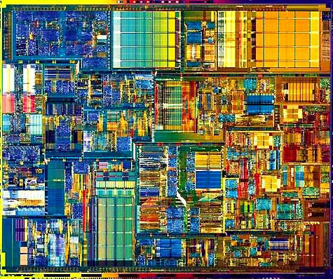
Pentium 4 Die Photo
42M Xtors
  PIII: 26M
217 mm²
  PIII: 106 mm²
L1 Execution Cache
  Buffer 12,000 Micro-Ops
8KB data cache
256KB L2$

Slide 23
Benchmarks: Pentium 4 v. PIII v. Althon
SPECbase2000
  Int, P4@1.5 GHz: 524, PIII_x0008_@1GHz: 454, AMD Althon@1.2Ghz:?
  FP, P4@1.5 GHz: 549, PIII_x0008_@1GHz: 329, AMD Althon@1.2Ghz:304
WorldBench 2000 benchmark (business) PC World magazine, Nov. 20, 2000 (bigger is better)
  P4 : 164, PIII : 167, AMD Althon: 180
Quake 3 Arena: P4 172, Althon 151
SYSmark 2000 composite: P4 209, Althon 221
Office productivity: P4 197, Althon 209
S.F. Chronicle 11/20/00: "… the challenge for AMD now will be to argue that frequency is not the most important thing-- precisely the position Intel has argued while its Pentium III lagged behind the Athlon in clock speed."

Slide 24
Why?
Instruction count is the same for x86
Clock rates: P4 > Althon > PIII
How can P4 be slower?
Time =
Instruction count x CPI x 1/Clock rate
Average Clocks Per Instruction (CPI) of P4 must be worse than Althon, PIII
Will CPI ever get < 1.0 for real programs?

Slide 25
Another Approach: Mulithreaded Execution for Servers
Thread: process with own instructions and data
  thread may be a process part of a parallel program of multiple processes, or it may be an independent program
  Each thread has all the state (instructions, data, PC, register state, and so on) necessary to allow it to execute
Multithreading: multiple threads to share the functional units of 1 processor via overlapping
  processor must duplicate indepedent state of each thread e.g., a separate copy of register file and a separate PC
  memory shared through the virtual memory mechanisms
Threads execute overlapped, often interleaved
  When a thread is stalled, perhaps for a cache miss, another thread can be executed, improving throughput

Slide 26
Multithreaded Example: IBM AS/400
IBM Power III processor, “ Pulsar”
  PowerPC microprocessor that supports 2 IBM product lines: the RS/6000 series and the AS/400 series
  Both aimed at commercial servers and focus on throughput in common commercial applications
  such applications encounter high cache and TLB miss rates and thus degraded CPI
include a multithreading capability to enhance throughput and make use of the processor during long TLB or cache-miss stall
Pulsar supports 2 threads: little clock rate, silicon impact
Thread switched only on long latency stall

Slide 27
Multithreaded Example: IBM AS/400
Pulsar: 2 copies of register files & PC
< 10% impact on die size
Added special register for max no. clock cycles between thread switches:
  Avoid starvation of other thread

Slide 28
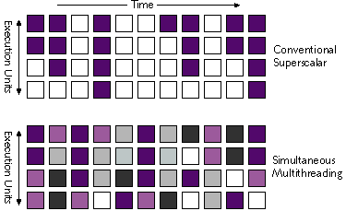
Simultaneous Multithreading (SMT)
Simultaneous multithreading (SMT): insight that dynamically scheduled processor already has many HW mechanisms to support multithreading
  large set of virtual registers that can be used to hold the register sets of independent threads (assuming separate renaming tables are kept for each thread)
  out-of-order completion allows the threads to execute out of order, and get better utilization of the HW
Source: Micrprocessor Report, December 6, 1999
“Compaq Chooses SMT for Alpha”

Slide 29
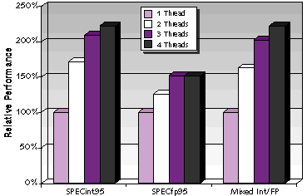
SMT is coming
Just adding a per thread renaming table and keeping separate PCs
  Independent commitment can be supported by logically keeping a separate reorder buffer for each thread
Compaq has announced it for future Alpha microprocessor: 21464 in 2003; others likely
On a multiprogramming workload comprising a mixture of SPECint95 and SPECfp95 benchmarks, Compaq claims the SMT it simulated achieves a 2.25X higher throughput with 4 simultaneous threads than with just 1 thread. For parallel programs, 4 threads 1.75X v. 1
Source: Micrprocessor Report, December 6, 1999
“Compaq Chooses SMT for Alpha”

