Slide 1

Azure Service Fabric
James Sturtevant
@aspenwilder
Developer Experience Team

Slide 2
What Is Service Fabric?
Clustering – Create a pool of resources
Hosting & Environment Abstraction – Run your workloads
High Availability – Detect and React to Failures
Orchestration – Manage desired state configuration
Management – Upgrades and Health monitoring
Programming Model – Microservices Application Platform
Reliability & Latency – Support for Stateful workloads
Integrated Solution – Necessary tools already integrated
Battle Hardened – Technology has been in use for ~10yrs
Notes:
Re: 2 They can be in any language, written against the SF App Model or not, hosted in containers or not, on Windows or Linux

Slide 3
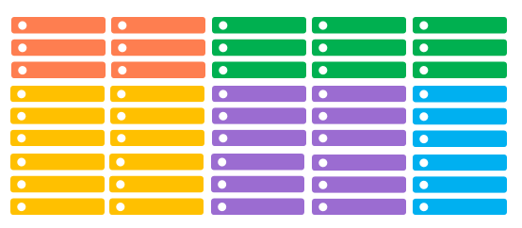
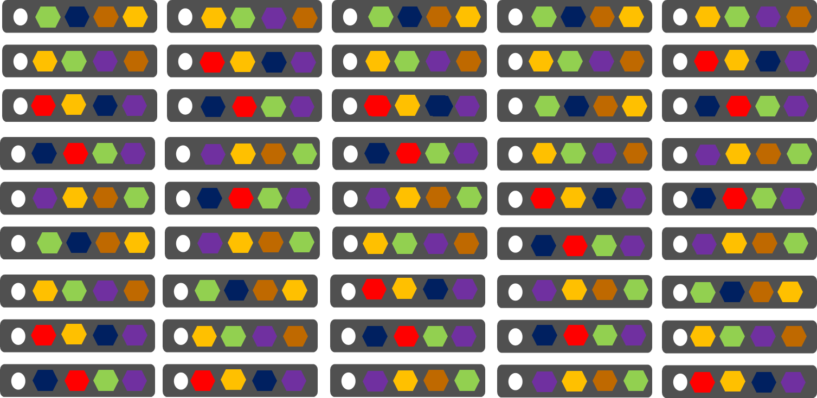
Cloud Services vs Service Fabric
Azure Cloud Services (Web & Worker Roles)
Azure Service Fabric
(Services)
1 service instance per VM
Slow deployment & upgrades
Slow scaling of roles up/down
Emulator for development
Many microservices per PC/VM
Fast deployment & upgrades
Fast scaling in/out of microservices
Devbox cluster for development

Slide 4
Service Fabric 101

Slide 5



Azure Service Fabric: Run anything, anywhere
Web Apps
Reliable Actors (Java/C#)
Guest Executables
(Any Code)
Reliable Services (Java/C#)
Containers
(Windows Containers & Docker)
Lifecycle
Management
Always On Availability
Programming Models
Health & Monitoring
Dev & Ops Tooling
Auto
scaling
Orchestration
Dev Box
Azure
On Premise
Data centers
Other Clouds

Slide 6
Application Model
ApplicationType1
ApplicationType2
…
ApplicationTypeN
ServiceType1
ServiceType2
ServiceType3
ServiceType4
ServiceTypeN
Code
Config
Data
(Detail shown only for ServiceType3)
Notes:
Each item is independently versionable and upgradable
There can be many instances of each type in the cluster at once

Slide 7
Application and Service types and instances
Type: compiled, versioned, registered but not running
Instance: A running instantiation of a type

Slide 8
Application and Service types and instances
Registered application types
Running instances
MyApplicationType
1.0.0
2.0.0
fabric:/app-A
fabric:/app-B
fabric:/app-C

Slide 9
Application and Service types and instances
Run multiple versions side-by-side
Upgrade an instance from one version to another version
Dynamically create application or service instances
Shared environment multi-tenant workloads

Slide 10
Demo https://docs.microsoft.com/en-us/powershell/module/servicefabric/?view=azureservicefabricps

Slide 11
Lab https://docs.microsoft.com/en-us/azure/service-fabric/service-fabric-automate-powershell

