Slide 1

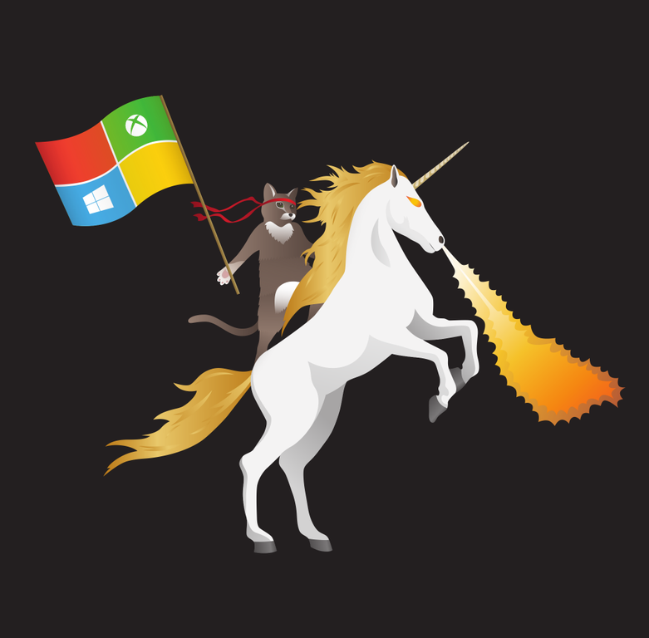




Nano in a flash
Deploy Nano VM on Hyper-V
Dan Stolts (@ITProGuru) Chief Technology Strategist US DX North East – Audience Blog: ITProGuru.com
dstolts@Microsoft.com
www.linkedin.com/in/danstolts
Specializations:
Cloud, Virtualization, Windows Server
Open Systems, Hybrid Cloud, Storage
aka.ms/70-534-book
@ITProGuru
Notes:
Linux, Windows Server and Hyper-V Containers: What They Are, Which One to Use, Why and How, plus Integration with Azure Private/Public/Hybrid Cloud, with Microsoft A container is an isolated and portable operating environment. It provides a mechanism for IT to deploy services in a portable, repeatable and predictable manner. Container technology is the next evolution in virtualization, and in addition to Linux, Windows now also offers two different types of containers for addressing various business needs. In this session Dan Stolts, world renown Technical Evangelist at Microsoft and a dynamic/engaging presenter, will examine the similarities and differences between a container and a virtual machine, review the requirements and walk through the processes and essential operations of enabling, creating, deploying and managing Linux and Windows containers and resources. Mr. Stolts will also evaluate when to use which containers, why and how? For those who are new to containers, his delivery serves as a jumpstart to accelerate your learning of containers. If you have already had some experience on Linux containers, his session familiarizes you with the specifics on Windows containers and helps bridge and extend your skills for bringing business value to both Linux and Windows communities. Mr. Stolts will conclude this session by highlighting the top five new features in Microsoft's Azure cloud platform for 2017, and how to integrate your organization's public/private/hybrid cloud and container strategies. Lots of valuable content for infrastructure, data center and DevOps professionals.
Name of Presenter: Dan Stolts
Bio of Presenter (max 500 spaces): Dan Stolts “ITProGuru” is a technology expert who is a master of systems management and security. He is Chief Technology Strategist for Microsoft, owns several businesses and is a published author. Reach him on his primary blog http://itproguru.com or twitter @ITProGuru. He is proficient in many datacenter technologies (Windows Server, System Center, Virtualization, Cloud, Etc) and holds many certifications including MCT, MCITP, MCSE, TS, etc. Dan is currently specializing in system management, virtualization and cloud technologies. Dan is and has been a very active member of the user group community. Dan is an enthusiastic advocate of technology and is passionate about helping others. See more at: http://itproguru.com/about

Slide 2
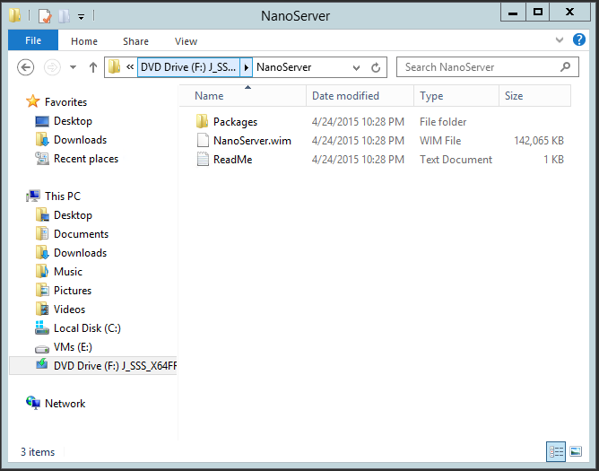
Getting started
Nano Server is an installation option
Like Server Core, but cannot be selected during Setup
Must be customized with drivers
Located on the Windows Server media
Available within the Windows Server

Slide 3
Getting Started | Nano in a VM
1
Mount the ISO, and, assuming the drive letter for the mounted image is D:\, run the following: Copy "D:\NanoServer" "C:\NanoServer" -Recurse
2
Make a new folder called DISM. From the Sources folder on the distribution media, copy these files to the DISM folder: api*downlevel*.dll, *dism*, *provider*
Generate a VHD from NanoServer.wim by using Convert-WindowsImage.ps1 from TechNet Script Center. Convert-WindowsImage.ps1 –WIM ‘C:\NanoServer\NanoServer.wim’ –VHD ‘C:\NanoServer\NanoServer.vhd’ –VHDformat VHD -Edition 1
3
4
Mount the image, to add drivers/packages: Mount-DiskImage –ImagePath C:\NanoServer\NanoServer.vhd’
5
Mount the image, to add drivers/packages: (it will choose the next drive letter, in our case E:\) Mount-DiskImage –ImagePath C:\NanoServer\NanoServer.vhd’
Add the driver packages relevant to your deployment: Add-WindowsPackage –Path E:\ –PackagePath C:\NanoServer\Packages\Microsoft-NanoServer-Guest-Package.cab
6
7
Dismount the image, ready to add as a VHD to a new VM: Dismount-DiskImage –ImagePath ‘C:\VHD\NanoServer.vhd’

Slide 4
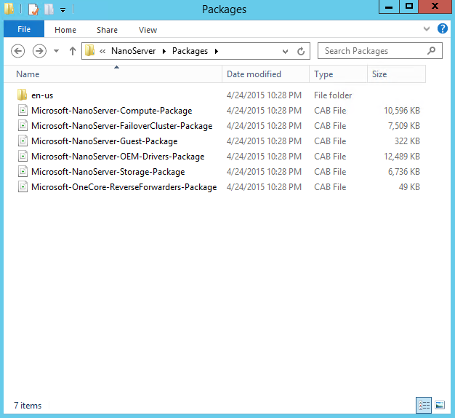
Drivers, Roles and Features
For the leanest image, install just the drivers your hardware requires.
Dism /Add-Driver /driver:<path>
Nano Server includes a package of all drivers in Server Core
Dism /Add-Package /PackagePath:.\packages\ Microsoft-NanoServer-OEM-Drivers-Package.cab
Packages are provided for:
Hyper-V Host
File Server Host
Failover Clustering
Nano as a VM
All OEM Drivers (in Server Core)
Reverse Forwarders

Slide 5
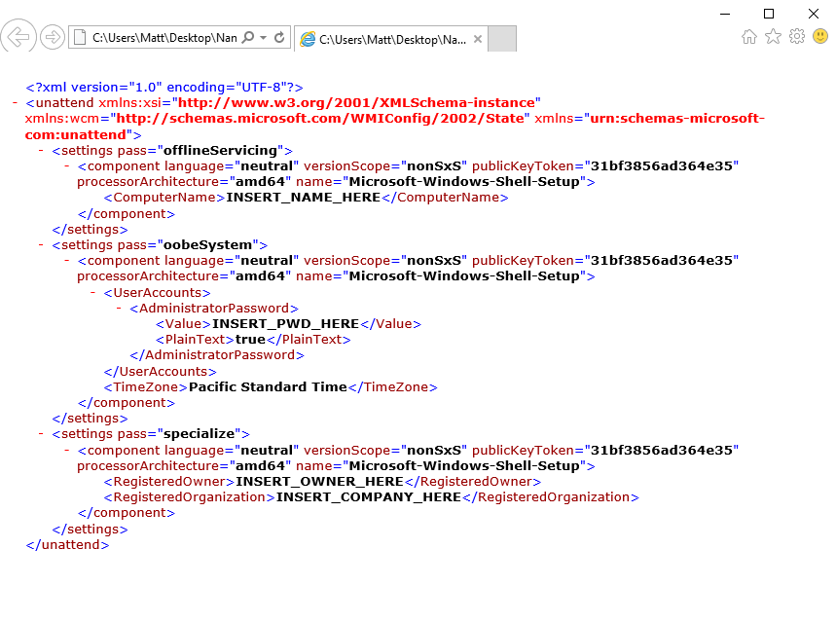
Customizing Nano Server
To complete the configuration, you need: computer name and administrator password.
Simplest way is with an Unattend.xml file.
Place Unattend.xml inside C:\NanoServer folder
Can include Domain-Join information.

Slide 6
Customizing Nano Server
1
From an elevated command prompt, run: dism\dism /Mount-Image /ImageFile:.\NanoServer.vhd /Index:1 /MountDir:.\mountdir
2
Then apply the unattend.xml file: dism\dism /image:.\mountdir /Apply-Unattend:.\unattend.xml
Create a “Panther” folder (used by Windows systems for storing files during setup. Copy the Unattend.xml file to it, and then unmount the VHD with these commands: md .\mountdir\windows\panther copy .\unattend.xml .\mountdir\windows\panther dism\dism /Unmount-Image /MountDir:.\mountdir /Commit
3
4
To have IP information displayed on first boot, use a SetupComplete.cmd file (created with Notepad, containing the string “ipconfig”:
dism\dism /Mount-Image /ImageFile:.\NanoServer.vhd /Index:1 /MountDir:.\mountdir
md .\mountdir\Windows\Setup
md .\mountdir\Windows\Setup\Scripts
copy .\SetupComplete.cmd .\mountdir\Windows\Setup\Scripts
dism\dism /Unmount-Image /MountDir:.\mountdir /Commit
Also see: http://blogs.technet.com/b/nanoserver/archive/2015/05/19/how-to-display-ipconfig-on-nano-server-every-time-it-boots.aspx

Slide 7
Demo.
Getting started | Nano in a VM

Slide 8
Joining a domain
Harvest a data blob from a domain machine that is already running Windows Server Technical Preview djoin.exe /provision /domain <domain-name> /machine <machine-name> /savefile .\odjblob
Copy the “odjblob” file to the Nano Server then configure with PowerShell (may require firewall adjustment on Nano Server first) #Edit Firewall Settings $ip = "<ip address of Nano Server>“ Enter-PSSession -ComputerName $ip -Credential $ip\Administrator netsh advfirewall firewall set rule group="File and Printer Sharing" new enable=yes #Copy Data Blob to Nano Server net use z: \\<ip address of Nano Server>\c$ md z:\Temp copy odjblob z:\Temp #Apply the data blob file and reboot djoin /requestodj /loadfile c:\Temp\odjblob /windowspath c:\windows /localos shutdown /r /t 5 Exit-PSSession

Slide 9
Nano Server management.

Slide 10
Remotely Managing Nano Server
Remote Graphical & Web Tools
Server Manager
PowerShell Remoting
Core PowerShell engine, language, and cmdlets
VM and Container Management
Hyper-V Manager
Deployment & Monitoring
PowerShell Direct over PSRP
Hyper-V cmdlets
SCOM agent
SCVMM agent & console
VSO App Insights
Unattended setup
DISM online & VHD support
Partners & Frameworks
Chef integration
.NET Core and CoreCLR
ASP.NET 5
Python, PHP, Ruby, Node.js
PowerShell Classes
PS Script Analyzer
Visual Studio integration
Azure Op Insights
Setup & boot eventing
PowerShell Gallery
Docker
CimSession support
Azure Portal tools
Task manager
Registry editor
File explorer
Server configuration
Event viewer
Disk manager
Device & driver management
Performance
Users & groups
Windows Server cmdlets (network, storage, etc.)
PowerShell DSC
Remote file transfer
Remote script authoring & debugging
PowerShell Web Access
3rd party agents & consoles
DSC Local Config Manager
PowerShellGet

Slide 11
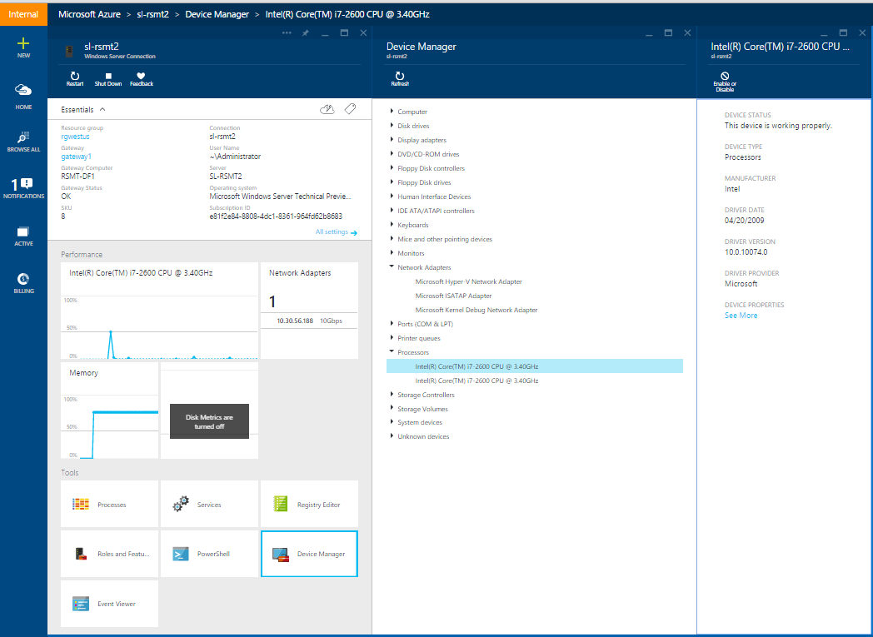
Remotely Managing Nano Server
Remote Server Management Tools
Core PowerShell & WMI
PowerShell DSC
Hyper-V Manager
Failover Cluster Manager
Server Manager
Perfmon, Event Viewer, Disk Manager, Device Manager etc.…

Slide 12
Resources.

Slide 13
Nano Resources and Feedback
Shift your org and tools to full remote management of Server Core
Inventory tools and agents that only run locally
Check with your ISV for a remotable version
Send list of those with no remote equivalent and ISV to nanoserver@microsoft.com
Deploy Nano Server, your apps, and your tools
Deployment guide at: https://msdn.microsoft.com/en-us/library/mt126167.aspx
Give use feedback and let us know where you encounter difficulties: http://windowsserver.uservoice.com/forums/295068-nano-server
Remote Management feedback
http://windowsserver.uservoice.com/forums/ 295071-remote-management-tools

Slide 14



TechNet Virtual Labs
Deep technical content and free product evaluations
Hands-on deep technical labs
Free, online, technical courses
At the TechNet Evaluation Center you can download free, trial versions of Microsoft software, with no feature limits. Dozens of trials are available – all at no cost.
Try Windows Server 2012 R2 for up to 180 days. Download the Windows 8.1 Enterprise 90-day evaluation. Or try Microsoft Azure at no-cost for up to 90 days.
Microsoft Hands On Labs offer virtual environments that will take you through guided, technically deep product learning experience.
Learn at your own pace in labs that you can complete in 90 minutes or less. There is no complex setup or installation is required to use TechNet Virtual Labs.
Microsoft Virtual Academy provides free online training on the IT scenarios that are important to your company and your career.
Learn at your own pace and boost your IT skills with over 100 courses across more than 15 Microsoft technologies including Windows Server, Windows 8, Microsoft Azure, Office 365, virtualization, Windows Phone, and more.
Download Microsoft software trials today.
Find Hand On Labs.
Take a free online course.
Technet.microsoft.com/evalcenter
Technet.microsoft.com/virtuallabs
microsoftvirtualacademy.com

Slide 15


© 2015 Microsoft Corporation. All rights reserved. Microsoft, Windows and other product names are or may be registered trademarks and/or trademarks in the U.S. and/or other countries.
The information herein is for informational purposes only and represents the current view of Microsoft Corporation as of the date of this presentation. Because Microsoft must respond to changing market conditions, it should not be interpreted to be a commitment on the part of Microsoft, and Microsoft cannot guarantee the accuracy of any information provided after the date of this presentation. MICROSOFT MAKES NO WARRANTIES, EXPRESS, IMPLIED OR STATUTORY, AS TO THE INFORMATION IN THIS PRESENTATION.

