Slide 1

The PowerShell CLI & ISE
Bryan Cafferky
BPC Global Solutions LLC

Slide 2


Bryan Cafferky
@bryancafferky
bryan256@msn.com
Data Solutions Consultant and Trainer with BPC Global Solutions LLC
Microsoft MVP
Decades of IT experience
Author of Pro PowerShell for Database Developers by Apress
SQL PASS Chapter Lead
Lead the Southern New England UseR Group
I married my partner of seven years, Paul, on Saturday.

Slide 3
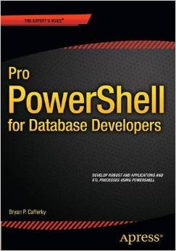
In-Depth Coverage of PowerShell Options and Configuration Features.
How to Create and Deploy Script Modules.
Advanced Functions that Inherit the PowerShell Common Parameters Support.
Reading and Writing to Databases.
How to Use PowerShell for Application Development.
Extensive Code Samples with Step by Step Walk Through.
Creating and Extending Custom PowerShell Objects.
Available on Amazon

Slide 4
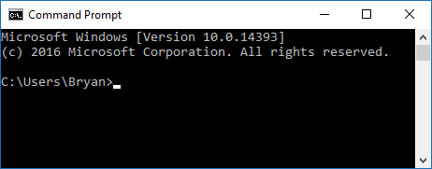
PowerShell = A Shell Built for Windows
The legacy Windows Shell is the Command Prompt, a carry over from DOS. It is not designed to work with Windows.
The completely new and re-architected Windows Shell is PowerShell.
PowerShell was designed from the ground up to integrate with .Net and anything in the Windows environment.

Slide 5
Two Ways to Use PowerShell
Command Line Interpreter (CLI)
Integrated Script Editor (ISE)

Slide 6
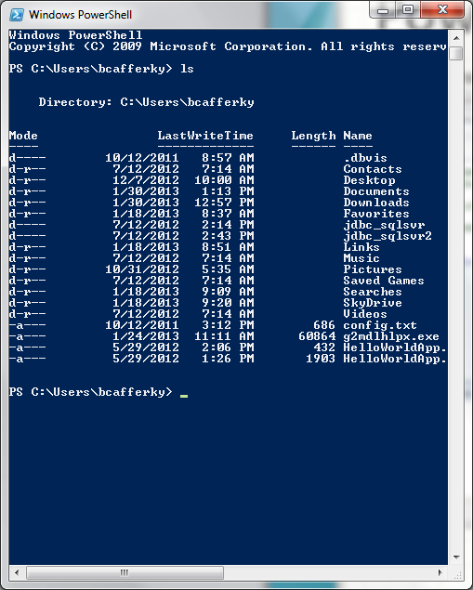
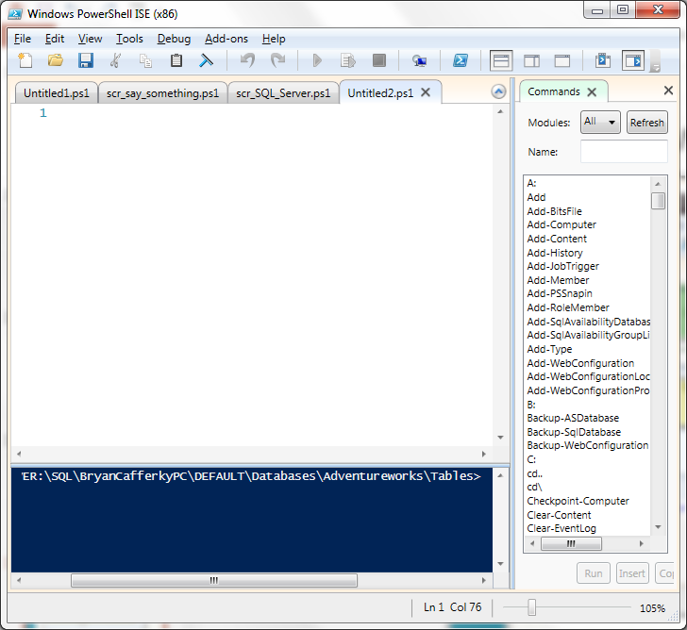
PowerShell Environments
The PowerShell CLI
… or …
The PowerShell ISE

Slide 7
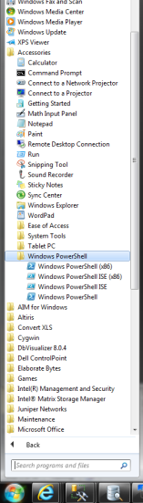
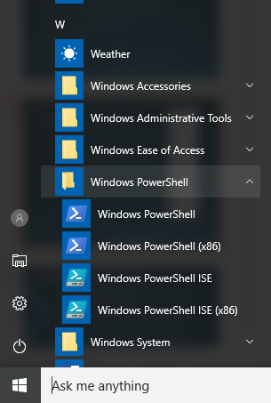
Starting PowerShell
Pre Windows 10
Windows 10
CLI
ISE
(x86) = 32 bit versions

Slide 8
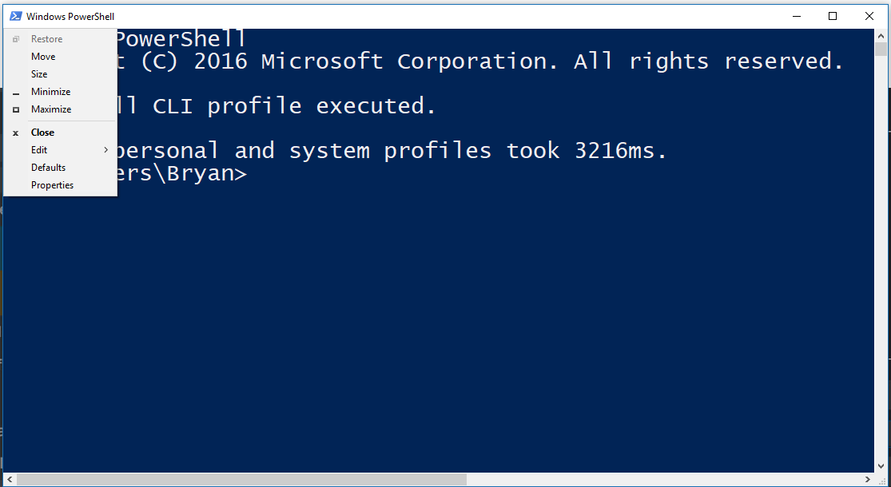
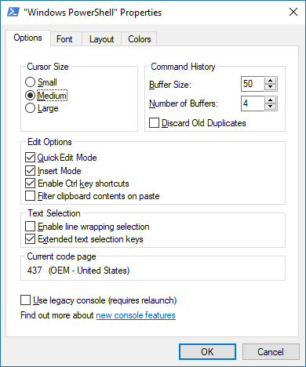
CLI Properties

Slide 9
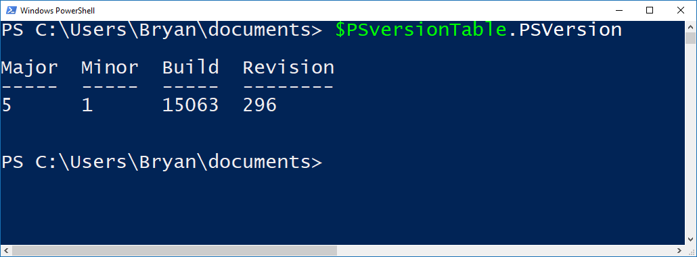
Checking Your PowerShell Version
Latest Version is 5 - Recommended

Slide 10
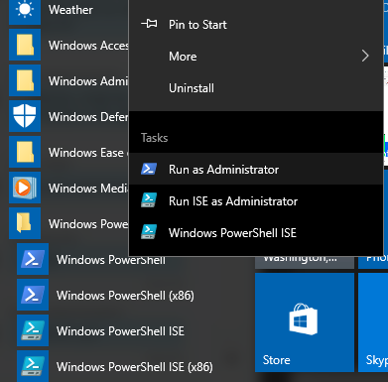
Enabling Scripting
Need to run as Administrator

Slide 11
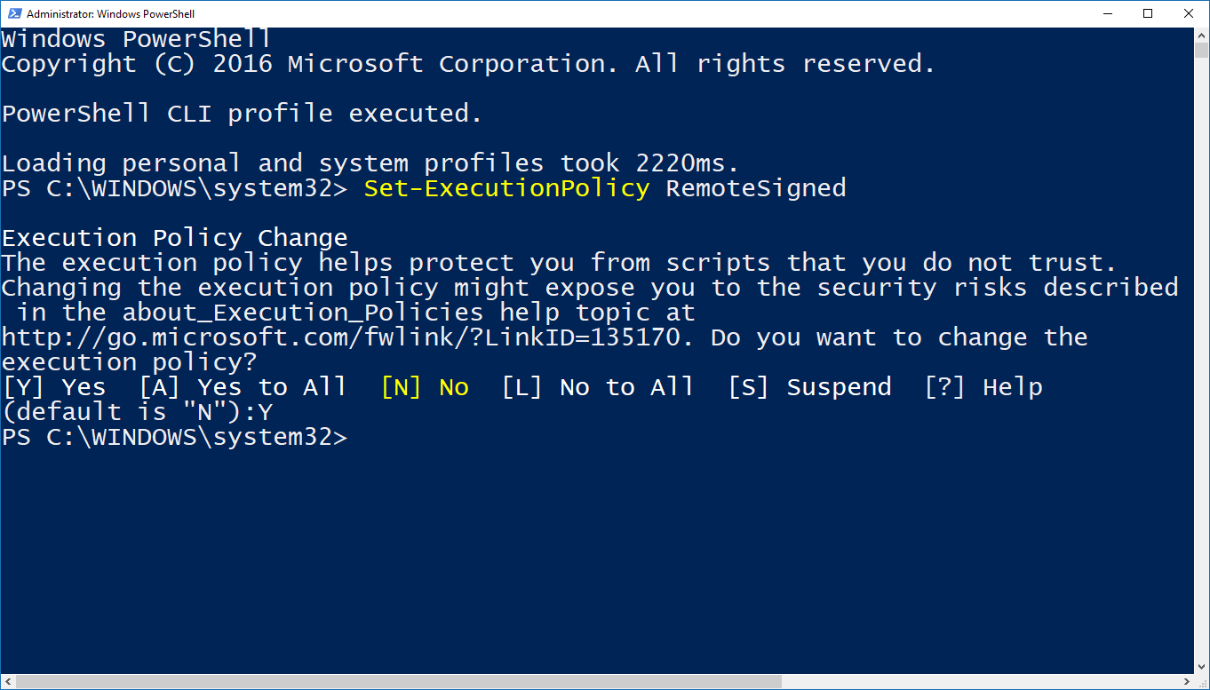
Setting the Execution Policy to Allow Scripts

Slide 12
PowerShell CLI Demo
Set-ExecutionPolicy
$PSVersionTable.Version
Using AzureRM

Slide 13
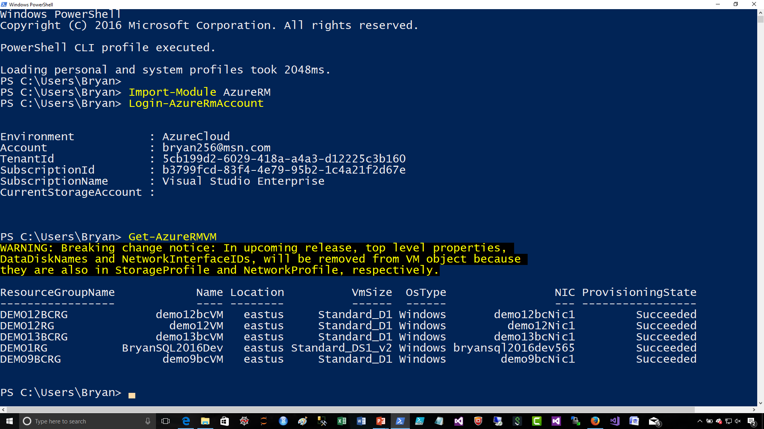
PowerShell CLI – Using AzureRM

Slide 14
By Default Running Scripts is Disabled!!!
PowerShell: Set-ExecutionPolicy options
Set-Executionpolicy unrestricted # Must have elevated permissions
Set-ExecutionPolicy Restricted
Restricted - No scripts can be run. Windows PowerShell can be used only in interactive mode.
AllSigned - Only scripts signed by a trusted publisher can be run.
RemoteSigned - Downloaded scripts must be signed by a trusted publisher before they can be run.
Unrestricted - No restrictions; all Windows PowerShell scripts can be run.

Slide 15
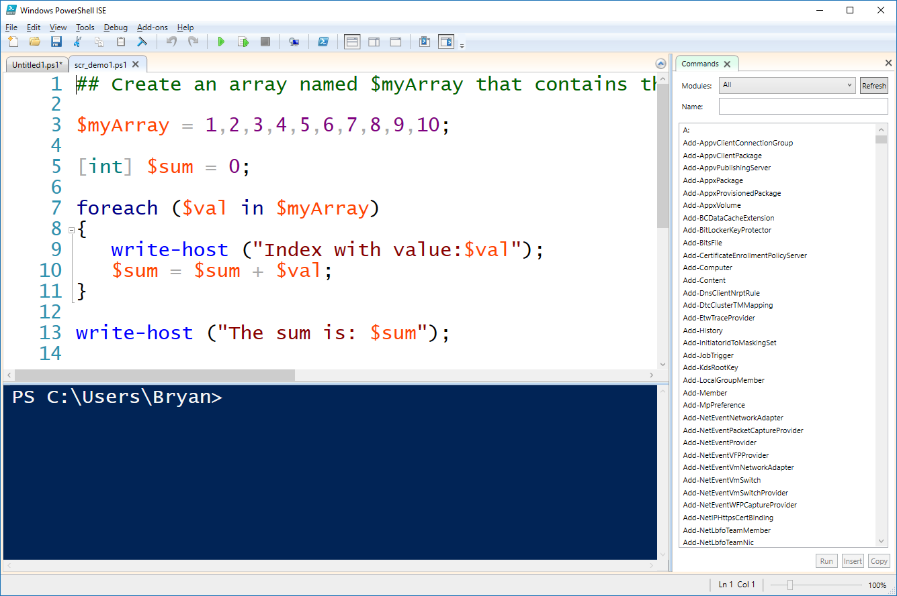
The PowerShell ISE
Script Editor
Console

Slide 16
ISE Demo

Slide 17
Installing the AzureRM Module
Start PowerShell with Elevated Privileges
Confirm PowerShellGet is Installed and the Correct Version
Get-Module PowerShellGet -list | Select-Object Name,Version,Path # 1.0.0.1 plus
Install the PowerShell AzureRM Module
Install-Module AzureRM
Import the AzureRM Module
Import-Module AzureRM -Force -Verbose # Will list cmdlets being imported
Verify the Azure Module Installation
Get-Module AzureRM # Will list module information
https://docs.microsoft.com/en-us/powershell/azure/install-azurerm-ps?view=azurermps-3.7.0

Slide 18

Closing: Q & A

