Slide 1

SQL Server with PowerShell
Bryan Cafferky
BPC Global Solutions LLC

Slide 2
What’s Ahead?
Why SQLPS
PowerShell Module SQLPS – Installs with SQL Server
Provider Functionality
Scripting Functionality
SQL Agent
SQLServer Module

Slide 3
Remoting
Restart-Computer
Dev Server 1
Mary Smith’s Computer
DNS Server
Invoke-Command
Get-EventLog
Restart-Computer
PowerShell
Dev Server 2
Prod Server 1
Set-Service
Restart-Service
Show-EventLog
Enable-PSRemoting -Force
Dev Server 3
John Doe’s Computer
Prod Server 2
Test-Connection

Slide 4
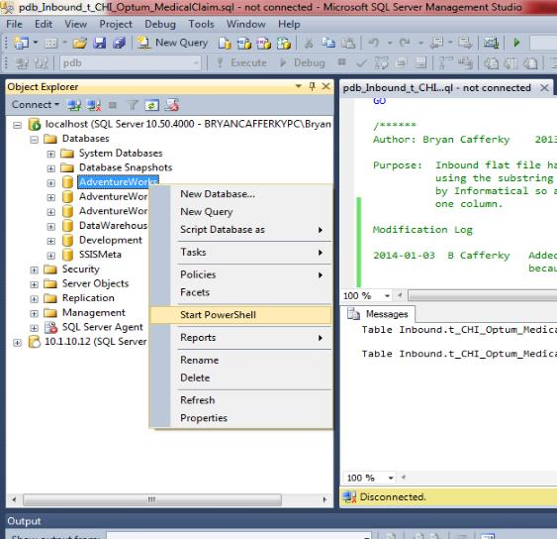
Starting the SQL Server PowerShell Provider

Slide 5
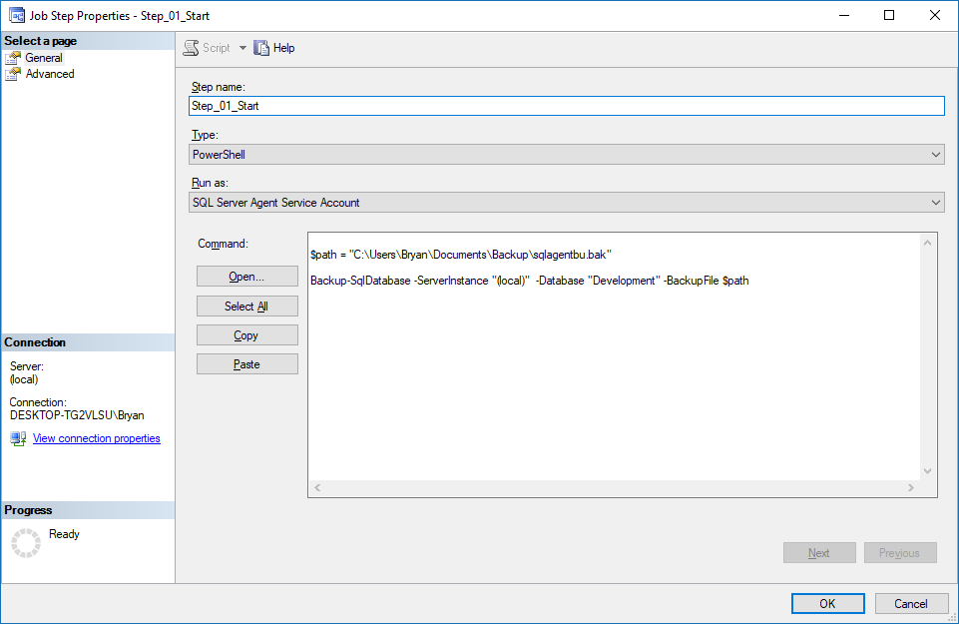
Using PowerShell in SQL Agent Jobs

Slide 6
SQLServer Module
Will Replace SQLPS
Installs with SSMS
Is Not Used by SQL Agent
May Have Issues Using

Slide 7
Review
PowerShell Remoting
PowerShell Module SQLPS – Installs with SQL Server
Provider Functionality
Scripting Functionality
SQL Agent

Slide 8
Closing: Q & A

