Slide 1

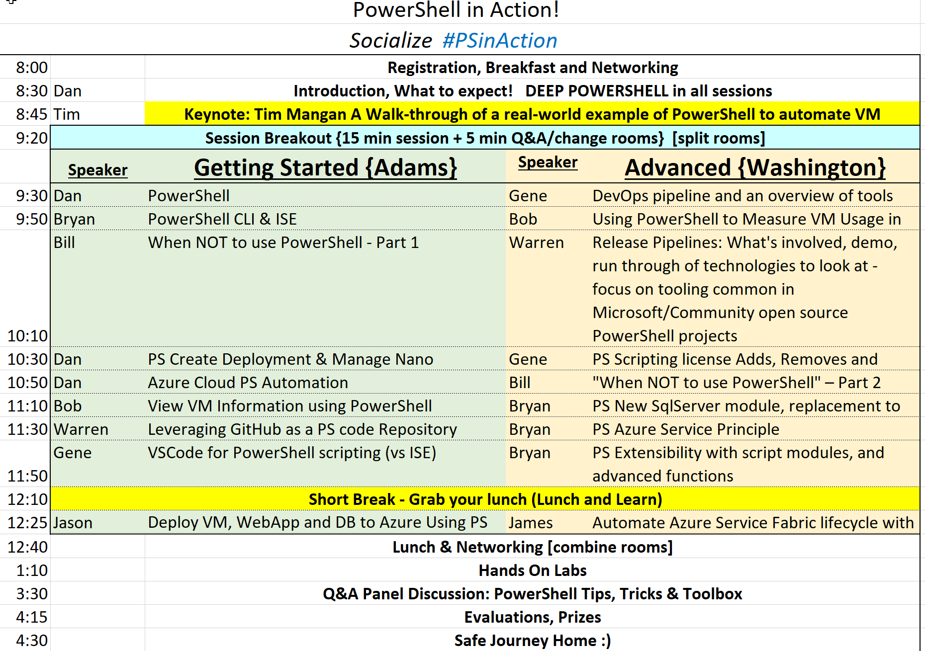
Wireless : MSFTGUEST
Event Code: msevent41ck
\\HALS-LENOVO\PSinAction-New
Content:
http://github.com/dstolts/PSinAction
https://www.microsoftazurepass.com/

Slide 2
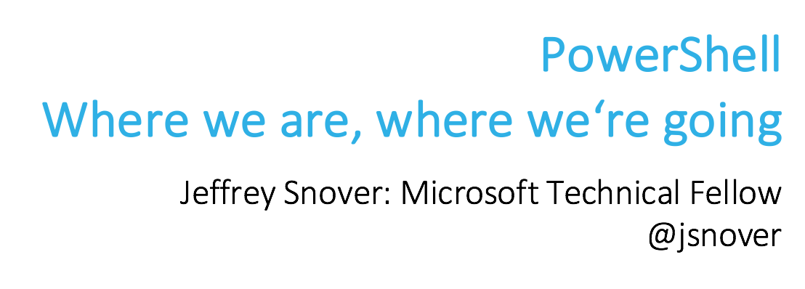
Date: June 5th, 6:00 PM (This Monday!)
Location: Wayfair @ Copley Place (See meetup)
Long: https://www.meetup.com/Boston-PowerShell-User-Group/events/239704767/
Short: bit.ly/bostonsnover
Agenda:
Jeff Dillon (Wayfair): Windows CD Pipelines at Enterprise Scale ~10 minutes
Jeffrey Snover (Father of PowerShell)…

