Slide 1
Release Pipelines in Microsoft Ecosystems
Warren Frame

Slide 2


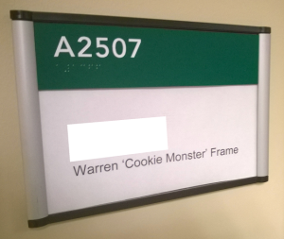


About Me
What do I do?
Infrastructure Engineer, FAS Research Computing, Harvard University
Design and build solutions, learn, share
Other interests:
science, infosec
tech, cooking
tennis, family
Where to find me
Twitter.com/PSCookieMonster
LinkedIn.com/in/wframe
RamblingCookieMonster.github.io
Github.com/RamblingCookieMonster
PowerShell Slack Community
Notes:
Microsoft, VMware, Citrix, etc.
I'm on LinkedIn and Twitter, feel free to connect
Slack - Modern hosted chat service, it's bridged with the PowerShell channel on IRC and is quite handy:
I can ask questions and talented folks like Joel Bennet, Dave Wyatt, Kirk Munro, Justin Rich, and many others, including a few from the PowerShell team, might jump in to help.
I also find that trying to help others can help you learn a bit.
If your boss is asking 'why are you in a chatroom at work!' - turns out when you put a bunch of PowerShell folks in a chat room, some interesting ideas that you could take back to work and implement might come up. Or someone mentions an issue you're experiencing and how they fixed it. Very helpful!
slack.poshcode.org > submit your e-mail, join up!

Slide 3

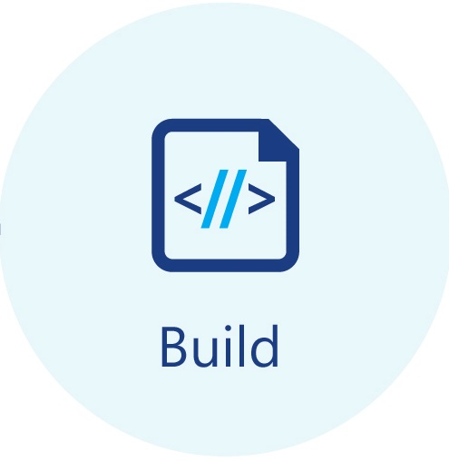
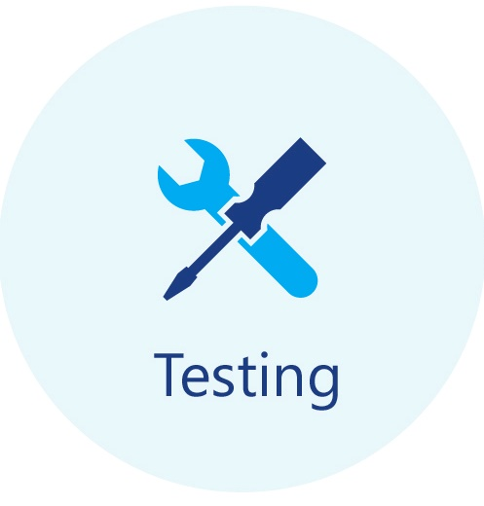
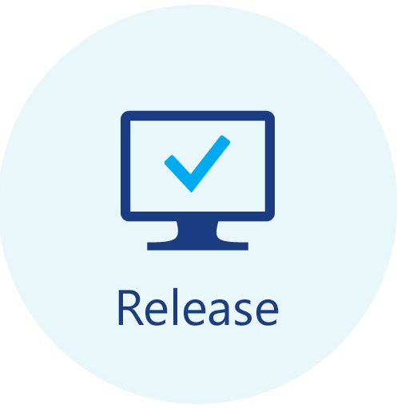










What’s a Release Pipeline?
Prod environment (etc.)…
Systems / Services
Modules
Scripts
Config files
AKA Continuous Deployment AKA Continuous Delivery (ish)
Notes:
Start with something as simple as a PowerShell script, remoting endpoint, or module… all the way to defining and deploying entire services via this pipeline
Many other services, these are some common tools, among many others (e.g. Atlassian stack):
GitLab (Source, Build)
GitHub (Source)
Gogs (Source)
VSTS (Source, Build Release)
AppVeyor (Build, Release(ish))
Pester (Test)
Test-Kitchen (Test)
Octopus Deploy (Release)

Slide 4
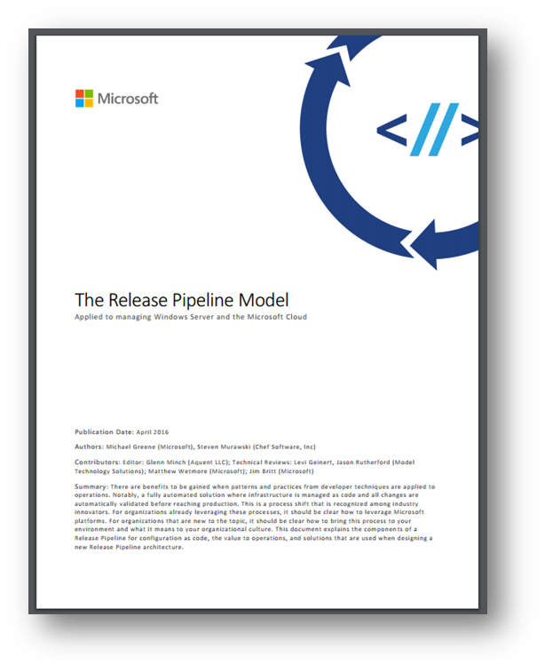
Why Release Pipelines?
Greater success of changes (x60) ¹
Better mean time to recover (x168) ¹
Shorter lead time for deployments (x200) ¹
More frequent deployments (x30) ¹
Reduce risk
I’m lazy
More:
aka.ms/trpm
Notes:
1: aka.ms/trpm - Steven Murawski’s forward (inc. 2015 State of DevOps Report)

Slide 5
How does it work? (generally)
You push a change to source control
Source control sends a message to build system
Build system knows what to do when this project changes
Optionally build things - compile code, concat functions, etc.
Test things - code, operations, security, etc.
Deploy things - artifacts (scripts and modules!), systems, etc.

Slide 6


Tooling
“a bunch of random open source projects bound together with duct tape and chewing gum”
Notes:
Paraphrasing Chris Wahl from the Datanauts podcast
Open source tooling might feel like MacGuyver
Solutions like VSTS and Octopus Deploy exist, and are more polished, but might be costly
Now throw in task automation modules like psake or Invoke-Build – it gets messy

Slide 7
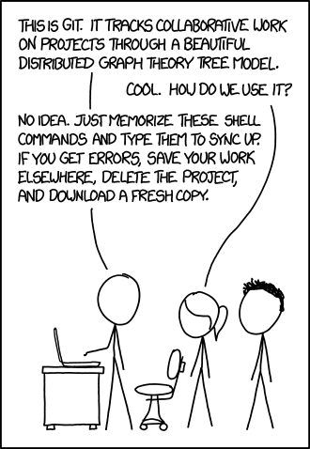
Source
System to manage changes to files
Use it. Too many reasons to list
Pick a git-based solution like GitHub/GitLab/BitBucket/VSTS
Notes:
Git references…. So many... Some linked here: https://github.com/RamblingCookieMonster/Git-Presentation
Like PowerShell, just using the CLI on a regular basis will clarify many things, but you also need to flip through the docs or a decent reference
Common client tools – git for windows, poshgit, github desktop, atlassian sourcetree, more (https://git-scm.com/downloads/guis)
Don’t roll vanilla git without a solution layered over it. Why?
Yeah, it’s a D(istributed)VCS, but having a central source-of-truth on top of that is valuable.
GitHub isn’t popular because it’s based on git. The sharing and collaboration features layered over git were far more important.
Writing your own hooks is esoteric and fragile. Using a git-based solution like GitHub or GitLab lets you use webhooks to hook up a real CI solution (or may provide CI out of the box)

Slide 8
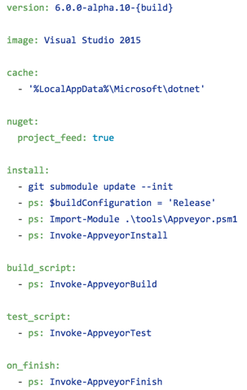
Build
System that runs things
On demand
On a schedule
Via a trigger (e.g. web hook from source control)
Builds…
Do one or more things
Usually associated with a repo
Solution-specific syntax:
.gitlab-ci.yml
appveyor.yml
Jenkinsfile
Defined in code ideally. Avoid GUI definitions…
Notes:
I’m a fan of GitLab – you get source control and a build system, integrated together, and GitLab CE is open source/free and works quite well. Otherwise, if you use something like Jenkins, you need to configure each source control repo to talk to Jenkins, and configure Jenkins to know about each repo. VSTS is also nice and integrated
“Build” word is overloaded
Build System (runs things)
Build (the steps that the build system runs for a project)
Build phase (produce an artifact)
In the code on the right above…
‘Build System’ is AppVeyor
‘Build’ is what happens when AppVeyor reads and runs the AppVeyor.yml file (code on the right in the slide)
‘Build phase’ is what happens in Invoke-AppVeyorBuild (presumably, it builds usable PowerShell packages to deploy)
Most PowerShell projects likely won’t need a ‘Build phase’

Slide 9
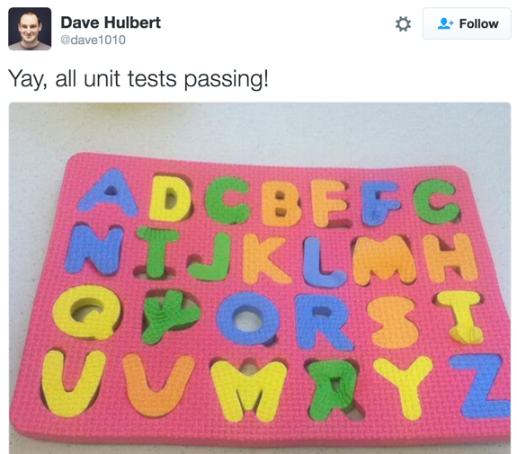
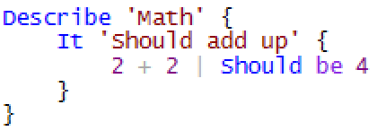

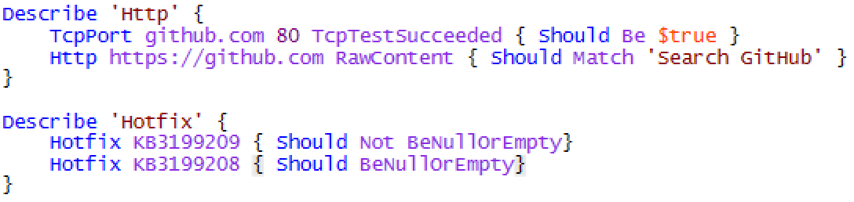
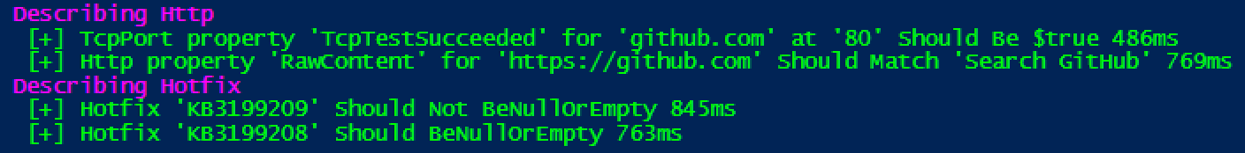
Testing
Assertions
Tests to consider:
Linting
PSScriptAnalyzer, AST
Style and Formatting
Unit Tests
Is a small piece of code working as expected
Mocking
Integration Tests
Do components work together
Maybe mocking
Functional Tests
Does a feature work as intended
Operational Validation
Poshspec, OVF
Does a running system behave as expected
More: Security? Performance? Etc.
Notes:
https://github.com/pester/pester
https://github.com/Ticketmaster/poshspec
https://github.com/PowerShell/Operation-Validation-Framework
Many other tools using Pester:
https://www.automatedops.com/blog/2016/06/21/the-pester-pipeline/
Don’t be overwhelmed! No need to do all of these types of tests, and while 100% coverage would be nice, it’s often not realistic. Start with the most common things that break / that would be good to know if they broke. E.g. for a PowerShell module… Does a module load? Do particular functions in the module work as expected?

Slide 10
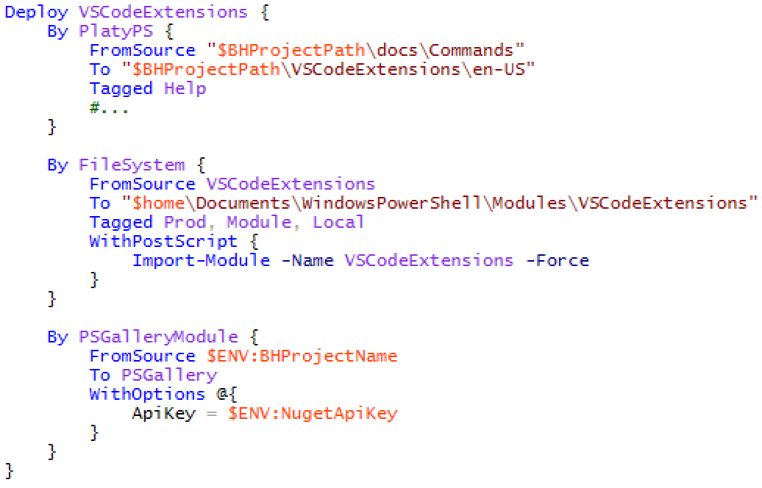
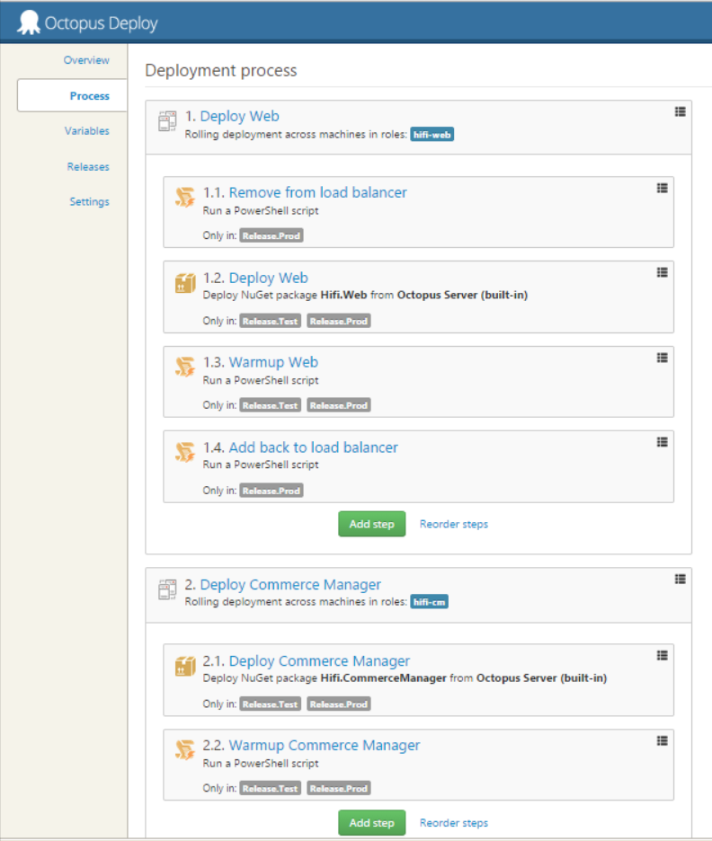
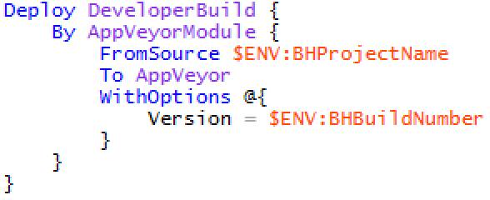
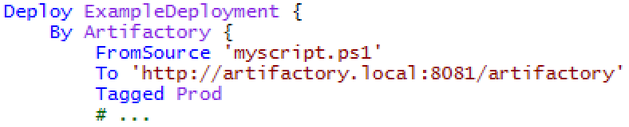
Release
Deploy your project (ideally) to production
Octopus Deploy and VSTS
Many pre-canned tasks
Flexible
Pretty
Potentially $$
Not deployment-as-code
Random PowerShell code
Fun to read and maintain!
PSDeploy
Some pre-canned tasks
Deployment-as-code
Poorly written
Open source
Notes:
Code in the middle is PSDeploy
GUI on the right is Octopus Deploy (Image: http://www.karolikl.com/2015/02/from-complete-chaos-to-octopus-deploy_13.html)
What do you want to release?
Push to a particular branch, if tests pass, commit and push to a locked-down branch?
Push out a file? Package?
Shuffle systems into and out of a load balanced pool

Slide 11


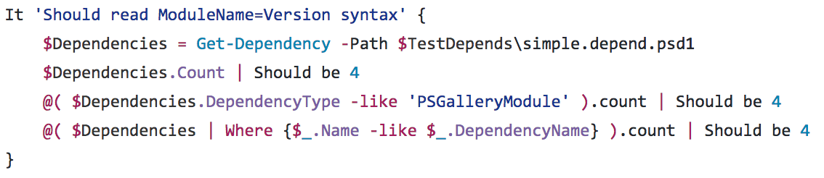


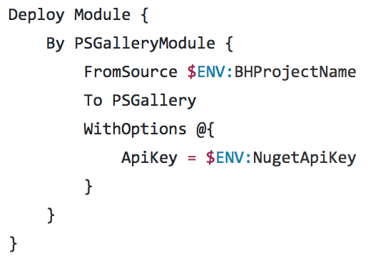
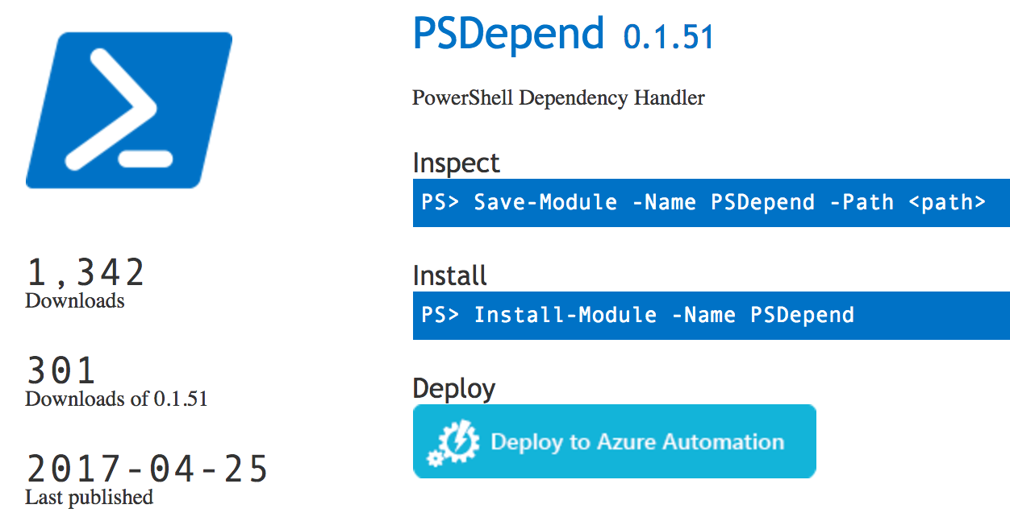
GitHub + Pester + AppVeyor
Source:
Build:
Test:
Release:
Notes:
Example deployment of a PowerShell module using GitHub, AppVeyor, Pester, and PSDeploy.
You can see output from this specific build here:
https://ci.appveyor.com/project/RamblingCookieMonster/psdepend/build/1.0.87

Slide 12
Where to start
Source Control and/or Tests over entire pipeline at once
Existing tools over resume-driven-development
New service(s) / value proposition over re-engineering everything
No luck in house? Play with GitHub+AppVeyor, VSTS, etc.
Notes:
Existing tools (i.e. devs already have VSTS or GitLab set up) are nice – quick ramp up, and everyone using the same system (particularly version control) is quite valuable
New services / value proposition bit means… if you want to bring things into a release pipeline model, prioritize! Don’t try to bring all your projects in. Which projects need to change quickly and often? Which are straightforward to test and deploy? You might wait for that legacy system that never changes and that would be horrid to test and deploy with code... to die. At the very least, de-prioritize it over new projects and projects where a release pipeline would be valuable

Slide 13
References
The Release Pipeline Model - Michael Greene, Steven Murawski
Building a Simple Release Pipeline in PowerShell Using psake, Pester, and PSDeploy - Brandon Olin
Stack Overflow: How We Do Deployment - 2016 Edition - Nick Craver
DevOps Reading List - Steven Murawski
Reading List - Chris Hunt
The Pester Pipeline - Chris Hunt
Best Practices with Packer and Windows - Matt Hodgkins
Introduction to Kitchen-DSC - Gael Colas
Testing Ansible Roles Against Windows with Test-Kitchen - Matt Hodgkins
Twitter, Slack, and other communities
Etc.
Notes:
Common community projects: https://gist.github.com/RamblingCookieMonster/89fb436e27dd715a2d0e2c5380f2008f
Since then, some folks have started using BuildHelpers, Invoke-Build, and to a lesser extent, PSDepend, in release pipelines

