Slide 1

The Hong Kong Polytechnic University Department of Computing COMP5138 Service Science Management Semester 3, 2016-2017
EG07
HUANG SIDA, STEFAN | 16102564G
YUNG MAN KWAN, JERRY | 160314222G
KWONG KA CHUN, LOUIS | 16034468G
CHIU KA CHUN | 15003627G
LUI TSZ TO | 16031567G
TAI KIN HUNG | 16053186G
SHAM SHIRLEY | 15055899G
TANG HIU CHUNG | 16011638G

Slide 2
Outline
Company Profile
Complaint handling Process & performance issues
CPN
State Space Analysis
Performance Analysis
Future Works

Slide 3
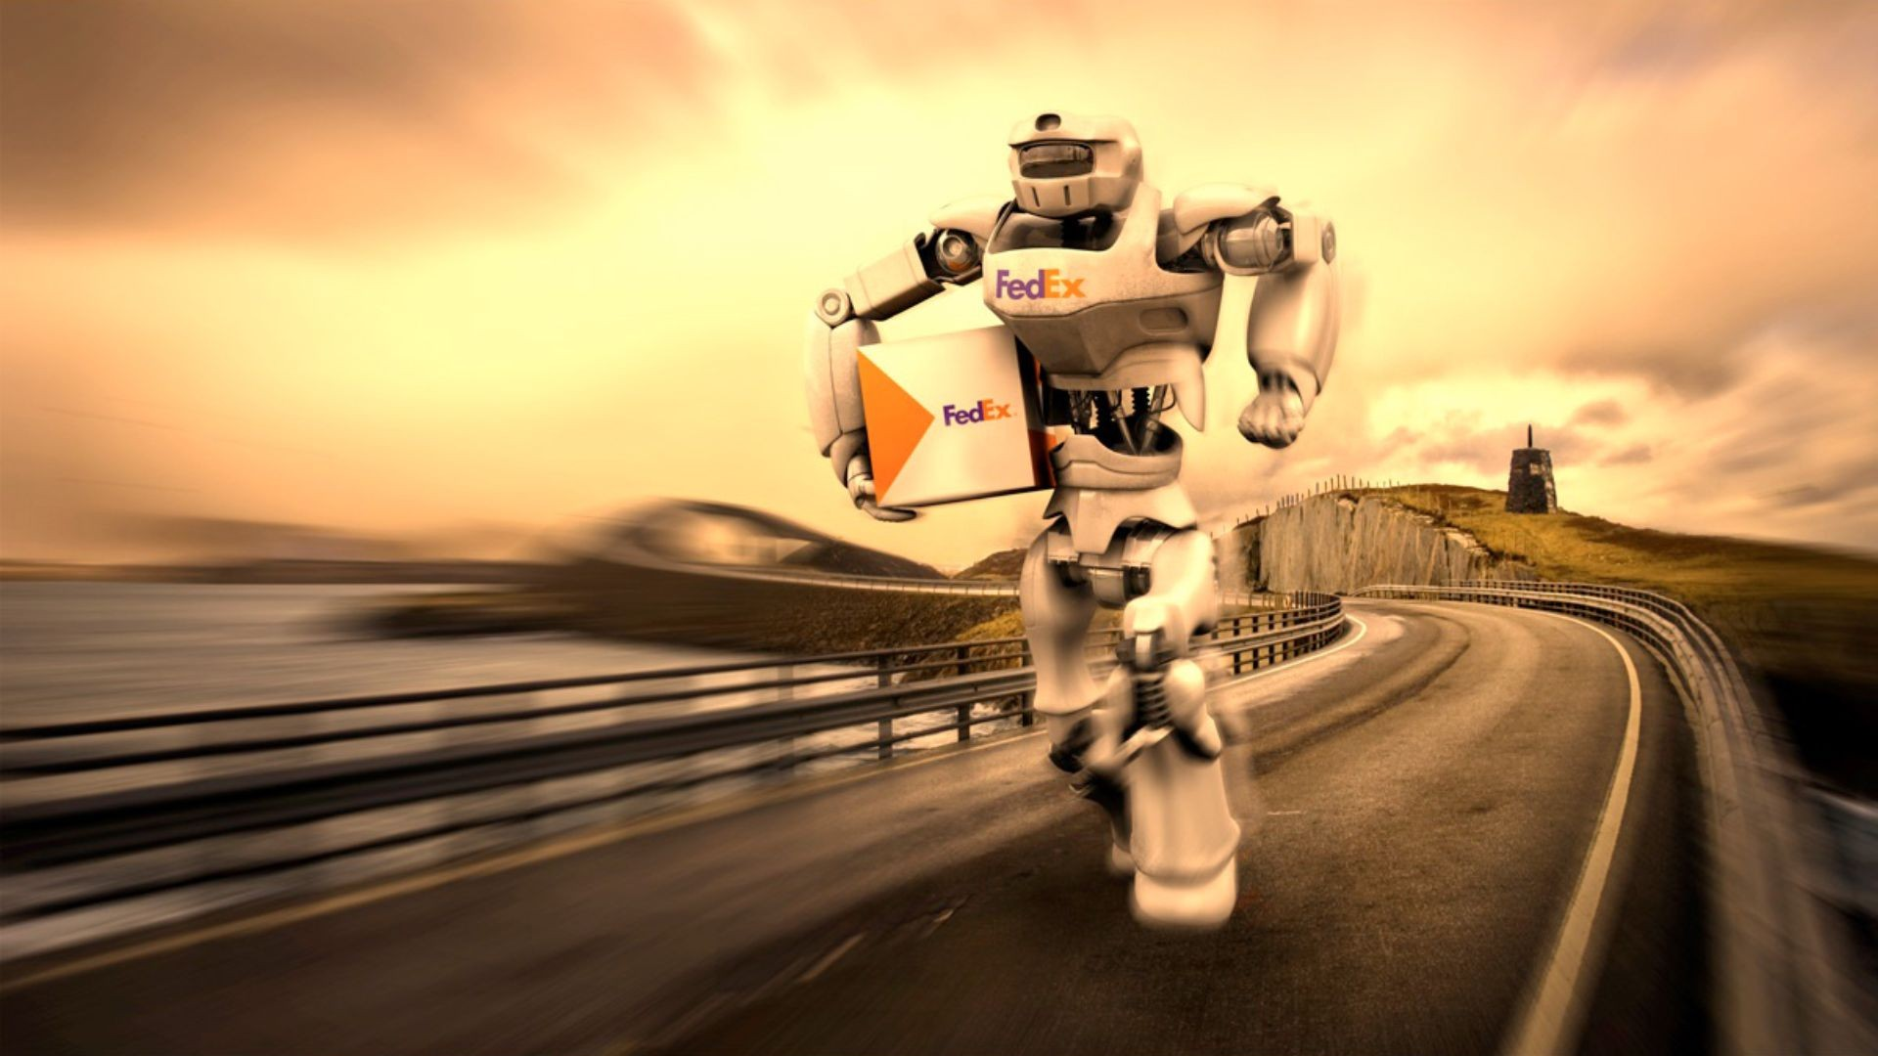
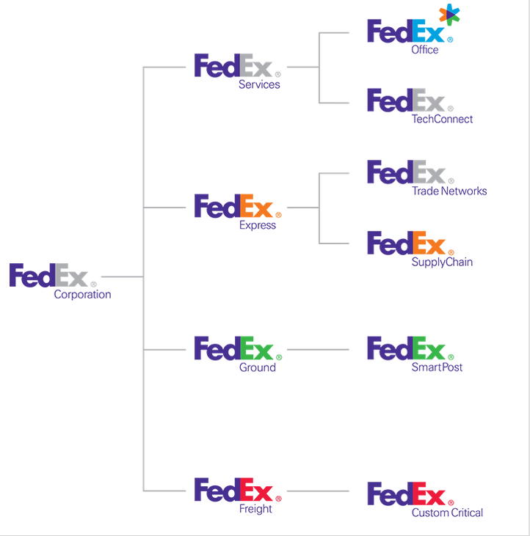
Company Background
FedEx is an international shipping company. It provides reliable, fast, and convenient delivery & air freight services to more than 220 countries
1.25 billion packages shipped annually by FedEx
0.55 % shipped packages lost by FedEx

Slide 4
The Process of Complaint Handling System
If customers are Unhappy with services, make complaints via different channels, such as mail, email, phone call, comment at websites, social media and so on.
Complaint handling system will automatically send a reply to that customer
System will compare the complaint with previous cases in the data base, and find out the similarity.
Group the complaint into the right category, and send it to right department.
The related department will handle the complaint and provide solution.
The customer can give feedback when they receive the solution or response.
The customer unsatisfied with the response or solution, then doing the process again.

Slide 5
Performance Issues
Some of customers responded that the complaint system cannot send “reply” on time. There is some delay of system.
Few consumers complaints cases lost (dead end in the system), since the mistake of complaint handling system.
Some consumers respond that they receive the solution, but it’s not useful or it avoid answer directly.

Slide 6
Coloured Petri Nets(CPN)
A language for modelling and validation of concurrent and distributed systems and other systems in which concurrency, synchronisation, and communication plays a major role.
Developing a modeling that helps FedEx to improve the efficiency of complaint handling.

Slide 7
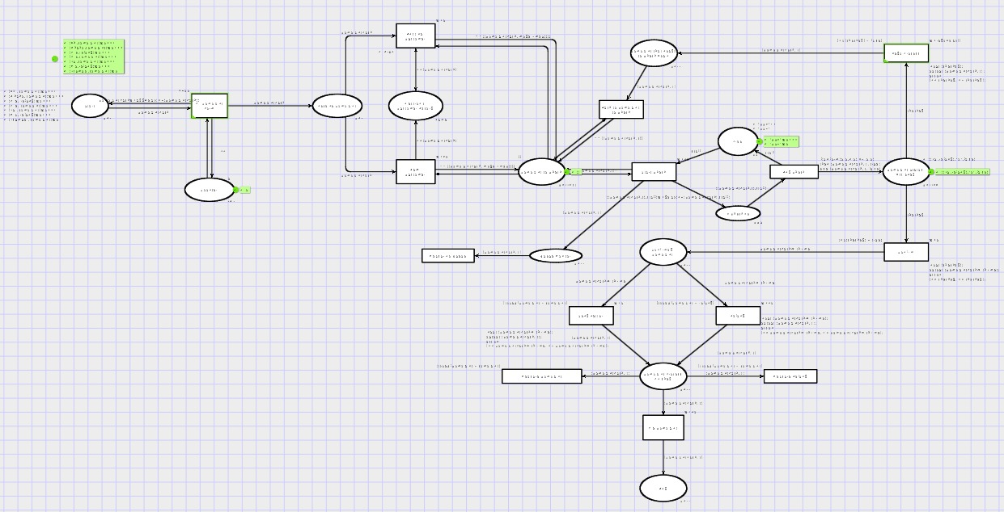
Complaint Handling Flow

Slide 8
The reason of using CPN
CPN has a graphical representation.
CPN has a well-defined semantics which unambiguously defines the behavior of each CP-net.
CPN is very general and can be used to describe a large variety of different systems, such as description of work process, communication protocols or distributed algorithms etc.
CPN has an explicit description of both states and actions.
CPN has a semantics which builds upon true concurrency, instead of interleaving.
CPN integrates the description of control and synchronization with the description of data manipulation.
CPN offers interactive simulations where the results are presented directly on the CPN diagram.

Slide 9
Original Method

Slide 11
Re-engineering Method

Slide 12
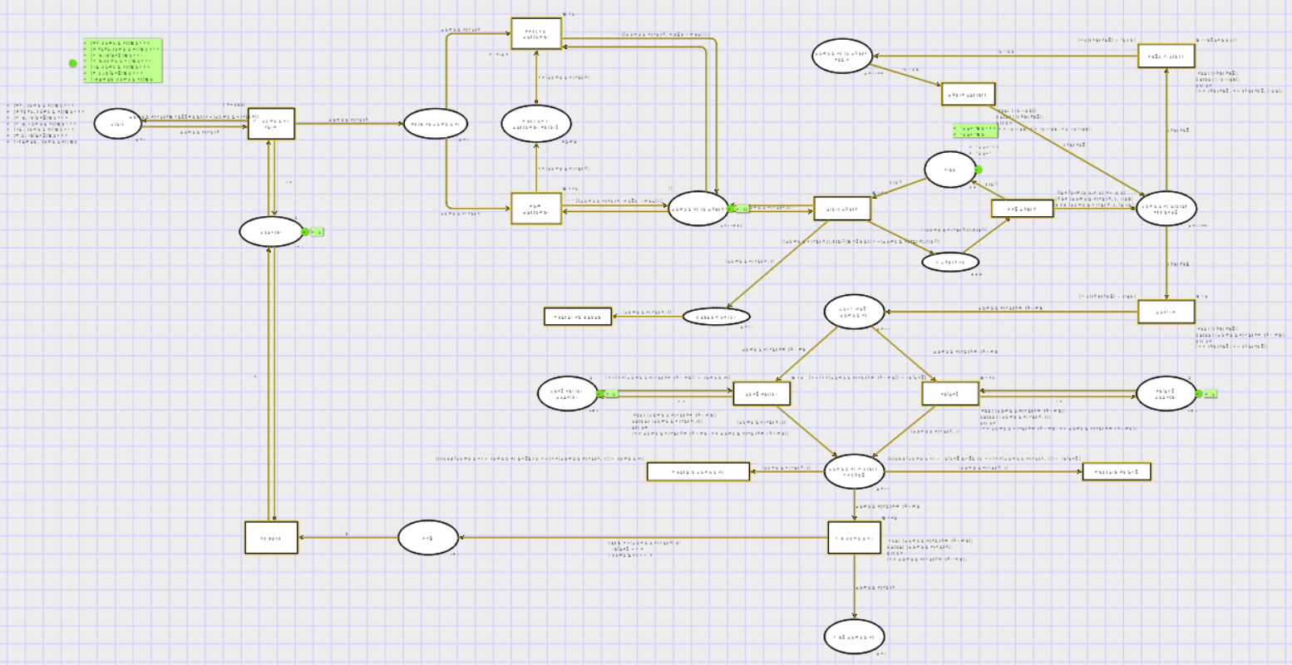

Slide 13
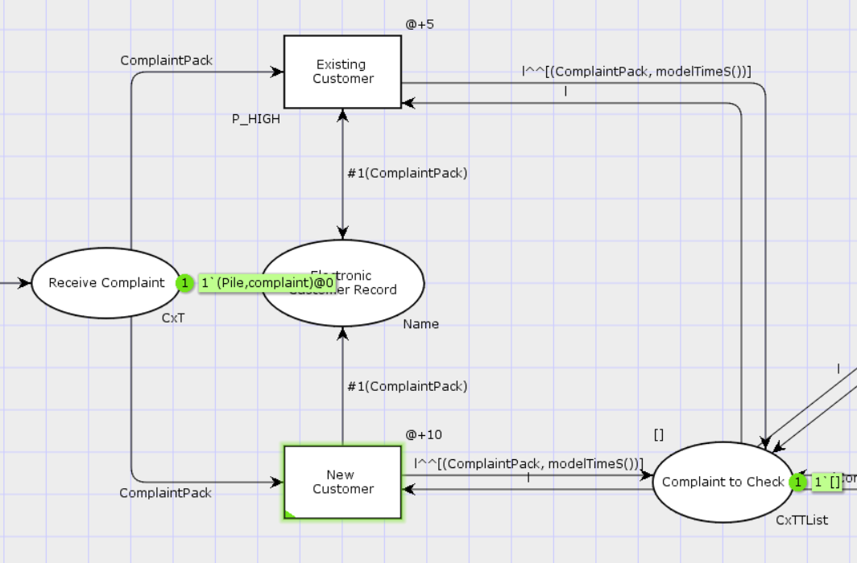
Logic
Electronic Customer Record act as a Database to store user information

Slide 14
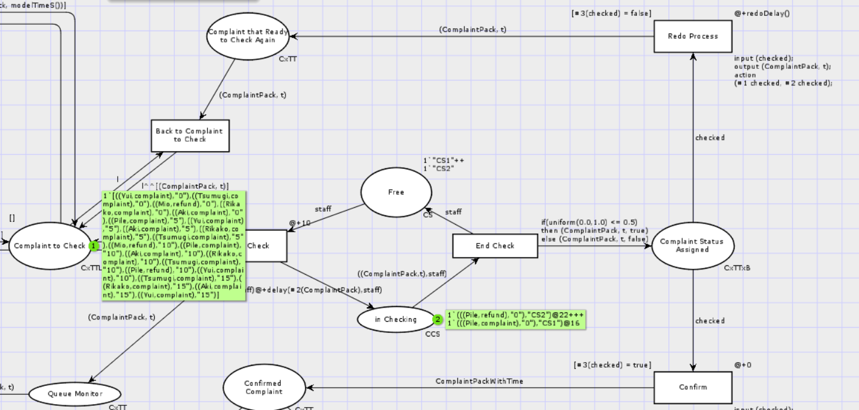
Logic
Assign Customer Service Representative to each complaint (or refund)
Use Uniform Distribution to act as a checking process to show whether false or true
False will go to re-checking; true will continue to proceed their request
Old complaint system

Slide 16
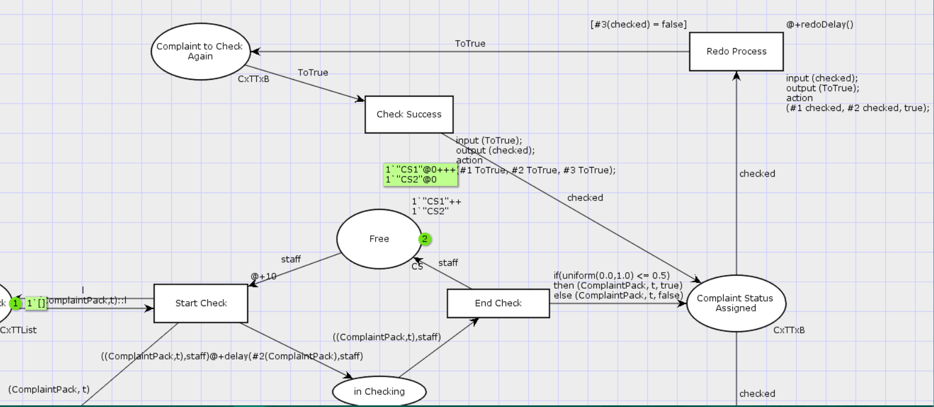
Logic
New complaint system
Assign a special CS for redo complaint

Slide 17
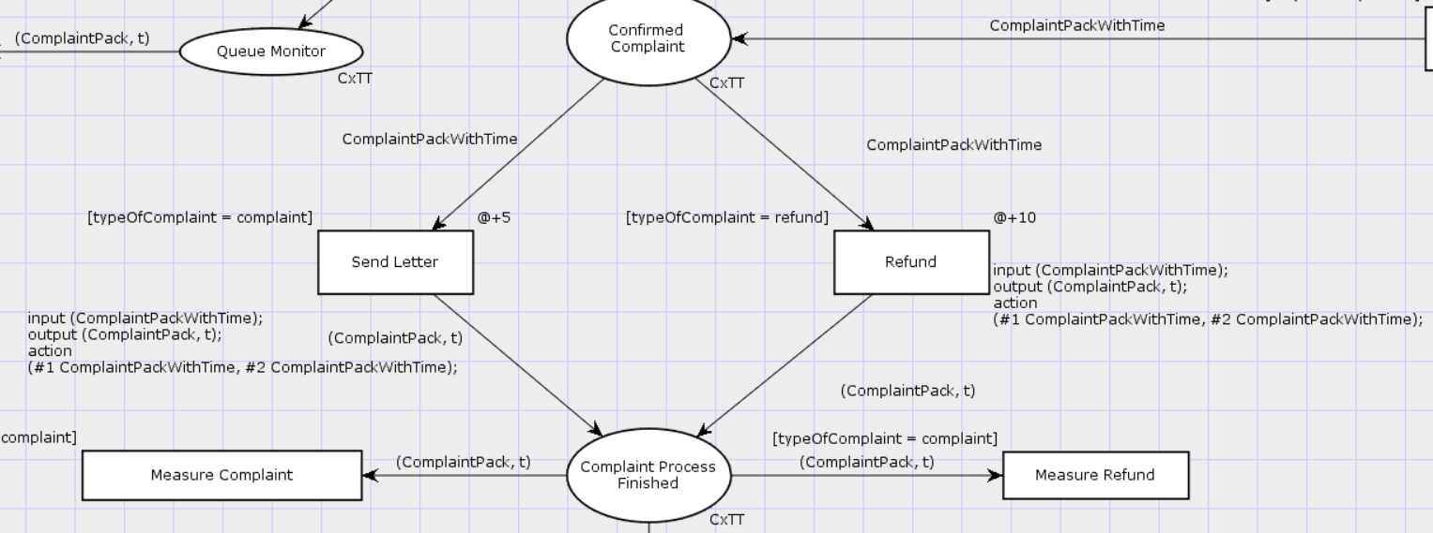
Logic
Complaint or refund
Use Guard to differentiate

Slide 18
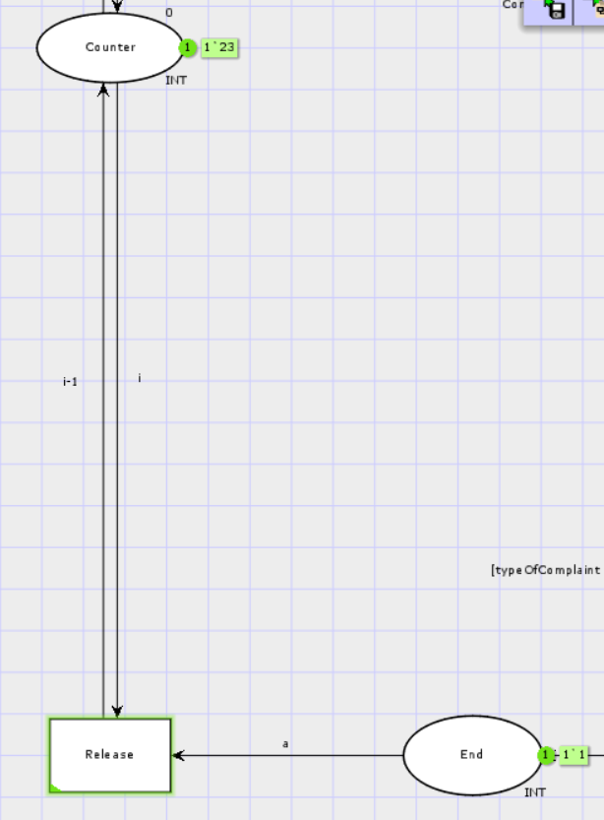
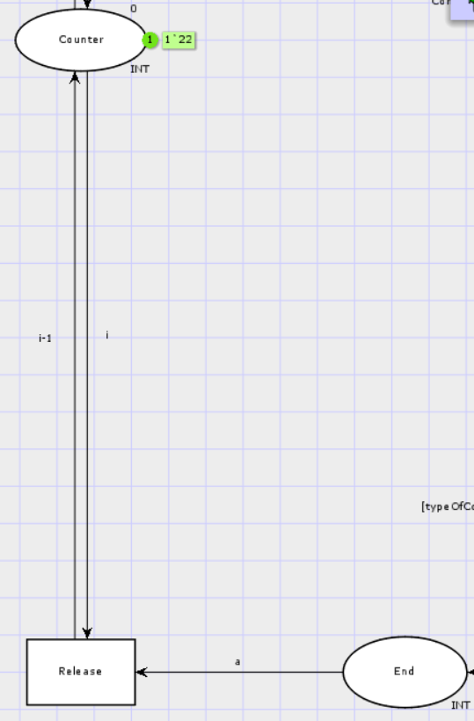
Logic
Release counter to allow new complaints

Slide 19
Design – Use of Colour Types
colset Name = with Aki | Rikako | Pile | Yui | Mio | Tsumugi | Ritsu | Azusa | Ui | Alice | Bob | Louis | Jeff | Keith | Jerry | Stefan | Felix | Shirley | Nicky | Matthew | Terry | Jack | Kelvin | Jane | Theresa;
var customerName : Name;
colset ComplaintType = with refund | complaint;
var typeOfComplaint : ComplaintType;
colset CxT = product Name * ComplaintType timed;
var ComplaintPack : CxT;

Slide 20
Design – Use of Colour Types
colset CxTT = product CxT * T;
var ComplaintPackWithTime : CxTT;
colset CxTTList = list CxTT;
var l : CxTTList;

Slide 21
Design – Use of Colour Types
colset CxTTxB = product CxT * STRING * BOOL;
var checked : CxTTxB;
var ToTrue : CxTTxB;
colset CS = string timed;
var staff : CS;
colset CCS = product CxTT * CS timed;

Slide 22
Design – Guards
Fill Complaint Form : [i < 200]
Redo Process: [#3(checked) = false]
Confirm : [#3(checked) = false]
Send Letter : [typeOfComplaint = complaint andalso #2(#1(ComplaintPack,t)) = complaint]
Refund : [typeOfComplaint = refund andalso #2(#1(ComplaintPack,t)) = complaint]

Slide 23
Design – Functions
fun addDelay(typeOfComplaint) = if (typeOfComplaint = complaint) then 5 else 10 : int;
Add delay to different type of complaint
Normal complaint: 5 delays
Refund: 10 delays

Slide 24
Design – Functions
fun delay(typeOfComplaint:ComplaintType,staff:CS) = if typeOfComplaint = complaint then (if staff="CS2" then 2 else 6) else (if staff="CS2" then 12 else 4);
Each CS may have different working ability

Slide 25
State Space Analysis
The state space is partial
Not enough time to generate the full stats space
300 seconds of space state simulation
The generated report is different every time
But conclusions are the same

Slide 26
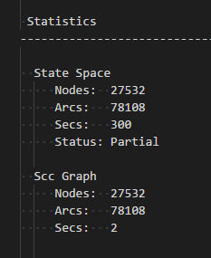
State Space Analysis – Generated Report
Size(State Space) = Size(SCC Graph)
No cycle
~30000 nodes, 80000 arcs
Partial

Slide 27
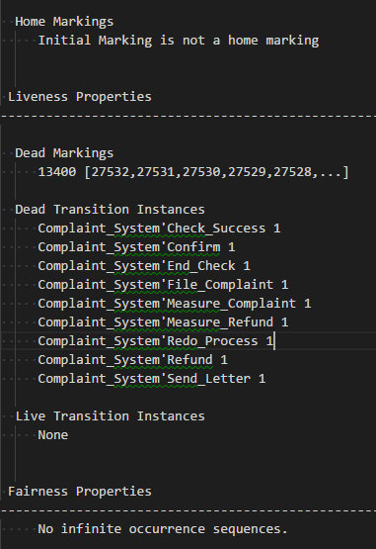
State Space Analysis – Generated Report
Home markings - None
Dead Markings – A Lot
Dead Transition Instances – A few
No infinite occurrence sequences

Slide 28
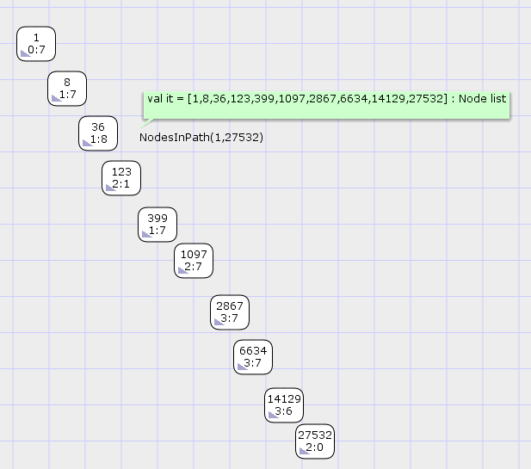
Dead markings?

Slide 29
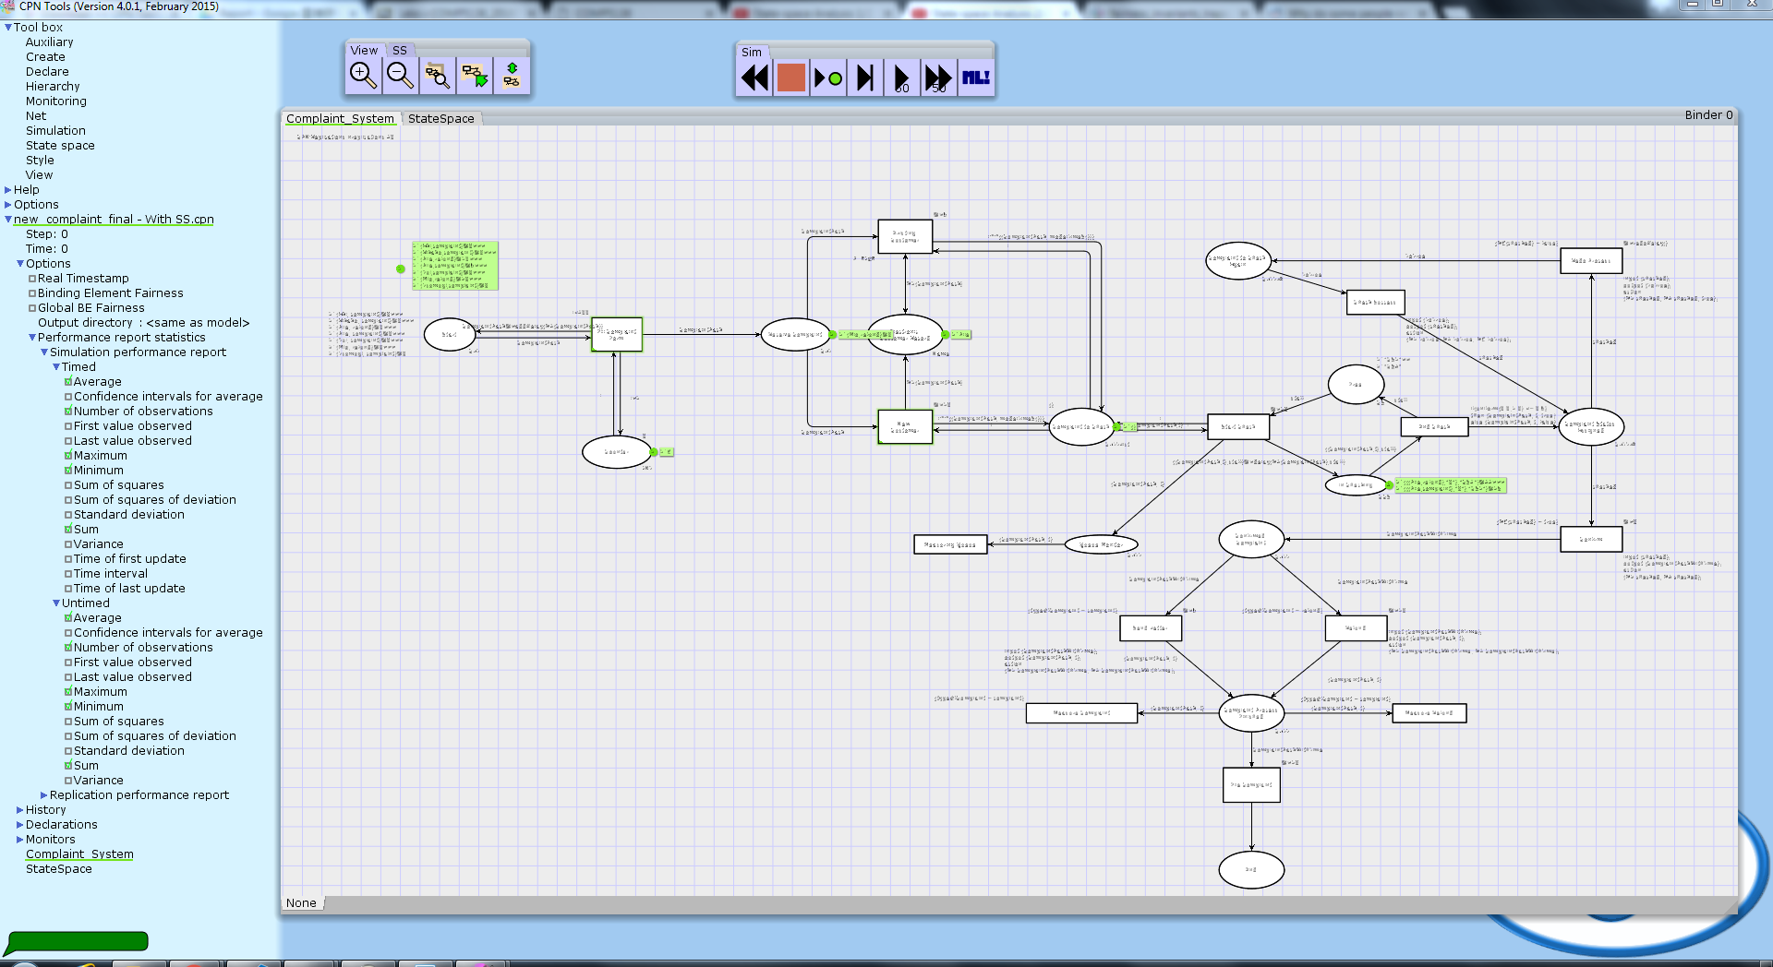

Slide 30
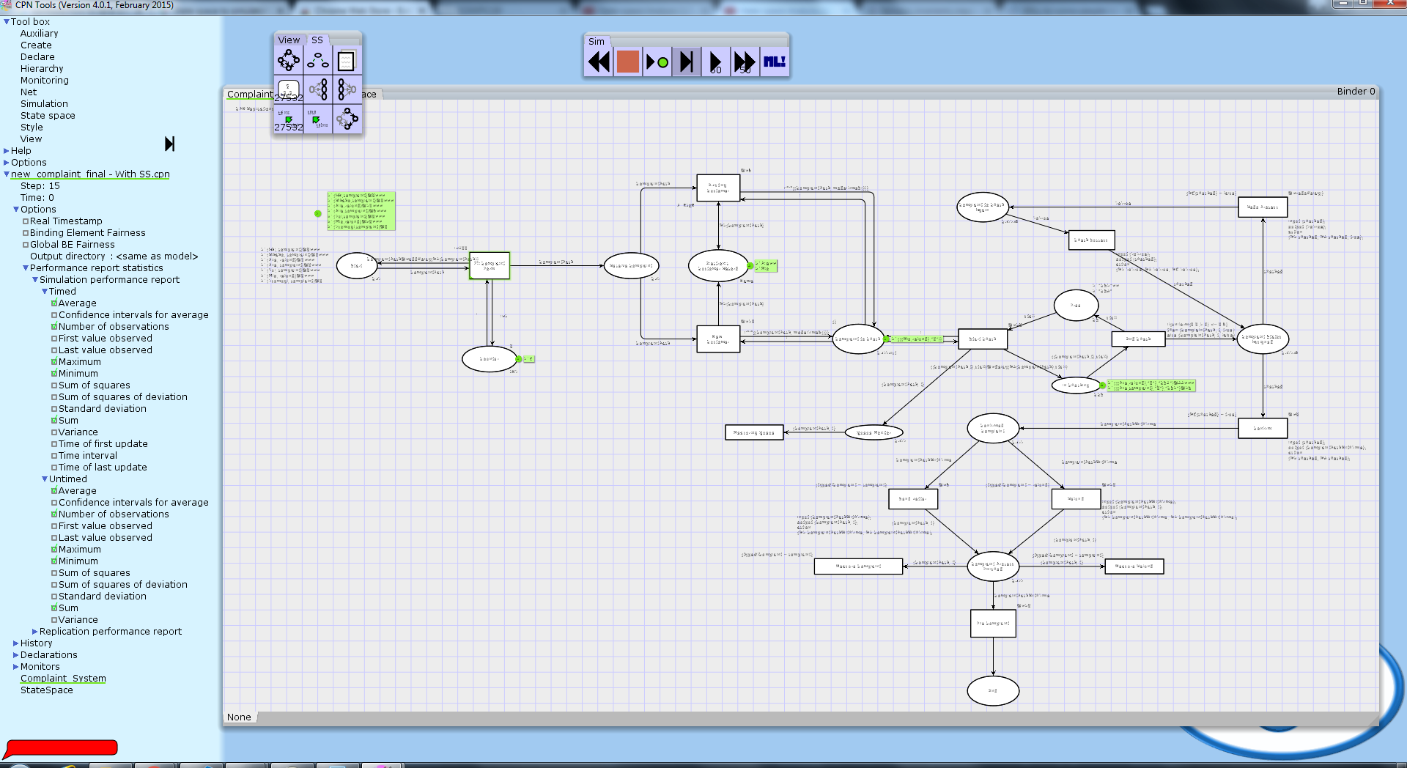

Slide 31


Slide 32
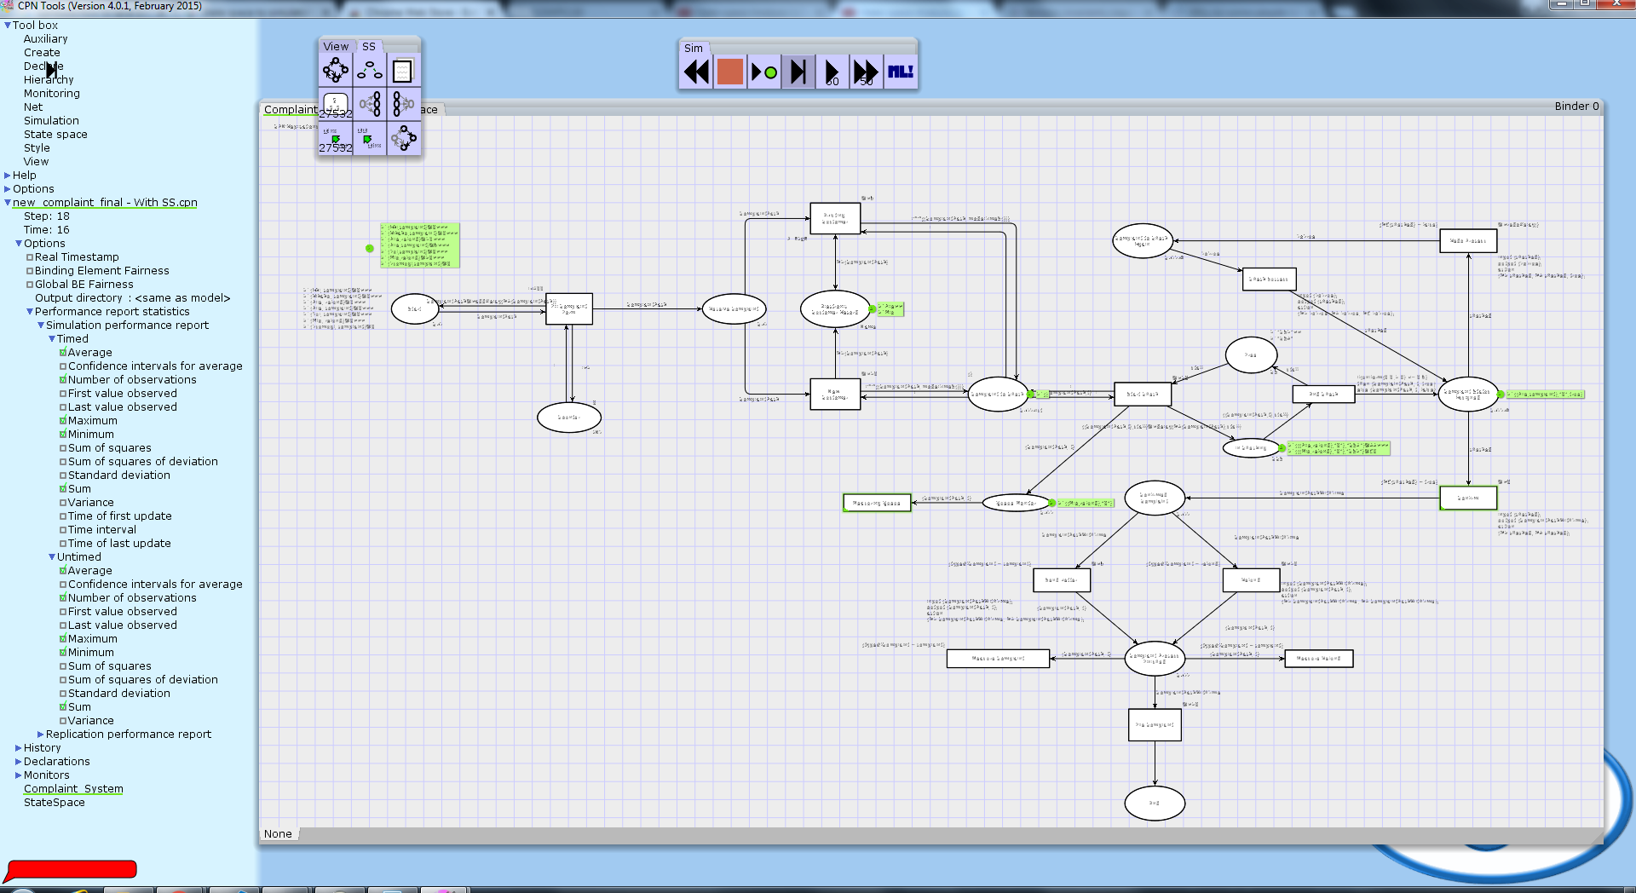

Slide 33
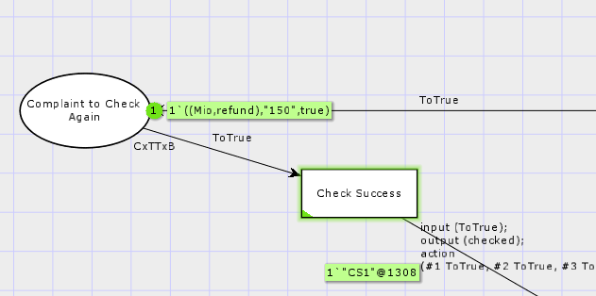
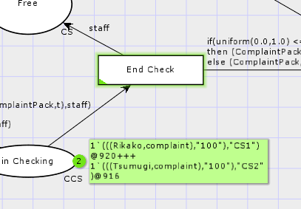
Dead Transitions?

Slide 34
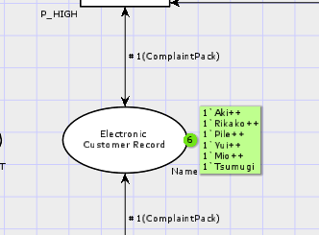
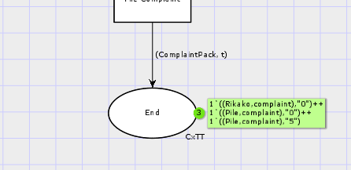
No home marking

Slide 35
Performance Analysis
Functions
fun modelTime() = ModelTime.time();
fun modelTimeS() = ModelTime.toString(modelTime()) : string;
fun StoT(t:string) = ModelTime.maketime(t);

Slide 36
Performance Analysis
Overall results show the performance of re-engineering method is better than that of original method

Slide 37
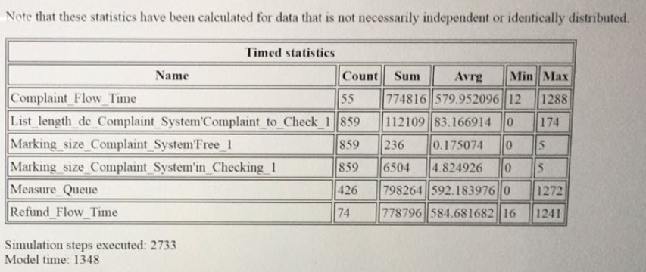
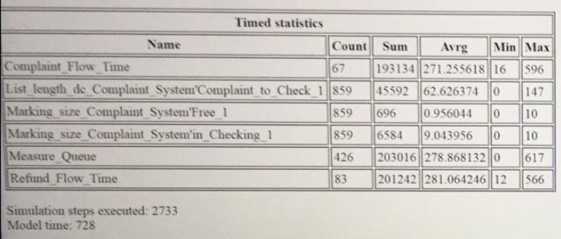
Performance Analysis
More employees (for customer service) will lead to a better performance
Sum, Avg and Model time are smaller
10 employees
5 employees

Slide 38
Future works
More things to model
Replenishment of resources
Quality of complaint resolution
Interactions with other parts of the business
Improve state space analysis
Complete the state space
Remove the false negatives

Slide 39
Future Works
Redo process: Assign employees on doing “redo complaints”
Measure the performance of employees in redo process
Define user type: Normal | Premium
Re-arrange the queue of complaint
Include some processes to consider whether it is a real “refund”
Using distribution method to differentiate real or not

Slide 40

The End

