Slide 1
Lab 1 Report
yl3377
Yuxiang Long
Robin Ying

Slide 2
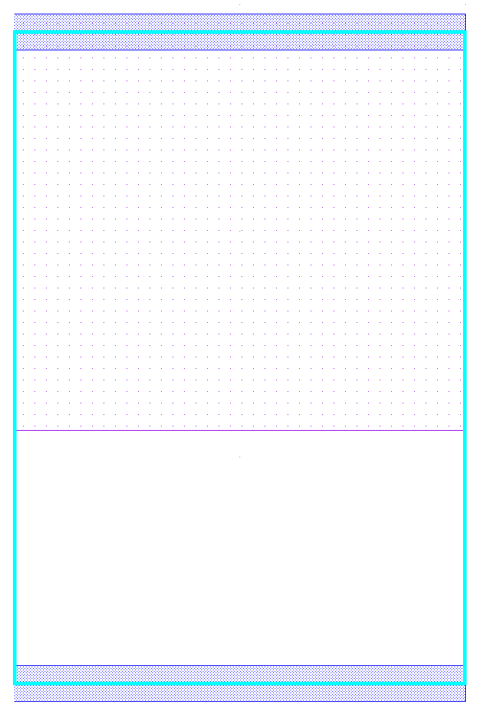
Standard Cell Dimensions
Fill-in the dimensions of the standard cell that you measured in Lab 1 Part 2, Student Activity 1:
0.16um
V_{DD} rail
standard cell
1.67um
n-well
2.87um
GND rail
0.16um

Slide 3
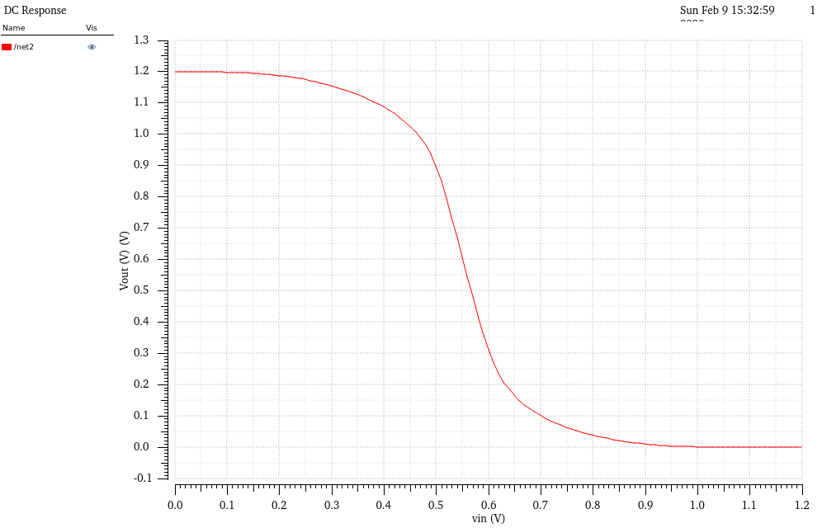
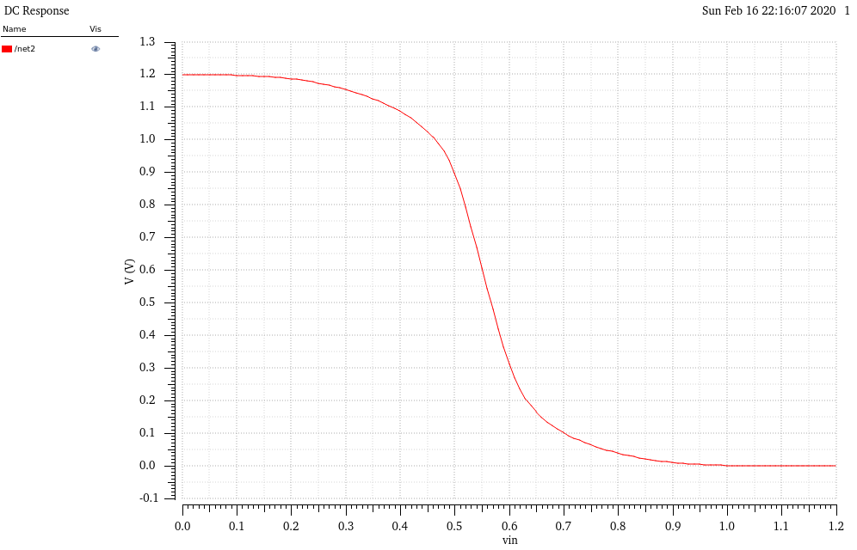
Inverter’s VTC
From Schematic view
From Extracted view
Are your VTC curves different? Why or why not?
I didn’t see much difference between these two VTC figures. The reason I think is because the VTC simulation doesn’t take the wire capacitors or other internal characteristics into consideration, it only simulate the result based on the schematic design.

Slide 4
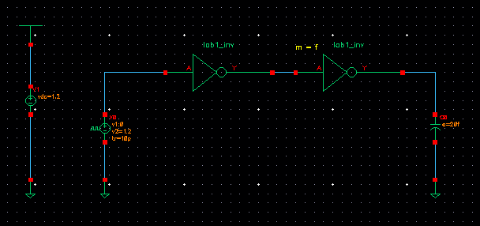
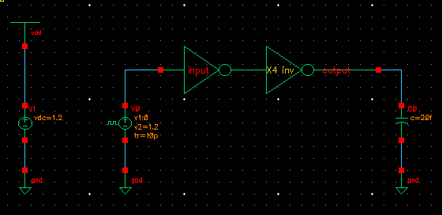
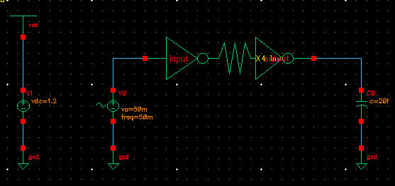
Test Bench Schematic
Test Bench schematic for Lab1 Part3
Test Bench schematic for Lab1 Part4
(side-side inverters)
Test Bench schematic for Lab1 Part4
(separated inverters)

Slide 5
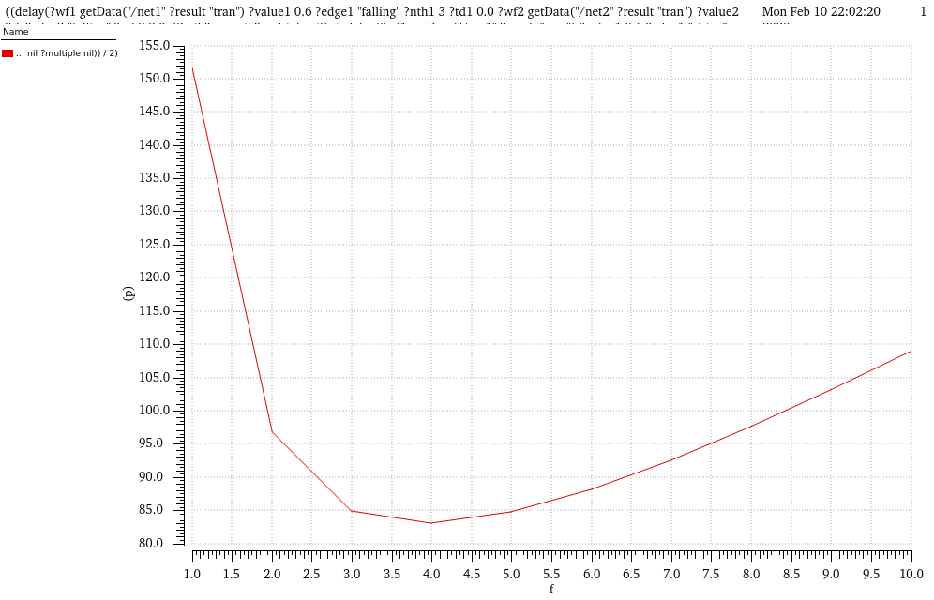
t_{pd} vs. f
Optimal integer f: 4

Slide 6
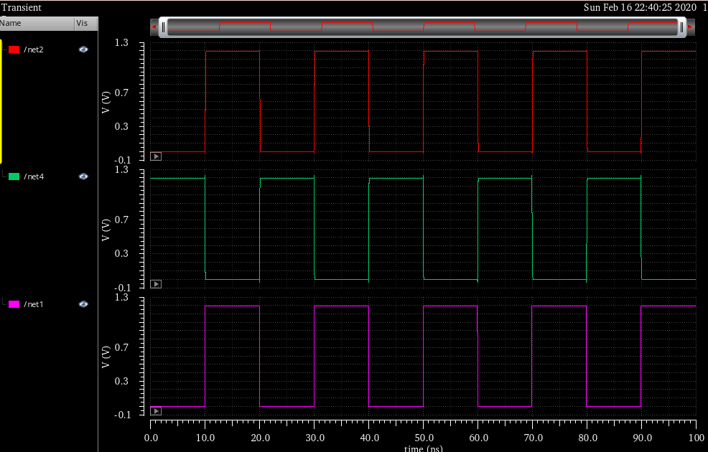
Transient Simulation
net 1 : Vin
net 4: middle node of the inverter chain
net 2: Vout

Slide 7
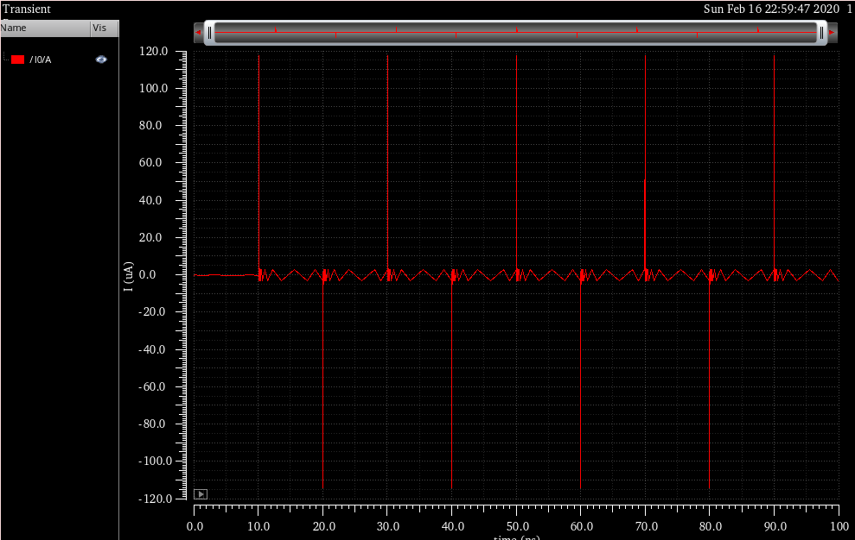
Plot of I_{supply}
Show plot of the current from the VDD voltage source versus time
Use the same time window as in the previous slide
Compute the power consumed by the inverter chain
Power for the inverter chain: P = I_{supply ave} * Vdd = 2uA * 1.2V = 2.4uV

Slide 8
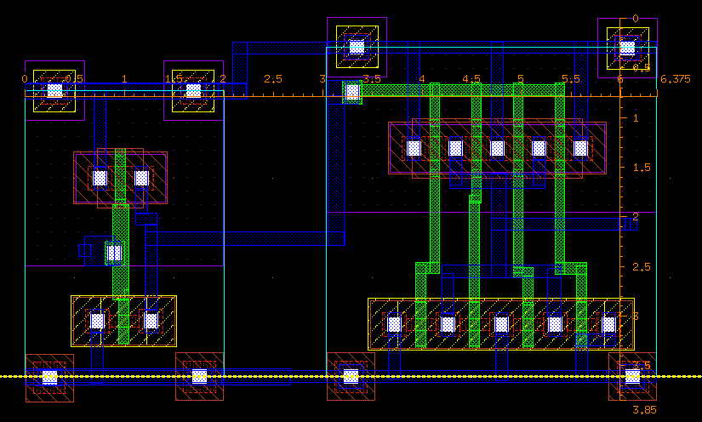
Layout of Inverter Chain
Picture of completed layout for the first task of Lab 1 Part 4, “Layout of Inverter Chain”

Slide 9
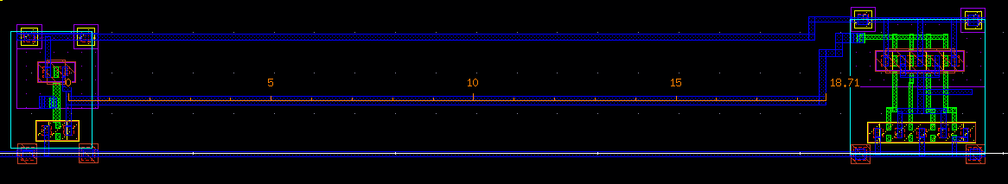
Layout of Modified Inverter Chain
Picture of completed layout for the second task of Lab 1 Part 4, “Effect of wiring”. Include in your picture a ruler that measures the separation between the standard cells.

Slide 10
Result Summary
 | Side-to-side Standard Cells | Separated Standard cells
Separation between standard cells [µm] | 0 | 18.71
t_{pd,HL} [ps] | 70.825 | 131.752
t_{pd,LH} [ps] | 85.791 | 131.741
t_{pd} [ps] | 78.308 | 131.747
Area [µm x µm] | 24.544 | does not apply
Area-delay product [ps·µm²] | 1921.99 | does not apply
Area-delay product = Area x t_{pd}

