Slide 1
Lab 2 Report
yl3377, yx455
Yuxiang Long, Yibang Xiao
Thomas Tapen

Slide 2
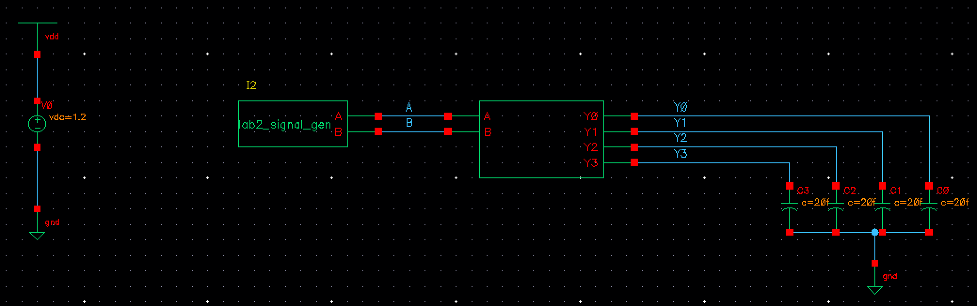
Schematic of Test Bench
Show test bench: Signal sources, symbol for decoder, load capacitors, power supply

Slide 3
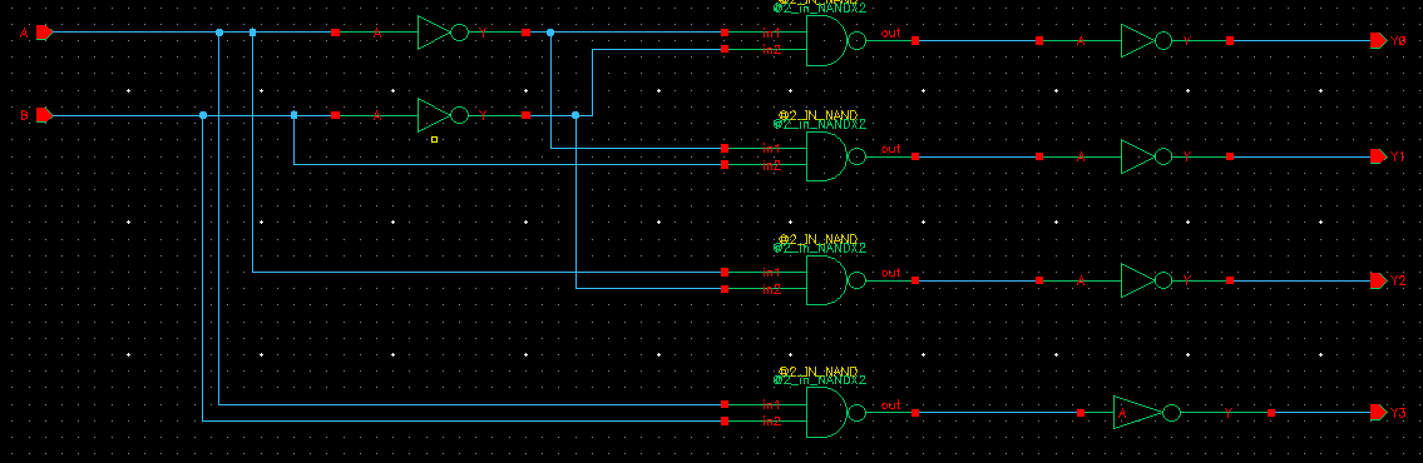
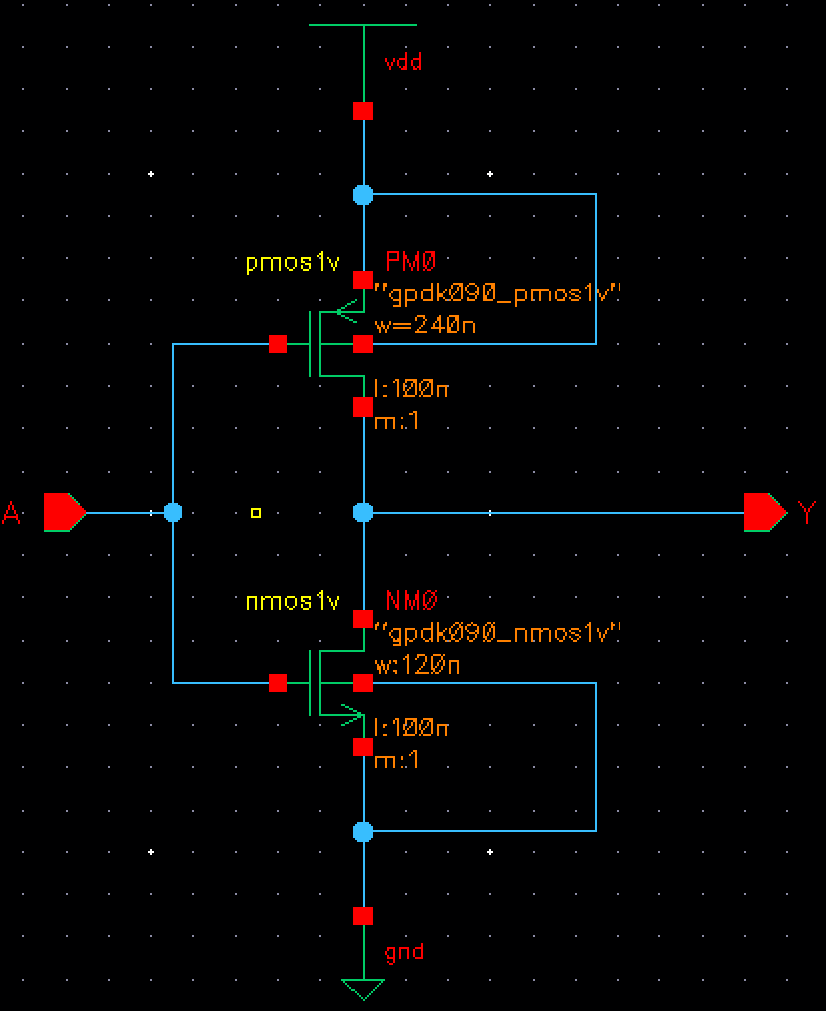
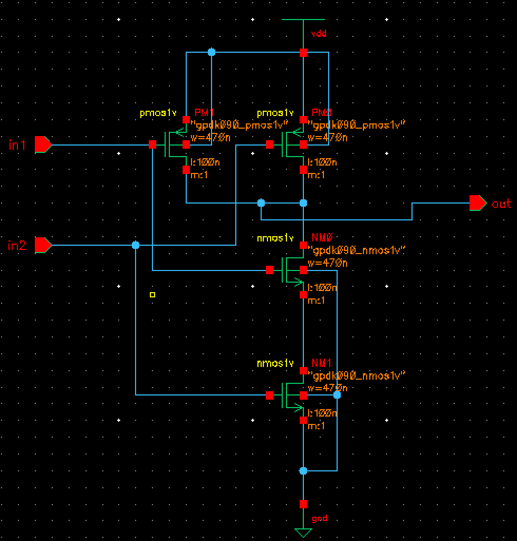
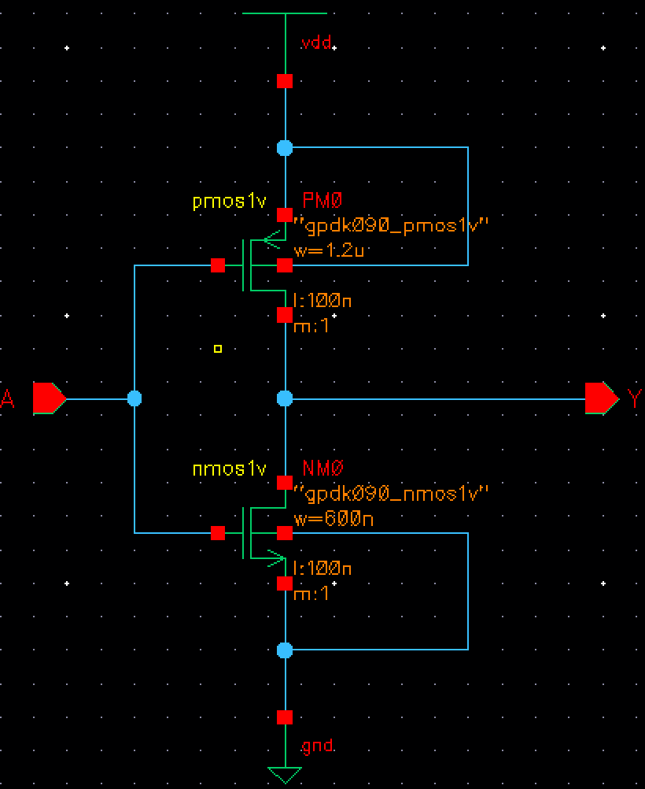
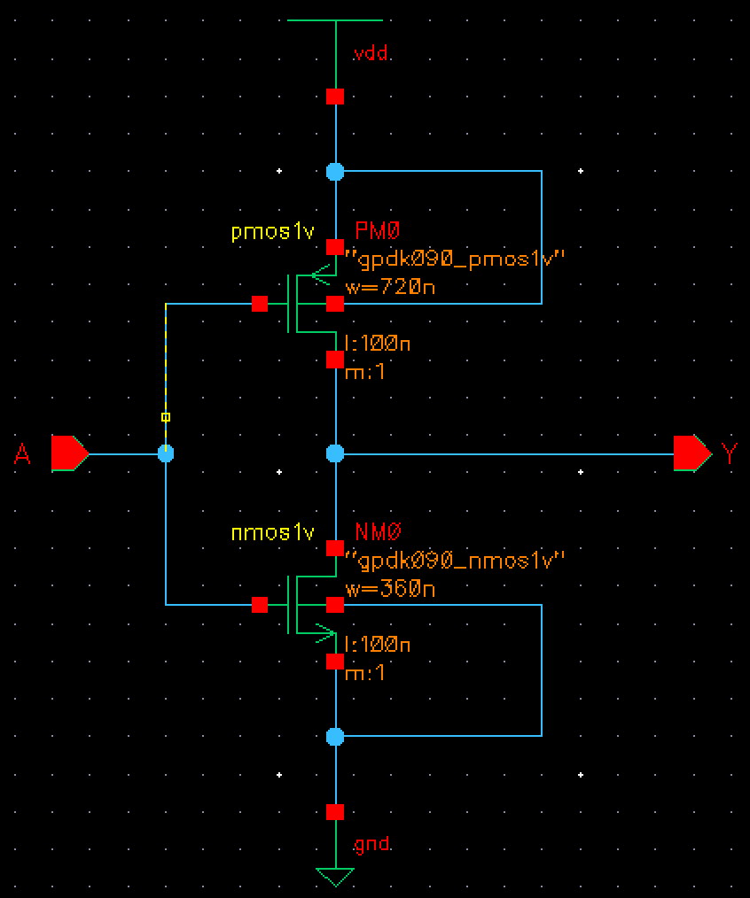
Schematic of the Decoder
Cadence Virtuoso schematic at gate level (i.e., showing the INV and NAND gates only; clearly show the size of each gate)
sizing is 1, Pmos length is 100nm, width 240nm; nmos length is 100nm, width 120nm.
sizing is 2, Pmos length is 100nm, width 470nm; nmos length is 100nm, width 470nm.
sizing is 5, Pmos length is 100nm, width 1200nm; nmos length is 100nm, width 600nm.
sizing is 3, Pmos length is 100nm, width 720nm; nmos length is 100nm, width 360nm.

Slide 4
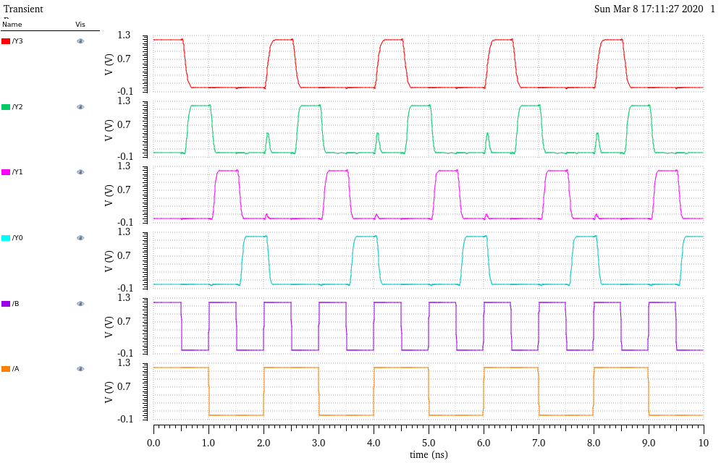
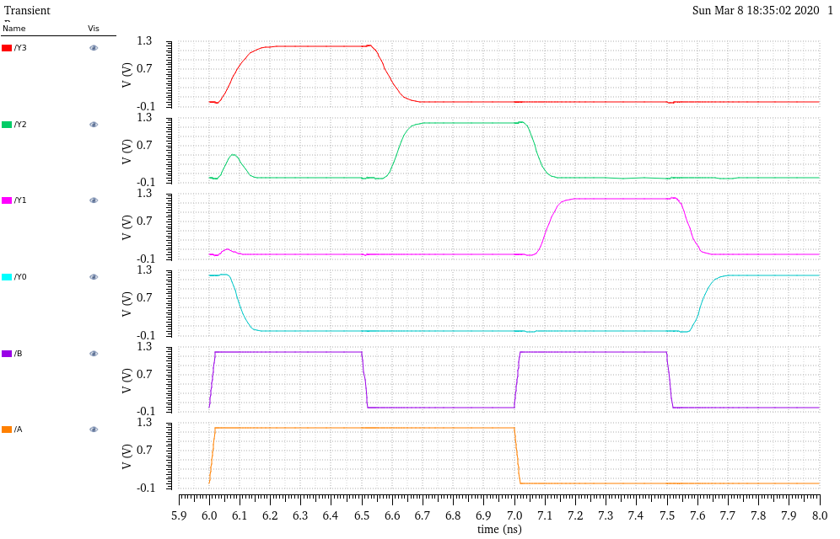
Transient Simulation
Plot voltage traces of Y0 to Y3 vs. time
Show the results in a time window that goes from 6ns to 8ns

Slide 5
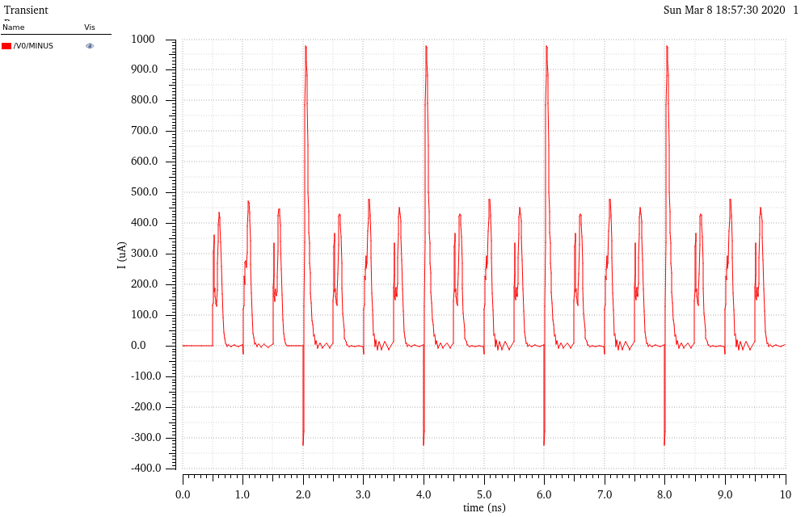
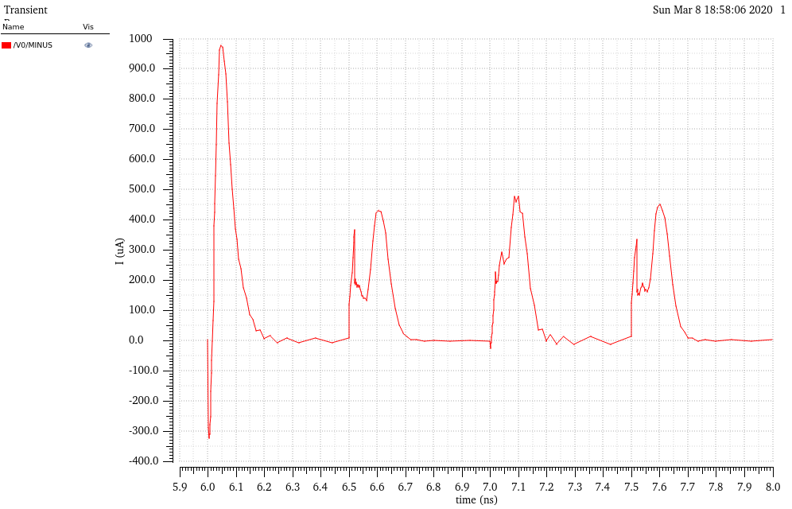
Plot of I_{supply}
Plot current from V_{DD} voltage source vs. time
Use the same time window as previous slide

Slide 6
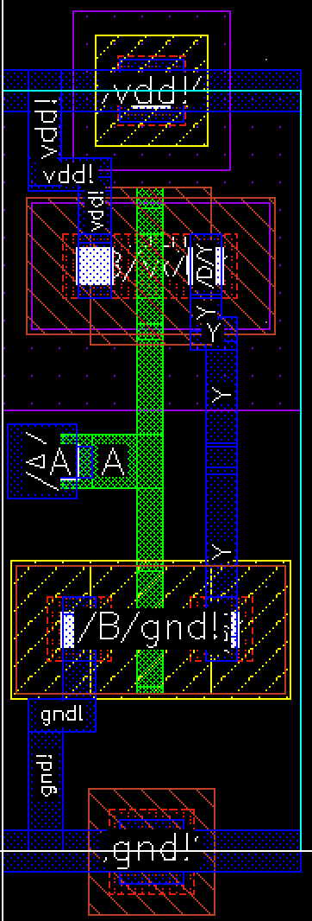
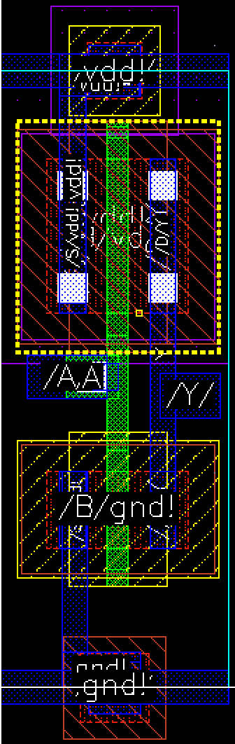
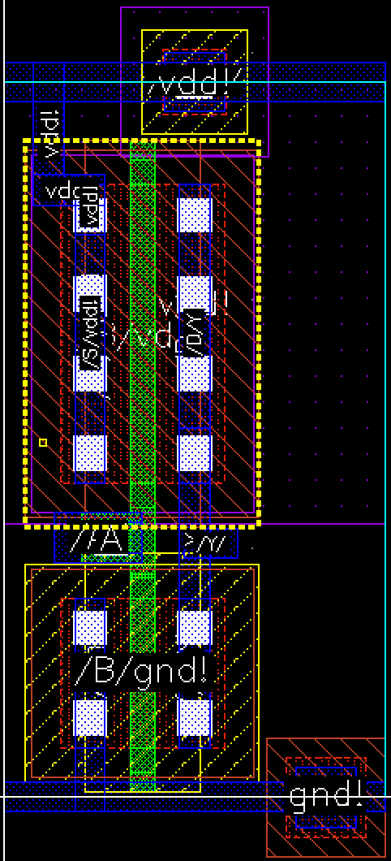
Layout of Inverter
Layout of inverters used (include the different sizes you used, if that was the case)
Sizing is 1
Sizing is 3
Sizing is 5

Slide 7
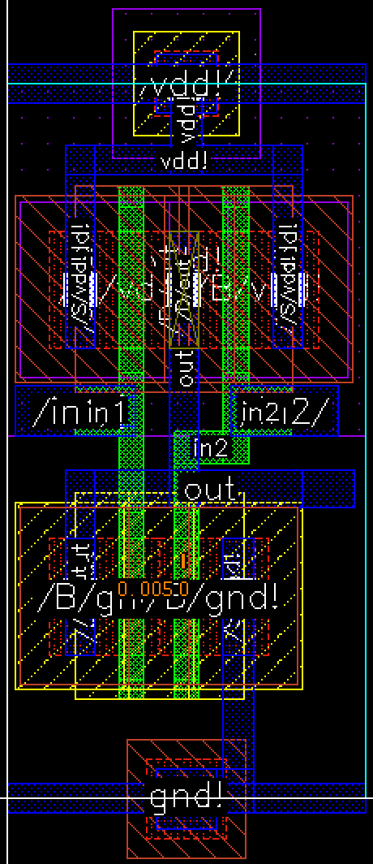
Layout of NAND
Layout of NANDs used (include the different sizes you used, if that was the case)
Sizing is 2

Slide 8
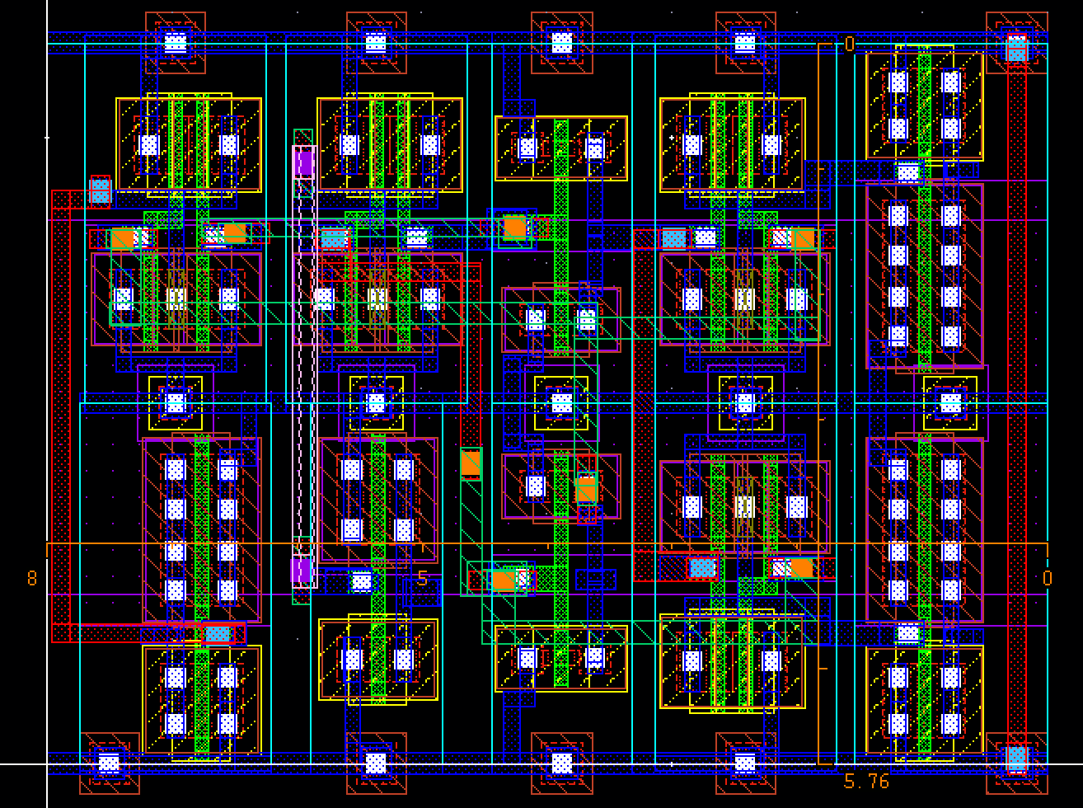
Layout of Entire Decoder
Complete decoder layout with dimensions labeled

Slide 9
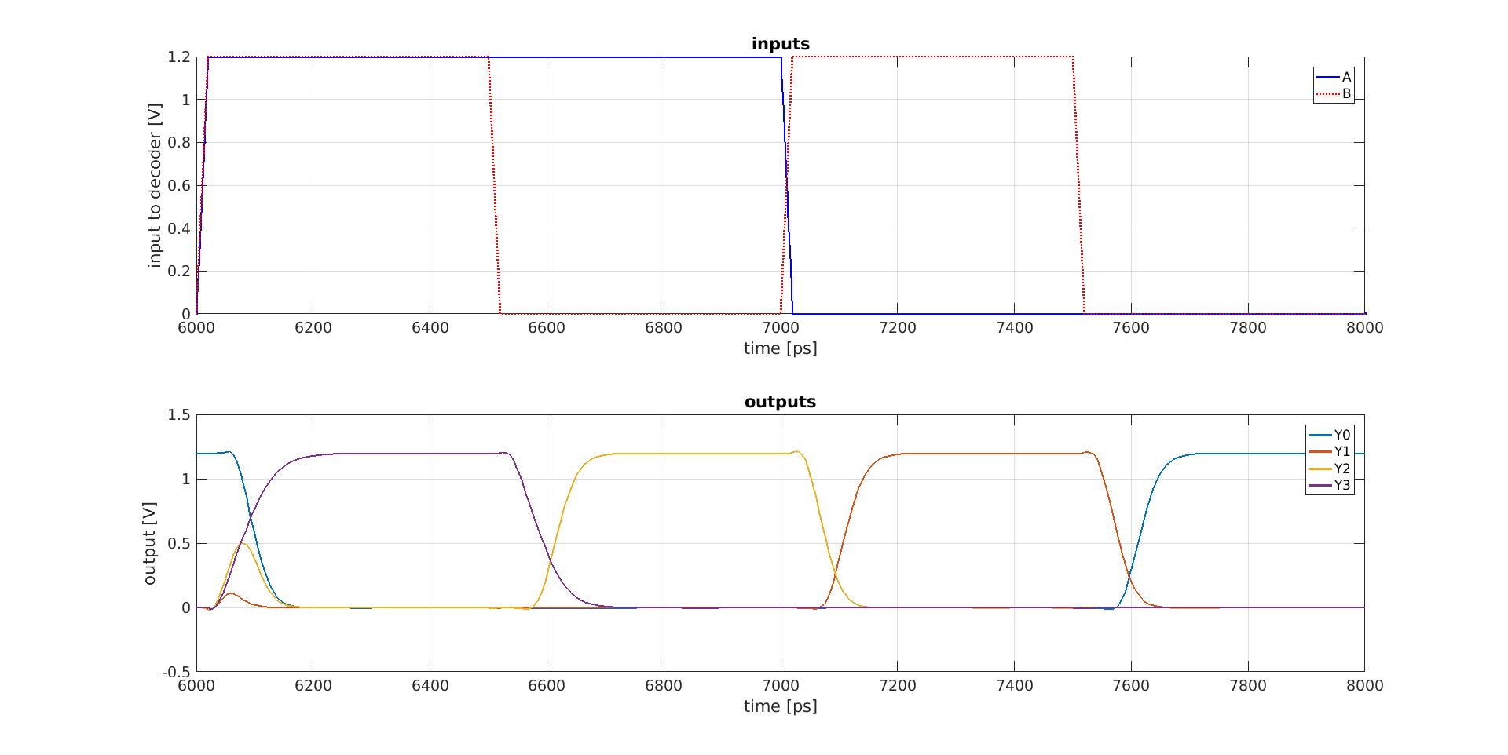
Plot of Verification: Input/Output
Put the input/output plot from MATLAB here

Slide 10
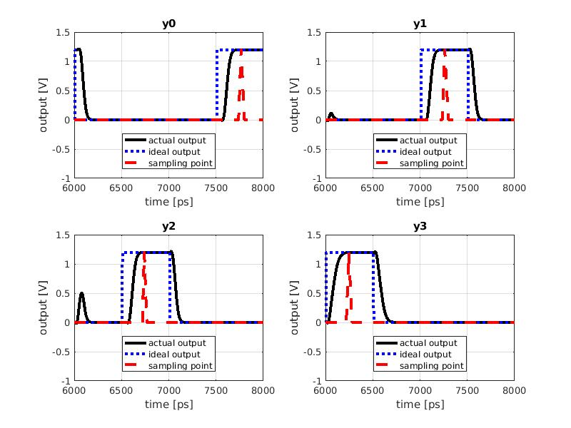
Plot of Verification: Decoder Outputs
Put the actual/expected plot from each decoder output here:
Do you see glitches in your output signals? If yes, why is this happening?
Answer: Yes, there are glitches in my output signals, the reason is that during the process of the input voltage of the NAND transfer from 1 to 0, there will be a time when both the pull up network and the pull down network are closed, this will cause the output of the NAND to drop, then this drop will go through the inverter and the final output will be pull high and become a glitch.

Slide 11
Results Table
Signal | Y0 | Y1 | Y2 | Y3
t_{pHL} (ps) | 89.54 | 67.92 | 68.49 | 83.22
t_{pLH} (ps) | 103.19 | 101.34 | 104.41 | 78.65
Peak Current (µA) | 972.46
Time of Peak Current (ns) | 2ns,4ns,6ns,8ns
Area (µm²) | 46.11 (8.005 * 5.76)
Worst-Case Delay (ps) | 104.41 ( t_{pLH} of Y2)
Energy (fJ) | 1.2 V * 93.9 uA * 10ns = 1126.8
Fill right side according to units on the left. No need to write the units again on the right side.

