Slide 1
Lab 4 Report
Yixiao Du(yd383), Yifan Yang(yy887), Yuxiang Long(yl3377), Yibang Xiao(yx455)

Slide 2
Topology Description
State your adder topology and explain its basic theory of operation
Our adder used the carry skip adder architecture. We divided 16 input bits into four carry groups, four bits in one group. In each group, there are four mirror full adders to calculate the Co,i and Si and four XOR gates to calculate the P0, P1, P2, P3 (Pi = Ai XOR Bi, i = 0, 1, 2, 3). If P0, P1, P2, P3 are all 1, then the Cin of this carry group will be propagated to the Cout of this carry group. Otherwise, the Cout of this carry group will be C0, 3. So, there is a MUX to select from Co, 3 and Cin, controlled by BP signal ( BP = P0P1P2P3), which is implemented using a 4-input NAND. The output of this MUX is the Cin of the next carry group. This architecture basically adds a bypass path to the ripple carry adder and pre-calculates the propagation signal and skips the carry chain if the carry in can be directly propagated from Cin to Cout.

Slide 3
Why this adder?
Explain your design decision. Why this particular adder?
First of all, we decided not to use the parallel prefix/tree adder architecture because our adder only takes 16-bit inputs but the topology is too complicated and is apparently more suitable and worthful for data with more bits. Compared to the tree adders, carry skip/select adders have not so good delay (but still much better than the RCA) but save a lot of area. Then we selected from carry skip adder and carry select adder. Carry select adder is actually a type of carry look ahead adder and it needs to pre-calculate carry propagation as well as carry generation. The improvement of delay(compared to RCA) of carry skip adder is pretty close to carry select adder(about half of the delay of RCA) but the carry select adder increases the design complexity due to the calculation of carry generation(and it can be more complicated if we use a square root carry select adder and not divide the input bits evenly into four groups). Besides, carry skip adder has better regularity than the carry select adder and we can reuse the carry group for four times which saves a lot of work for us.
To conclude, carry skip adder is the most cost-effective architecture for a 16-bit input adder implementation.
Notes:
good regularity
not so good delay but less area. delay can be reduced to half of the RCA

Slide 4
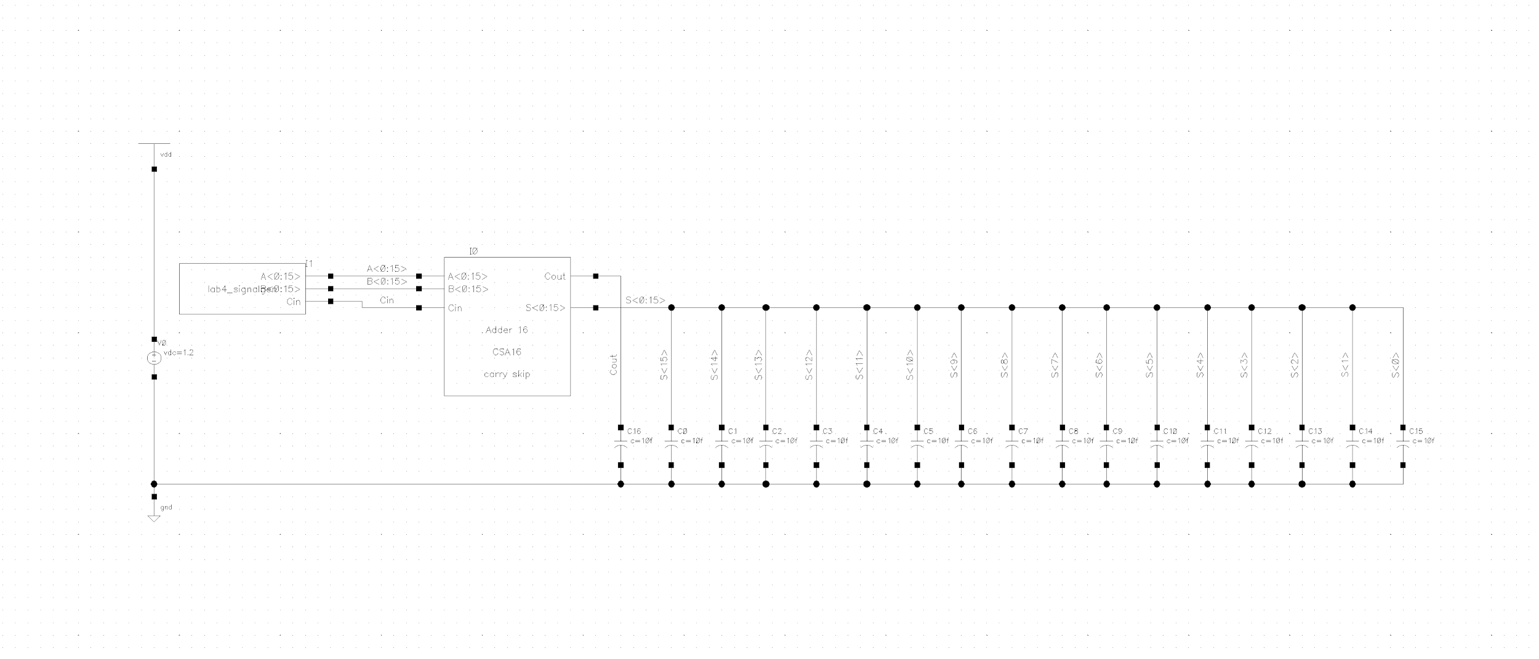
Schematic of Test Bench
Show test bench: signal sources, symbol for adder, load capacitors, everything…

Slide 5
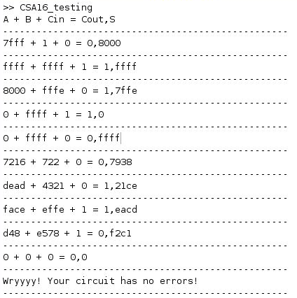
Proof of functionality
Show examples that the adder actually adds numbers correctly;
We used MATLAB to verify the functionality of our adder. The program was adopted from the provided one in lab2 and the output is shown aside. The MATLAB code (CSA16_testing.m) will be submitted together with our design files.

Slide 6
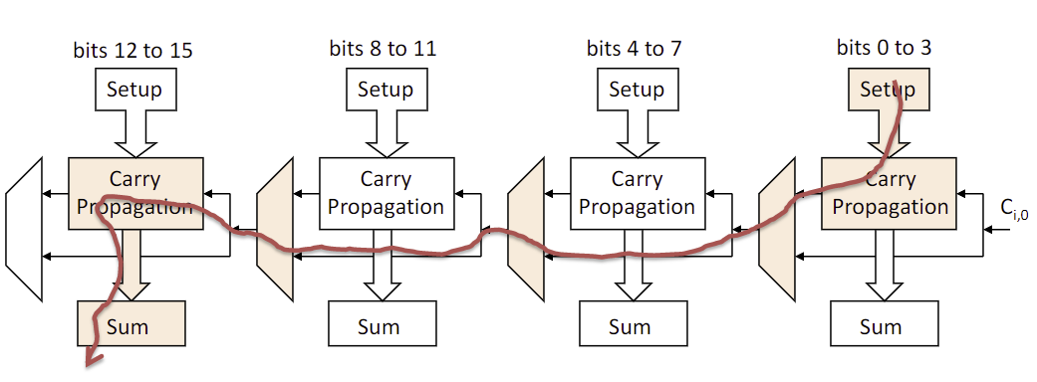
Description of Worst-Case Delay
Show and explain your worst-case delay; explain how you found that signal.
Explanations are on the next page

Slide 7
Description of Worst-Case Delay
The worst-case is we need to generate (or kill) carry from the least significant bits of the inputs (A0 and B0), propagate it to the most significant bit of the sum (S15). Generate carry for t_{pd,LH}, kill carry for t_{pd,HL}.
We chose 0x7FFF + 0x0001 + 0 for worst-case low-to-high delay, 0x8000 + 0xFFFE + 0 for worst-case high-to-low delay.

Slide 8
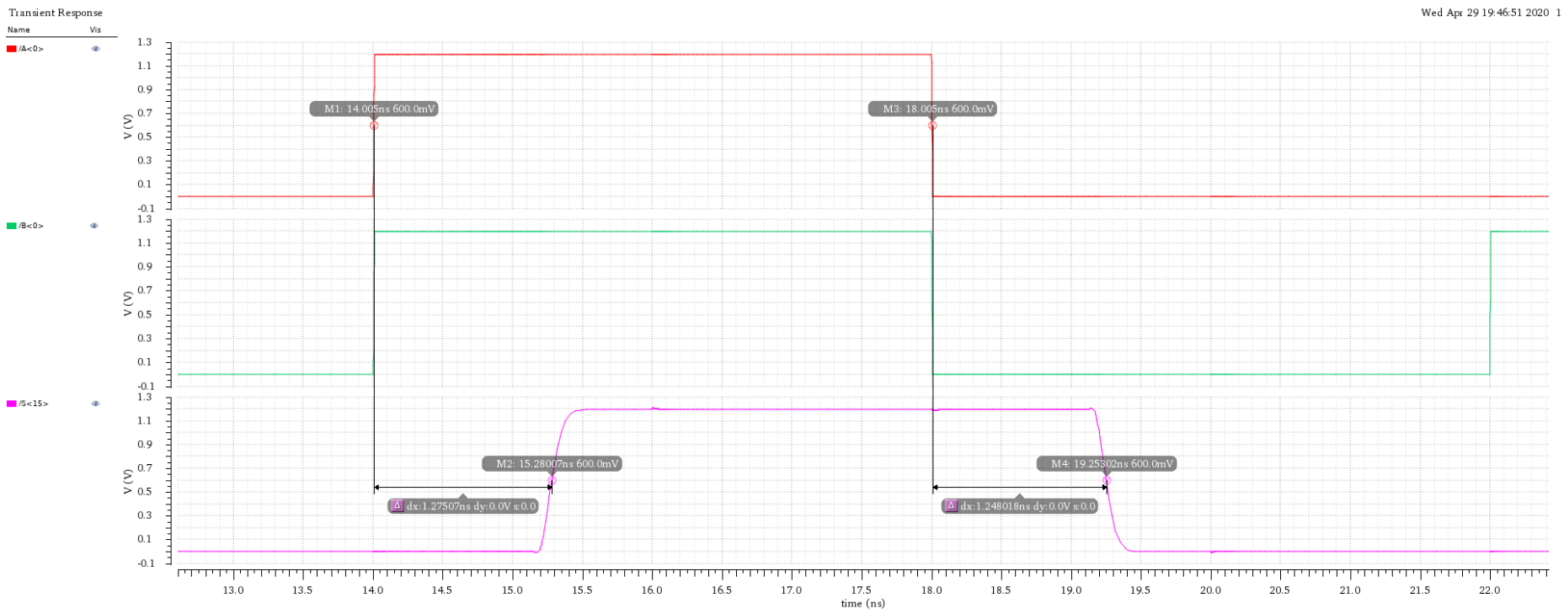
Transient Simulation
Show simulation input & output for worst-case

Slide 9
Plot of I_{supply}
Show plot of the current from the VDD voltage source versus time
Use the same time window as on the previous slide
Label the peak current & calculate the energy; then compute the power for this time window

Slide 10
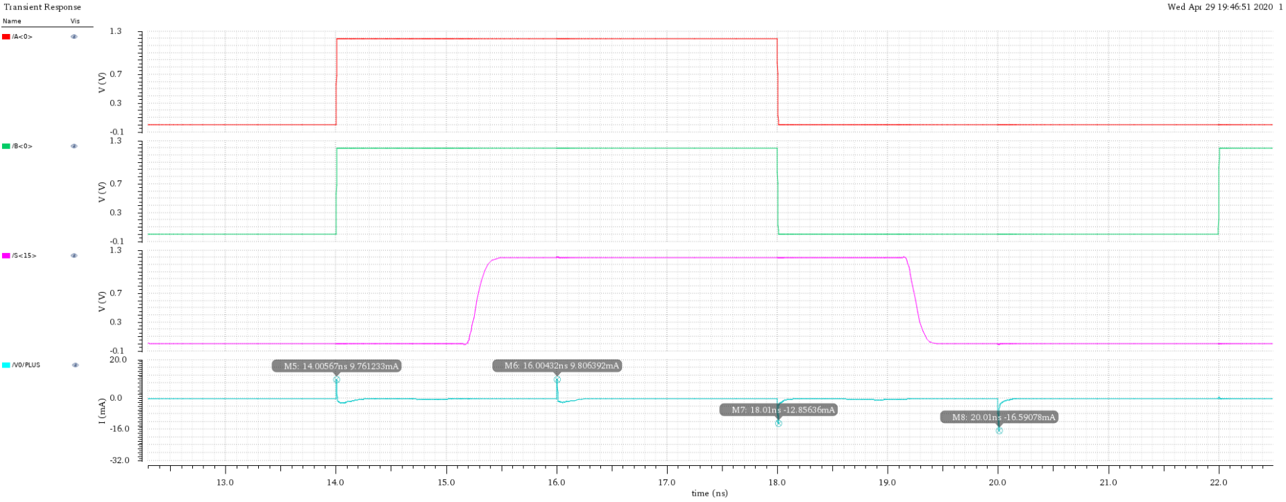
Plot of I_{supply}
Average power according to the average current:
179.11 uA * 1.2V = 214.93 uW

Slide 11
Layout of Adder
Picture of completed layout with area dimensions labeled
Optional (separate slide): Photo of person(s) who completed the infamous 24 hour layout challenge (after challenge, of course)
Note: The 24 hour layout challenge is not recommended for your health/grade

Slide 12
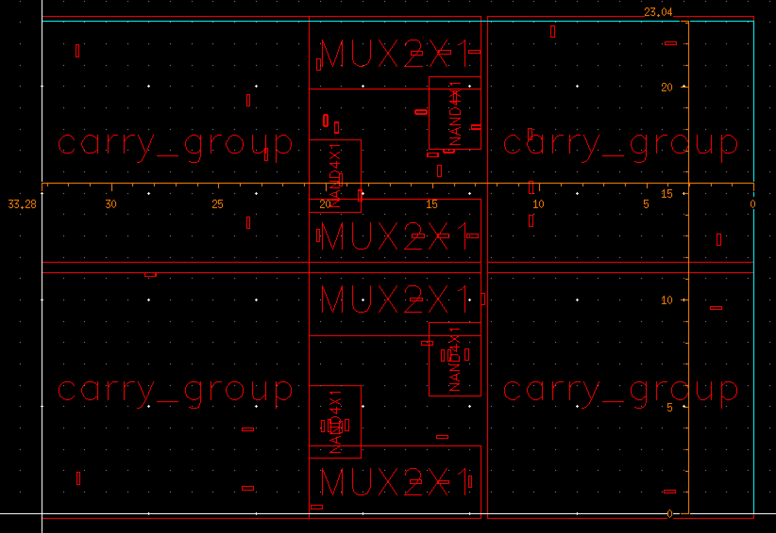
Layout of the 16-bit adder: Placement view

Slide 13
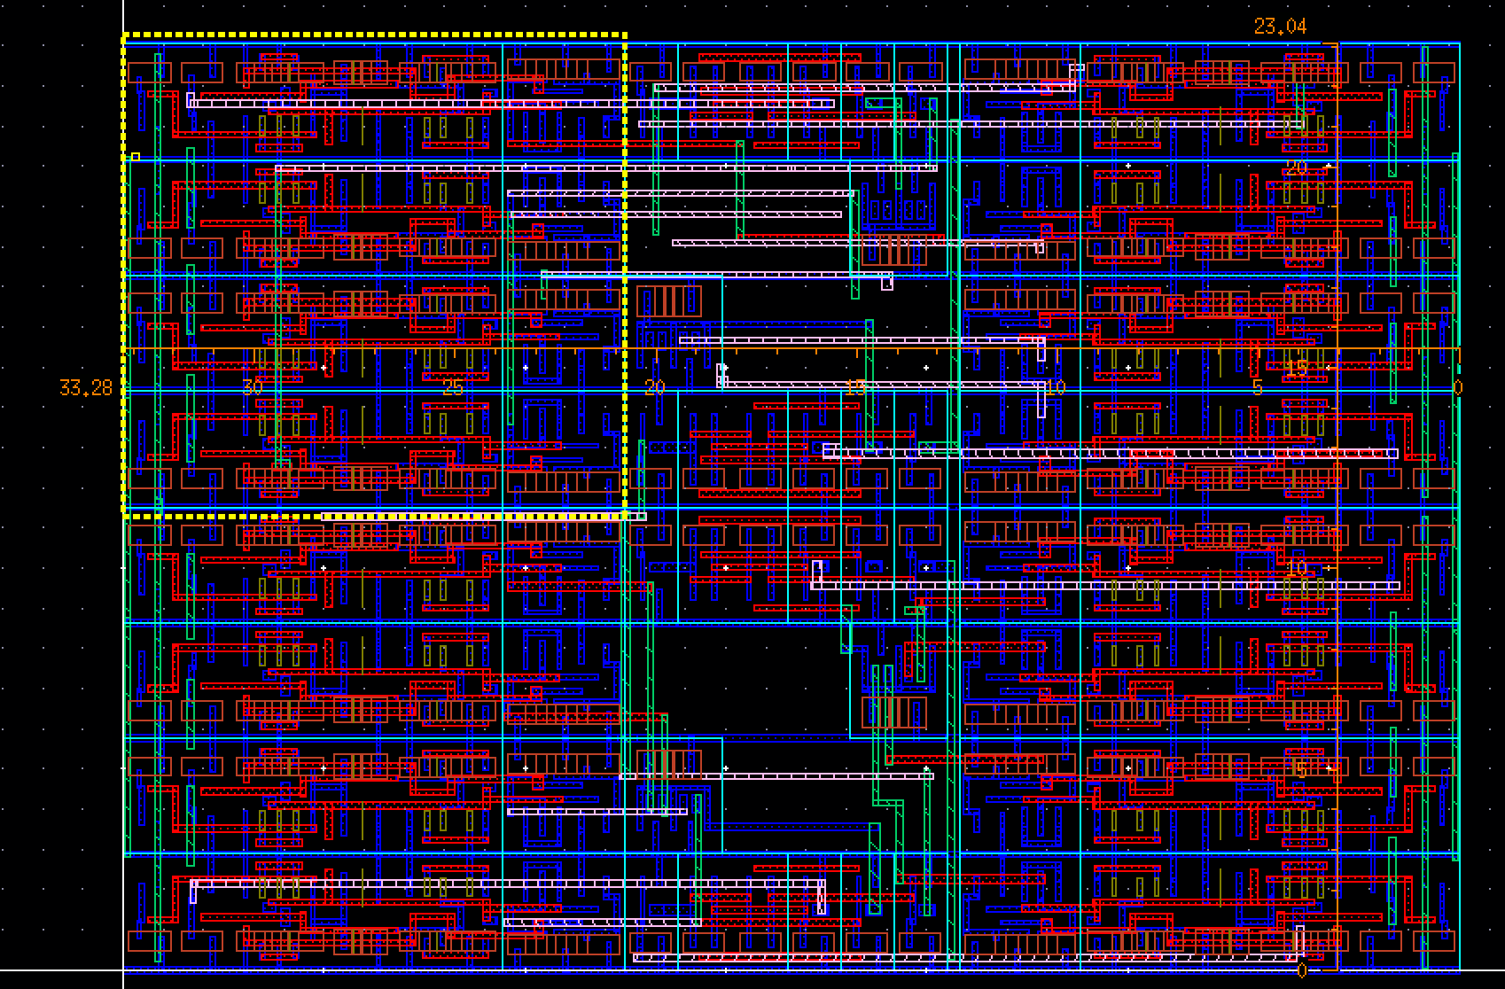
Layout of the 16-bit adder: Routing view

Slide 14
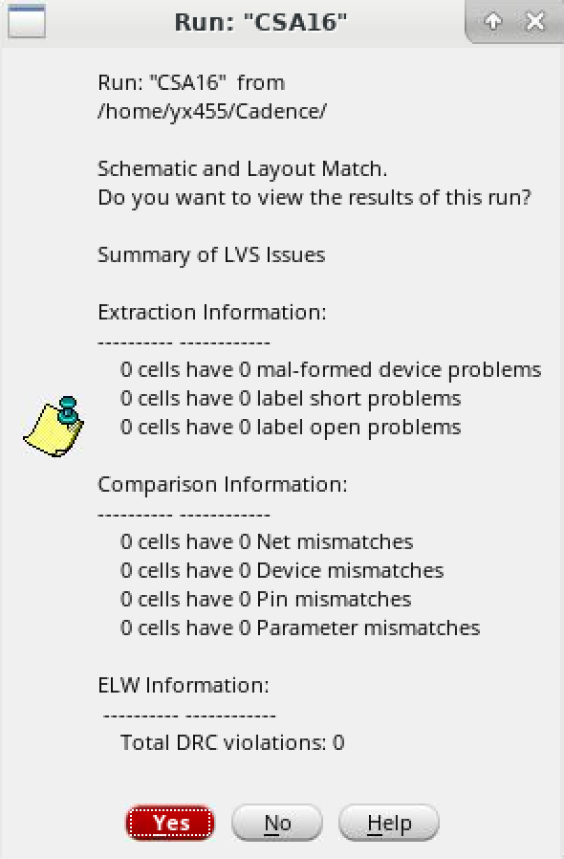
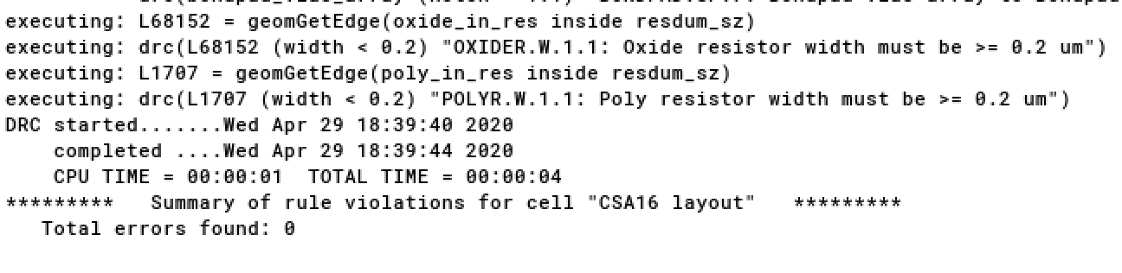
LVS Report
Screenshot of successful DRC/LVS
Clean DRC of final layout: CSA16
Successful LVS

Slide 15
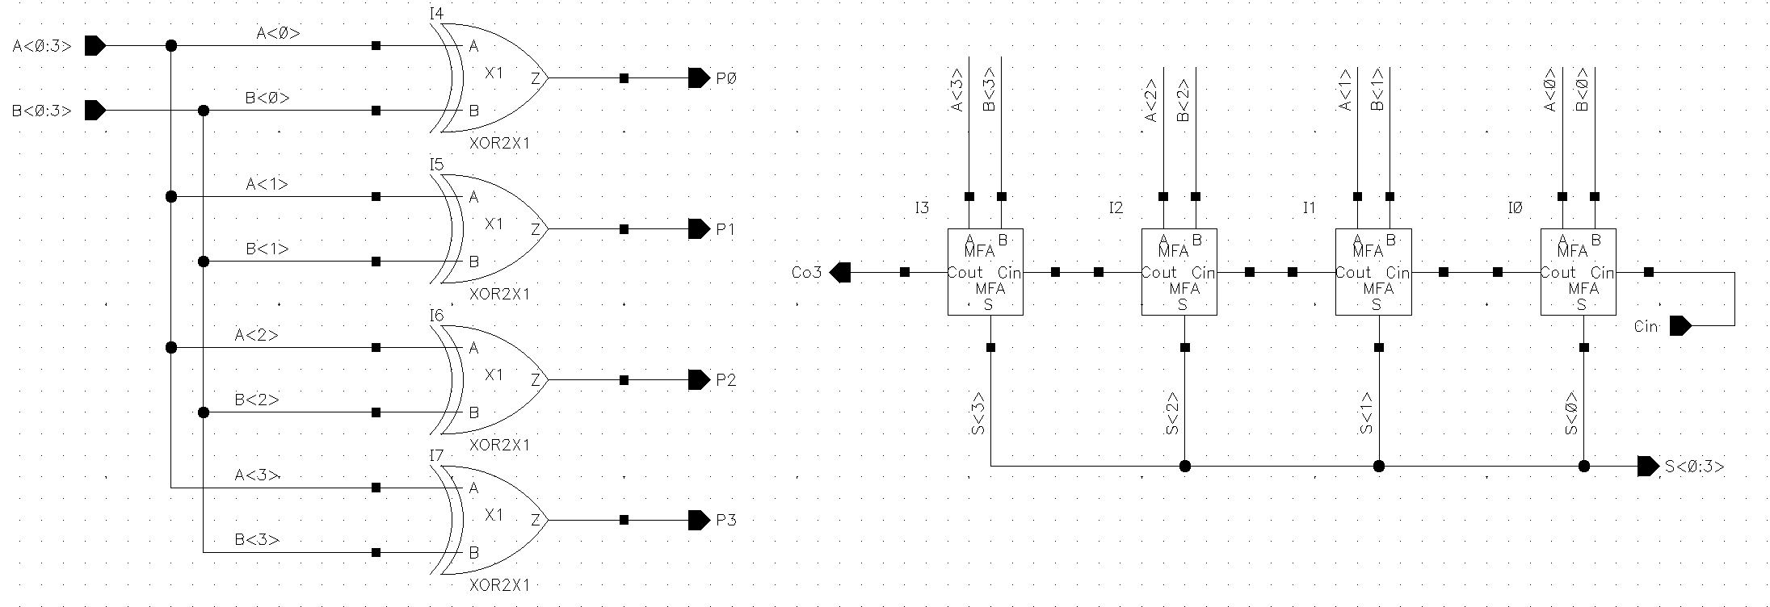
Schematic & Layout of Carry Group Block
Schematic of the Carry group block

Slide 16
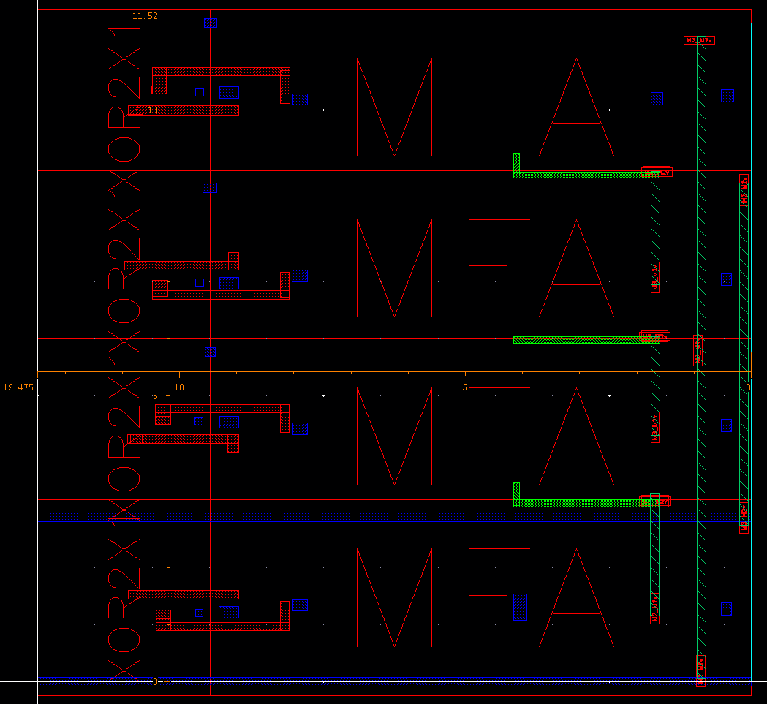
Schematic & Layout of Carry Group Block
Layout of the Carry group block: Placement view

Slide 17
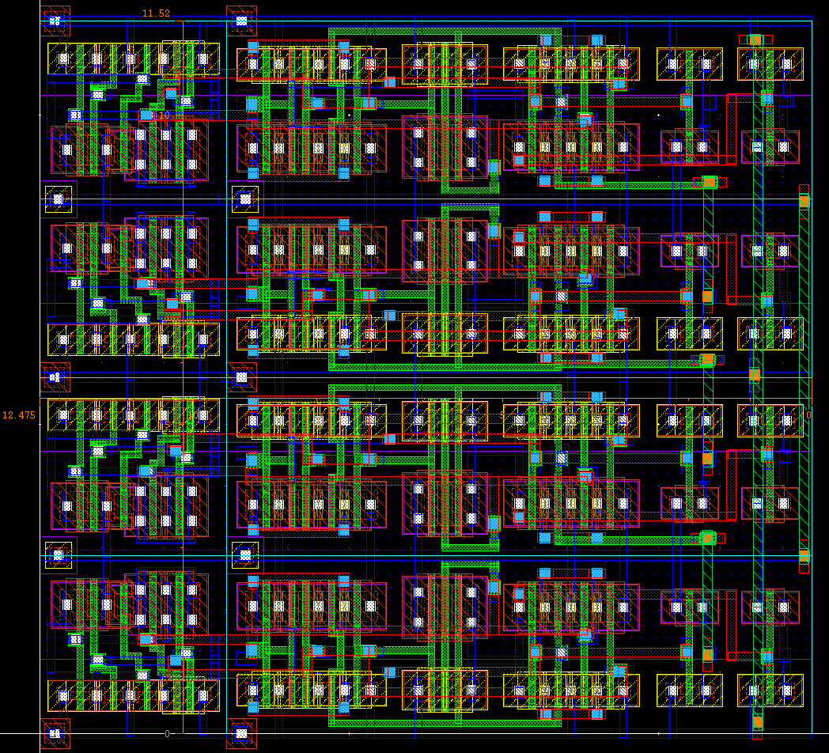
Schematic & Layout of Carry Group Block
Layout of the Carry group block: Routing view

Slide 18
Schematic & Layout of Carry Group Block
If applicable
Describe sizing & placement strategy
Feel free to divide this into two slides
Sizing strategy:
We sized each of the Mirror Full adder to X1, because we think it can help us save a lot of area, and there is not so much need to increase the drive ability, because the fan-out is always one here.
Placement strategy:
We place the output pin as close as possible to the input pin of next module. For example, we place the four MFAs at one row, so that the Cout of one MFA could be close to the Cin of the next MFA, which is good for the delay. In addition, we place the four XORs at one column on the left, so that the inputs and outputs of the MFAs could be properly arranged and could make it easier to route and save the length of wires.

Slide 19
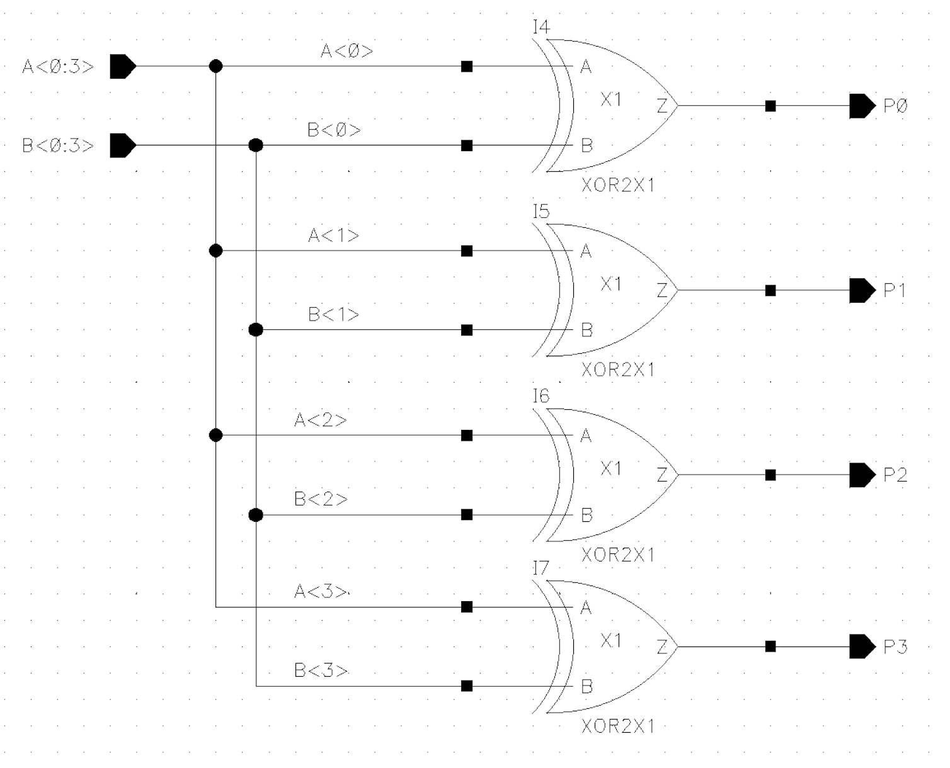
Schematic of Propagate Circuitry

Slide 20
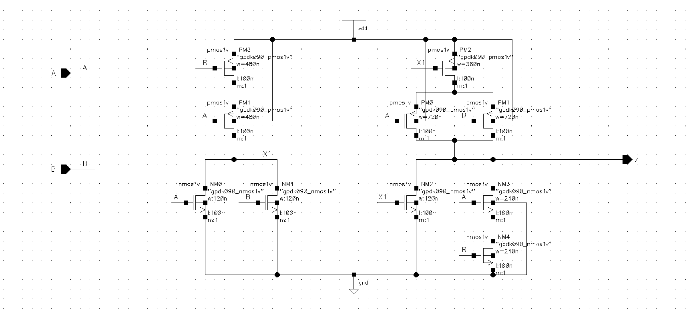
Schematic of Propagate Circuitry
XOR gate. The sizes of PM0, PM1 and PM2 are optimized for X1 will arrive later than A and B.

Slide 21
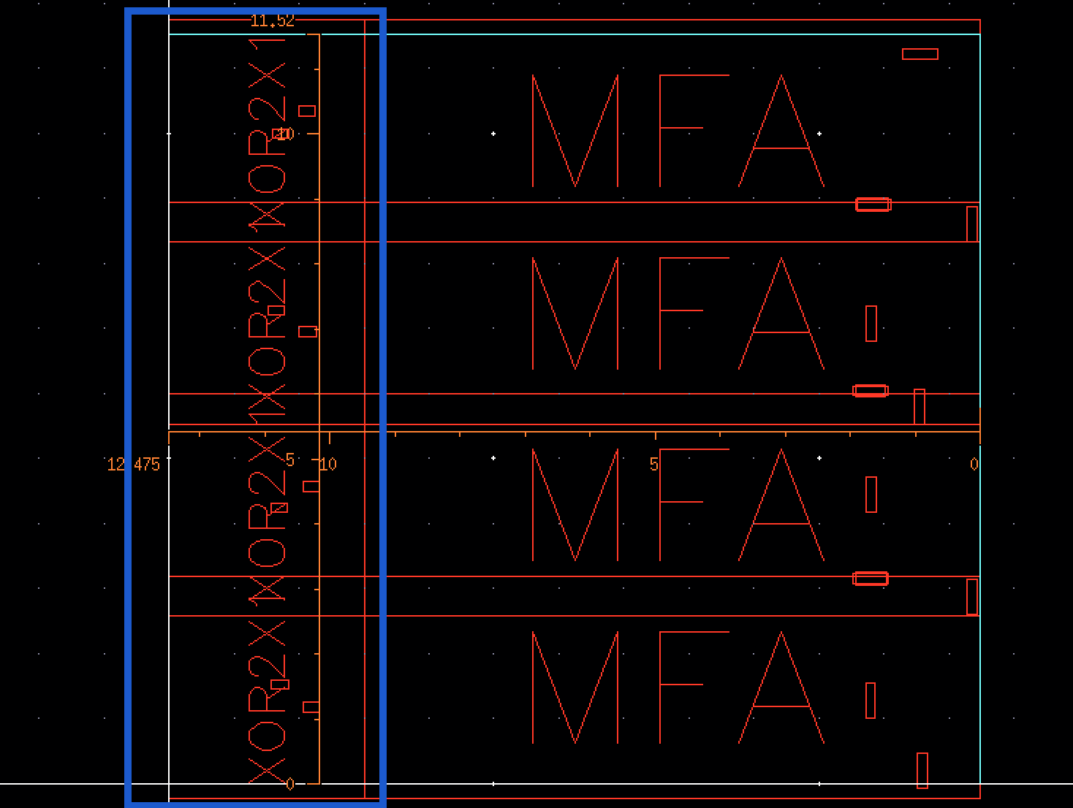
Layout of Propagate: Placement view
(Propagate part is in the blue box)

Slide 22
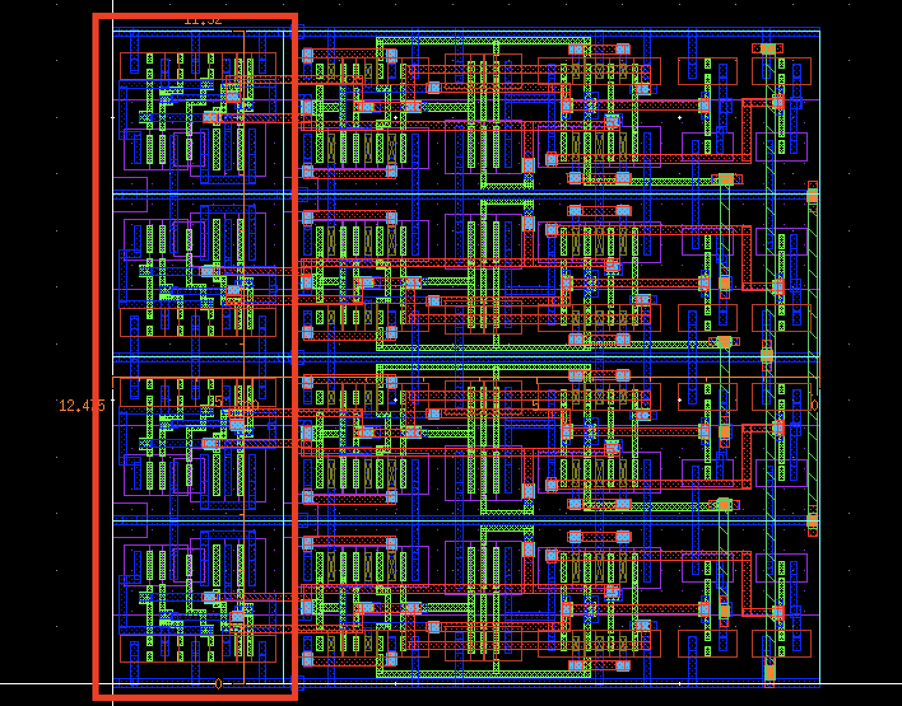
Layout of Propagate: Routing view
(Propagate part is in the red box)

Slide 23
Schematic & Layout of Propagate Circuitry
If applicable:
Describe sizing & placement strategy
Sizing Strategy: Each propagate signal is generated by a 2-input XOR gate which is sized X1. Because we do not have branches from the input of A and B to the mux selection signal and it is not on the critical path in the design, we do not need a gate with a strong driving ability. Therefore, we choose X1 as our XOR gate design and it can also save the area of our final design. The XOR gate is composed with an NOR and an AOI gate. The sizing of the transistors of the AOI gate has been optimized towards the difference time of arrival of its inputs.
Placement strategy: We place the four XOR gates aside the MFA. The reason is that MFA and the four XOR gates shares the input of A and B. The XOR gates have A and B inputs on the right side and MFAs have A and B inputs on the left side. We can use minimum length of the metals to connect them. Another benefit of this placement is that we can ensure the output of the XOR gates, which are the P0, P1, P2, … can lie on the far left-side of the layout shown above. It is easier to connect them with the carray select part which needs these four propagate signals.

Slide 24
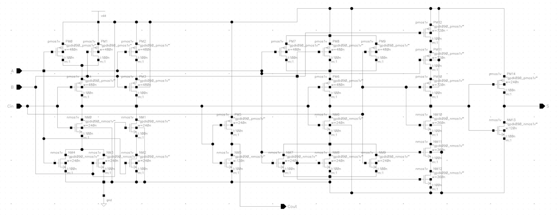
Schematic & Layout of Generate Circuitry
Schematic of the Mirror Full Adder, and the generate circuity for one MFA, which is used to generate Carry out is framed in the yellow window

Slide 25
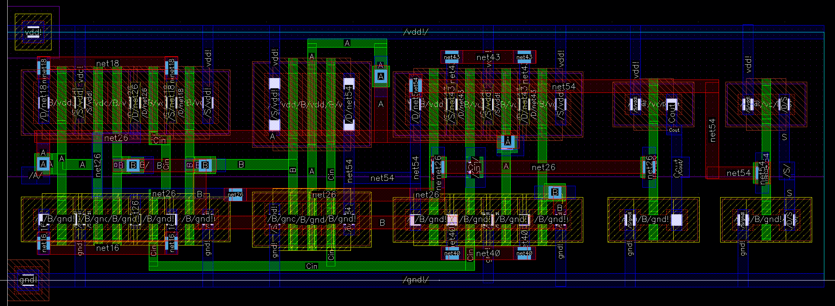
Schematic & Layout of Generate Circuitry
Layout of the Mirror Full Adder, and the generate circuity for one MFA, which is used to generate Carry out is framed in yellow window

Slide 26
Schematic & Layout of Generate Circuitry
If applicable
Describe sizing & placement strategy
Sizing strategy:
We sized Mirror Full Adder according to the principle of the static CMOS, which follows the rule that the ratio of the PUN and PDN is 2:1, so that the rising delay and falling delay could be equal, which is good for our design. And the detailed sizing information is displayed on the schematic of the Generate circuity.
Placement strategy:
The Mirror Full Adder takes the main area of the whole 16-bits adder, so it is very important to take effort on saving the area of the MFA. In order to do this, we place the devices according to the stick diagram, and make full use of sharing diffusion method to place the transistors.

Slide 27
Schematic & Layout of Sum Circuitry
Schematic of the Mirror Full Adder, and the Sum circuity for one MFA, which is used to generate “S[i]” is framed in the yellow window

Slide 28
Schematic & Layout of Sum Circuitry
Layout of the Mirror Full Adder, and the Sum circuity for one MFA, which is used to generate “S[i]” is framed in yellow window

Slide 29
Schematic & Layout of Sum Circuitry
If applicable
Describe sizing & placement strategy
Sizing Strategy:
We sized Mirror Full Adder according to the principle of the static CMOS, which follows the rule that the ratio of the PUN and PDN is 2:1, so that the rising delay and falling delay could be equal, which is good for our design. And the detailed sizing information is displayed on the schematic of the Generate circuity.
Placement strategy:
The Mirror Full Adder takes the main area of the whole 16-bits adder, so it is very important to take effort on saving the area of the MFA. In order to do this, we place the devices according to the stick diagram, and make full use of sharing diffusion method to place the transistors.

Slide 30
Results Table
Group number | 4:15 pm
Total Area (µm x µm ) | 766.77 um^2
Max. Clock Frequency (MHz) | 784MHz
Worst-Case Input Patterns | 0x7FFF + 0x0001 + 0 for tpLH 0x8000 + 0xFFFE + 0 for tpHL
Worst-Case Delay (ps) | tpHL: 1.248ns tpLH: 1.275ns
Best-Case Input Patterns | 0x0000 + 0x0001 + 0 for tpLH 0x0000 + 0x0000 + 0 for tpHL
Best-Case Delay (ps) | tpHL:106.93 ps tpLH: 127.57 ps
Layout fun level (Mfls*) | 1
*Mfls = mega fun levels
Notes:
Mfls = mega fun levels

Slide 31
Team Contributions
Team member | netID | Contributions
Yibang Xiao | yx455 | Design the layout of MUX, Carray Group, and final 16-bit Carry Select Adder
Yuxiang Long | yl3377 | Design the layout of Mirror Full Adder, and the final 16-bit Carry Select Adder
Yixiao Du | yd383 | Design the layout of the XOR gate. Design the verilog-A signal generation unit, all testbenches, and MATLAB code for verification.
Yifan Yang | yy887 | Design the layout of the NAND gate. Compare across different designs and decided the architecture of the adder.

Slide 32
Appendix
Description of:
Verilog-A Code
Potential scripts to generate test signals and for verification
Do not forget to include all these files in your submission!

Slide 33
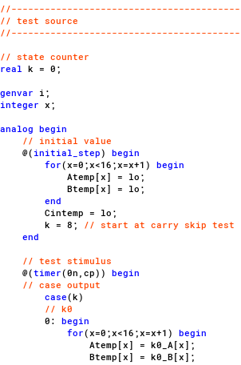
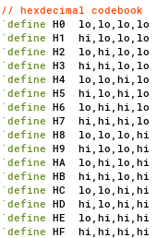
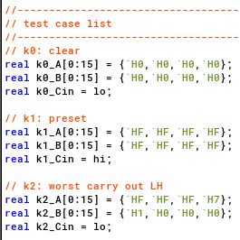
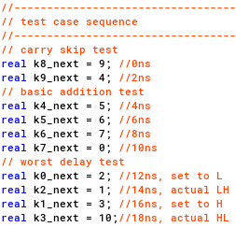
Appendix
Verilog-A
The verilog-A module is divided into 4 parts: macro definition, test case definition, test sequence definition and test source.
The macro definition includes short names that are used to assign value to the output, clock period is also defined in this part.
The test cases are defined in the test case definition part. Each case has its own output values. These cases are connected in the test sequence definition section to form a flow of test vectors. The test vectors will be
assigned to the output by the test source every clock cycle.

Slide 34
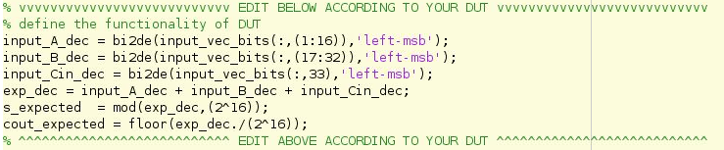
Appendix
MATLAB
The MATLAB code is adopted from the provided one in lab2. Now it could be applied to any combinational circuit with any number of input and outputs. The code enclosed by “EDIT BELOW/ABOVE ACCORDING TO YOUR DUT” need to be modified according to your design under test (DUT).
The program does similar things as in lab2: sample the inputs and the outputs, calculate the expected output according to sampled inputs and check the actual outputs with the expected outputs.

