Slide 1
Lecture Roadmap
Will present image processing operations in turn then case studies:
Histograms
Point operations
Algebraic operations
Geometric operations
Convolution & spatial filtering
Fourier analysis & frequency filtering
Segmentation overview
Case studies (graduate students)

Slide 2
The Fourier Transform
OBJECTIVES
1. Motivation
2. 2D Discrete Fourier Transform (DFT) and examples
3. Properties of the DFT

Slide 3
1. Motivation
1. Often interested in the “frequency content” of signals (including images)
E.g., noise may have different frequency content than signal of interest.
2. Makes analysis and design of filters more intuitive than when using convolution since we are often interested in manipulating the frequency content of a signal. We can manipulate Fourier transform (represents frequency content) of a signal and then take inverse transform.

Slide 4
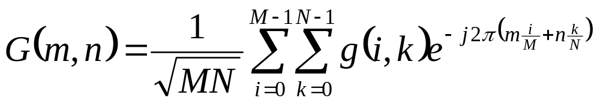
2. 2D DFT
DFT of image g(i, k) is denoted G(m, n) and can be computed using the formula:
NOTES:
Used k instead of j to denote column position because we are using j² = -1
m, n are frequency variables and i, k are spatial variables
Book assumes image is square (i.e., N x N)
Other books use a slightly different formula (scale differently).

Slide 5
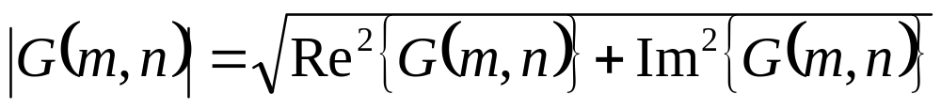
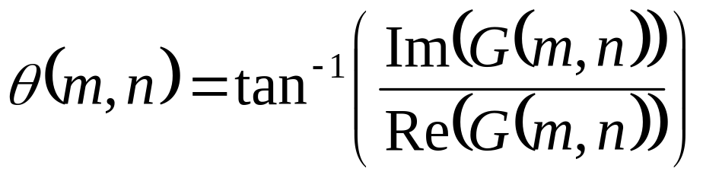
2. 2D DFT cont’d
Generally, G(m, n) is complex and we look at its magnitude and phase separately:

Slide 6
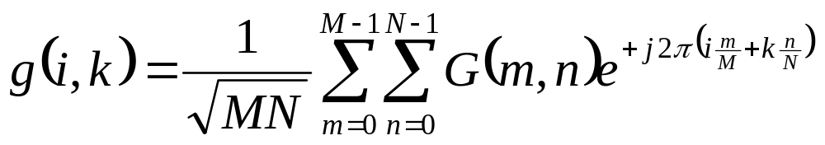
2. Inverse 2D DFT
Inverse DFT:

Slide 7
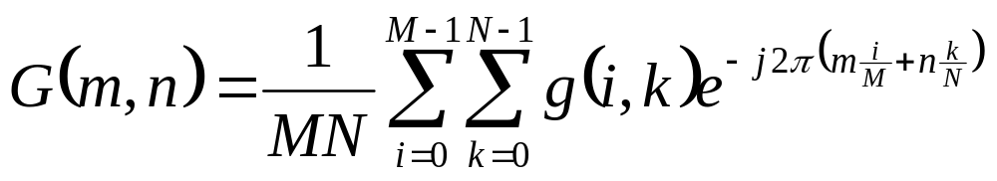
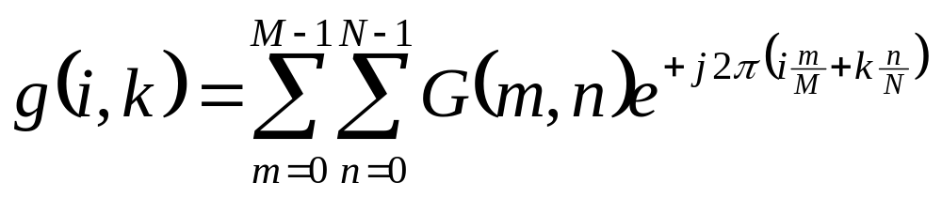
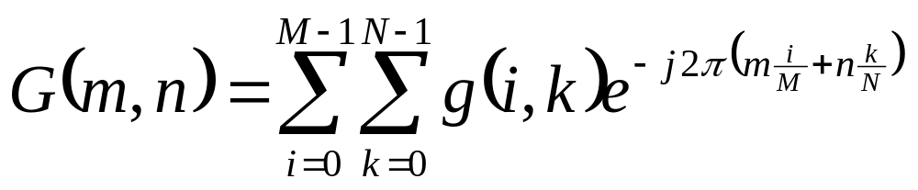
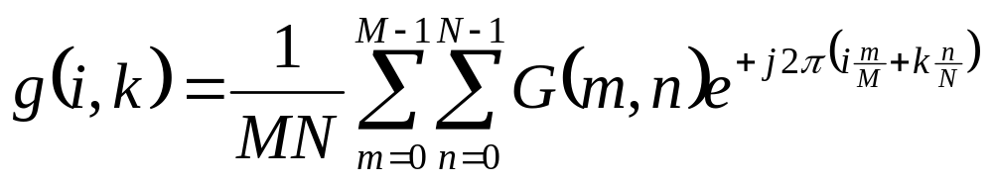
2. 2D DFT
Some books use the following formulae for the Fourier transform pair:
whereas others (including MATLAB) use:

Slide 8

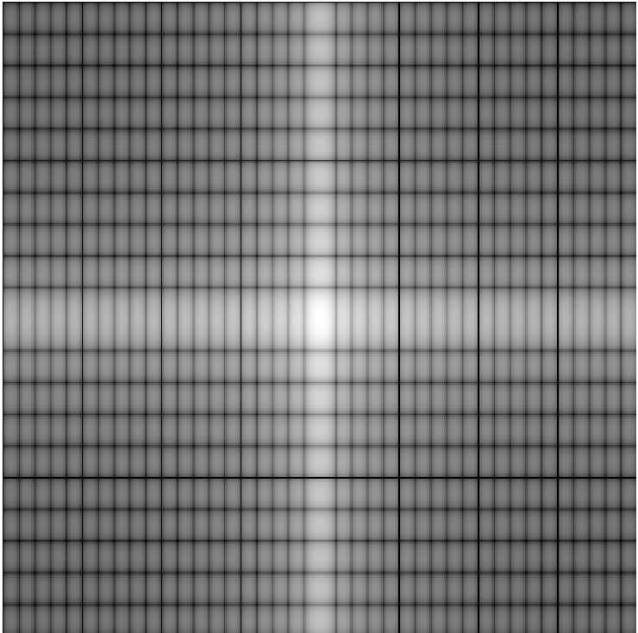
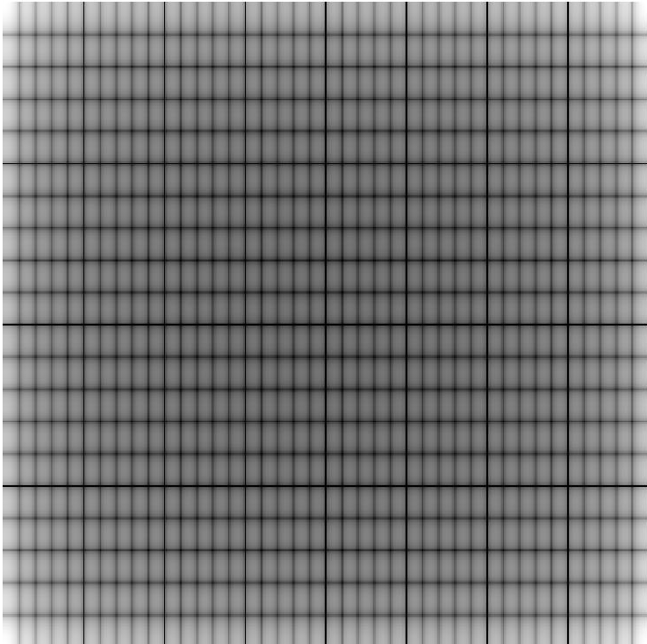
2. 2D DFT - MATLAB Example
>> % Assuming image is in variable im
>> X = fft2( im );
>> X = fftshift( X );
>> mag = abs( X );
>> mag = log10( 1 + mag );
>> imshow( mag, [] );
Image
Mag spectrum
Mag spectrum - omitting FFTSHIFT

Slide 9
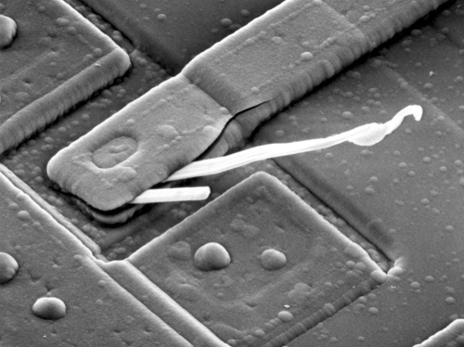
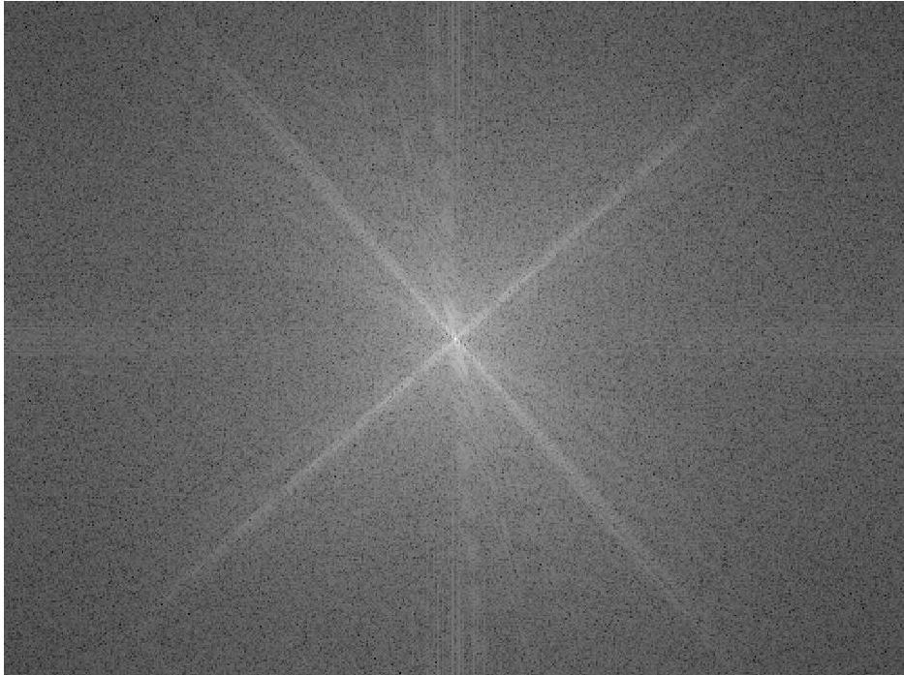
2. 2D DFT - MATLAB Example
Image
Mag spectrum

Slide 10
2. 2D DFT - MATLAB Example
It is hard to make a direct association between image values and transform values, but we can make general statements.
The DFT tells us what frequencies are present in the image and their relative strengths. Since frequency is directly related to rate of change, we can associate frequencies in the DFT with patterns of intensity variations in the image.
m = n =0 is the DC component (zero frequency)
Near the origin (m = n = 0) of frequency space, we have low frequencies that correspond to slowly varying components in the image. For example, in an image of a room, these low frequencies might correspond to smooth gray-level variations on the walls and floors.
As we move away from the origin, we encounter terms in frequency space at higher frequencies. These begin to correspond to faster and faster gray-level changes in the image. These are edges of objects and other components (e.g., noise) of an image characterized by abrupt changes in gray level. An example of a sudden change in gray level would be where a wall meets a ceiling.

Slide 11
3. Properties
(this is review, see p. 200 if following textbook)
Convolution
Similarity
DFT of real & even signal is also real and even
There are other properties, but the above are most important for us. The last one may be useful in checking your solutions to homeworks.
Practice Problem Set 6 will involve proving some of these other properties. You may be asked to prove some properties on exam too.

