Slide 1
Lecture Roadmap
1
Will present image processing operations in turn then case studies:
Histograms
Point operations
Algebraic operations
Geometric operations
Convolution & spatial filtering
Fourier analysis & frequency filtering
Segmentation overview
Case studies (graduate students)

Slide 2
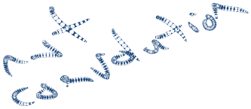

Convolution
OBJECTIVES
1. Applications
2. Define convolution
3. Implementation (Practice Problems)
4. Smoothing spatial filters
-Linear filters
-Order-statistic filters
5. Sharpening spatial filters
-First derivative filters
-Second derivative filters
Chapter 9 is relevant but presentation is different and also deals with continuous signals. Specific kernels not covered in book but in lecture.

Slide 3
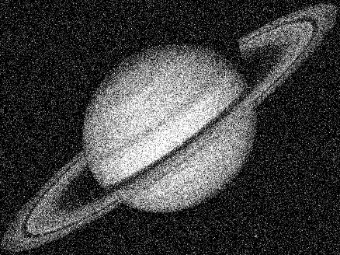
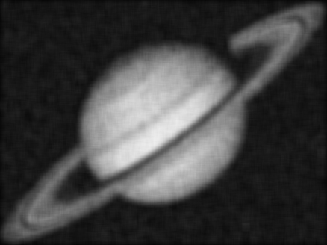
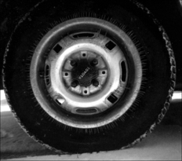

Applications
Noise reduction
  e.g., smoothing to remove high-frequency noise
  Noisy Image After smoothing
Feature enhancement
  enhance some features (e.g., edges) at the expense of others
  Original Unsharp masked,  = 1.0

Slide 4
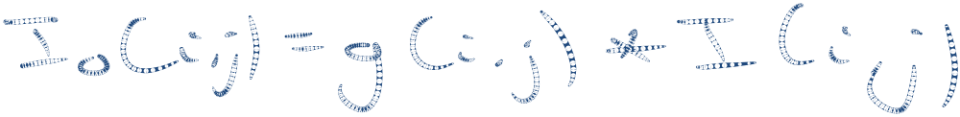



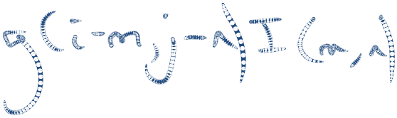

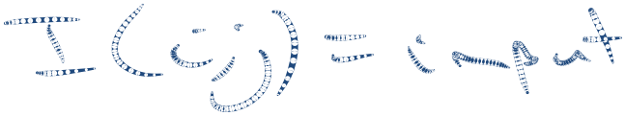



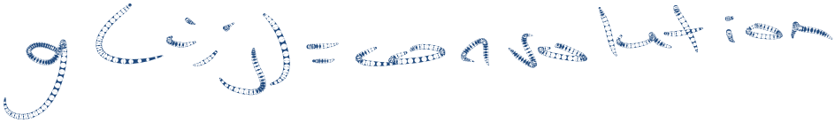













Definition & Implementation
The convolution of two discrete signals I(i, j) and g(i, j) gives another signal I_{o}(i, j):

Slide 5

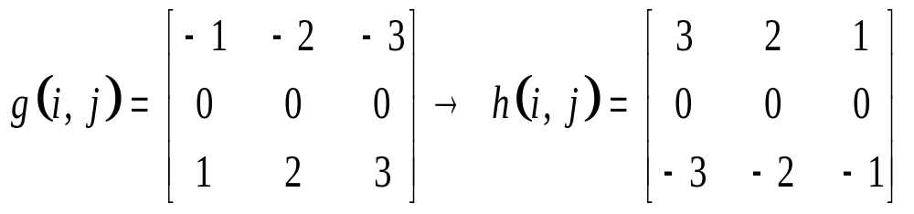



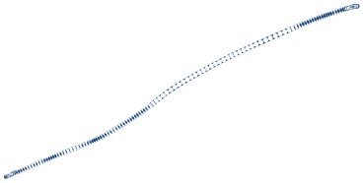
Definition & Implementation
1. Rotate the convolution kernel g(i, j) by 180º to get computational molecule h(i, j).
2. Overlay h(i, j) on top of a pixel in I(i, j), multiply corresponding elements, sum the products and place result in corresponding pixel in output image, I_{o}(i, j). NOTE: Need to maintain separate output image matrix.
3. Repeat for all pixels in input image.
I(i, j)
I_{o}(i, j)
X
X
h(i, j)

Slide 6









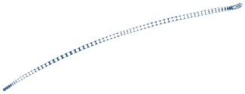









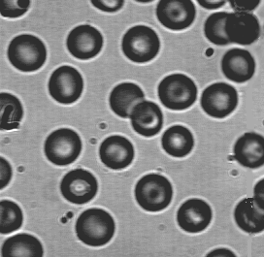
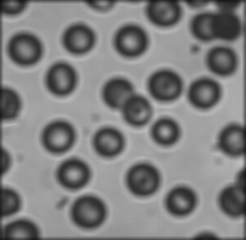
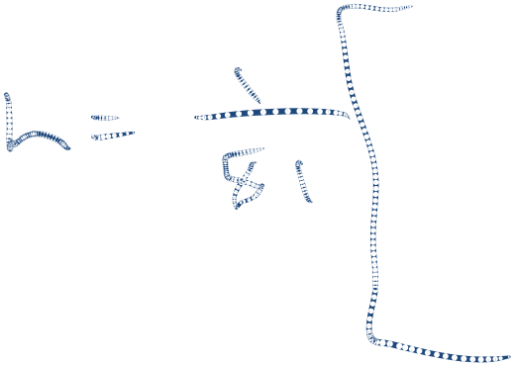





MATLAB Example
>> im = imread(‘filename’);
>> imshow(im)
>> h = fspecial(‘average’, 9);
>> im2 = uint8( filter2(h, im));
>> imshow(im2)
im im2

Slide 7







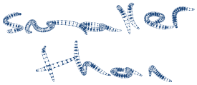

MATLAB Example (Cont’d)
Options in MATLAB for handling borders:
‘same’ (default): applies central pixel of molecule to input image pixels, assuming missing values in input are zero
>> im2 = filter2( h, im, ‘same’ );
- ‘valid’: only returns gray level values of pixels that can be computed without zero padding
>> im2 = filter2( h, im, ‘valid’ );

Slide 8
Linear Smoothing Spatial Filters
Also called lowpass filters or averaging filters
Reduce or smooth out sharp transitions in gray levels
Uses:
  Noise reduction
  Fill in small gaps in lines
  Blur out small details prior to large object detection
Main drawback: Edges are also sharp transitions and can be blurred

Slide 9
Smoothing Spatial Filters
3 x 3 boxcar filter, M X N filter
Weighted average: Give central pixel more weight than others

Slide 10
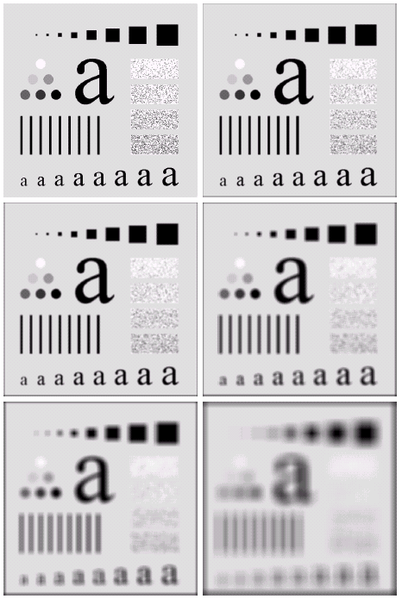
Example: N x N Boxcar Filter
N=3
N=5
N=9
N=15
N=35

Slide 11
Previous example
Original image (top left) contains squares of sizes 3, 5, 9, 15, 25, 35, 45, and 55 and are 25 pixels apart
Vertical bars are 5 pixels wide and 100 pixels high
Circles have diameter of 25 pixels and borders are 15 pixels apart with “black content” ranging from 0% to 100% in 20% increments. Background is 10% black.
For uint8:
  0% black means gray level of 255
  20% black means gray level of 0.8 x 255 = 204
  …
  100% black means gray level of 0
Filter with boxcar filter of size N = 3: slight blurring with objects about same size as filter being blurred the most (e.g., 3x3 and 5x5 squares and noise in rectangles)
N = 5 similar to N = 3 but a bit more blurring
N = 9: More blurring with 20% black circle blending more into background. Gray levels close to background start blending into background.
N = 15 and N = 35: Extreme blurring. Used to eliminate small objects (e.g., 3 smallest squares, 2 circles and most noisy rectangles). Note pronounced black border that results from zero padding of border.

Slide 12
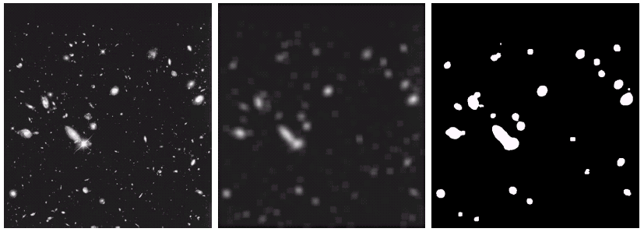
Example Application of Spatial Smoothing
Spatial smoothing is used to eliminate small objects prior to large object detection
Small objects blended into background whereas large objects become “bloblike” and easier to detect

Slide 13
Order-Statistic Filters
Nonlinear spatial filters based on ordering (ranking) pixels in window and replacing central pixel with ranking result (Not convolution based)
Median filter:
Max filter:
Min filter:

Slide 14

Median Filters
Median filters provide excellent noise reduction for impulse (salt-and-pepper) noise with less blurring than spatial averaging

Slide 15
Sharpening Filters
Highlight fine detail in an image
Applications in medical imaging, target detection in military applications, industrial inspection
Involve spatial differentiation (either first- or second-order derivatives)

Slide 16
First-Order Derivatives
Use gradient of image I(x, y) which is denoted as:
The magnitude is:

Slide 17
First-Order Derivatives
There are several approximations to the gradient of a digital image.
A commonly used approximation is given by the Sobel kernels
Computational molecules:

Slide 18
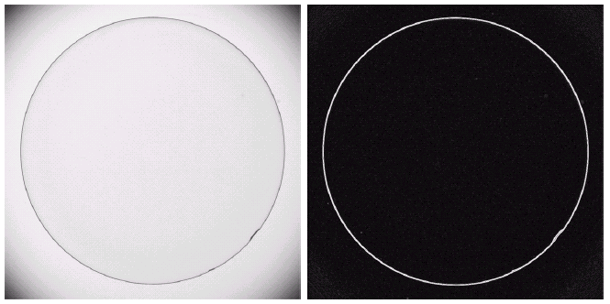
First-Order Derivatives
Used for edge extraction (more on this later graduate students present segmentation algorithms); not used as frequently in enhancement
Highlights edges and other transitions (including noise!) over slowly varying components
Often used in industrial inspection to highlight defects for human inspection or usually for later processing in an algorithm.

Slide 19
First-Order Derivatives in MATLAB

Slide 20
Second-Order Derivatives
Commonly used second-order derivative is the Laplacian which is denoted:
Commonly used kernels are:

Slide 21
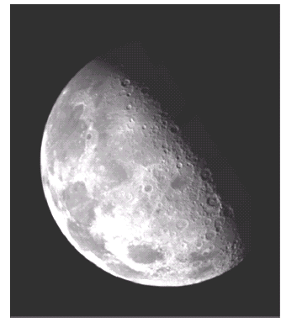
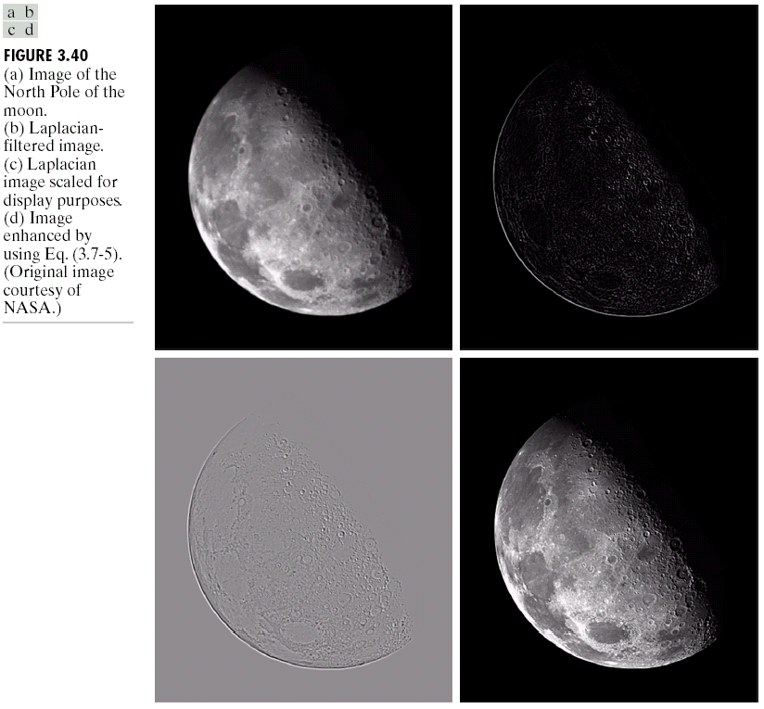
Second-Order Derivatives
Highlights gray-level discontinuities more than first-order derivative
Produces image that has light/dark response at lines, edges, points and other discontinuities superimposed on a grayish background

Slide 22
Second-Order Derivatives
Usually superimpose original image to “recover” background features using formula:
which can be implemented using the kernel:

Slide 23
Second-Order Derivatives

Slide 24
Second-Order Derivatives: High-boost Filter
Used for sharpening details in an image like edges, lines, etc.
Same as before but superimpose original image after scaling it by a constant A using following masks:

Slide 25
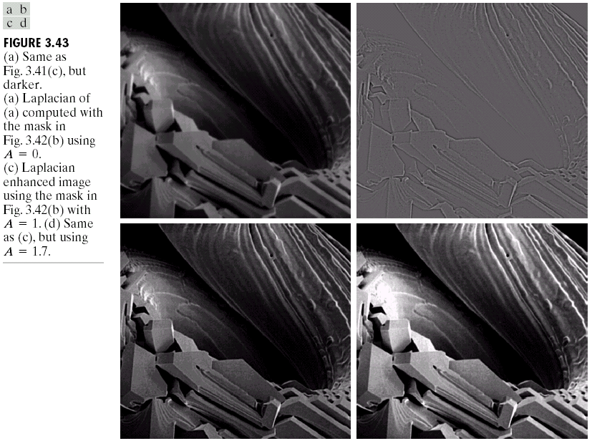
Second-Order Derivatives: High-boost Filter
(a)
(b)
(c)
(d)
(a) SEM image of tungsten filament following
thermal failure (250x magnification),
(b) Laplacian filtered image, and high-boost filtered images with (c) A=1,
(d) A = 1.7.

Slide 26
Summary
Defined digital convolution
Should be able to implement
Discussed following filters:
  linear smoothing spatial filters
  first-order and second-order derivative filters
Know applications of each of above filters

