Slide 1
Definitions
OBJECTIVES:
1. Define “digital image”
2. Describe image digitization
3. Define:
  digital image processing
  digital image analysis
4. Compare continuous vs. digital approach
Roughly corresponds to Chapter 1 of textbook.

Slide 2










Digital Image
DEFINITION OF DIGITAL IMAGE
-contrast with definition on p. 5 of textbook
10
7
18
...
117
...
29
...

Slide 3










Digital Image
PIXEL (short for picture element)
GRAY LEVEL
-generally integer values, ranging from 0 to some maximum value

Slide 4
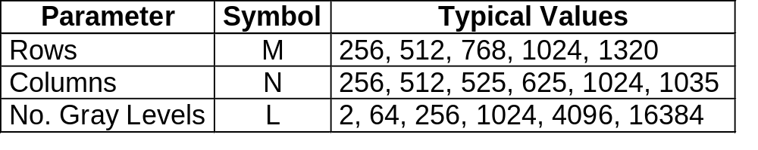










Digital Image - Standard Values
Standard values for rows, columns and gray levels.
The number of gray levels (L) is also usually a power of 2:
where B is the number of bits in the binary representation of the image.
E.g., B = 8 implies L = 256 gray levels numbered from 0,…,255.
Q: What does B = 1 imply?

Slide 5










Digital Image - Display
Generally, we try to map each pixel in the image to a single pixel on the screen.
COLORMAP:
E.g., for L = 256 gray levels, 0 maps into black, 255 into white and values in between map linearly into various levels of gray.
NOTE: p.3 of book uses reverse map.
Image matrix
Screen
0
0
0
0
0
127
255
0
0
255
127
0
0
0
0
0

Slide 6













Digital Image
MATHEMATICAL NOTATION
A digital image is denoted by:
j
i

Slide 7

Digital Image
MATHEMATICAL NOTATION
Range of indices:
j
i

Slide 8



Image Digitization
NOTATION
The 2D function I(x, y) represents a continuous-tone image. I(x, y) is the brightness or intensity of a point at location (x, y). I, x & y can take on a continuum of values.
In digital images, i & j are integers and I is also usually an integer.
I(x, y) - Cont.
I(i, j) - Digital
x
j
y
i

Slide 9









Image Digitization
DIGITIZATION
I(x, y)
I(i, j)
Digitizer (e.g.,
scanner)
Digitization consists of two steps:
1.
2.

Slide 10



Image Digitization
SAMPLING:
I(x, y)
Sampler
The continuous-tone image, I(x, y), is scanned and its brightness is measured or sampled at discrete locations to form an element in a rectangular matrix.

Slide 11






Definitions
QUANTIZATION:
I(i, j)
Quantizer
The sampled brightness values are still continuous.
Next, each element in the matrix is
quantized, i.e, replaced by an integer.
Quantized values are called gray levels.
Recall, a B-bit image has 2^{B} gray levels from 0 to 2^{B} - 1. The range of gray levels is called the dynamic range of the image.

Slide 12



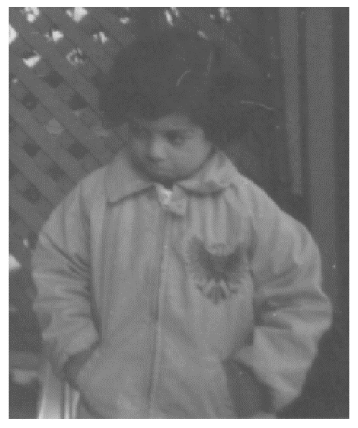

Image Digitization
SPATIAL RESOLUTION
What happens as the resolution decreases (i.e., becomes coarser)?
Full res
1 cm/pel
1/2 Res
2 cm/pel
1/4 Res
4 cm/pel
1/8 Res
8 cm/pel

Slide 13
Image Digitization
SPATIAL RESOLUTION (cont’d)
The picture at 1/8 resolution appears blocky, an artifact called pixelation.
36 X 30
1/8 Res
The sampling rate must be sufficiently high in order to accurately represent the original continuous-tone image or scene.
(Recall Nyquist rate.)

Slide 14


Image Digitization
BRIGHTNESS RESOLUTION
Refers to how accurately a pixel’s gray level can represent the brightness of the corresponding point in the original scene.
During quantization, the brightness sampled at each point in the continuous-tone image was replaced by an integer value.
7
B = 3 bits
Gray level of image
0
Scene brightness (a.u.)
I_{max}

Slide 15



Image Digitization
BRIGHTNESS RESOLUTION (cont’d)
The number of bits available affects how accurately our continuous-tone image is represented.
E.g., the figure below shows a digital image of a “wedge” quantized with 8 bits (256 gray levels). The image appears continuous.

Slide 16


Image Digitization
BRIGHTNESS RESOLUTION (cont’d)
The same scene quantized with only 4 bits (16 gray levels) is shown below.
The image brightness is discontinuous, an effect known as brightness contouring or posterization.

Slide 17
Image Digitization
BRIGHTNESS RESOLUTION (cont’d)
Essentially, with fewer bits, we cannot accurately represent the gradual intensity variations in the original scene because a wider range of intensities in the original scene is mapped into a single gray level.
Generally, the more bits we have, the better the brightness resolution.

Slide 18
Creating Digital Images
Of course, one need not acquire a continuous-tone image and then digitize it to form a digital image. There are other methods of forming digital images that convert the scene directly into digital form:
digital cameras
medical scanners (ultrasound, computed tomography and magnetic resonance)
interferometers (moiré, holographic, etc)
thermography
…others
Scene
I(i, j)

Slide 19








Continuous vs. Digital Approach
CONTINUOUS VS. DIGITAL
If
we can accurately represent the continuous-tone image I(x, y) by the digital image I(i, j).
We will develop digital image processing formulae in either continuous or digital form, whichever is convenient. The continuous forms must be converted to digital form during implementation.

Slide 20





Definition of Digital Image Processing
DIGITAL IMAGE PROCESSING
We will consider the following tasks as the course proceeds:
contrast enhancement
registration & warping
filtering for noise reduction, edge enhancement, etc.
segmentation
By contrast, digital image analysis refers to extracting information (e.g., object size) from images. We will briefly discuss this near the end of the course.

Slide 21
Applications
AGRICULTURE: Non-destructive testing of food quality; crop yield
DEFENSE/INTELLIGENCE: Enhancement and interpretation of images to find and track targets
DOCUMENT PROCESSING: Scanning, archiving, transmission
FACTORY AUTOMATION: Visual inspection of products
LAW ENFORCEMENT/FORENSICS: Fingerprint analysis
MATERIALS TESTING: Detection and quantification of cracks, impurities, etc.
MEDICAL: Disease detection and monitoring, therapy/surgery planning
...

Slide 22
Companies in Canada
AGRICULTURAL
  Digital Globe, Inc. (Longmont, CO): geospatial imaging for various applications
DEFENSE/INTELLIGENCE
  Government: defense, intelligence
  SPAR Aerospace (Toronto, Edmonton): detection of targets in radar clutter
DOCUMENT PROCESSING
  NCR (Duluth, GA): cheque processing; character recognition
FACTORY AUTOMATION
  Teledyne DALSA (Waterloo, ON): real-time product inspection
  IO Industries (London, ON): high-speed image acquisition
  Labatt (London, ON): high-speed inspection for bottle integrity
MEDICAL
  GE Healthcare
  Synaptive Medical (Toronto, ON)
...

Slide 23
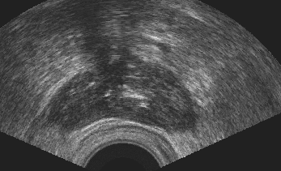
Creating Digital Images
ULTRASOUND IMAGE
Cross-sectional image through prostate. The prostate is the dark “blob”.

Slide 24
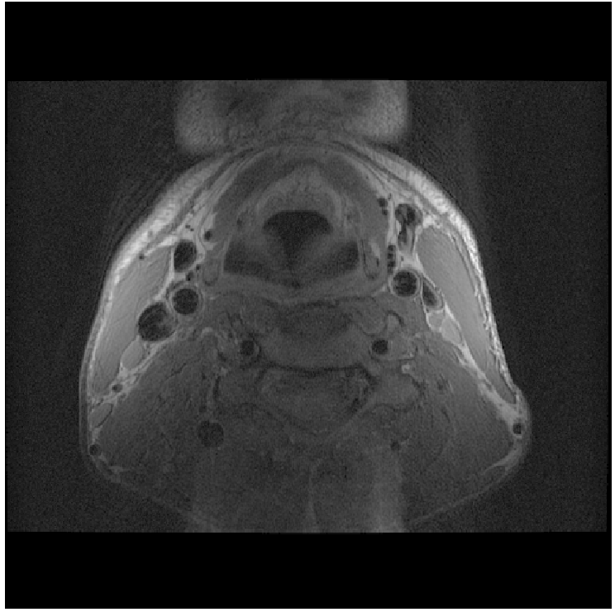
Creating Digital Images
BLACKBLOOD MR IMAGE
Cross-sectional image measured through the neck of a subject. Blood vessels appear black whereas tissues appear lighter.

Slide 25
Creating Digital Images
MOIRÉ IMAGE
Depth image showing the shape of the cat eardrum. Gray levels vary from black (furthest from viewer) to white (closest to viewer).

Slide 26
Summary
Should know following terms:
digital image (pixel, gray level)
colormap
digitization
  continuous-tone image
  sampling
  quantization
    dynamic range
  spatial resolution
    pixelation
  brightness resolution
    posterization & brightness contouring
digital image processing
digital image analysis

Slide 27
Is this possible?
https://www.youtube.com/watch?v=3uoM5kfZIQ0
https://www.youtube.com/watch?v=I_8ZH1Ggjk0

