Slide 1
Lecture Roadmap
Will present image processing operations in turn then case studies:
Histograms
Point operations
Algebraic operations
Geometric operations
Convolution & spatial filtering
Fourier analysis & frequency filtering
Segmentation overview
Case studies (graduate students)

Slide 2
Filtering
OBJECTIVES
1. Consider frequency filters:
  Lowpass
  Highpass
2. MATLAB implementation will be left for Practice Problem Set 6

Slide 3
Lowpass Filters (LPF’s)
Attenuate high-frequency components of image relative to low-frequency components.
Often, image has majority of energy at low or mid- frequencies, but at higher frequencies, info is buried in noise. Use LPF’s to reduce high-frequency noise relative to low-frequency components of image. Causes blur.
We will discuss:
(1) Ideal filter
(2) Butterworth filter
(3) Gaussian filter

Slide 4
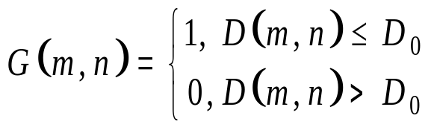


“Ideal” LPF
High-frequency cutoff (“Ideal” LPF)
where
is distance of point (m, n) from origin (0, 0) in spatial-frequency domain.
D₀ is cutoff frequency, i.e., transition from 1 to 0.
n
m

Slide 5

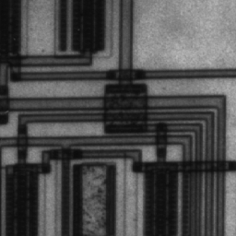


“Ideal” LPF (cont’d)
Recall
Ideal in that filter passes low frequencies without attenuation and completely eliminates high frequencies
Note ringing in filtered image
Original
Filter
Filtered image

Slide 6
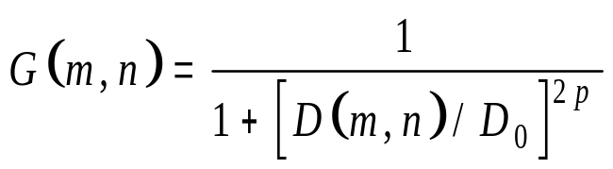

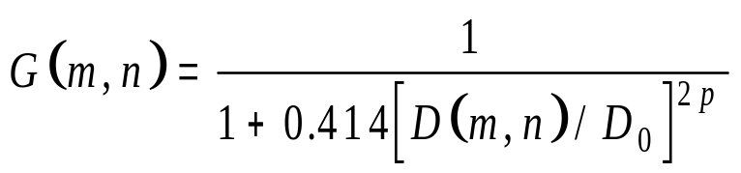
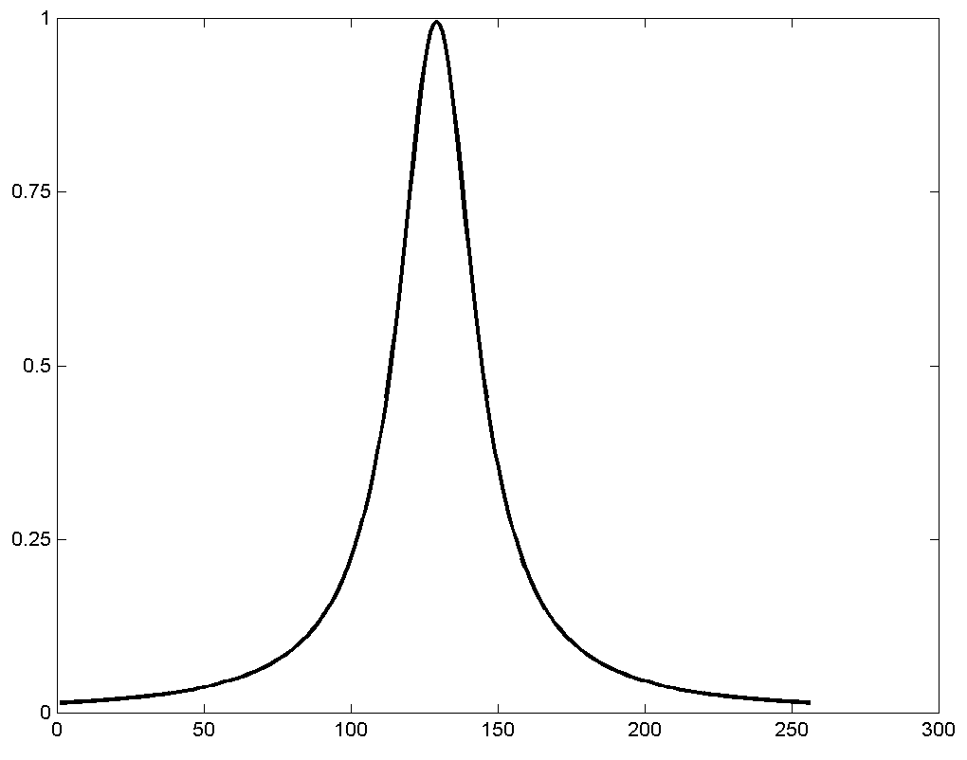
Butterworth LPF (BLPF)
Frequency response of BLPF of order p and cutoff frequency D₀ from origin is:
From plot below, there is no clear cutoff between frequencies that are passed and those that are not passed
Define cutoff frequency as being value of D₀ where G(m, n) has fallen to of maximum value of G(m, n). Following equation yields desired value at D₀ :
p = 1

Slide 7
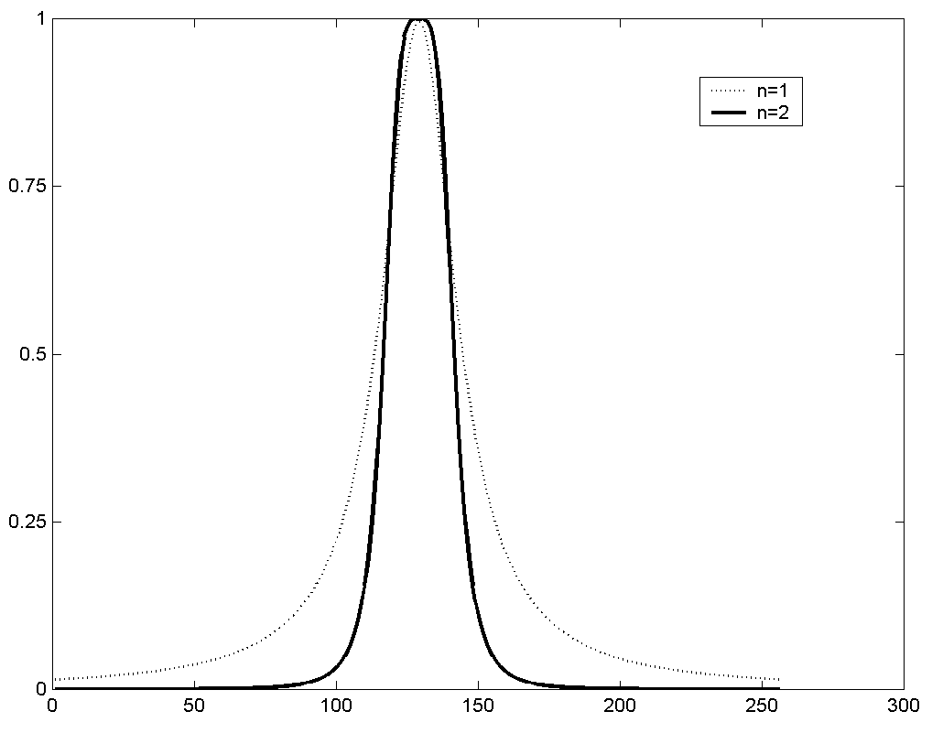
BLPF (cont’d)
Ringing not evident in filtered images for p = 2 or lower.
Increasing p makes cutoff sharper:

Slide 8
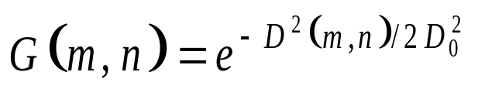
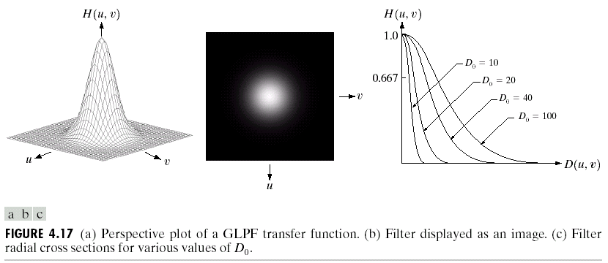
Gaussian LPF
where
is distance of point (m, n) from origin (0, 0) in spatial-frequency domain.
|G |
n
n
m

Slide 9
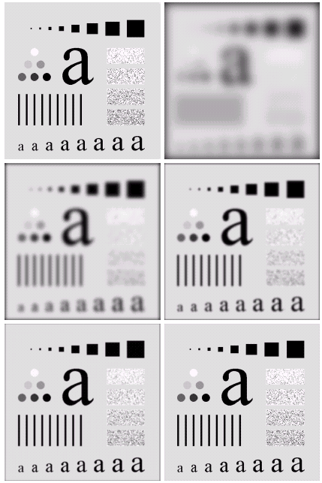
Gaussian LPF

Slide 10
Highpass Filters
Pass high frequencies but attenuate low frequencies
Useful for enhancing edges
NOTE: Book talks about high-frequency enhancement filters that pass all frequencies but enhance high frequencies
Ideal Highpass Filter (2D)
n
m

Slide 11
“Ideal” Highpass Filters
E.g., D₀ = 10
Unfiltered
Filtered

Slide 12
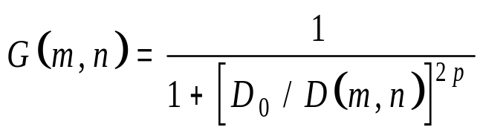
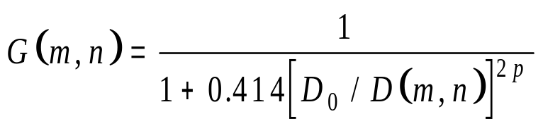
Butterworth Highpass Filter (BHPF)
Frequency response of BHPF of order p and cutoff frequency D₀ from origin is:
Define cutoff frequency as being value of D₀ where G(m, n) has fallen to of maximum value of G(m, n). Following equation yields desired value at D₀ :
p = 1

