Slide 1
Lecture Roadmap
1
Will present image processing operations in turn then case studies:
Histograms
Point operations
Algebraic operations
Geometric operations
Convolution & spatial filtering
Fourier analysis & frequency filtering
Segmentation overview
Case studies (graduate students)

Slide 2

Geometric Operations
OBJECTIVES
1. Define geometric operations
2. Overview of applications
3. Translation, rotation, scaling
4. Gray-level interpolation
5. Implementation
6. Landmark-based registration
Roughly corresponds to Sections 8.1, 8.2.1, 8.2.2, 8.3.1, 8.4.1-8.4.3, 8.4.6 of textbook. Mathematical details of image registration not covered in book.

Slide 3








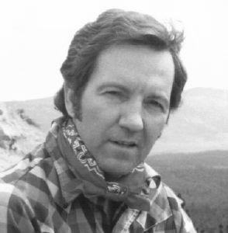
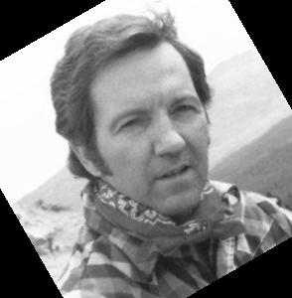
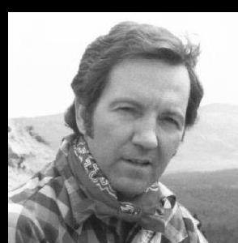
Geometric Operations: Definition
E.g., Moving objects around in an image. (a) Original. (b) Rotated by 30 degrees about centre. (c) Translated 10 pixels to right and 15 pixels down.
(a)
(b)
(c)

Slide 4
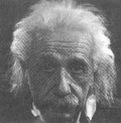
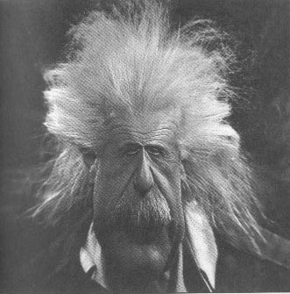
Geometric Operations
E.g., image warping

Slide 5
Overview of Applications
Geometric calibration
Image morphing
Image registration **

Slide 6






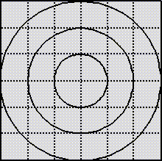
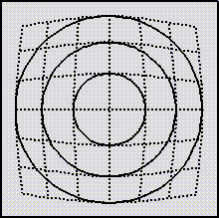
Applications
Geometric calibration
E.g., barrel distortion (shown below); pin-cushion distortion
Correct by imaging a known grid pattern and designing a warping function based on known pattern and imaged pattern.

Slide 7












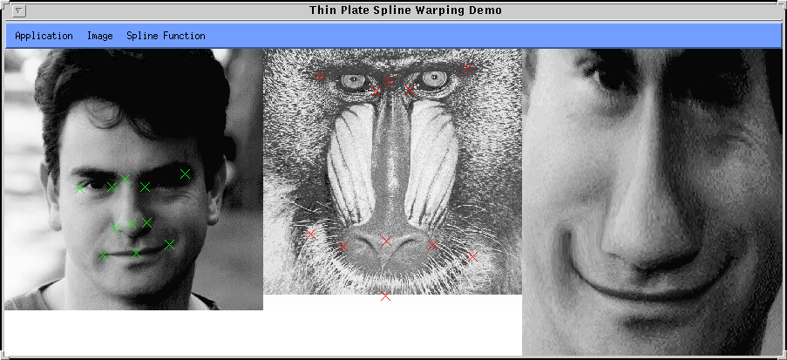
Applications
Image morphing
Note, we are warping from one image to a different image. Compare with Einstein example.
-used in motion pictures & animation

Slide 8






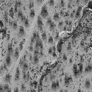
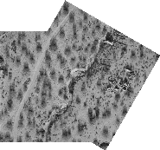
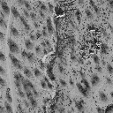
Applications
Image registration
E.g., may image a tumor at two different instants in time and may want to check if it is growing.
E.g., Surveying land: Image 1 shows an area of Mojave desert; 2 shows adjacent area; 3 formed by registering overlapping regions and stitching images together.
1
3
2

Slide 9












































Geometric Operations: Mathematical Definition
I(i, j)
I_{o}(i’, j’ )
j
j’
i
i’

Slide 10



Linear Operations
LINEAR OPERATIONS
…
NOTE: Warping is a nonlinear transformation, and is not covered.

Slide 11









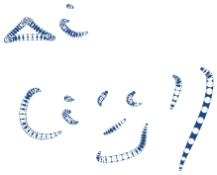




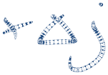








Linear Operations
TRANSLATION
I(i, j)
I_{o}(i’, j’ )
j
j’
i
i’

Slide 12














Linear Operations
SCALING ABOUT THE ORIGIN
I(i, j)
I_{o}(i’, j’)
j
j’
i
i’
Effect of (a) s_{i} , s_{j} > 1? (b) 0 < s_{i} , s_{j} < 1? (c) s_{i} , s_{j} = 1?
(d) s_{i} = 1, s_{j} < 0?

Slide 13



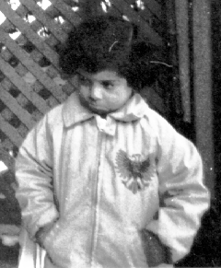
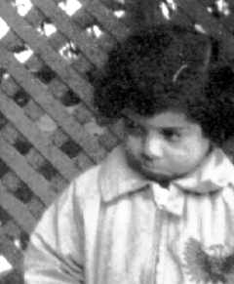
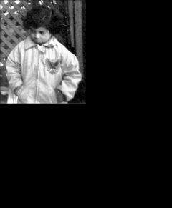
Linear Operations
SCALING ABOUT THE ORIGIN
s_{i} , s_{j} = 1
s_{i} , s_{j} = 1.5
s_{i} , s_{j} = 0.5
s_{i} = 1, s_{j} = -1

Slide 14









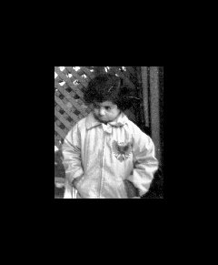
Linear Operations
SCALING ABOUT ANY POINT
Wish to scale image about any point (i_{c} , j_{c} ), i.e., the image should shrink or expand about this point rather than the origin.
Method to derive formula: translate to origin, scale, then translate back
s_{i} = s_{j} = 0.5
About centre of image

Slide 15






















Linear Operations
ROTATION ABOUT THE ORIGIN
(i, j)
θ
(i’, j’ )

Slide 16












Linear Operations
ROTATION ABOUT ANY POINT
Wish to rotate image about any point (i_{c} , j_{c} ).
Method to derive formula:
-translate to origin
-rotate about origin
-translate back by (i_{c} , j_{c} )
(i_{c} , j_{c})
(i, j)
θ
(i’, j’ )

Slide 17







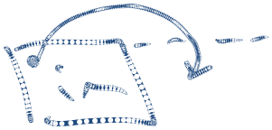





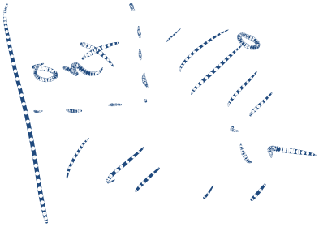
Linear Operations
PROBLEMS
Transformed coordinates may be non-integers, but require integer coordinates for indexing into a matrix
Parts of image may go outside bounds of input image
Parts of image may become blank (black)

Slide 18










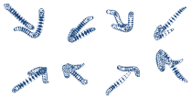






Gray-Level Interpolation
PROBLEM
Transformed coordinates may be non-integers, but require integer coordinates for indexing into a matrix
SOLUTION: Gray-level interpolation
I(i, j)
I_{o}(i', j' )

Slide 19












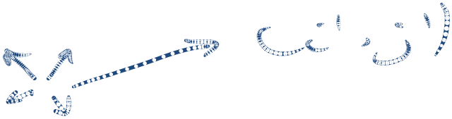
Gray-Level Interpolation
Two (2) approaches to applying transformation and doing interpolation:
(1)
(2)
(1) Forward Mapping
-compute new coordinates
I(i, j)
I_{o}(i’, j’ )
-then “spread” gray level over four neighbouring pixels using interpolation
I_{o} (i’, j’)

Slide 20

















































Gray-Level Interpolation
(2) Backward Mapping
E.g., for translation
I(i, j)
I_{o} (i’, j’ )
- (i, j) could in general fall at non-integer coordinates
-obtain gray-level at coordinates (i, j) using interpolation of input image

Slide 21








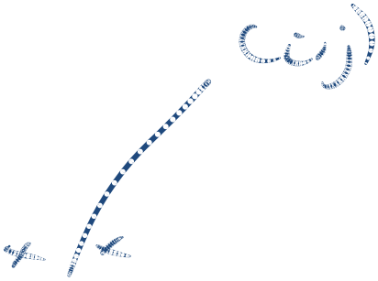


Gray-Level Interpolation
Forward mapping is wasteful:
Many input pixels may map outside border of output image
Each output pixel may be addressed many times, with many input pixels contributing to final gray level (esp. for demagnification)
I(i, j)
I_{o} (i’, j’ )
In backward mapping, gray level of each output pixel is determined by one interpolation step between exactly 4 input pixels
I(i, j)
I_{o} (i’, j’ )
Backward mapping is more effective, although calculating inverse operation may be difficult.

Slide 22


Gray-Level Interpolation
Interpolation methods:
Nearest neighbour
Bilinear
Bicubic,...
Nearest Neighbour (Zero order):
Example: From which input pixel (1, 2, 3 or 4) would you get the gray level of the output pixel?
I(i, j)
I_{o}(i’, j’ )
1
2
3
4

Slide 23
Nearest Neighbour Interpolation in MATLAB

Slide 24
Gray-Level Interpolation
Original
Nearest Neighbour

Slide 25
Gray-Level Interpolation
Bilinear (First-Order) Interpolation:
Gray level at non-integer coordinates found by interpolating values of four (4) neighbouring pixels using bilinear function.
I(i, j)
t
s
(s, t)
Define a local coordinate system (s, t) attached to the upper lefthand neighbouring pixel as shown with 0 ≤ s, t ≤ 1.
In local coordinates, the upper lefthand pixel has coordinates (0, 0).
What are coordinates of other neighbours?

Slide 26
Gray-Level Interpolation
Bilinear (First-Order) Interpolation:
Normally, we are given output pixel coordinates, (i’, j’ ), and input pixel coordinates, (i, j ), in terms of a global coordinate system as shown below.
(0,0)
j, j’
i, i’
(M-1,N-1)

Slide 27
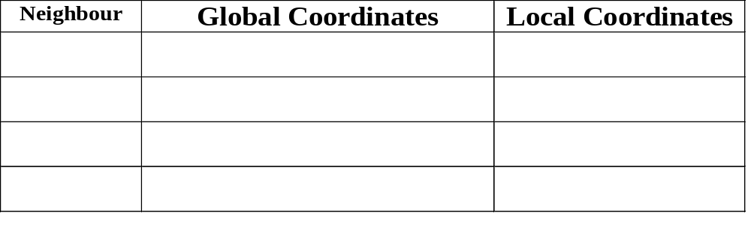
Gray-Level Interpolation
Bilinear (First-Order) Interpolation:
Given integer output pixel coordinates (i’, j’ ), the inverse mapping gives the input coordinates (i, j), which may be non-integers. What are the global & local coordinates of the 4 neighbouring input pixels?

Slide 28
Gray-Level Interpolation
Bilinear (First-Order) Interpolation:
The interpolated gray level at coordinates (s, t) is given by the bilinear function:

Slide 29
Example 1
The table below lists gray levels for specific image locations (i, j) in an input image I(i, j). Calculate the gray level at location (i, j) = (221.3, 396.7) using:
Nearest neighbour interpolation
Bilinear interpolation
I(i, j)
I(221, 396) = 18
I(221, 397) = 45
I(222, 396) = 52
I(222, 397) = 36

Slide 30
Example 1 cont’d

Slide 31
Example 2
An output pixel with coordinate (i', j' ) = (437, 124) is obtained using the geometric operation:
What gray-level should be assigned to it if the following interpolation methods are used:
Nearest neighbour interpolation
Bilinear interpolation
The table below lists gray levels in the input image.
I(i, j)
I(221, 396) = 18
I(221, 397) = 45
I(222, 396) = 52
I(222, 397) = 36

Slide 32
Example 2 cont’d

Slide 33
Gray-Level Interpolation
Bilinear vs Nearest Neighbour:
Original
Nearest Neighbour
Bilinear

Slide 34
Implementation
Rotation about centre of image:
function im2 = rotateImage( im, theta )
%ROTATEIMAGE Rotates image about its centre
%
% im2 = rotateImage( im, theta) where im is the
% image to be rotated and theta is the rotation
% angle in degrees. Uses nearest neighbour
% interpolation.
%
% Hanif M. Ladak, 2017
% Get image info, including centre
[rows, cols] = size( im );
ic = round( rows / 2); % i coord of centre
jc = round( cols / 2); % j coord of centre
% Convert theta to radians
theta = theta * pi / 180;
% Create output image: same size and type as input
im2 = uint8(zeros(size(im)));
for ip = 0 : rows-1, % NOTE: origin is (0,0)
for jp = 0 : cols-1,
% Find source (i, j) coordinates. Add 1 to
% i and j since indexing starts at (1,1),
% not (0,0).
j = (jp-jc)*cos(theta) + (ip-ic)*sin(theta) + jc + 1;
i = (jc-jp)*sin(theta) + (ip-ic)*cos(theta) + ic + 1;
% Find gray-level value at im(i+1, j+1),
% i,j may be non-integers
im2(ip + 1, jp + 1) = nearest(im, i, j);
end
end

Slide 35
Implementation
Rotation about centre of image (cont’d):
function gl = nearest( im, i, j )
%NEAREST Nearest neighbour gray-level interpolation
i = round(i);
j = round(j);
% Make sure computed (i, j) are within bounds
if ~((j < 1) | (j > size(im, 2)) | (i < 1) | (i > size(im, 1))),
% Within bounds
gl = im(i, j);
else
% Out of bounds
gl = 0;
end
Call as follows:
>> im = imread( ‘pout.tif’ );
>> im2 = rotateImage( im, 30 );
>> imshow( im2 )
Compare with the MATLAB function imrotate.
>> im2 = imrotate( im, -30, ‘nearest’, ‘crop’ );

