Slide 1


Lecture Roadmap
1
Will present image processing operations in turn then case studies:
Histograms
Point operations
Algebraic operations
Geometric operations
Convolution & spatial filtering
Fourier analysis & frequency filtering
Segmentation overview
Case studies (graduate students)

Slide 2


The Gray-Level Histogram
OBJECTIVES
1. Define “histogram”
2. Examples
3. Implementation
4. Applications
  digitization
  segmentation

Slide 3






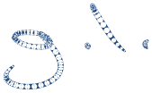







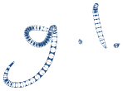









Definition

Slide 4


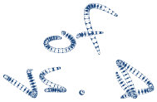


































imhist in MATLAB
>> im = imread(‘pout.tif’);
>> imhist(im);
or
>>[H, D] = imhist(im);

Slide 5






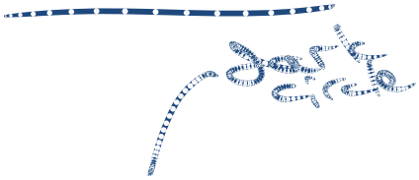





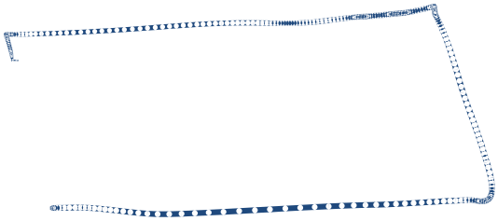






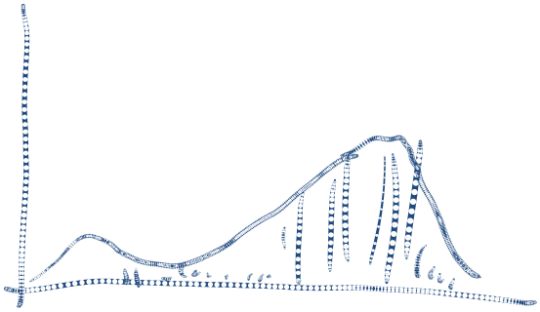


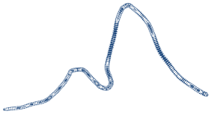


What does it tell us?
CONTRAST
Amount of difference between average gray level of an object and that of surroundings
Intuitively, how vivid or washed-out an image appears

Slide 6

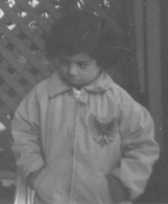


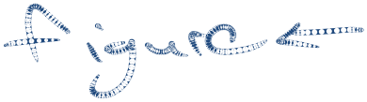

Examples
Low contrast & small amount of dynamic range used

Slide 7
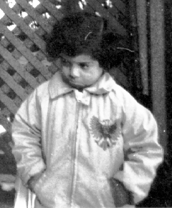



Examples
Higher contrast & more of dynamic range used

Slide 8



Examples
Dark image

Slide 9
Application: Digitization
DIGITIZATION
Histogram gives quick indication as to whether or not we have used the entire dynamic range of digitizer
Histogram indicates if clipping is a problem

Slide 10






Application: Digitization
Added 150 to all pixels. If sum >255 at a pixel, gray level for that pixel is clipped to 255.

Slide 11



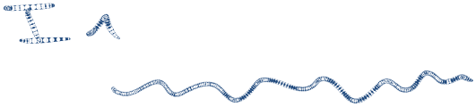






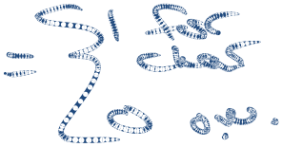
Application: Thresholding
THRESHOLDING
Separate contrasting objects (in this case, letters) from background
Why?
I(i, j)
B(i, j)

Slide 12
Application: Thresholding
For an object on a contrasting background, histogram is bimodal (i.e., contains two peaks)
Threshold gray level T separates object from background
T
Object
(Characters)
Back-
ground

Slide 13
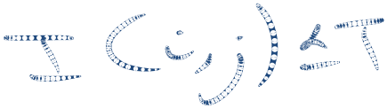












Application: Thresholding
Dark objects are segmented (i.e., separated) from a contrasting light background to form a binary image by setting all pixels with gray levels less than or equal to T to 1 and others to 0:
Q: What if we have a bright object on a contrasting dark background?

Slide 14















Application: Thresholding
The total area A of dark objects on a contrasting light background can be computed from the histogram H(D) and the threshold T:
What are the units of area?

Slide 15
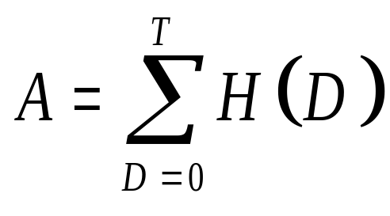
Application: Thresholding
If the threshold T is selected at the dip, then variations in T will have minimal effect on the estimated area of the objects:
because H(D) takes on small values at the dip.

Slide 16








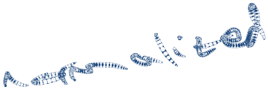



Thresholding in MATLAB
Use the graythresh function to automatically find a threshold
  This is only one of many algorithms for finding a threshold
Use im2bw command to threshold image to create binary image: Considers objects to be brighter than background
>> im = imread(‘coins.png’);
>> imshow(im)
>> th = graythresh(im);
>> bw = im2bw(im, th);
>> figure, imshow(bw)

Slide 17
Example 1
The table below is the histogram of a 2-bit image of a purely white square on a purely black background.
What is the area of the white square in terms of the number of pixels it occupies?
If the actual area of the imaged square is 400 mm², what is the pixel spacing? Assume isotropic pixels.
How many pixels are there in the image?
D | H(D)
0 | 8400
1 | 0
2 | 0
3 | 1600

Slide 18
Example 1 (cont’d)

Slide 19
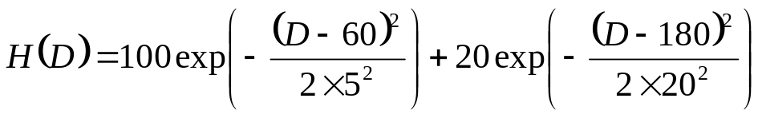
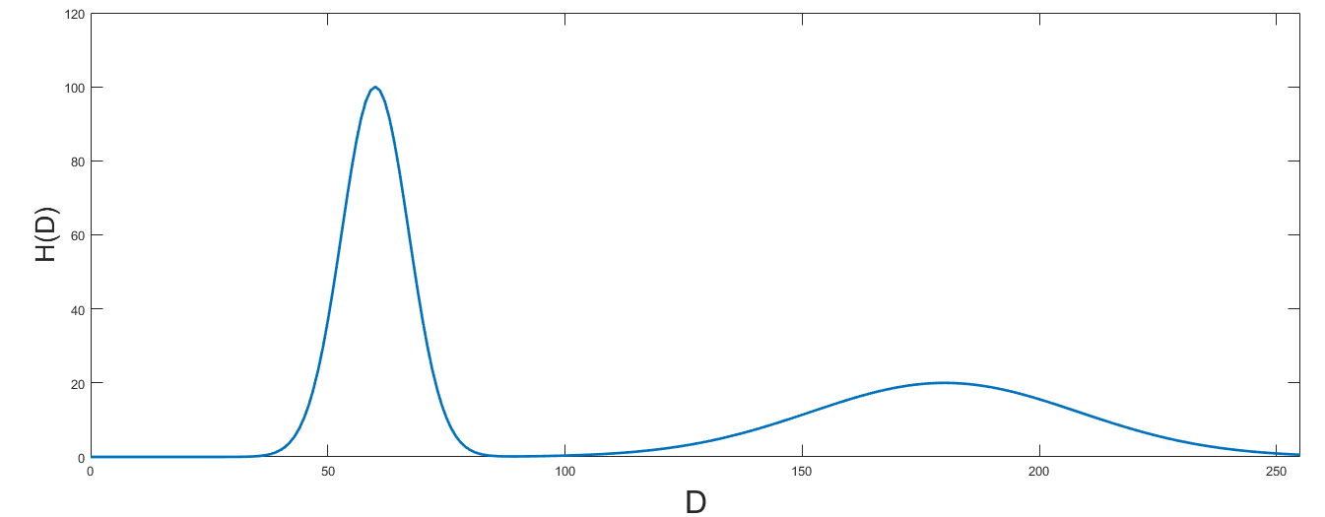
Example 2
The histogram of an 8-bit image of a bright object on a dark background has the following form:
Where would you place the threshold T to segment the bright object from the dark background?

Slide 20
Example 2 – cont’d

Slide 21
Summary
Should be able to define “histogram”
Be able to write C-like code to calculate histogram (see Assignment 1)
Describe applications
  digitization
  thresholding (calculate area of objects)
Do Practice Problem Set #1
  Asks you to try problems 3 and 4 on p. 80 of textbook. We did similar questions in class if you don’t have textbook

