Slide 2
Process
Model
(B)
Delta_{B}
Process
Model
(B’)
Correspondences
Correspondences
Process
Model
(IT)
Process
Model (IT’)
Delta_{IT}

Slide 3
Process
Model
(B)
Delta_{B}
Process
Model
(B’)
Process
Model
(B)
op₁^{T}
Process
Model
(B1)
op₂^{T}
Process
Model
(B2)
…
Process
Model
(B’)
Correspondences
Process
Model
(IT)
Process
Model (IT’)
Process
Model
(IT)
Process
Model (IT1)
Process
Model (IT2)
…
Process
Model (IT’)
Delta_{IT}
op₁
op₂
(a)
(b)

Slide 4
Process
Model
(B)
op₁^{T}
Process
Model
(B1)
op₂^{T}
Process
Model
(B2)
…
Process
Model
(B’)
Correspondences
Process
Model
(IT)
Process
Model (IT1)
Process
Model (IT2)
…
Process
Model (IT’)
op₁
op₂

Slide 5
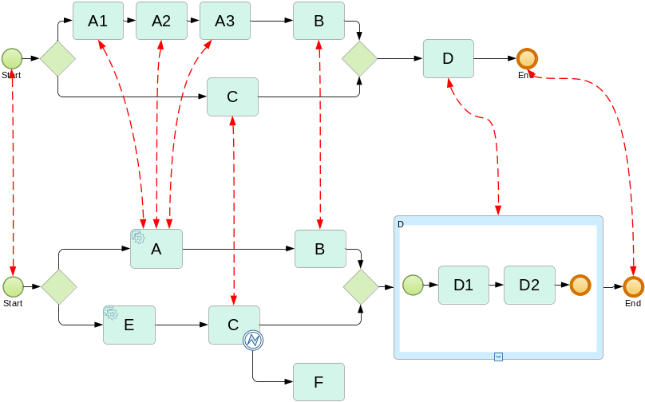
Shared
Process
Model

Slide 6
a)
Process
Model
(B)
Process
Model
(B’)
Delta_{B}
Correspondences
Correspondences
Process
Model
(IT)
Process
Model (IT’)
Delta_{IT}
b)
op₁^{T}
op₂^{T}
Process
Model
(B)
Process
Model
(B1)
Process
Model
(B2)
…
Process
Model
(B’)
Correspondences
Correspondences
Process
Model
(IT)
Process
Model
(IT1)
Process
Model
(IT2)
…
Process
Model (IT’)
op₁
op₂

Slide 7
Change Operation op
Effects on Process Model V
InsertActivity(x, a, b)
Insertion of a new activity x between two succeeding elements a and b in process model V and reconnection of control flow.
DeleteActivity(x)
Deletion of activity x and reconnection of control flow.
MoveActivity(x, a, b)
Movement of activity x from its old position into its new position between two succeeding elements a and b in process model V and reconnection of control flow.
InsertFragment(f, a, b)
Insertion of a new fragment f between two succeeding elements a and b in process model V and reconnection of control flow.
MoveFragement(f, a, b)
Movement of a fragment f from its old position to its new position.
DeleteFragment(f, c, d)
Deletion of fragment f between c and d from process model V and reconnection of control flow.

Slide 8
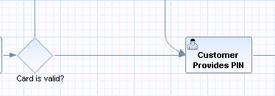
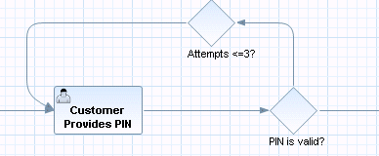
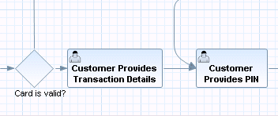
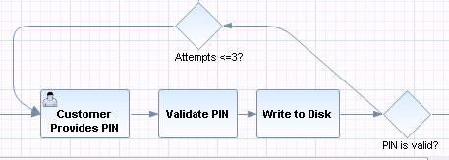
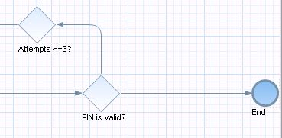
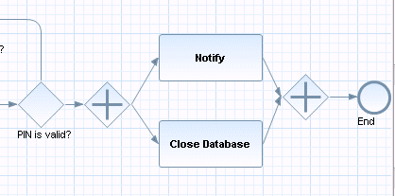
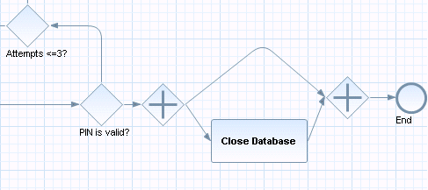
a)
b)
c)
d)

