Slide 1
BusinessDelta
Process
Model
(B)
Process
Model
(B’)
Business changes’
Delta₂
Delta₁
IT-only changes
IT-only and business changes
Process
Model
(IT)
Process
Model (IT’)
Business changes

Slide 2
Slides from reviews

Slide 3
ArtCon Overview
Drive new approach to consistency management in BPM. Propose and demonstrate prototypical solutions for selected key artifacts and their consistency.
Goals
  Drive new approach to artifact consistency management in BPM, Propose and demonstrate prototypical solution for selected key artifacts and their consistency
  Solve Business-IT gap problem for process models
  Support product integration of our previous BPMN 2.0 related contributions when required
Milestones
  Q1: Identification and selection of most relevant and challenging consistency conditions (aligned with product priorities) and first conceptual solution
  Q2: Requirements analysis and first design. Validation with PLM and architects. Completed conceptual design of shared process model to address all requirements.
  Q3-Q4: Further implementation of consistency prototype, addressing additional scenarios (business change scenario, consistency between business and IT view), determination of integration plan/schedule.
  Q3: Demo BPMN 2.0 contributions to PLM for determining integration plan/schedule.
Accomplishments
  First prototype of Shared Process Model completed, main scenario is working (syncing changes from IT view to business view)
  Validation of existing and collection of new requirements with some customers to gain further insights of customer needs
  Prototype reviewed with PLM and architects, confirmation of direction and technical approach
Issues
  None

Slide 4



The Business-IT Gap Problem for Process Models
IBM BPM customers use process models in two ways:
  Process documentation, specification, and analysis (Business model)
  Automated process execution (Executable IT model)
Situation in companies today
  Business and IT models are changed independently by different roles and thus get out of sync
Business Analyst
IT Architect/ Developer
IT
Shared Process Model
get
Business View
get
IT View
update
update
Proposed Approach: Shared Process Model manages consistency between Business and IT View
  Offers operations to get current and update both business and IT model
  Internally synchronizes common elements of business and IT to maintain business-IT consistency

Slide 5
General Insights from Survey
Survey with various stakeholders in a bank (Business Analyst, IT Architect, etc), in collaboration with University of Waterloo, IBM CAS project
23 responses to 30 questions plus free form comments
Aligning Business and IT models is considered important (or very important) for various use cases
  Process optimization (92% agree)
  Initial development or change request implementation (96% agree)
  Auditing and compliance (96% agree)
  Development Outsourcing (78% agree)
Business model needs to be updated after release due to various reasons
  Business model is incomplete (frequently)
  Business model contains inconsistencies (frequently to occasionally)
  IT model cannot be mapped anymore to business model (occasionally)
  Business model does not anymore faithfully represent the actual business process (rarely)
Further application of survey in other banks under consideration

Slide 6
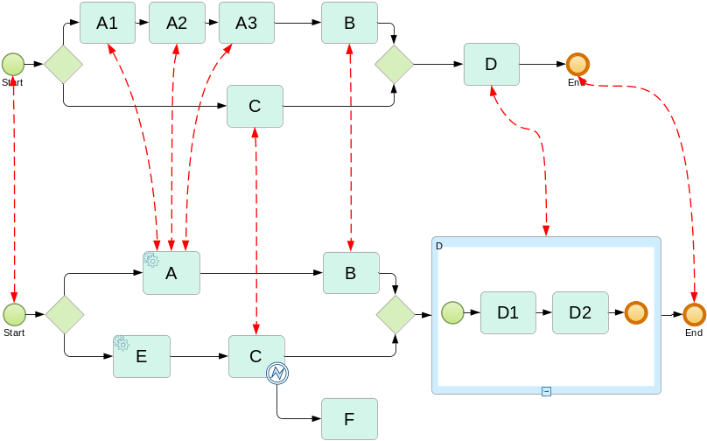
Overview of Solution Design
Shared Model
Business View
IT View
Maintain internally two separate models and links between their elements
Distinguish main (e.g. tasks and events) and dependent model elements (e.g. sequence flow)
Main elements are explicitly linked by traceability links
  Often 1:1, also 1:m and m:1
  Some IT elements do not have a Business counterpart
  Sometimes IT model is split into multiple processes
Changes to IT view may be business relevant or not
  Only business-relevant changes are propagated to business view
Likewise, changes to Business view can be propagated to IT view
  Requires translation of changes to the IT view

Slide 7
Solution Details - Challenges
Process
Model
(B)
Process
Model
(B’)
Business changes’
Delta₂
Delta₁
IT-only changes
IT-only and business changes
Process
Model
(IT)
Process
Model (IT’)
Business changes
Refinement or abstraction between business and IT models
  Traceability links have to be 1-to-1, 1-to-many, or many-to-1 in order to support this
  Traceability links must be automatically managed
Business changes can be dependent on IT changes
  It is not possible to ignore the dependencies, otherwise model could be broken
Postprocessing for fixing resulting model B’
  Some required model elements (connections) are missing, they need to be created for obtaining a syntactically correct model in the postprocessing
  Challenging due to many different cases and traceability links

Slide 8
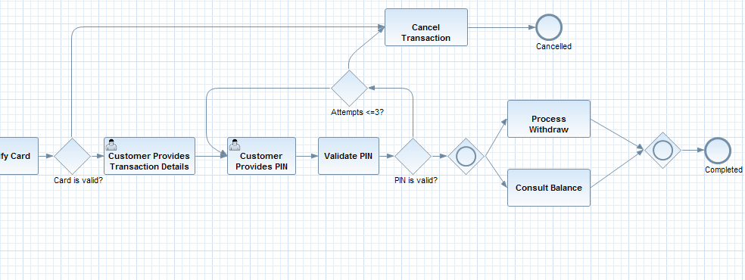
Shared Process Model – Current Prototype – Main scenario
Prototype displays both a business view and an IT view
IT starts with released Business model and refines it to build an executable process model
  Initially, business view and IT view of shared model are identical
At any time, the changes made by IT can be checked into the Shared Model as either
  IT only changes (private changes of IT, not propagated to the business view), or
  Business-relevant changes (changes common to business and IT, propagated to business view)
Business & Initial IT View

Slide 9
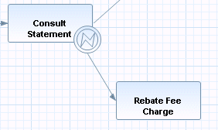

Status and Limitations of Prototype
Focus on refinement of business models for IT implementation
Completely automatic propagation (although approval could be added)
Support for wide range of changes
  Structural changes (e.g. addition/removal of activities, error handling etc.)
  Attribute changes (e.g. renaming of activities)
  Refinement of task into subprocess
  Refinement of task into fragment
Limitation: changes are either business-relevant or IT-only for each edit session.
Possible extensions:
  Support for other scenarios (e.g. business change scenario, planned for 3rd/4th quarter)
  Approval of business changes by business
  Explicit Consistency check between business and IT views

Slide 10
Plan and Status
Goal: Solve the Business-IT Gap problem for process models
Close contact with Product Management and BPM lead architects
  Jeff Brent (PLM), Matthias Kloppmann, Phil Coulthard
  Feedback from product management on prototype extremely positive: “very applicable” and “excellent move”
  Agreement to include concept and demo in internal wiki for product management to foster road to integration
  Agreement to demonstrate this to customers as soon as prototype is consumable
Project plan and status
  Q1: Identification and selection of most relevant and challenging consistency conditions (aligned with product priorities) and first conceptual solution (Achieved)
  Q2: Requirements analysis and first design. Validation with PLM and architects. Completed conceptual design of shared process model to address all requirements. (Achieved)
  Q3-Q4: Further implementation of consistency prototype, addressing additional scenarios (business change scenario, consistency between business and IT view), determination of integration plan/schedule.
  Q3: Demo BPMN 2.0 contributions to PLM for determining integration plan/schedule.

Slide 11
Backup

Slide 12
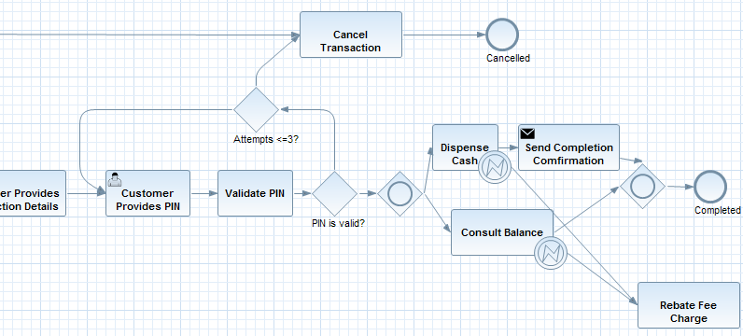
Main Scenario using Prototype – IT Only Changes
Show button again and circle in red
IT View
Some IT only changes are made and are checked into the Shared Model
  Refinement into service calls, send tasks, addition of error handling etc. etc.
  Business View and IT view differ now
  Some changes create traceability links in the shared model

Slide 13
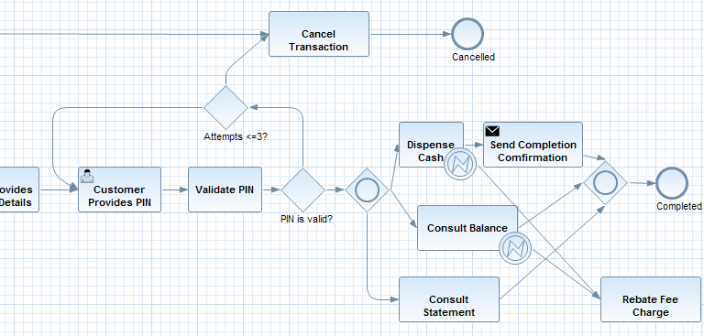
Main Scenario using Prototype – Business Changes
Show again labelled button
IT View
Addition of changes that are business relevant
  E.g. adding a new task
  Various reasons why this is necessary, e.g. incompleteness of the released business model
Business changes are propagated to the business view when checked into the Shared model

Slide 14
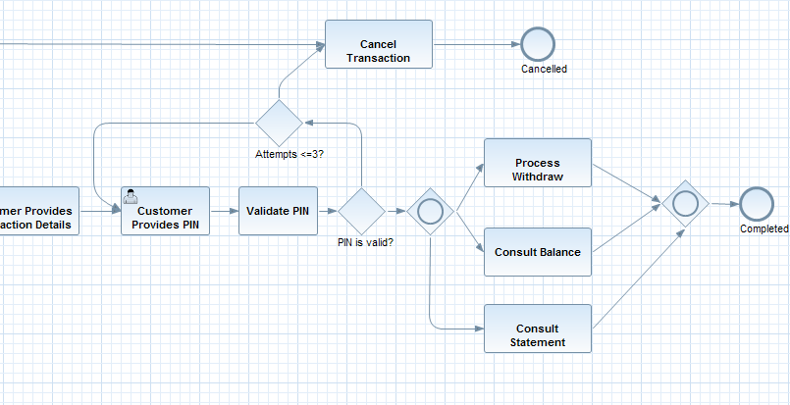
Sample Scenario using Prototype – Resulting Business View
Business View
Business view was automatically updated
On this level, a change management process can be added
  New business changes maybe reviewed and accepted/rejected by business stakeholder

Slide 15
ArtCon Status of Action Items from previous Review
No action items from last review.

Slide 16
Elaboration of Usage Scenarios of Shared Process Model
Refinement of business models for IT implementation
  Currently main working scenario
  Prototype supports this through distinction of IT-only and business-relevant changes
Business change scenario
  IT implementation model has been completed
  Business wants to make changes to the business view
  Propagation of business changes to the IT model
  Currently not yet supported in the prototype
Consistency check scenario
  For changes to the shared model that do not guarantee preservation of consistency between business and IT views, e.g. freehand editing in private IT changes
  Check consistency and support fixing consistency
Change classification of Business/IT elements in shared model
  Business wants to hide details in business view that it is not interested in, or
  IT wants to publish additional details to business which were not published previously to business

Slide 17
IT conform (i.e. meets IT requirements = accepted by IT architect), valid (i.e. accepted by modeling tool), and executable (i.e. accepted by execution engine)
Business conform (i.e. meets business requirements = accepted by business analyst) and valid (i.e. accepted by modeling tool)
Shared Model
 / 
 / 
Business View
IT View
 / 
Business-IT consistency (= integrity of shared model, i.e., business view reflects the executable model)

Slide 18
IT conform (i.e. meets IT requirements = accepted by IT architect), valid (i.e. accepted by modeling tool), and executable (i.e. accepted by execution engine)
Business conform (i.e. meets business requirements = accepted by business analyst) and valid (i.e. accepted by modeling tool)
Shared Model
 / 
 / 
Business View
IT View
 / 
Business-IT consistency (= integrity of shared model, i.e., business view reflects the executable model)

Slide 19
Business Analyst
change
change
get
Shared Process Model
get
Business View
IT View
IT Architect/ Developer
update
update
End User

Slide 20
Business Analyst
change
change
IT Architect/ Developer
get
Shared Process Model
get
Business View
IT View
update
update

Slide 21
Business Analyst
change
change
IT Architect/ Developer
get
Shared Process Model
get
Business View
IT View
put
put
 / 
 / 
 / 
Business conformance
IT conformance
Business-IT consistency

Slide 22
Vertical Consistency/Traceability
3. New M4Doc must be made consistent
Process
Model (M4Doc)
Process
Model (M4Doc’)
1. M4Doc exported to
be initial M4Exec
2 .Evolution by
change operations
Process
Model (M4Exec)
Process
Model (M4Exec’)
Consistency and traceability between M4Doc and M4Exec
  Classification of changes between M4Exec and M4Exec’
  Compute change operations on M4Doc based on changes between M4Exec and M4Exec’
  Reestablishing traceability while constructing M4Doc’

Slide 23
Requirements for a Shared Process Model (1)
We have collected and analyzed the following requirements (from discussion with IT architects in GBS, SWG, PLM, customers)
  (Initialization) business may initialize a shared process model with an initial business level process model
  (Refinement) IT may refine an initial shared process model into an executable model by adding details, adding activities, refactoring the model and , if necessary, changing the structure of the shared model
  (Refinement) Such refinement operations are offered wizard-driven or offered by free-hand editing of the process model (or both)
  (Change categorization) changes to the shared process model done by IT must be designated as business-relevant or not business relevant; IT is responsible for doing this but there may be rules restricting the freedom in this designation
  (View generation) the business view of the shared process model can be displayed at any time, it shows all business relevant elements of the shared model, likewise an IT view of the shared model can be displayed
  (Change propagation) business-relevant changes to the shared process model done by IT will be automatically reflected in a changed business view
  (Change propagation) (business-relevant) changes to the shared process model done by business will be automatically/semi-automatically reflected in a changed IT-view of the shared model

Slide 24
Requirements for a Shared Process Model (2)
  (Change approval) business-relevant changes done by IT may be subject to approval by business
  (Change approval) business may approve only a subset of the changes done; the shared process model should be updated automatically to reflect only the approved changes
  (Change visualization) there should be support for business to see all changes in a consumable way
  (Change visualization) there should be support for IT to see all changes done by business in a consumable way, this should allow IT to understand the required IT changes to implement the business changes
  (Status) the shared process model shows whether it is currently consistent, i.e., its current business view and its current IT view are in sync
  (Status) the shared process model shows whether its current business view is approved by business (i.e., it complies with business req's)
  (Status) the shared process model shows whether its current IT view is approved by IT (i.e., it complies with IT req's)

Slide 25
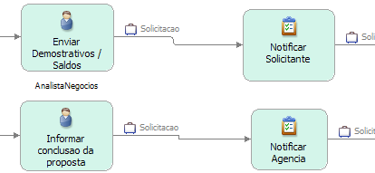
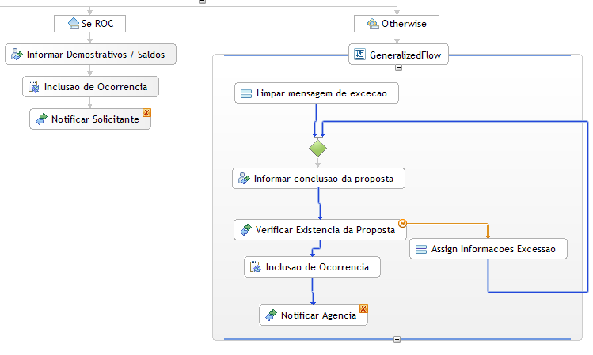
Example
(from Business to IT)
Source: BNB, Brazilian bank
(uses WBM/WID/WPS 6.2)
IT restructures the process to take IT requirements into account
IT adds details that may be irrelevant and overwhelming for business
  Error handling
  Transactionality, Compensation
  Setting attributes
  Data transformation
  Additional snippets/scripts
Business and IT want to have different “views” of the same process

Slide 26
Example for Requirement: Change Approval
Business View
Shared Process
Model
Approve subset of changes done by IT
Shared
Process Model
Business View
IT View
Set of changes
Business View
IT View
Set of changes
Business as well as IT can see the evolution of the shared model from their view
Business can approve/reject business-relevant changes that were introduced by IT

