Slide 1

TTC 2011 Live Contest
Louis Rose

Slide 2
Themes
Transformation for interoperability
Behavioural modelling
Model matching
(A little) model-based testing

Slide 3
Overview
Metamodels:
Specification
Configuration
Results
Your solution
Simulation Engine
Core Task:
Transform specifications to configurations.

Slide 4

Task Resources
All resources are stored on GitHub:
https://github.com/louismrose/ttc2011
  Metamodels.
  Source models.
  Reference target models.
  Instructions and these slides.

Slide 5
Core Task
Configuring the simulation

Slide 6
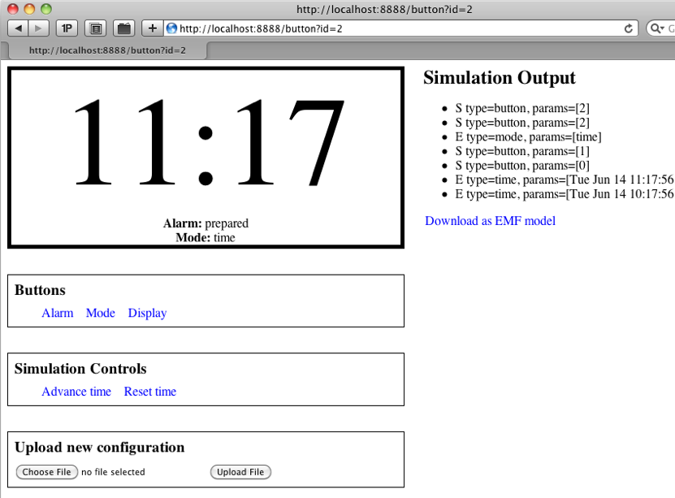
The Simulation Engine
Domain: digital watches
http://ttcsim.appspot.com
Configured with an EMF model
Produces an EMF results model

Slide 7
A Simple Specification
Given the watch is in mode “on”
Then the first button must be called “off”
When the watch enters mode "on"Then the "display" must show "hello"
Given the watch is in mode "on"When the first button is pressedThen the watch must be in mode "off"
...

Slide 8
A Simple Specification
...
Given the watch is in mode “on”
Then the first button must be called “off”
When the watch enters mode "on"Then the "display" must show "hello"
Given the watch is in mode "on"When the first button is pressedThen the watch must be in mode "off"

Slide 9
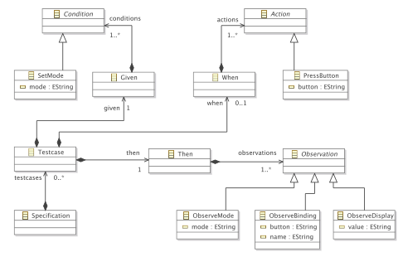
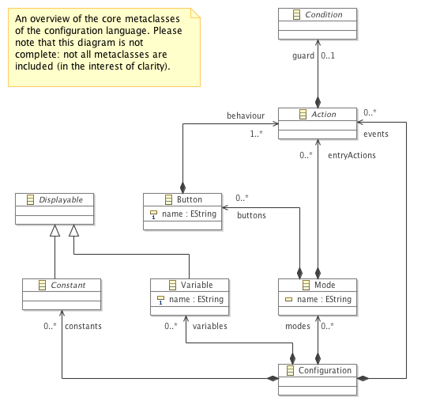
The Transformation
Specification
Simulation configuration

Slide 10
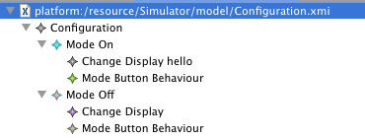
A Configuration
The on/off watch specification should be transformed to produce the following configuration:

Slide 11
Extension 1
Robustness of the transformation

Slide 12
Unusual Specifications
Given the watch is in mode "alarmTime"Then the third button must be called "minute" the first button must be called "mode" the second button must be called "hour"
Given the watch is in mode "time" the "indicator" is showing "unset"When the second button is pressedThen the "indicator" must show "set" the alarm must ring the display must show "alarm"

Slide 13
Unusual Specifications
Can your transformation manage these unusual specifications?
Can you define further types of (valid and consistent) specification that all solutions should aim to tolerate?

Slide 14
Extension 2
Matching test results with specifications

Slide 15
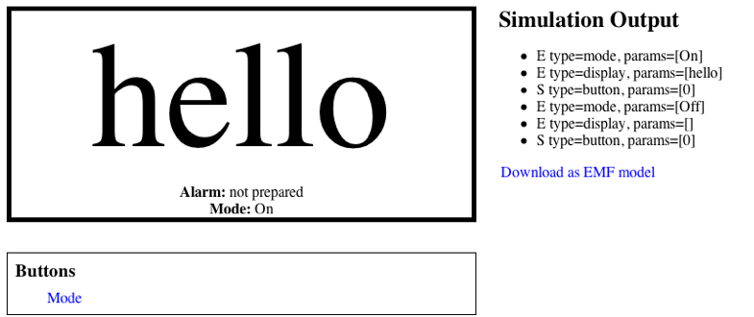
Simulation Results
The simulation provides a results model:

Slide 16
Extension 2 (Matching)
Match the specification and results models to produce a test report
Specification model
Test report
Results model

Slide 17
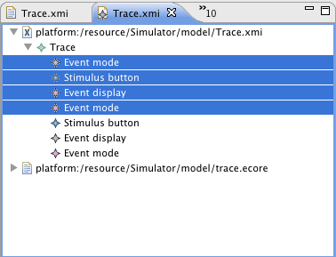
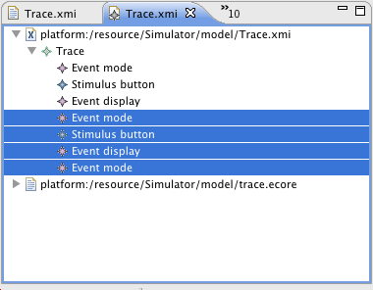
Matching Example
Given the watch is in mode “off”
When the first button is pressed
Then the mode must be “on”
the display must show “hello”
Given the watch is in mode “on”
When the first button is pressed
Then the mode must be “off”
the display must show “”

