Slide 1


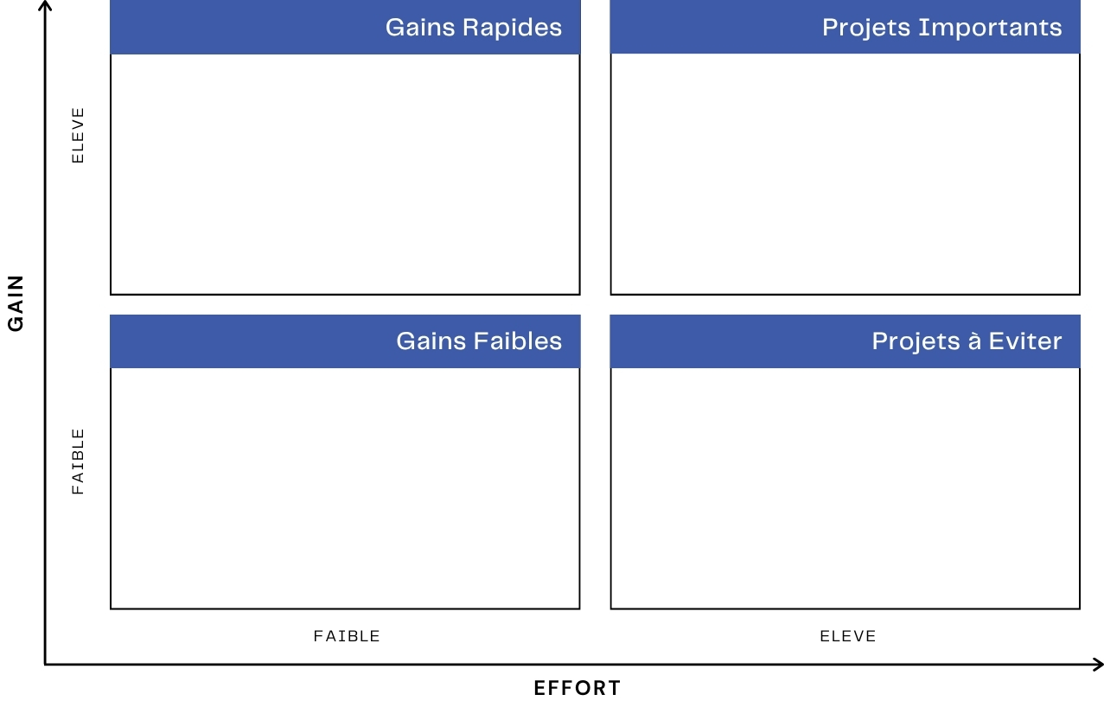
Matrice Gain Effort
Chantier : _______________________________________
Date : _________________

