Slide 1
TRAINING SESSION
Deploy Your First Website
to GitHub Pages
Manual deployment → automated with a Claude Code skill
Louis Roehrs · TeleTrex · Mountain View, CA
https://teletrex.com

Slide 2

What we'll cover today
1
Part 1 — Manual deployment
Create a repo, push your code, enable GitHub Pages step by step
2
Part 2 — Automate it
Build a /deploy-github-pages Claude Code skill that does all of Part 1 in one command
3
Part 3 — Work together
Fork a repo and make lasting changes
Materials at this link —>
Prerequisites: a GitHub account, Git installed, and a text editor.
https://teletrex.com
2

Slide 3
PART 1
The Manual Way
Six steps from zero to a live website
https://teletrex.com
https://teletrex.com

Slide 4
BACKGROUND
What is GitHub Pages?
Free static website hosting provided by GitHub
Serves HTML, CSS, JS and images directly from a repository
Instant HTTPS — no configuration needed
Custom domains supported (CNAME file)
Deploys automatically on every push to your chosen branch
Free for public repos; private repos need GitHub Pro or Team
Your URL will be
https://username.github.io/repo-name
https://acme.github.io/landing
https://teletrex.com
4

Slide 5
PREREQUISITES
Before you start
Free GitHub account
https://github.com/signup
Open a terminal window
Terminal.app, iTerm, Windows Terminal
Install GitHub CLI (gh)
cli.github.com or brew install gh — optional but handy
A text editor
VS Code, Cursor, Notepad — anything works
Install Git on your machine
git-scm.com or brew install git
https://teletrex.com
5

Slide 6
STEP 1 OF 6
Create your HTML file
Create a folder for your project and add a file named index.html — GitHub Pages serves this as your homepage.
<!-- index.html -->
<!DOCTYPE html>
<html lang="en">
<head>
<meta charset="UTF-8" />
<title>My First Site</title>
</head>
<body>
<h1>Hello from GitHub Pages!</h1>
<p>My first live website.</p>
</body>
</html>
https://teletrex.com
⚠ The file must be named exactly index.html (all lowercase). Any other name won't be served automatically.
6

Slide 7
STEP 2 OF 6
Initialize a local Git repository on your machine
In your terminal, navigate to your project folder and run:
# Navigate to your project folder
cd ~/projects/my-site
# Initialise a new git repository
git init
# Stage all files
git add .
# Create your first commit
git commit -m "Initial commit"
What this does
git init — creates a hidden .git folder that tracks changes on your machine
git add . — stages every file in the folder
git commit — saves a snapshot you can push
https://teletrex.com
7

Slide 8


STEP 3 OF 6
Create a GitHub.com repository
Option A — GitHub website (UI)
Option B — GitHub CLI (faster)
If you have gh installed and authenticated:
gh auth login
# One command creates the repo
gh repo create my-site \
--public \
--source=. \
--remote=origin \
--push
# Then skip to slide 10!
Go to github.com and sign in
Click New for new repository
Give it a name
Add a description
Set visibility to Public
Do NOT initialize with a README
Click Create
https://teletrex.com
8

Slide 9
STEP 2 OF 6
Install gh
Macintosh
Windows
winget install --id GitHub.cli
# chocolatey
choco install gh
brew install gh
# verify
gh —-version
Linux
https://github.com/cli/cli/blob/trunk/docs/install_linux.md
https://teletrex.com
7

Slide 10
STEP 4 OF 6
Push your code to GitHub
Connect your local repo to GitHub, then push. Copy the URL from the repo page you just created.
# Add GitHub as the remote named 'origin'
git remote add origin https://github.com/YOU/my-site.git
# Rename the default branch to 'main' (GitHub's default)
git branch -M main
# Push and set upstream tracking
git push -u origin main
# Future pushes are just:
git push
Replace YOU with
your GitHub username
https://teletrex.com
9

Slide 11
STEP 4 OF 6
Development cycle
# Make edits
# View in the browser, if you don’t like, edit until you like:
# See what files changed
git status
# See what exactly changed
git diff
# If you like the result, add files to the change list
git add <files>
git add —all
# If you like the result, add files to the change list
git commit -m “Added a pretty icon to the home page”
# Publish the changes to your site.
git push -u origin main
https://teletrex.com
9

Slide 12
STEP 3 OF 6
Syncing
git add
git commit
Local repository on your machine in the .git directory of your project.
https://github.com repository
git push
git pull
https://teletrex.com
8

Slide 13
STEP 5 OF 6
Enable GitHub Pages
Option A — GitHub website (UI)
Option B — GitHub CLI
1
Open your repo on github.com
# Enable Pages via the gh CLI
gh api \
-X POST \
/repos/YOU/my-site/pages \
-f source[branch]=main \
-f source[path]=/
# Check deployment status
gh api /repos/YOU/my-site/pages \
--jq '.html_url'
2
Click Settings (top tab row)
3
Scroll to Pages in the left sidebar
4
Under Source, select "Deploy from a branch"
5
Branch: main / Folder: / (root)
6
Click Save
https://teletrex.com
10

Slide 14
STEP 6 OF 6
Your site is live. 🎉
Visit it at:
https://YOUR-USERNAME.github.io/my-site
It takes ~60 seconds for the first deployment to go live
Check the Actions tab in your repo to watch the deploy progress
Every git push to main will auto-redeploy
https://teletrex.com

Slide 15
TROUBLESHOOTING
Common gotchas
File named wrong
Must be exactly index.html — not Index.html, home.html, or index.htm
Repo is private
GitHub Pages on private repos requires GitHub Pro, Team, or Enterprise
Site not updated yet
First deploy takes ~60 s. After that, changes propagate in 1–2 minutes
404 on all pages
Pages is enabled but pointing at the wrong branch or folder — re-check Settings → Pages
Authentication error on push
Run gh auth login or create a Personal Access Token at github.com/settings/tokens
https://teletrex.com
12

Slide 16
PART 2
Automate It with
a Claude Code Skill
One command. All six steps. Done.
https://teletrex.com
https://teletrex.com

Slide 17
CONCEPT
What is a Claude Code skill?
A custom /slash-command you define for Claude Code
Stored as a Markdown file in either:
~/.claude/commands/ (user-wide) or
.claude/commands/ (per-project)
When invoked, Claude reads the file and follows the instructions — it can run shell commands, edit files, call APIs
Accepts optional $ARGUMENTS so you can parameterize the command
No plugin system, no build step — just a .md file
~/.claude/
└── commands/
├── deploy-github-pages.md
├── create-pr.md
└── run-tests.md
Invoke it in Claude Code:
claude$ /myskill
https://teletrex.com
14

Slide 18
THE SKILL
deploy-github-pages.md — the skill file
---
description: Deploy the current project to GitHub Pages
---
Deploy this project to GitHub Pages.
Repo name (optional): $ARGUMENTS
1. Verify git is installed. If not, tell the user and stop.
2. Verify gh is installed and authenticated (gh auth status).
If not authenticated, run gh auth login and wait.
3. If no .git folder exists: git init, git add ., git commit.
4. If no remote 'origin': gh repo create $ARGUMENTS --public
--source=. --remote=origin --push, then skip step 5.
5. Otherwise: git push -u origin main
6. Enable Pages: gh api -X POST /repos/{owner}/{repo}/pages
-f source[branch]=main -f source[path]=/ (ignore 409).
7. Poll gh api /repos/{owner}/{repo}/pages --jq .html_url
until it returns a URL. Print: 'Live at <url>'
https://teletrex.com
16

Slide 19
CONCEPT
Install /deploy-github-pages skill for all sites
mkdir -p ~/.claude/commands
curl https://raw.githubusercontent.com/louisroehrs/github-pages-training/refs/heads/main/deploy-github-pages.md -O
cp deploy-github-pages.md ~/.claude/commands/
https://teletrex.com
14

Slide 20
USAGE
How to use the skill
Run it from any project
In Claude Code, just type:
# Specify the repo name:
/deploy-github-pages my-landing-page
Claude will check prerequisites, create the repo,
push your code, enable Pages, and return your live URL — all without leaving your editor/claude code.
The skill handles every edge case: no git repo, no remote, Pages already enabled — all gracefully.
https://teletrex.com
17

Slide 21
UNDER THE HOOD
What the skill does — step by step
1
Check prerequisites
Verifies git and gh are installed and gh is authenticated
2
Git init if needed
Runs git init, git add ., git commit if no repo exists yet
3
Create GitHub repo
gh repo create — public, no README, sets origin remote
4
Push code
git push -u origin main
5
Enable Pages
GitHub API call via gh api to activate Pages on main /
6
Return live URL
Polls until the site is live, then prints the URL
https://teletrex.com
15

Slide 22
You're live.
Manual: 6 steps, ~5 minutes, zero cost
Automated: /deploy-github-pages, ~30 seconds
Skill file lives in ~/.claude/commands/ — works in any project
https://teletrex.com
https://teletrex.com

Slide 23
PART 3 Concept
Fork, Edit, & Pull Request (PR)
The concept
https://teletrex.com
https://teletrex.com

Slide 24
CONCEPTS
What is Forking?
A fork is your personal copy of someone else's repository.
Lives under your GitHub account — you have full write access.
The original repo is called the upstream.
Changes in your fork don't affect the upstream repo until a Pull Request (PR) is merged.
You create a Pull Request to propose your changes back to the original project.
Maintainers review, discuss, and merge (or decline) your PR.
Example repo for today
https://github.com/hd-admin/hackerdojo.org
Your fork: https://github.com/YOUR-USERNAME/hackerdojo.org
https://teletrex.com
20

Slide 25

CONCEPTS
Process visualized: Fork the repo
github.com/hd-admin/hackerdojo.org
github.com/louisroehrs/hackerdojo.org
cd /Users/lroehrs/awork
git clone https://github.com/louisroehrs/hackerdojo.org.git
# creates /Users/lroehrs/awork/hackerdojo.org
git remote add upstream https://github.com/<original-owner>/project.git
git remote -v
https://teletrex.com
20

Slide 26
CONCEPTS
Process visualized: Make a cool change
github.com/hd-admin/hackerdojo.org
github.com/louisroehrs/hackerdojo.org
Never work on main!
git checkout -b my-feature-name
# edit edit debug edit edit debug say things edit edit got it
git add .
git commit -m “What changed and why”
# push to your fork
git push origin fix-login-bug
https://teletrex.com
20

Slide 27

CONCEPTS
Process visualized: Make a pull request
github.com/hd-admin/hackerdojo.org
https://teletrex.com
20

Slide 28
PART 3 Action
Fork, Edit, & Pull Request (PR)
Now, let’s do it.
https://teletrex.com
https://teletrex.com

Slide 29
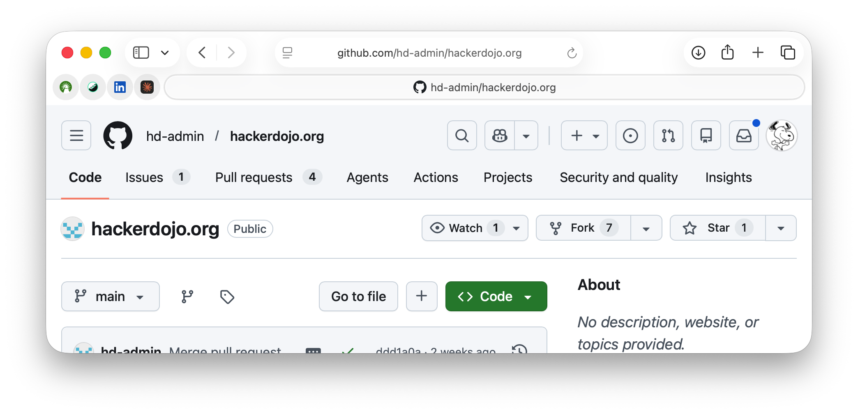
STEP 1 OF 4
Fork the repository on GitHub
Navigate to the repo on GitHub and click Fork in the top-right corner.
https://teletrex.com
💡 Your fork is fully independent. Pushes go to YOUR copy only — nothing changes upstream until you open a PR.
21

Slide 30
STEP 2 OF 4
Clone your fork to your machine
Clone YOUR fork (not the original), then add upstream so you can pull future updates.
# Clone your fork
git clone https://github.com/YOUR-USERNAME/hackerdojo.org
# Enter the project folder
cd hackerdojo.org
# Track the original as 'upstream'
git remote add upstream https://github.com/hd-admin/hackerdojo.org
# Confirm both remotes are set
git remote -v
https://teletrex.com
💡 Always clone YOUR fork, not the upstream. Cloning upstream gives you no push access and skips the PR workflow.
22

Slide 31
STEP 3 OF 4
Create a branch, make your changes, and commit
Work on a dedicated branch — never commit directly to main.
# Create and switch to a feature branch
git checkout -b fix/update-homepage-text
# Edit the file you want to change
# e.g. open index.html in your favorite editor or agent
# Stage your changes
git add index.html
# Commit with a clear, descriptive message
git commit -m "Update homepage welcome text"
https://teletrex.com
💡 Branch names like fix/…, feat/…, or docs/… signal intent at a glance and keep your main branch clean.
23

Slide 32
STEP 4 OF 4
Push your branch and open a Pull Request
Push the branch to YOUR fork, then open a PR against the upstream repo.
# Push the branch to your fork
git push -u origin fix/update-homepage-text
# Open a PR with the GitHub CLI
gh pr create --repo hd-admin/hackerdojo.org \
--title "Update homepage welcome text" \
--body "Improves the welcome message for new visitors."
# GitHub also prints a URL after the push — open it to
# create the PR in the browser instead.
https://teletrex.com
💡 After your PR is merged: git pull upstream main && git push origin main keeps your fork in sync.
24

Slide 33
STEP 4 OF 4
After PR is merged
Get the latest back into your repository and on your machine.
# Get the latest code from upstream (hd-admin/hackerdojo.org)
git pull upstream main
# Now the latest is on your machine but not in your
# github.com repository.
# Let’s push it there.
git push origin main
# You can also use the UI to sync your github.com repo and
# do:
git pull origin main
https://teletrex.com
Now, everything is in sync and ready for the next branch.
24

Slide 34
PART 4 Domain Name
Git yer CNAME in lights
Use one of those domains you registered years ago for your new site!
https://teletrex.com
https://teletrex.com

Slide 35
STEP 1 OF 4
Add a CNAME file to the root of your site.
Same directory as your index.html. It contains your domain name.
CNAME
teletrex.com
https://teletrex.com
22

Slide 36
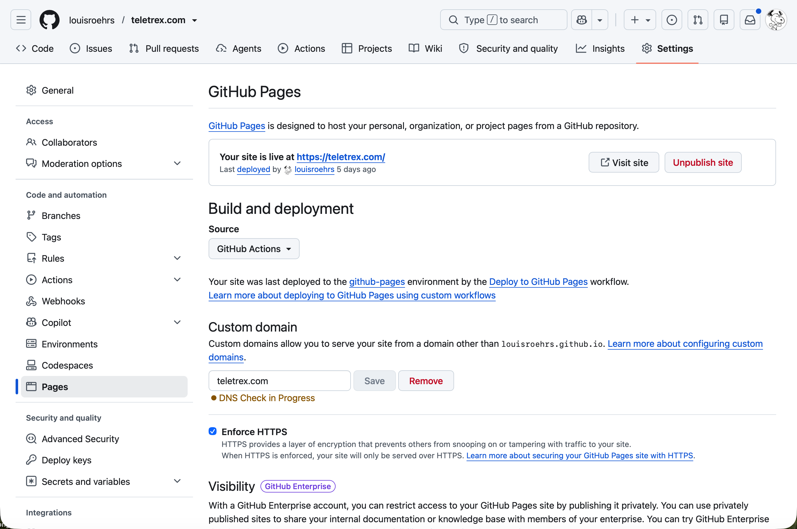
STEP 2 OF 4
Tell Github Pages about it.
Settings -> Pages https://github.com/<username>/<repository name>/settings/pages
https://teletrex.com
22

Slide 37
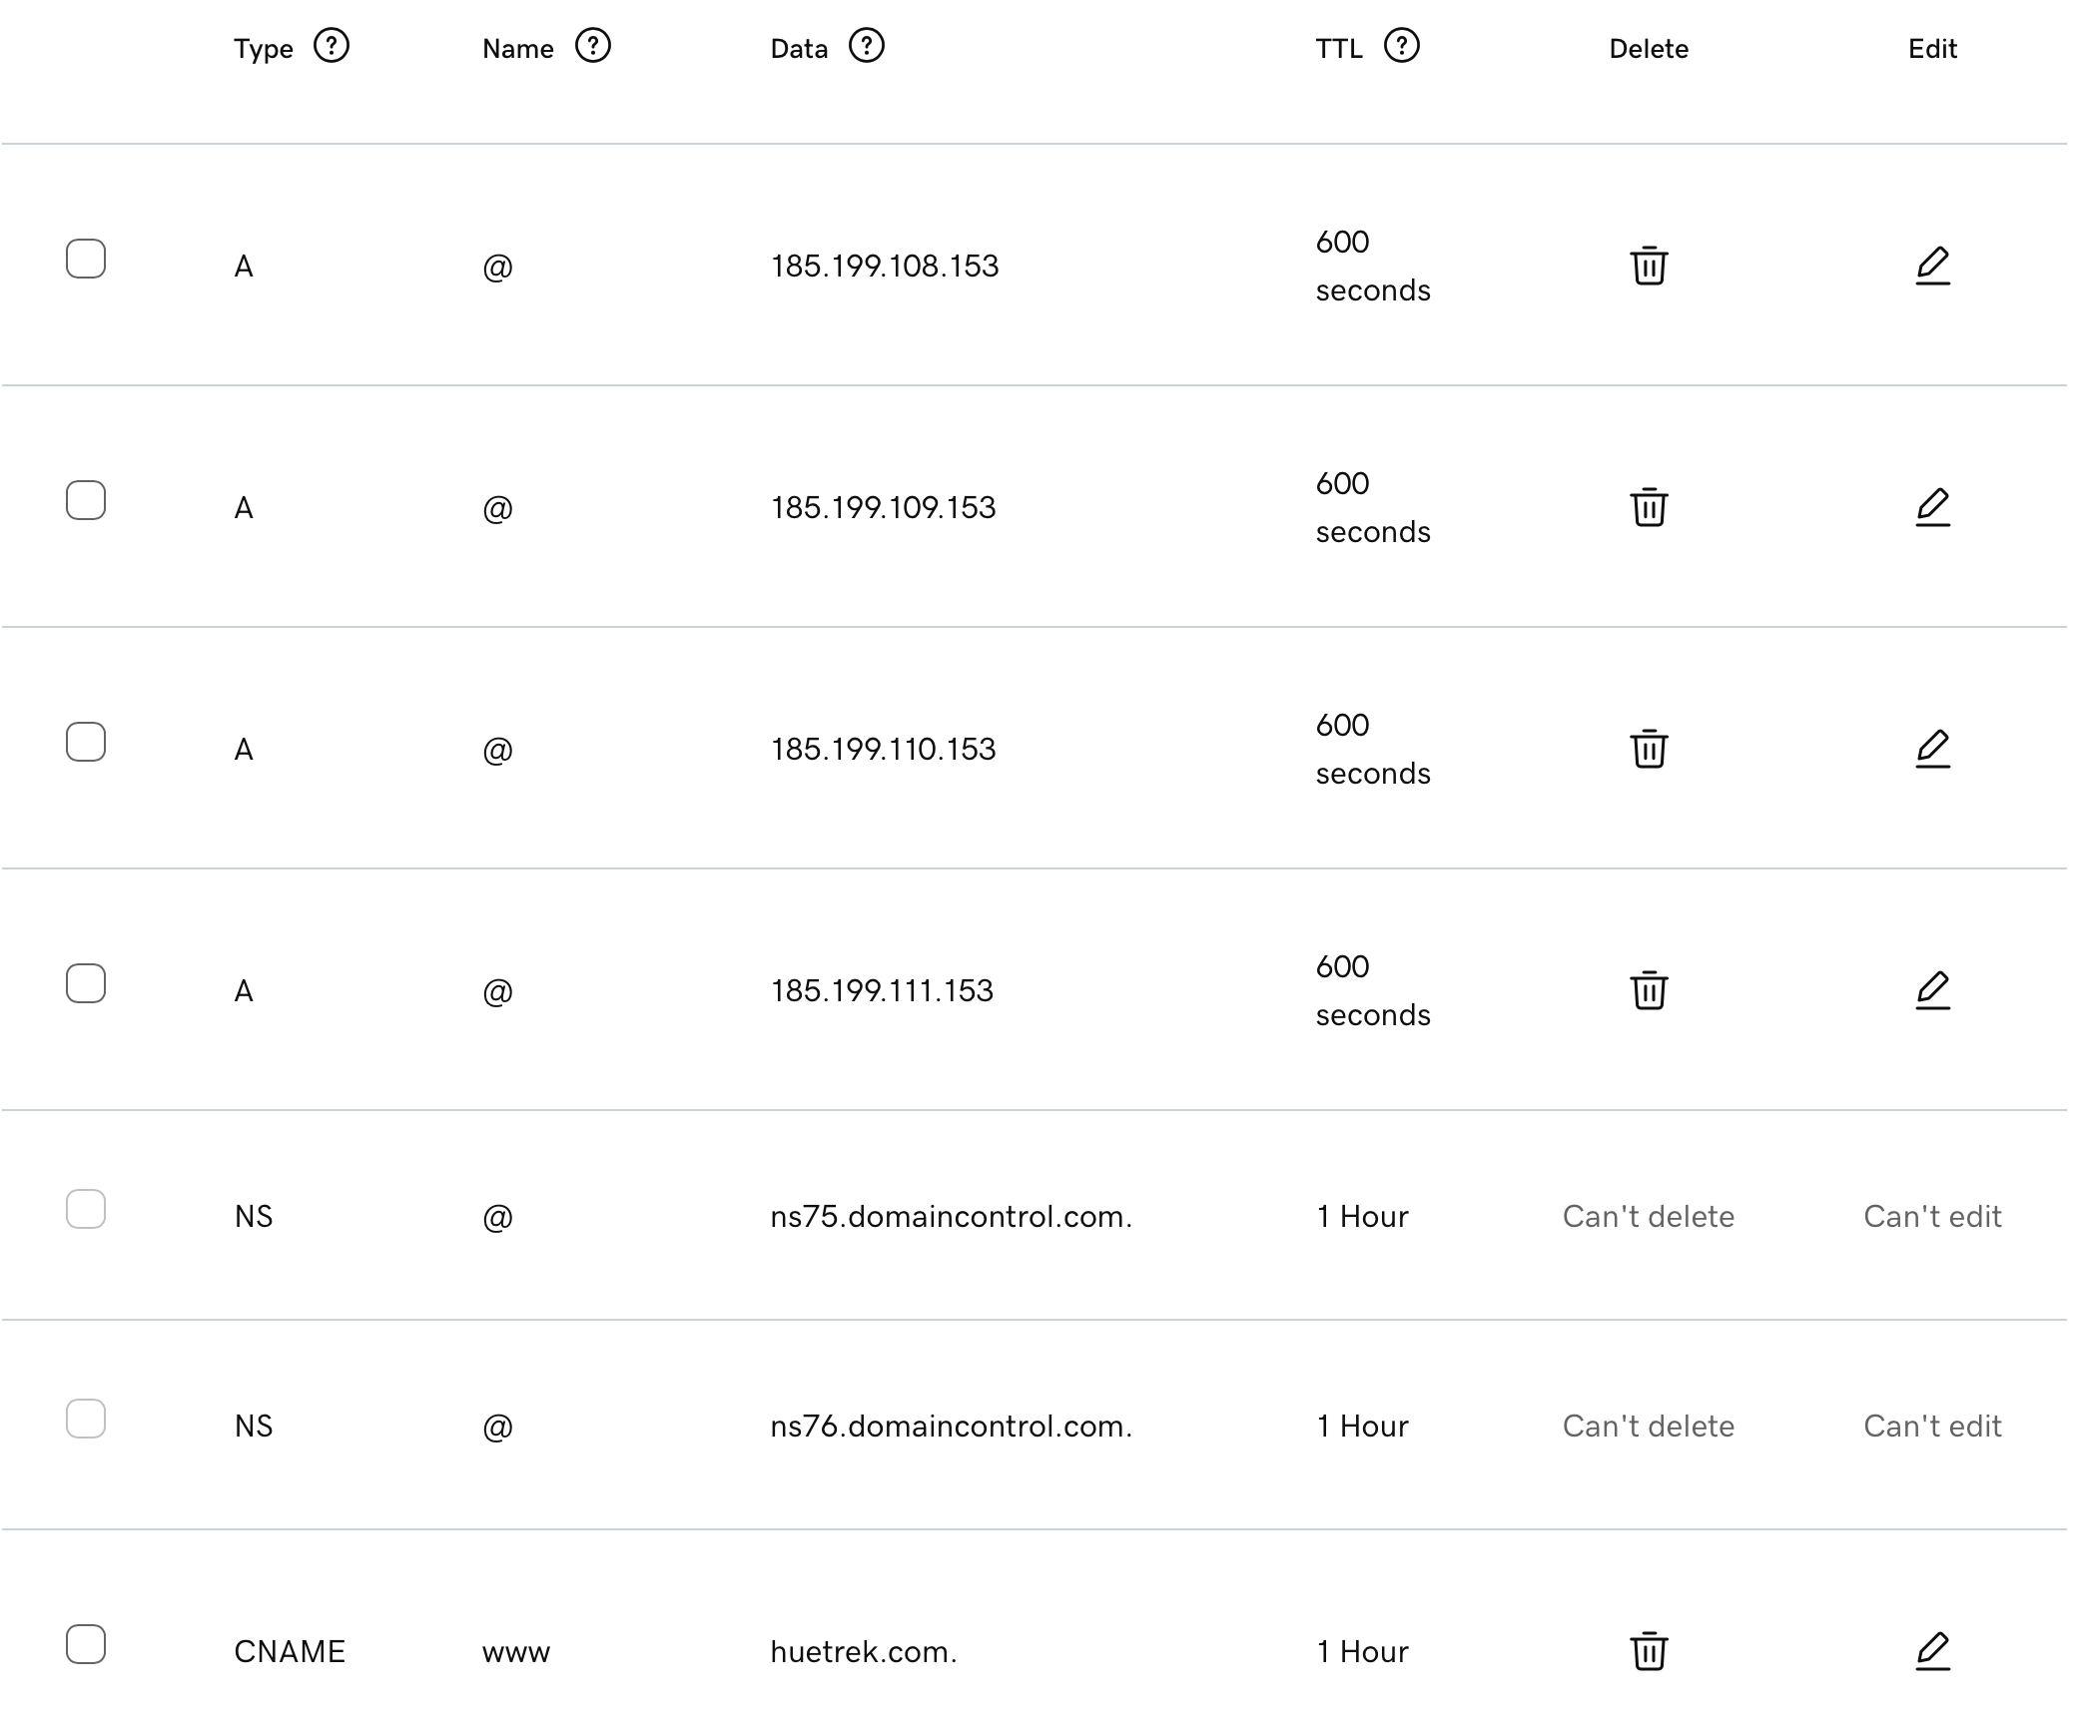
STEP 3 OF 4
Tell your domain registrar where to point your domain.
Varies by domain registrar. GoDaddy shown here.
Login to Domain Registar where your domain name is registered. GoDaddy, Network Solutions, etc.
Look for Domain management.
Look for DNS Records
Set A records to github domains
Set CNAME www record.
Check back tomorrow.
https://teletrex.com
22

Slide 38
STEP 4 OF 4
Take a break.
The domain will take overnight to propagate.
Check github to see if your domain was validated.
If so, enforce https.
Github will set up a certificate so that your site will work at https in addition to http giving your site more social web cred.
https://teletrex.com
22

Slide 39
You're ready.
Now you can contribute to any open source project the right way.
https://teletrex.com
https://teletrex.com

Slide 40
Next session
How to chat with your site.
QR Code to get on the list.
https://teletrex.com
https://teletrex.com

