Slide 1
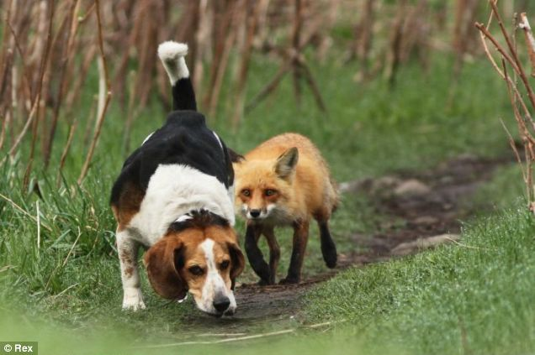




How to measure and predict the culling impact on red fox population dynamics ?
29.08.2013
International
Union of
Game
Biologist
Congress
Brussels - Belgium
LIEURY Nicolas¹, RUETTE Sandrine², ALBARET Michel²,
DEVILLARD Sébastien³ et MILLON Alexandre¹
1 – IMBE, Aix-Marseille Université, Aix-en-Provence, France
2 – ONCFS CNERA Animaux prédateurs et déprédateurs, Birieux, France
3 – LBBE, UCB Lyon 1, Villeurbanne, France
Notes:
Good afternoon Ladies and Gentlemen, my name is Nicolas Lieury and it’s a great pleasure to close this IUGB congress with some on-going work of my PHD, which takes place between AIX-Marseille University (with Alexandre Millon) and the University of Lyon (with Sebastien Devillard).

Slide 2
Introduction – I. Measure – II. Predict – Conclusion
Population management occurs :
N
WHEN : “overabundant”
“pest” species
“invasive”
CULLING
FOR : Biodiversity protection
Disease reservoir
Economical damages
Predation on game species
t
Objectives:
Population Management
Sustainability
Efficacy
Annual plan
Debate
Population management = understanding + prediction
Notes:
Animal population management by culling is a common practice that is used to control population density of species that are considered as “overabondant”, “pest”, or “invasive” in order to control the spread of disease reservoir, economical damages and predation on game species. The aim of such management is to keep the target species at densities which are consistent with human economic activities, human health and biodiversity objectives. On the other hand, a management has to be efficient with annual plan optimizing the cost/benefit ratio. Finally, managing wild populations can raise conflicts between different actors about its relevance. In this context, a careful understanding of management consequences on population dynamics and the ability to make prediction are key...

Slide 3

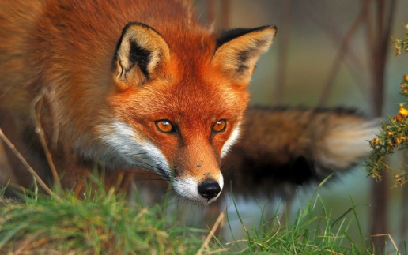


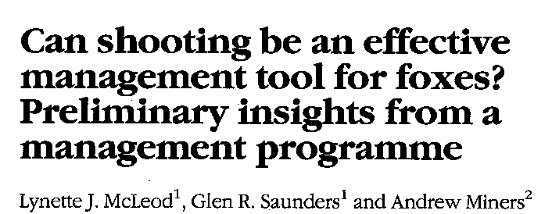



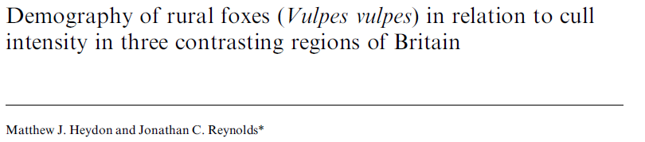
Introduction – I. Measure – II. Predict – Conclusion
The Red fox
Hunt as a game species in Europe
Culled in Europe for population management
Culled in Australia as an invasive
Intense debate about the relevance of fox culling
Vulpes vulpes
Quantification of culling impact on population growth is required
Notes:
The Red fox is managed by culling worldwide. The red fox is hunted as a game species and culled for management purpose all over Europe. It’s also culled for its invasiveness in several islands as in Australia. However, there is an intense debate about the efficacy of fox culling in control population densities: Here are several references around the issue, some authors involved in this hot debate being present at the congress. If local management is known to be efficient, the culling impact at large scale (>1000km²) is less accepted. Rather surprisingly, some key data are still lacking if we are to assess the relevance of fox culling. Particularly, the methods used in these papers to quantify culling effort and its consequences (such as density estimation, cull quantification and statistical analysis) are often criticized for bias or irrelevance.

Slide 4
Introduction – I. Measure – II. Predict – Conclusion
Part I : Measure the culling impact
A new quantification of culling intensity
Time decomposition along red fox life cycle
To further the debate about culling relevance
Part II : Predict the culling impact
Matrix Population Models from our demographic survey
Retrospective analysis to investigate the role of demographic parameters during the culling treatment
Population management = understanding + prediction
Notes:
That’s why, in the first part of my talk, I will present a concrete measure of culling intensity that enable us to further the current debate with additional quantitative arguments. I will show how this metric can also take care of red fox life cycle and investigate the importance of a time-scheduled management.
Because (Remember it: population management = understanding+prediction), I will investigate in a second part our ability to predict red fox population dynamics from our demographic survey using Matrix population modelling. If matrix models have already been used to propose management guidelines from parameter elasticities, the difficulty to interpret prospective analyses is today well known. However, here we were able to carry out retrospective analyses and study the a posteriori contribution of each demographic parameters during the culling treatment.

Slide 5
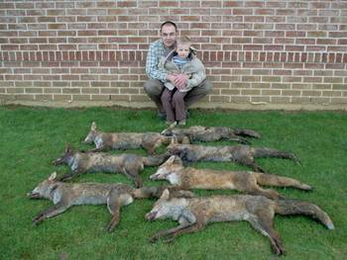
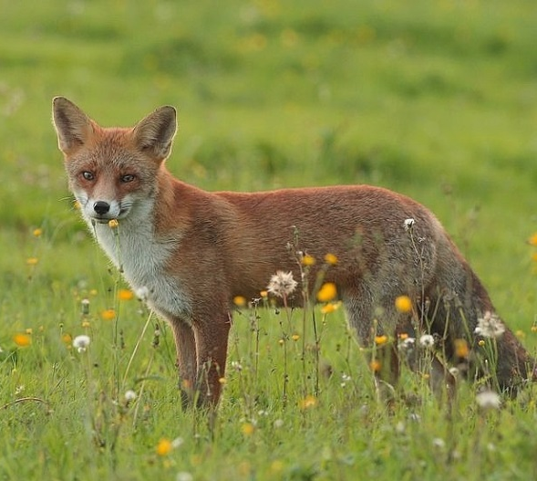
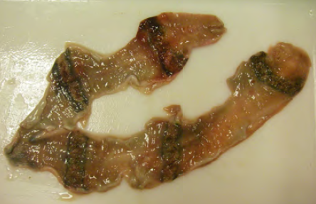
Introduction – I. Measure – II. Predict – Conclusion
Number of known killed foxes
Culling Rate
Number of red foxes that could have been killed
126 m
Distance sampling spotlight count
Reproductive performance from uterus examination
Assumptions: All the mortality causes are anthropogenic (hunting, culling, road)
The population is closed, i.e. no immigration and emigration
A new numerical metric to investigate culling impact
Notes:
So, let’s start with my first part about the measure of culling impact from different data sources. Here, I present the principle of the measurement. First, we obtained beside hunters and trappers the annual number of killed foxes. Then, from annual density estimated by Distance Sampling and annual reproductive performances measured by analysis of vixen uteri, we derived the number of red foxes that could have been potentially killed each year. The ratio of these quantities gives an annual site specific culling rate, which constitutes the numerical explanatory variable of the variation of population growth. However, we need to assume that anthropogenic causes of mortality are a majority (which appears to be true in controlled population) and that the population is closed, without immigration and emigration, which is perfectly wrong.

Slide 6
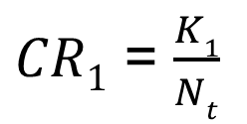
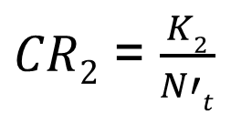
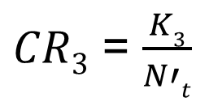
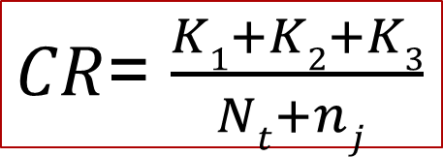
Introduction – I. Measure – II. Predict – Conclusion
_{with nj = N’t x LS x PB}
N_{t}
N‘_{t} =N_{t} -K₁+ n_{j}
N_{t+1}
K₁
K₂
K₃
February
Year n
April
September
February
Year n+1
Gestation
Cubs in the den
Dispersal
Notes:
We can project this idea on the red fox life cycle. After copulation, the gestation takes place in February-March until parturition occurs early April. Cubs stay in the den under parent’s care and growth before to disperse in September. Autumn consists in a movement phase for finding a territory and a mate in Winter. The annual spotlight count estimates population density each beginning of February where all foxes are adults. A number of K1 individuals are killed before April and the culling rate during the first period is K1/Nt, the number of fox that can be killed. In April, it remains Nt-K1 adults on which are added the number of new-borns derived from the time series of age-specific reproductive performance. We can calculate the culling rates of the next two periods using this potential of individuals N’t. Finally, the annual culling rate is the sum of all killed foxes relative to the initial population size with the spring births.

Slide 7
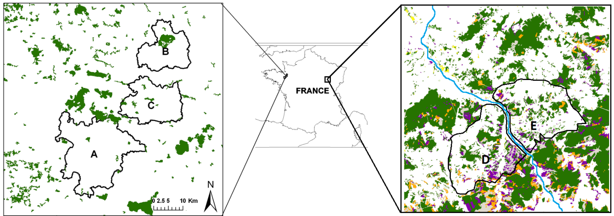
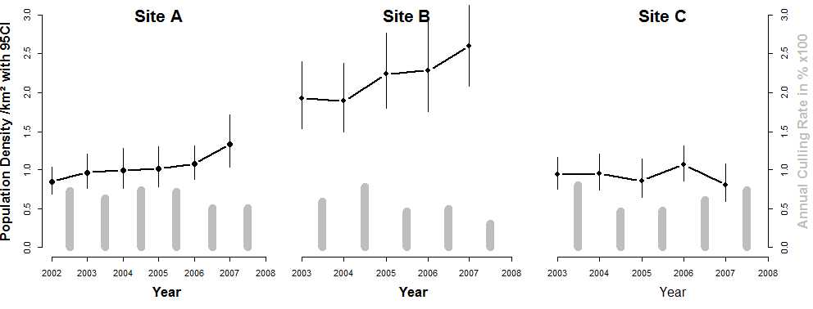
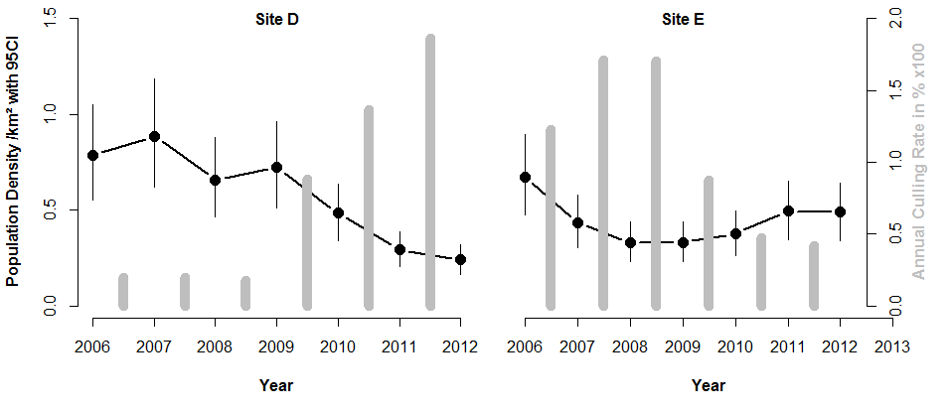
Introduction – I. Measure – II. Predict – Conclusion
6 years
5 sites
1200 km²
Intense culling
The protocol succeeds in creating contrasted situations, which enable the quantification of culling impact in various sites.
Notes:
The management protocol set up by Sandrine Ruette, from the French Game and Wildlife Agency consisted in 6 years of culling pressure in 5 areas of a total surface of 1200 km². Areas correspond to local management units where culling methods and pressure is homogeneous. You can observed here the co-variation of red fox density (in black) and culling rate (in grey) in the different locations. Roughly, the western sites present increasing or stable densities associated with decreasing or stable culling rates. In eastern sites, we observed a clear results of density variation after a BACI protocol where an intense culling treatment have been successively applied on the site, after in D and before in E, a control situation that corresponds to usual culling pressure. First, you have probably noticed that intense culling exceed 100 % of the available population. This is a consequence of the assumption of a closed population. Indeed, immigration is known to fill empty territories with surrounding individuals. Then, we can observe that this intense culling succeeds in reducing population density, even if recovery quickly operates after the release of the pressure. Thus, here is already the idea that culling needs to be intense and continuous to be efficient. In any case, this protocol succeeds in creating contrasted situations in several sites in a short time period, enough to enable the quantification of culling impact on population growth.

Slide 8
Introduction – I. Measure – II. Predict – Conclusion
Ability of the red fox to buffer culling
Negative density-dependence
Fox resistance to culling thanks density-dependence
Notes:
Here, you have the prediction of the selected GLM studying annual population growth rate variation on annual culling rate. At our scale, culling significantly impacts red fox dynamics but stability is obtained for an average of 75% culling rate, with large variation in relation to site specific initial state. This intense required culling suggests an ability of red fox populations to support culling. A mechanism that could explain this resistance is a negative density-dependence. Here, annual growth rate prediction decreases with population density. This implies that reducing density by culling may boost red fox population growth and could explain fox “resistance”.

Slide 9
Introduction – I. Measure – II. Predict – Conclusion
CR₁
CR₂
CR₃
Density-dependent immigration process occurs after culling.
An autumnal culling seems more efficient for limiting dispersal.
Density-dependent immigration enables fox resistance
Notes:
Now, we investigate in this three graphs how the time-scheduled of culling could influence results depending on red fox life cycle. The previous graph is simply split up with the three culling rate I already introduced. You can notice that culling significantly impacts population growth only during autumn after dispersal occurs. According several references, we hypothesized density-dependent immigration to occur after culling and to fill empty territories. In other works, we checked that reproductive performance is not increased by low density in our system. Thus we argue ere that autumnal culling seems to better impact population growth than other periods as it should limit filling by dispersal. We currently expected this process to be responsible for most red fox ability to support culling.

Slide 10
Introduction – I. Measure – II. Predict – Conclusion
Time series of survival estimates from life table
Time series of reproduction estimates from uterus examination
MATRIX POPULATION MODEL ITERATION
Compared to
126 m
Multiple information source to predict dynamic
Notes:
Let’s move to the second part of this presentation. Here, we used time series of survival estimates from life table built on age-at-death data and time series of reproductive performances to simulate matrix population model iterations that we compared to observed density variations. I highlight the fact that multiple and independent information sources was required here to predict population dynamics.

Slide 11
Introduction – I. Measure – II. Predict – Conclusion
S: Survival
pB: Breeding probability
LS: Litter size
Good prediction of population dynamics from demographic estimates
Equitability of elasticities with higher importance of (juvenile) survival
Good prediction of population trends from the survey
Notes:
Here, you can see in red the simulated trends according demographic estimates compared to observed population survey (in black). Such fairly good prediction is observed for all study sites. Moreover, we are able to derive the elasticity of all demographic parameters, two classes of survival rate and four ages of reproductive performance LS and PB. As a reminder, Elasticity corresponds to a priori contribution of vital rates to population growth. You can firstly observe the equal contribution of parameters (except for old ages) that is coherent to life-history theory of a small carnivorous. But you can also point out the higher importance of survival (especially for juveniles) in this model.

Slide 12
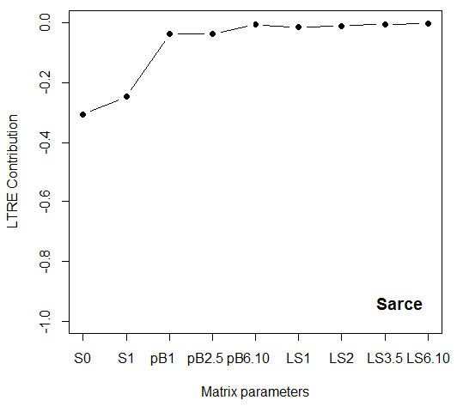
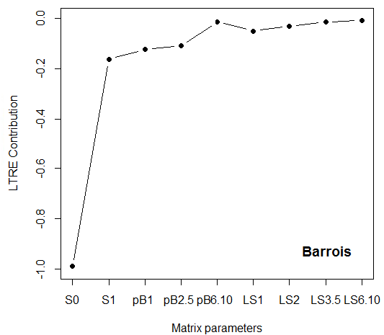
Introduction – I. Measure – II. Predict – Conclusion
Site D
Site E
Intense culling
Higher contribution of juvenile survival
Contrasting situations with different contributions of adult survival
Impact juvenile survival is more efficient
Gap between management actions and results
Notes:
Then, we take advantage of the BACI protocol in eastern sites to perform retrospective perturbation analysis or LTRE. Because an intense culling was sequentially imposed in the two areas, we could measured the contribution of each demographic parameter on the impact of the intense culling. You can notice in both sites the higher contribution of juvenile survival. However, we detect contrasting situations between the two places. In D, the intense culling reduced density by impacting mainly juvenile survival whereas the culling in E also impacts adult survival. Given that culling was more efficient in D than in E, it confirms the slight predominance of juvenile survival in fox dynamic. However, we are still enable to explain these two situations by differences in management action (especially the bias of culling methods used), suggesting a gap between the management action and the observed impact.

Slide 13
Introduction – I. Measure – II. Predict – Conclusion
Part I : Measure
A new metric of culling rate to measure culling impact.
Arguments for the ability of red fox to buffer culling
Density-dependent immigration ?
Part II : Predict
Multiple sources for demographic estimation but the use of age-at-culling data should be optimized.
Higher contribution of juvenile survival on fox dynamics
Gap between management actions and results
Significant new understanding on fox dynamics under culling
Notes:
It’s time to conclude and to remind you the take home message of this talk before the congress finishes. In the first part, we presented a metric of culling pressure that enable us to measure the impact of red fox management. We furthered the scientific debate with new arguments in favour of the ability of red fox population to buffer culling, which make management less efficient but not useless at a large scale. We also hypothesized that this fox resistance to culling is due to density-dependent immigration after culling. In the second part, we combined multiple information sources to obtain demographic parameters and simulate good-fitted prediction of population dynamic. Thanks to our experimental protocol, matrix modelling reveals the higher importance of juvenile survival contribution on fox dynamics but we warn for the existing gap between the management action and its results.

Slide 14
Introduction – I. Measure – II. Predict – Conclusion
Management application :
Multi-factorial survey is essential.
The issue of culling relevance
Optimize local management when its is necessary.
Concentrate culling in winter after the dispersal phase ?
Work perspectives :
Estimating immigration rate.
Optimizing monitoring surveys.
Developing a ready-to-use predictive model for managers.
Bayesian Integrated Population Models
Understanding the impact of culling methods (trapping vs. hunting) thanks contrasted homogeneous protocols.
Towards on adaptive management to improve our understanding of the species and optimize actions
Notes:
The title of this talk was very attractive but the main conclusion are less exciting. Our main conclusion confirms the inefficiency of fox culling due to a dynamic response of the species. Thus, this issue of culling relevance has to be raised, given that other actions can be consider without reducing density (cf M. Putman talk) such as the reduction of food supply in urban areas or the elimination of problematic individuals in farmland. In any case, our goal is to optimize culling management when it is necessary. We have demonstrated that a multifactorial survey is essential to promote a good population understanding. As JMG said, population count is not sufficient. Practically, our results are in favour of a concentrate culling during winter.
However, We need to improve several points of this study. First, we need to estimate immigration rate in order to confirm our density-dependent hypothesis. Then, we would like to optimize our demographic survey by estimation the relevant quantity and diversity of data sources that are necessary to make accurate and precise predictions. The aim is to develop a ready-to-use population models that managers may use to predict population trends. We are also interested in understanding the impact of culling methods thanks contrasted homogenous protocols. To finish, we claim that this kind of work in a good basis to develop adaptive management of the species in order to improve our understanding and to test annual management predictions developed from an optimized demographic survey.

Slide 15
Introduction – I. Measure – II. Predict – Conclusion
Ackowledgement
ONCFS : Sandrine Ruette and Michel Albaret
FDC 10 : Bruno Baudoux and Thibault Mendoza
FDC 35 : Franck Drouyer and Yves Desmitt
Importance of ecologist-manager interactions
Thank you for your attention !
Notes:
I am grateful to the French Game and Wildlife agency, especially Sandrine Ruette and Michel Albaret, who entrust their nice data set to me and I thanks the two local hunting federation, theirs directors and all locals managers for their enormous work. Finally, I also want to provide evidence of the importance to improve interactions between ecologist and managers, like in the present work. It’s the best way to provide an efficient work that directly answer to manager enquiries and take advantages of their field knowledge. It also favours the update of methodological background to provide the most relevant protocol to a management issue, avoiding loosing time and money. Thank you for your attention and if your have any questions, I will be glad to answer them.

