Slide 1


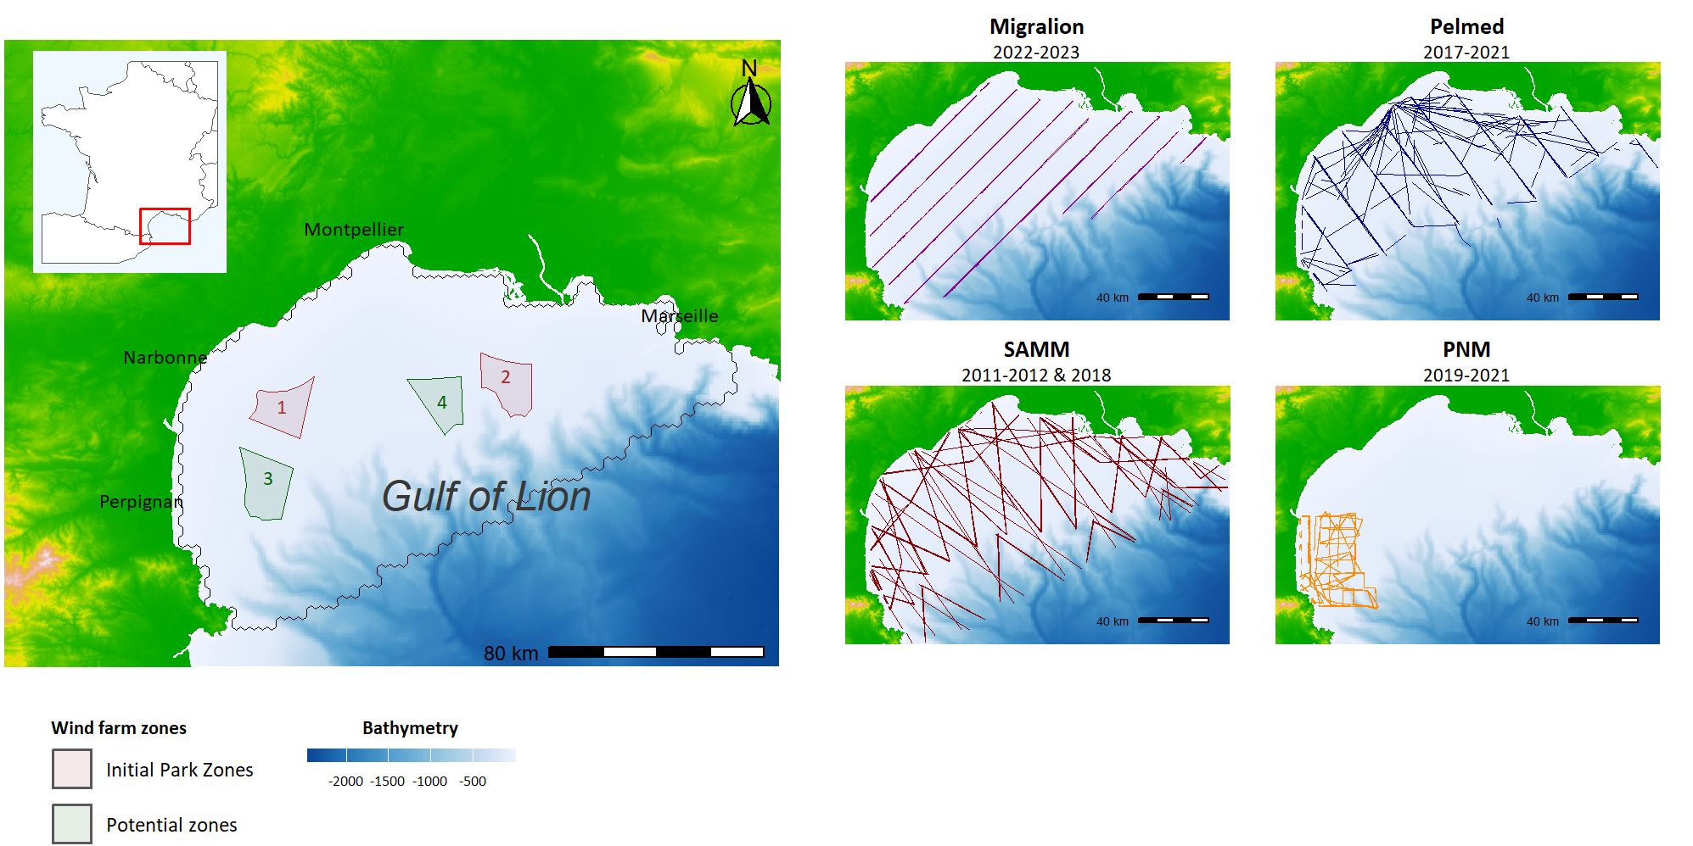




A
B
Monitoring programs
Study area
Counting platform
Sampling season
Boat
Winter
Summer
Plane
Spring
Autumn

