Slide 1

Climbing ahead, falling behind: social mobility across time and space
Week 10
June 24, 2024
Dr. Louis Henderson

Slide 2
“In education there should be no class distinctions”
Confucius (551-479 BCE)

Slide 3
China and meritocracy
Possible origins of civil service examinations in Han (c. 200 BCE-220 CE), Tang (c. 620-907 CE) and Song (c. 960-1280 CE)
Formal Confucian curriculum developed around 1400 following Mongol conquest (Elman 2009)
Candidates examined on music, mathematics, writing, customs derived from Confucian texts and commentaries (Classical Chinese)
Women, Buddhists, and Daoists barred, but otherwise no formal status barrier
Relatively unchanging; not dissolved until 1905

Slide 4
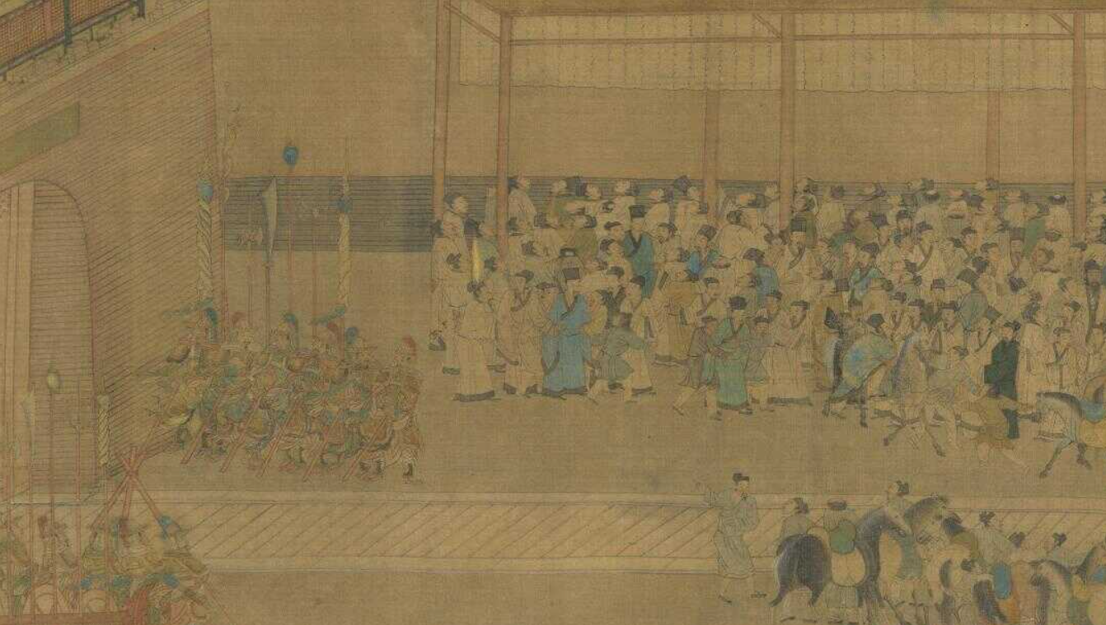
(Qiu Ying, “Civil Service Examination”)

Slide 5
China and meritocracy
Numerous social and economic rewards linked to exam performance
Passing exam eventually led to official appointment, comes with economic security, status and power
Large farmers and merchants would often donate money and land to successful candidates to win favour
Not subject to criminal and civil law, all scholars exempt from corvée

Slide 6
Chinese social stratification
Hereditary nobility
Eight noble ranks in Ming China, except for the highest ranks, sons granted a lower rank than father
Bureaucracy
Different exams (3) for different bureaucratic ranks (9)
Commoners
Scholars: literate but failed exam, tutors, scribes, etc.
Agriculture: larger land-owners, philanthropy, elderly, etc.
Artisans: small craftsmen and large capitalists
Merchants: pedlars and sea-going merchants

Slide 7
Wen, Wang, & Hout 2024
Social mobility in the Tang Dynasty, 618-917 CE
Research question: relative importance of family lineage (fangzhi), parental patronage, and exam success on social outcomes
Finding: aristocracy declined as exam performance rose in determining bureaucratic rank

Slide 8
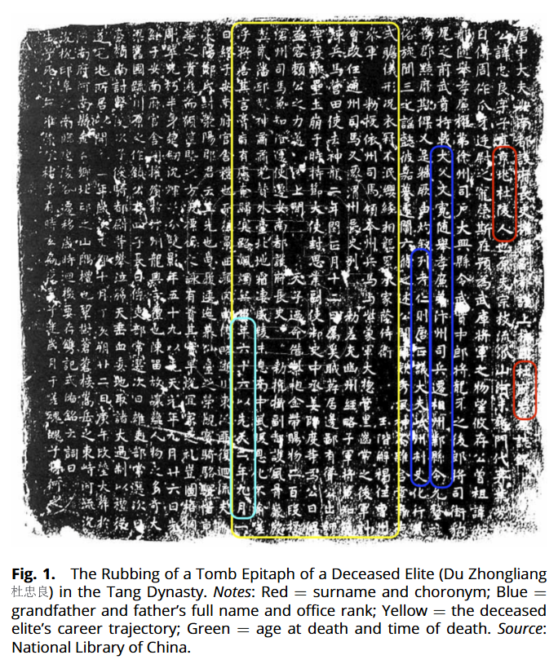
Wen, Wang, & Hout 2024

Slide 9
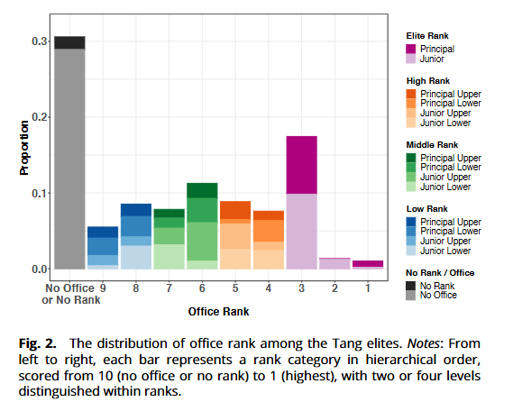
Wen, Wang, & Hout 2024

Slide 10
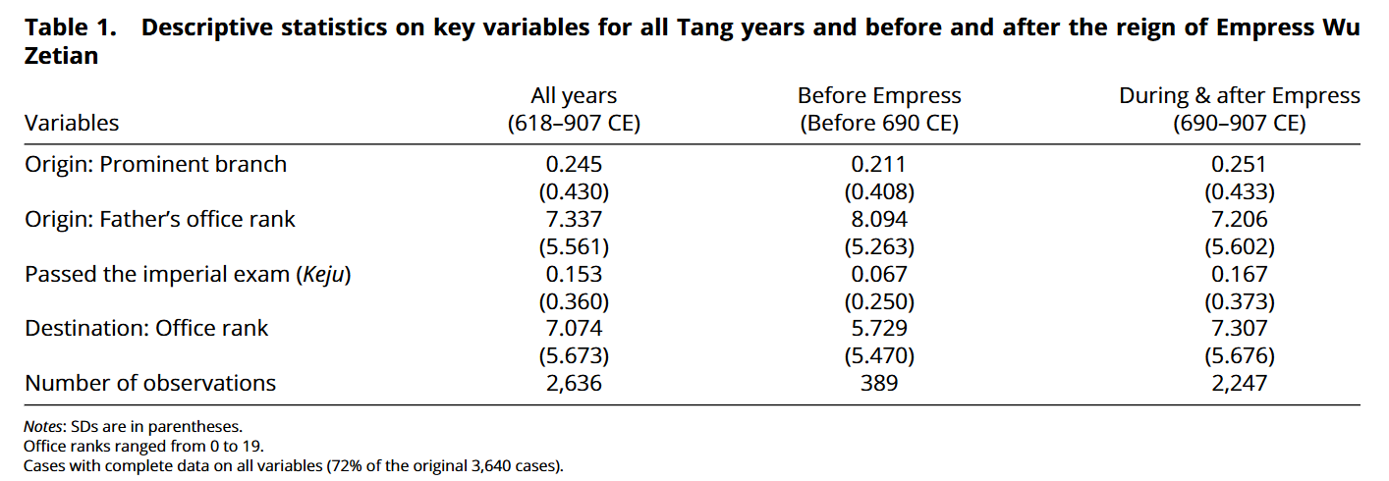
Wen, Wang, & Hout 2024

Slide 11
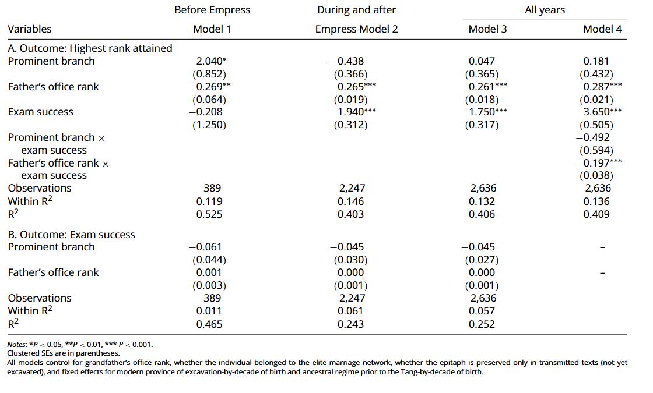

Slide 12
Conclusion: civil service exams
Importance of aristocratic family background declines after Tang reforms
Exam performance becomes significant
Father’s bureaucratic rank consistently significant
However, passing exam eliminates advantage from father’s rank
Relatively meritocratic selection process; important evidence of the effect of institutional change on social mobility

Slide 13
Wider effects
“Teaching to the test”
Status primarily linked to bureaucracy, not wealth
E.g. wealth had limited direct effect on social mobility in late Qing, as compared to exam performance (Jiang and Kung, 2021)
This limited incentives to innovate (O’Brian 2019)

Slide 14
China’s premodern economy
GDP per capita for three countries (Broadberry et al. 2015)
Highly developed early on, experiences reversal
China an imperial power in Asia
Year | China | Italy | Britain
c.1000 | 1247 | 1000 | 754
c. 1500 | 1127 | 1403 | 1114
1850 | 594 | 1350 | 2997

Slide 15
China’s premodern economy
Male labour force by sector, China (Yang 2019)
Rice agriculture in core regions
Free peasant agriculture, widespread land-ownership
High-intensity Malthusian equilibrium
Year | Primary | Secondary | Tertiary
c. 1770 | 58.1 | 13.9 | 28.0
c. 1830 | 59.2 | 12.0 | 28.8
c. 1890 | 58.3 | 12.0 | 29.6

Slide 16
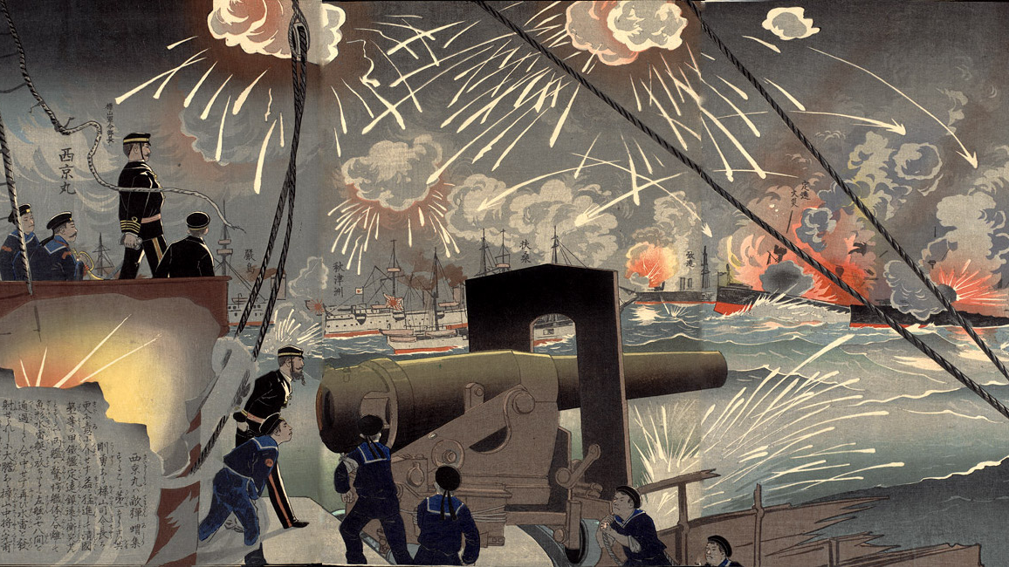
(Korechika, “Battle of the Yellow Sea”)

Slide 17
Late Qing reforms
First (c.1839) and Second (c.1856) Opium Wars
First Sino-Japanese War (c.1894)
Loss of esteem encourages search for reform
Guangxu emperor launches 100 days reform (1898), proposing to abolish civil exams in favour of new education system
Dowager Empress Cixi launches conservative coup
Nonetheless recognizes need for change, concedes in 1905 to end system of imperial exams

Slide 18
China’s premodern economy
Composition of persons by education level, Beijing (Gao et al. 2022)
Education reform was gradual in early 20th century
Year | Sishu | Modern | Secondary | Uneducated
1880 | 11 | 0 | 0 | 89
1900 | 11 | 2 | 0 | 87
1920 | 10 | 4 | 1 | 85

Slide 19
Yuchtman (2017)
Studies the wages of employees of Tianjin-Pukou Railroad, a modern technologically advanced firm, in 1929
Research question: were traditionally educated workers less productive than those who received modern education?
Finding: for average worker, no; for highly educated and specialized, yes, particularly engineers.

Slide 20
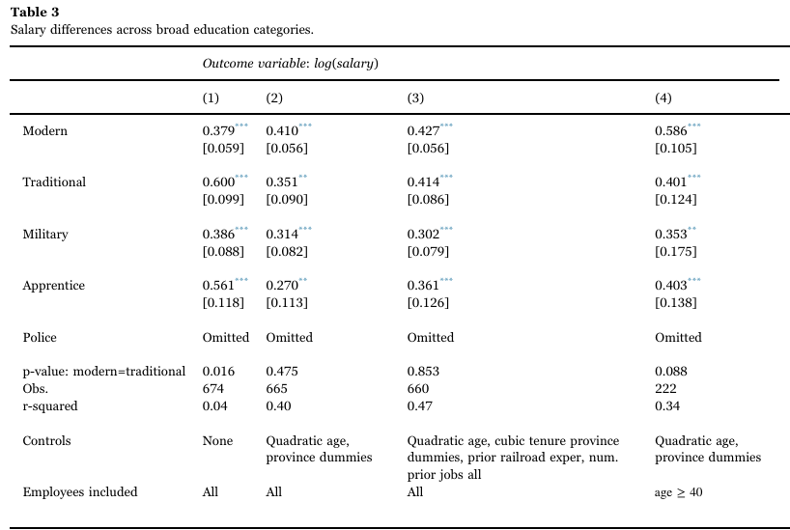
Earnings and education

Slide 21
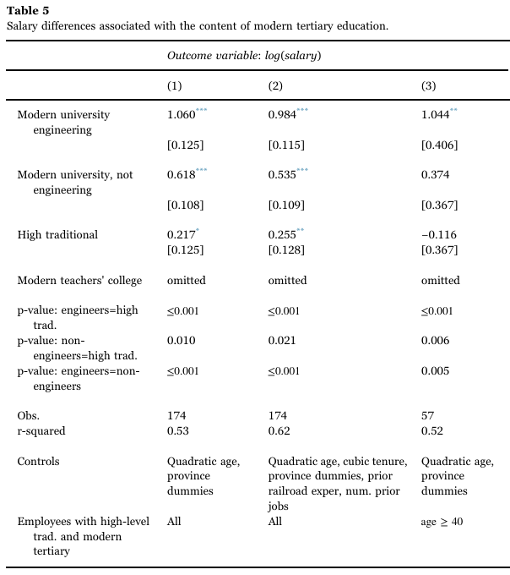

Slide 22
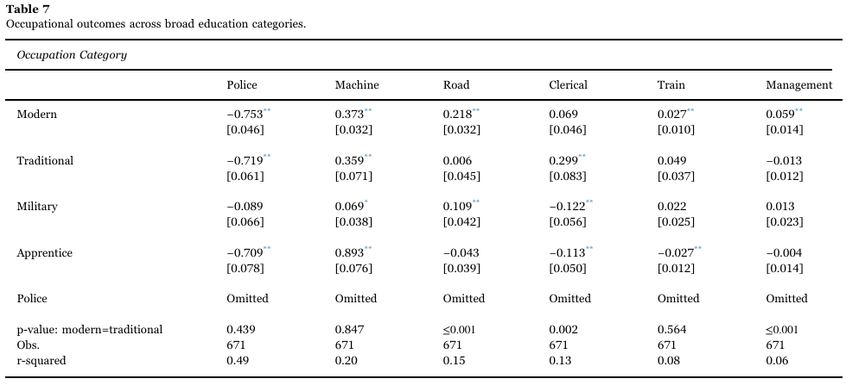
Earnings and education

Slide 23
Conclusion
Advanced modern education, particularly engineering, enormously productive
Traditional education still valuable, particularly in clerical work
Lack of modern education likely slowed China’s adoption of modern technologies

Slide 24
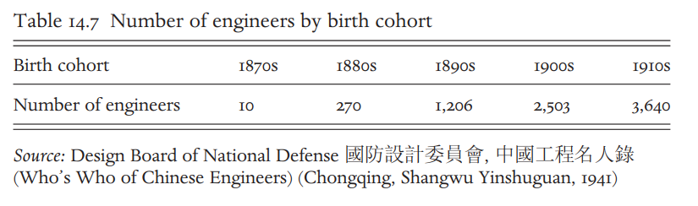
China’s premodern economy
(Gao et al. 2022)
Rapid expansion in supply of engineers following reforms

Slide 25
China in the 20th century
Republican revolution (1911), Komintang established
Warlords (c.1917-27)
CCP founded by Mao Zedong (1921)
Most of China united under KMT (1927-37)
Second Sino-Japanese War (1937-1945)
CCP-KMT civil war (1946-49), with CCP victorious
Great Leap Forward (1958-62), Cultural Revolution (1966-76)
Mao dies (1976). Economic liberalisation under Deng Xiaoping in 1980s

Slide 26
Chen et al. 2015
Examine the effect of institutional change in 20th century on social mobility
Research question: do governments face a trade-off between equality of opportunity and educational performance?
Findings: U-shaped pattern of intergenerational persistence over 20th century; Mao-era increased mobility

Slide 27
Republican Era
Access to tertiary education remained limited after reforms (e.g. Peking University)
Fees and living expenses exceeded average yearly income of urban household
High returns to schooling

Slide 28
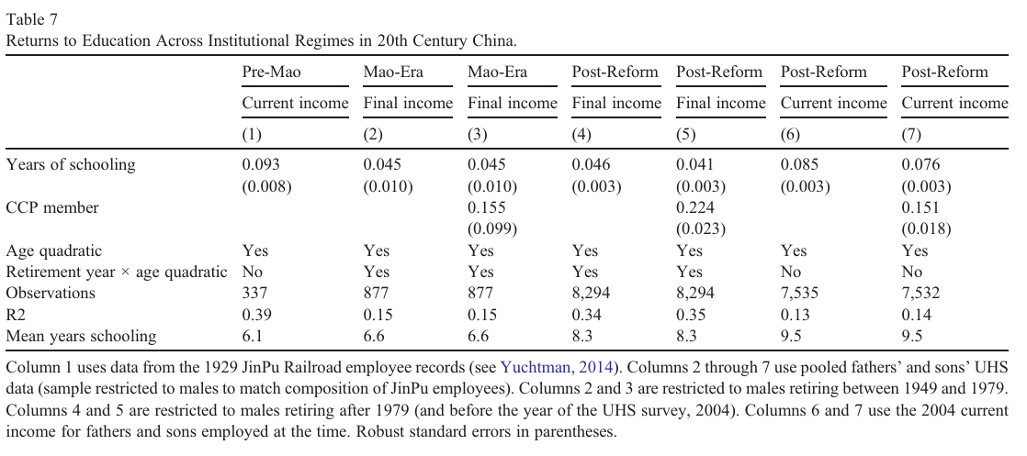
Return to education in the 20th century

Slide 29
Mao Era
“Mass road” not “genius road”
Mass education effort aimed at improving access of the poorest
State appropriated universities and colleges, abolished fees, introduced subsidies for poorest, and guaranteed jobs to graduates
Places reserved for peasants, workers, and soldiers, and teachers were encouraged to focus their effort on these students
Cultural revolution deliberately reverses social order

Slide 30
Reform Era
Brought in competitive examinations at primary, secondary and tertiary levels
Continued educational expansion, but competition reinforces advantages
Geographical concentration of state spending in leading urban areas: Shanghai and Beijing

Slide 31
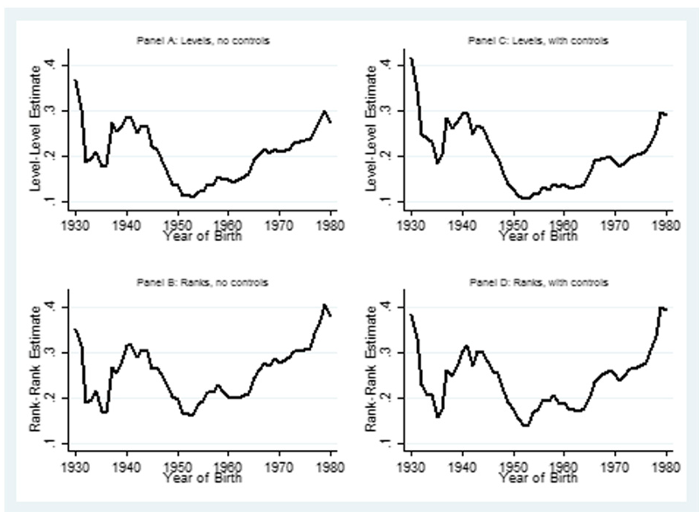
Social mobility in China

Slide 32
Conclusion
U-shaped pattern of social persistence
Competitive examinations may favour incumbents (high-status households) who are better able to prepare children for these exams
Increasing equality of opportunity may be costly: possible trade-off between educational performance and meritocracy

Slide 33
Meritocracy in China considered
Strong evidence of the importance of institutions affecting social mobility in China’s 1000-year documented history
Meritocratic selection may not lead to equality of opportunity
Social incentives matter and may hinder economic growth

Slide 34
Thank you!

