Slide 1

Climbing ahead, falling behind: social mobility across time and space
Week 11
July 1, 2024
Dr. Louis Henderson

Slide 2
"Make [women] free, and they will quickly become wise and virtuous, as men become more so; for the improvement must be mutual, or the injustice which one half of the human race are obliged to submit to, retorting on their oppressors, the virtue of men will be worm-eaten by the insect whom he keeps under his feet."
Mary Wollstonecraft (1792)

Slide 3
Women and social mobility research
Study of women frequently omitted from early generation of social mobility research
Justified on basis of “breadwinner” approach
Assumption women cared for household
Men primary earners, provide resources for next generation
Methodologically more challenging
Women change surname upon marriage in many places
Women’s earnings more irregular, contribution difficult to measure
Withdrawal from labour force typically modelled as utility-maximizing choice

Slide 4
Women’s market income
These arguments don’t really stand up to critical assessment
Empirically, many women worked for pay in the past and continue to do so today
Many women do not marry or form traditional households
Divorce more frequent, single motherhood more frequent

Slide 5
Bargaining models of household utility
Unequal resource distribution plausibly exists within households
Application of game theory to marriage (Lundberg & Pollak 1996) suggests woman’s share of household resources affected by her outside option and control over resources within marriage
Closely related to women’s labour market opportunities

Slide 6
Women and social reproduction
Women’s contribution to the production of next generation’s human capital is clear
Holding total household earnings constant, higher woman’s relative earnings associated with greater spending on children
Resources women contribute to next generation seldom priced by market, nonetheless important
Arthur Pigou: if a woman chooses to breastfeed her baby, GDP will fall

Slide 7
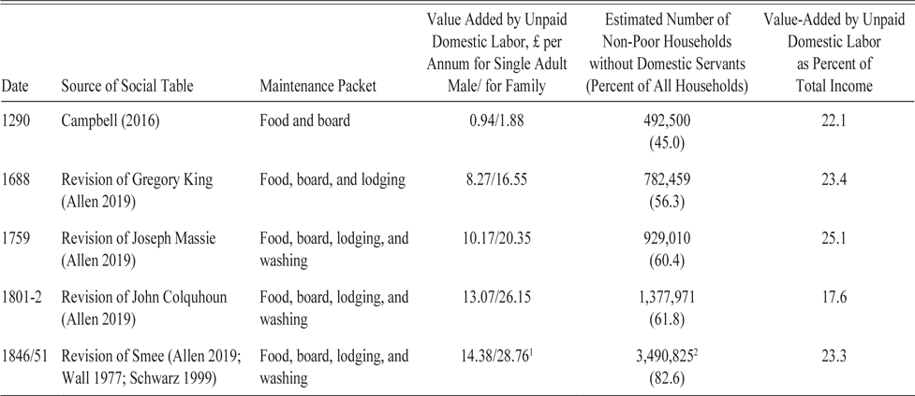
Unpaid care labour
(Humphries 2024)

Slide 8
Women and social mobility research
Clear that intergenerational mobility not fully characterised by men’s outcomes or men’s economic resources

Slide 9
Women and methodology
Methodology should be designed to suit research question, not the other way around
Researchers are developing methodologies to better study women’s social mobility (Thomas 2024; Bailey et al. 2023; Olivetti & Paserman 2015)

Slide 10
Stepping back
Social mobility as measure of “equality of opportunity” does not justify exclusive focus on men
Surely women’s access to opportunity is an integral part of this ideal, within or without marriage

Slide 11

Women and discrimination

Slide 12
Women and discrimination
Women experience discrimination in hiring
Famous study (Goldin and Rouse 2000) of introduction of blind auditions in U.S. orchestras

Slide 13
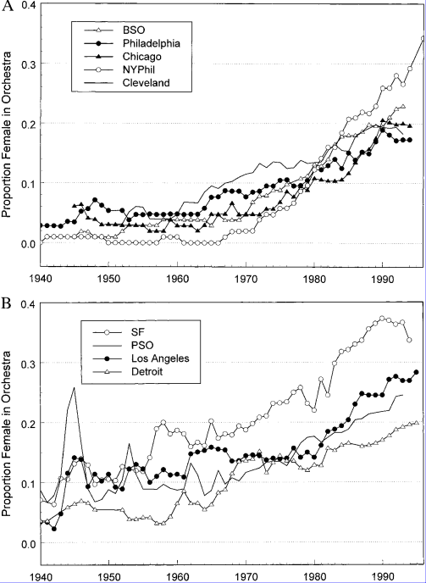
Goldin and Rouse (2000)
Women’s employment in orchestras rose sharply over the 20th century
Some orchestras introduced blind auditions during this time, others did not
At the same time, more women graduated from leading music colleges, attitudes shifted
Did blind auditions improve probability of hiring a woman?

Slide 14
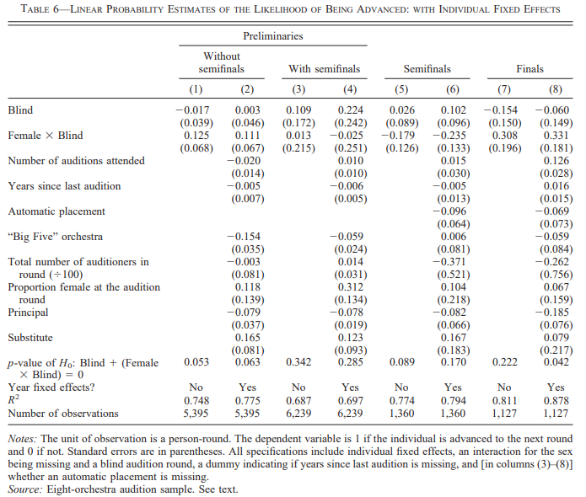

Slide 15
Women and discrimination
Orchestra playing requires serious commitment, regular group rehearsals
Objection may be that it is rational for orchestras to not hire women
Men and women do not observably differ on frequency of leaves of absence or their duration
Bias seems clearest explanation
Reducing hiring to only consideration of “ability” eliminates bias, opens opportunity to women

Slide 16
Women and labour markets over time
Marital status of women an important determinant of labour market participation
In U.S. early 20th century, prevailing expectation was that women would withdraw from labour market to rear children
Significant changes in women’s labour market opportunities and labour supply over time in U.S.

Slide 17
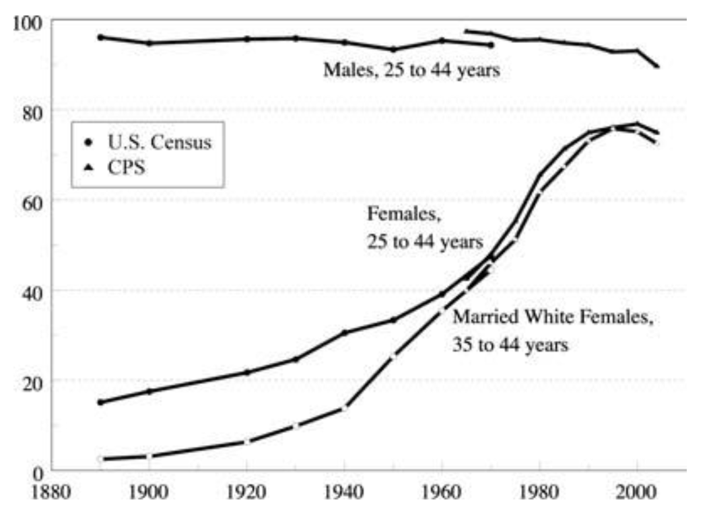
Labour force participation by sex and marital status, U.S., 1890-2004

Slide 18
“Evolutionary” change
Claudia Goldin (2006) characterizes change along two dimensions:
Income effect (-): with greater earnings, households “buy” less market work for wife
Substitution effect (+): own wage increase leads to greater labour supply, swap market work for home production
Early 20th century, income effect dominates. Mothers work to “make shift”, tend to be poorer.
Income effect gradually weakens and substitution effect strengthens

Slide 19
1890-1920
Income effect predominates, therefore inelastic female labour supply.
Increase in female labour supply comes from exogenous outward shifts of supply curve:
Greater female education
Decreased fertility
Structural change leading to increase in “nice” service jobs
Changes in norms surrounding women’s work

Slide 20
1930-1950
Process continues. Income effect weakens as married women’s work less stigmatised.
Institutional change eliminates “marriage bar”
Substitution effect:
Part-time work introduced in 1940s
Household technologies, refrigerator, washing machine, electricity, running water, etc., reduced women’s reservation wage

Slide 21
1950s-1970s
Income effect continues to weaken
Structural change continues
Greater return to education/training for women increases substitution effect

Slide 22
“Revolutionary” change, 1970s-
Starting in 1970s, Goldin points to “revolutionary” change: attitudes, prospects, behaviours.
Women start to define their prospects and identities beyond the family
In partial response to real changes in labour market
Change across many domains

Slide 23
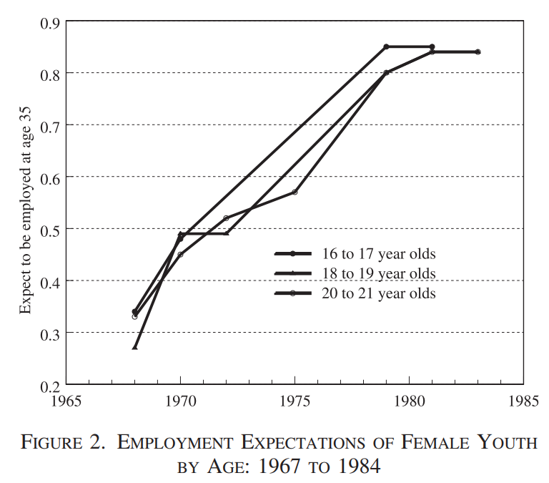

Slide 24
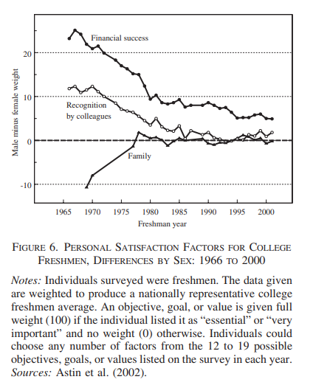

Slide 25
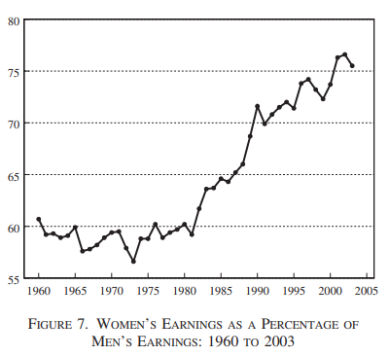

Slide 26
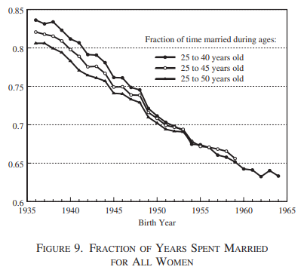

Slide 27
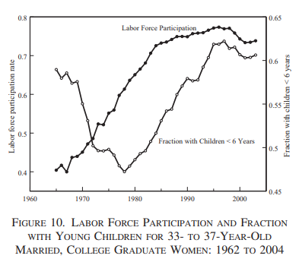

Slide 28
Summary
Decline in income effect and rise in substitution effect leads more women to participate in labour force
Expectations shift in next generation, who invest in more human capital
Widespread change in behaviour
Over time, American women were less likely to experience the same lives their mothers had lived

Slide 29
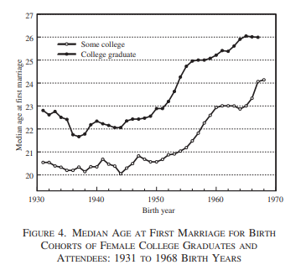

Slide 30
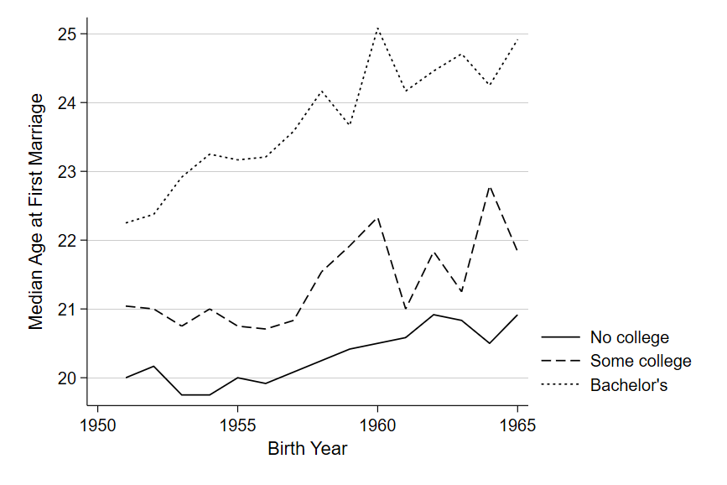

Slide 31
Social reproduction and social mobility
Does relationship between later marriage and human capital investment imply intergenerational transmission of marriage age?
Later marriage allows longer period of investment, longer period of return on human capital
Channel from Becker’s “endowed traits” to marriage age?
Attitudes, social capital, family culture
Genetic transmission

Slide 32
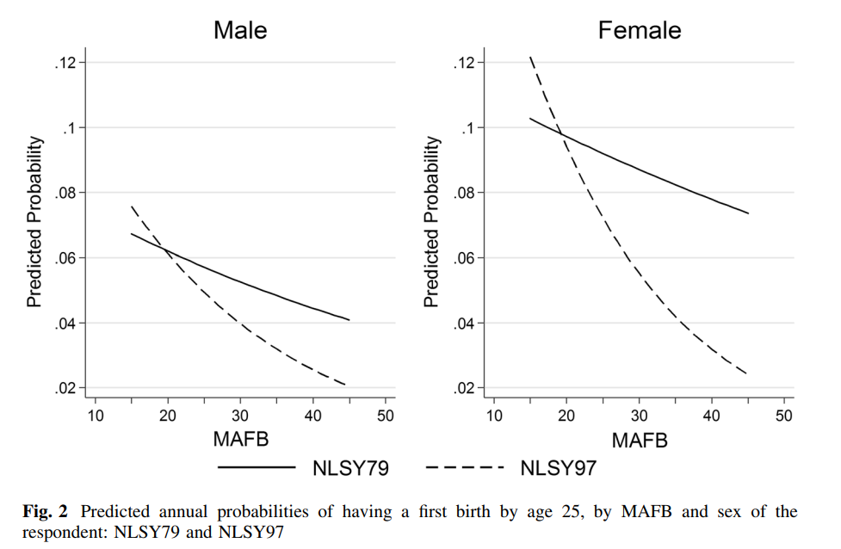
Social reproduction and social mobility
Supporting evidence from U.S. (Kim 2014)
For 1950s, odds of transition to parenthood decline by 2.0% for sons and 1.0% for daughters with each year increase in Mother’s Age at First Birth (MAFB)

Slide 33
Social reproduction and social mobility
For 1980s, odds of transition to parenthood decline by 4.5% for sons and 5.5% for daughters with each year increase in Mother’s Age at First Birth (MAFB)
Stronger intergenerational association over time

Slide 34
Social reproduction and social mobility
Much like intergenerational transmission of income, class, there is evidence of an increasing an intergenerational effect in demographic decisions (see also Steenhof and Liefbroer 2008)
Not fully explained by education, family structure, religion, place, race, or age at menarche
As more opportunities open to women, parental influence on outcomes apparently increases

Slide 35
Thank you!

