Slide 1

Climbing ahead, falling behind: social mobility across time and space
Week 12
July 8, 2024
Dr. Louis Henderson

Slide 2
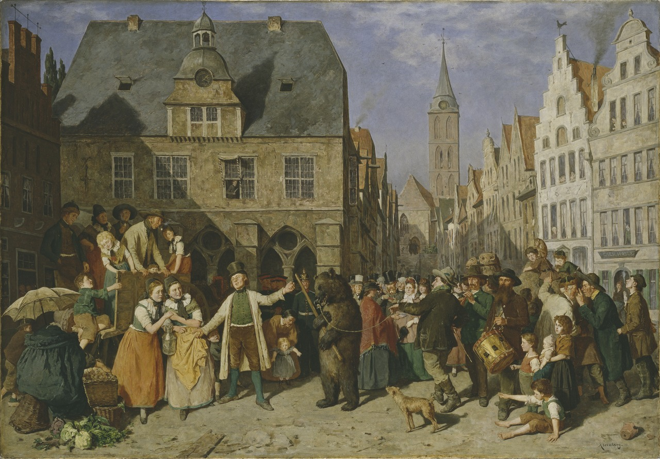
Work and marriage in Sweden, 1700-1900
(Nationalmuseum, Wikimedia commons)

Slide 3
Data
Sweden has unusually good demographic data going back a long time
Individual entry in parish registry, which is updated with life events
Includes women
Extends back to 18th century
Demographic Data Base (Umeå University)
Mostly northern Sweden

Slide 4
Data
https://louis-henderson.web.app/sweden.xlsx

Slide 5
Sweden in context
Urbanisation rate in Sweden 6.8% in 1850, 19.3% in 1900
Compared to European average of 16.4% in 1850 to 30.4% in 1900 (Bairoch & Goertz 1986)
Women pursue careers, attend higher education, later motherhood, at end of 20th century

Slide 6
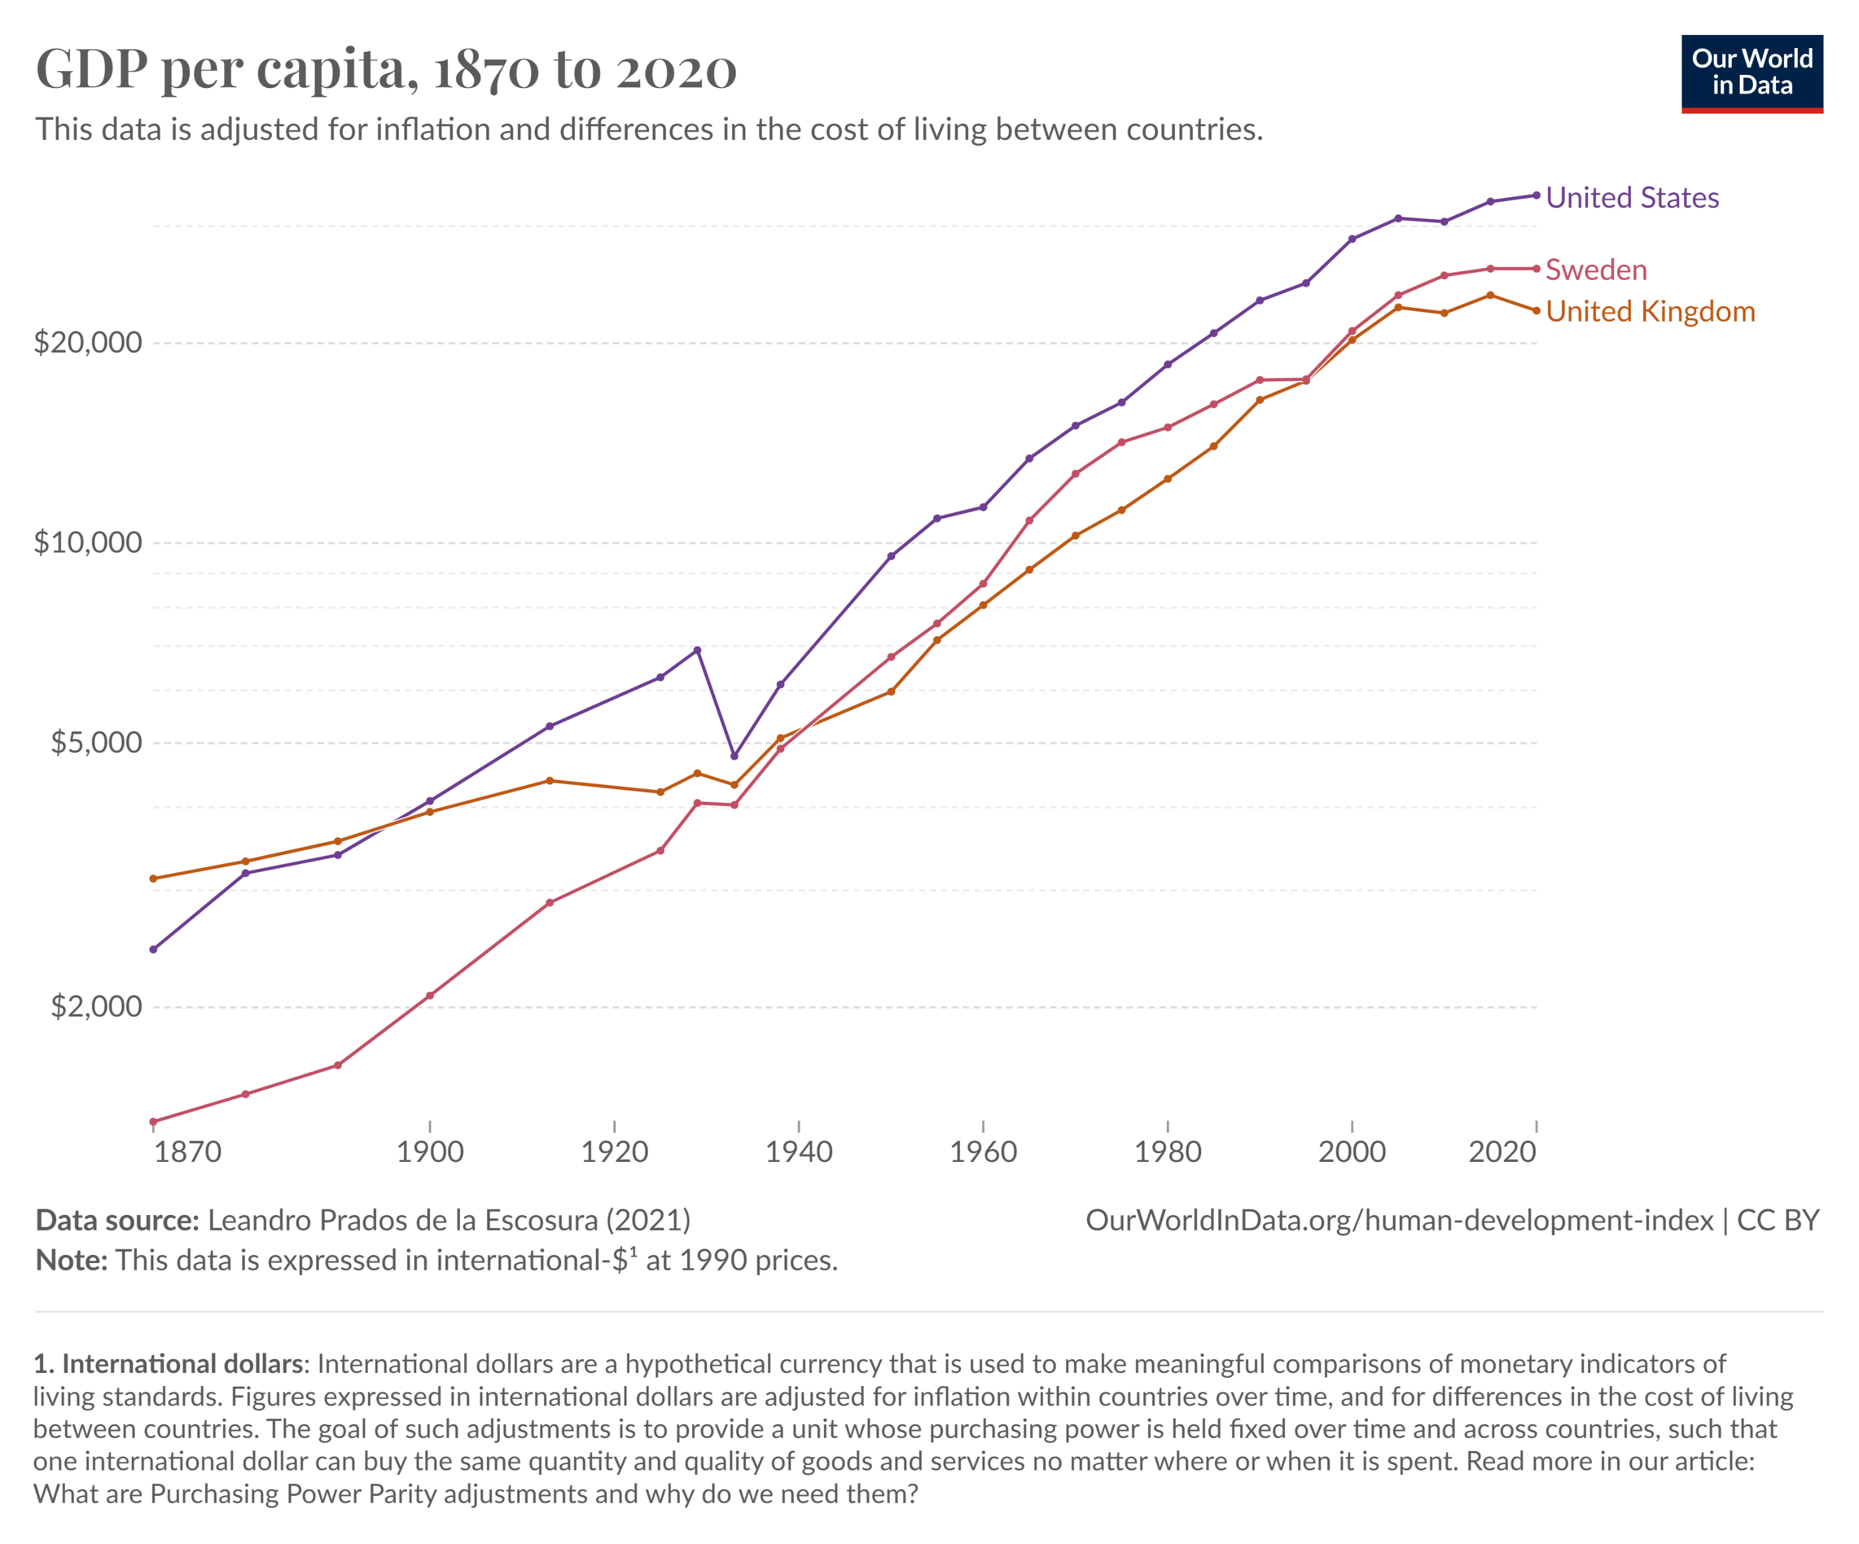

Slide 7
Social reproduction and social mobility
Evidence of intergenerational transmission of young parenthood in modern Sweden (Stanfors and Scott 2013)
When does this emerge (e.g. Rotering 2017)?
What can this tell us about women’s opportunities and social mobility over time?

Slide 8
Exercise Q1
First calculate coefficient before 1800
Filter observations by year
Generate scatter plot, fit line

Slide 9
Exercise Q2
Filter observations to only consider those after 1900
Generate scatter plot; fit line

Slide 10
Later 20th century
Last marriage in dataset in 1912
Intergenerational transmission apparently stronger at end of 20th century (Stanfors & Scott 2013)

Slide 11
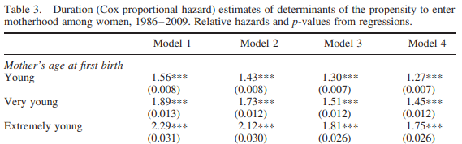

Social reproduction and social mobility
Mother’s education and LFPR |  | ✓ | ✓ | ✓
Father’s education and LFPR |  |  | ✓ | ✓
Own characteristics |  |  |  | ✓
(Stanfors & Scott 2013)

Slide 12
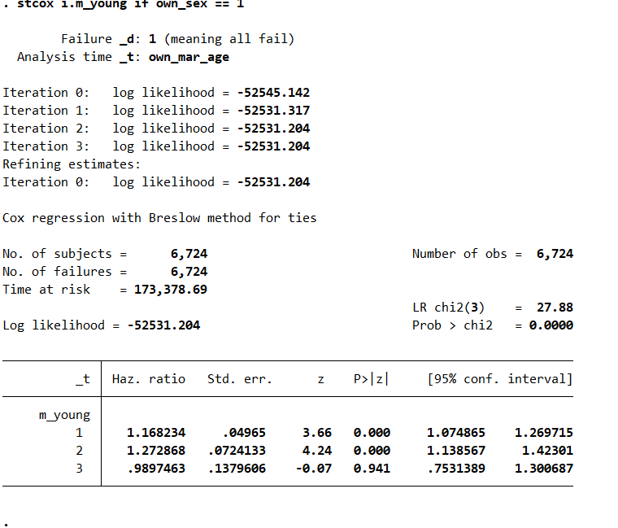
Social reproduction and social mobility

Slide 13
Social reproduction and social mobility
Intergenerational transmission of age of motherhood apparently increasing over time
What might explain this?

Slide 14
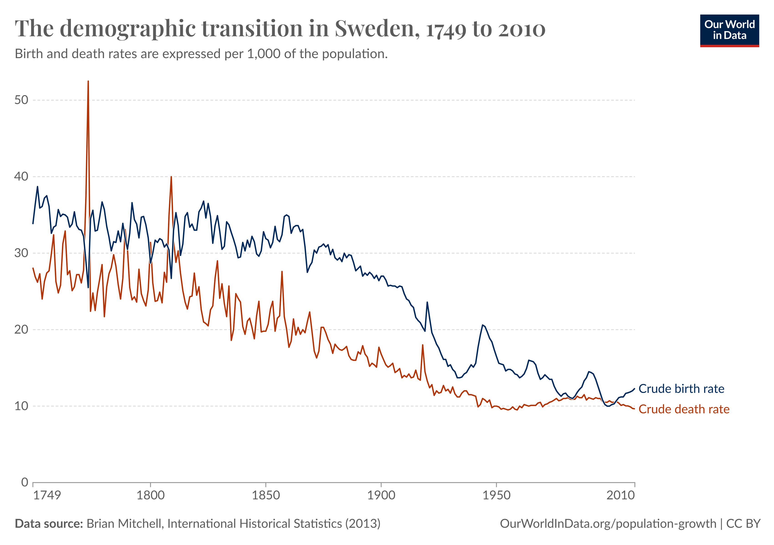
Demographic transition

Slide 15
“Two-supporter” model
 | Unmarried | Ever-Married
Administration and justice | 3.8 | 9.5
Agriculture and forestry | 16.0 | 5.4
Care | 6.0 | 5.6
Crafts and construction | 6.2 | 5.4
Credit | 2.4 | 4.4
Food and accommodation | 3.0 | 10.3
Hunting and fishing | 0.4 | 0.2
Managerial work | 5.4 | 9.5
Teaching | 0.0 | 0.3
Theft and misappropriation | 8.0 | 1.7
Trade | 6.2 | 28.5
Trade in real estate | 0.0 | 7.5
Transport | 10.8 | 4.1
Unspecified work | 14.2 | 2.4
Other specified work | 17.4 | 5.3
Total % | 99.8 | 100.1
Total no. | 499 | 2,235
(Ågren et al 2016)

Slide 16
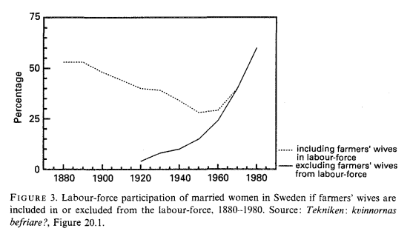
Women’s labour markets
(Nyberg 1994)

Slide 17
Conclusion
Alternate perspective on relationship between inequality and intergenerational persistence
As scope for choice is greater, greater persistence across generations

Slide 18
Thank you!

