Slide 1

Climbing ahead, falling behind: social mobility across time and space
Week 2
April 22, 2024
Dr. Louis Henderson

Slide 2
New email!
louis.henderson@wiso.uni-tuebingen.de

Slide 3

Economic approaches to social mobility
Strategic, rational decision-making in private life
E.g. fertility, health, education
Introduces microeconomic modelling (utility maximization) to intergenerational investment in human capital

Slide 4
What is a model?
Simplification of reality (usually mathematical)
Clear statement of hypotheses/predictions
Restricts scope of empirical study
not necessarily bad (Occam’s Razor)
e.g. car accident
Is it scientific or is it rhetorical?

Slide 5
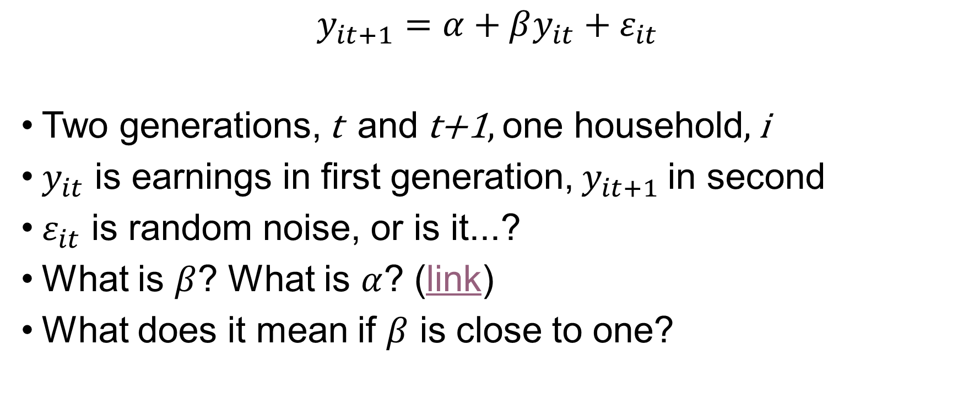
Linear model
$$y_{it+1}=α+βy_{it}+ε_{it}$$
Two generations, t and t+1, one household, i
$y_{it}$ is earnings in first generation, $y_{it+1}$in second
$ε_{it}$ is random noise, or is it...?
What is $β$? What is $α$? (link)
What does it mean if $β$ is close to one?

Slide 6
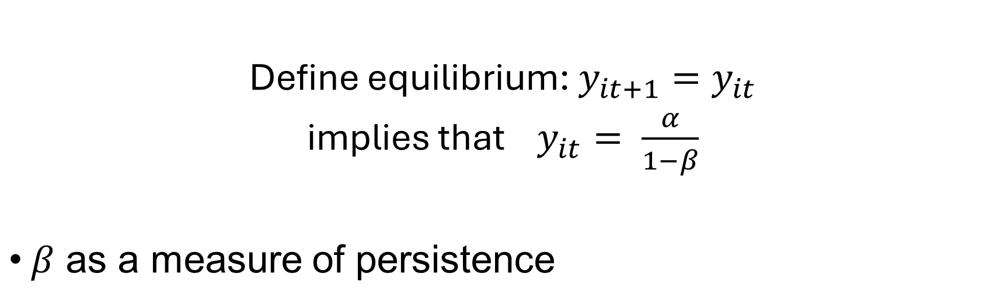
Linear model
Alpha | Beta | Equilibrium Income |  | 1 | 2 | 3 | 4 | 5 | 6 | 7 | 8 | 9 | 10 | 11 | 12 | 13 | 14
2 | 0.7 | 6.67 |  | 8.00 | 7.60 | 7.32 | 7.12 | 6.99 | 6.89 | 6.82 | 6.78 | 6.74 | 6.72 | 6.70 | 6.69 | 6.69 | 6.68
2 | 0.3 | 2.86 |  | 8.00 | 4.40 | 3.32 | 3.00 | 2.90 | 2.87 | 2.86 | 2.86 | 2.86 | 2.86 | 2.86 | 2.86 | 2.86 | 2.86
Define equilibrium: $y_{it+1}=y_{it}$
implies that $y_{it}= \frac{α}{1−β}$
$β$ as a measure of persistence

Slide 7
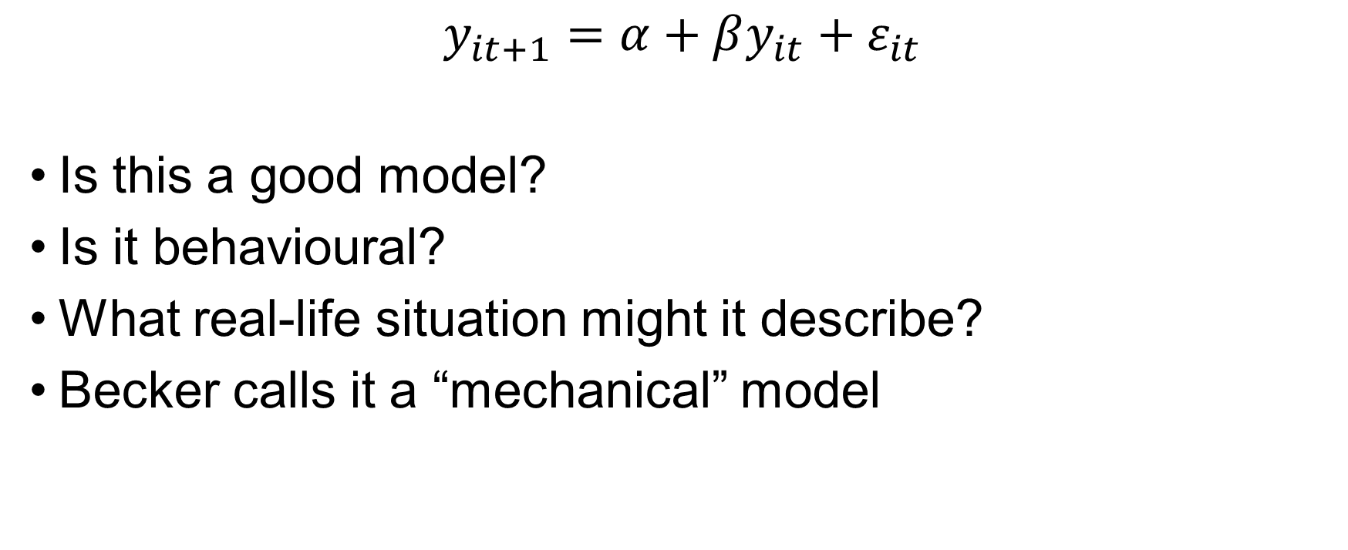
Linear model
$$y_{it+1}=α+βy_{it}+ε_{it}$$
Is this a good model?
Is it behavioural?
What real-life situation might it describe?
Becker calls it a “mechanical” model

Slide 8
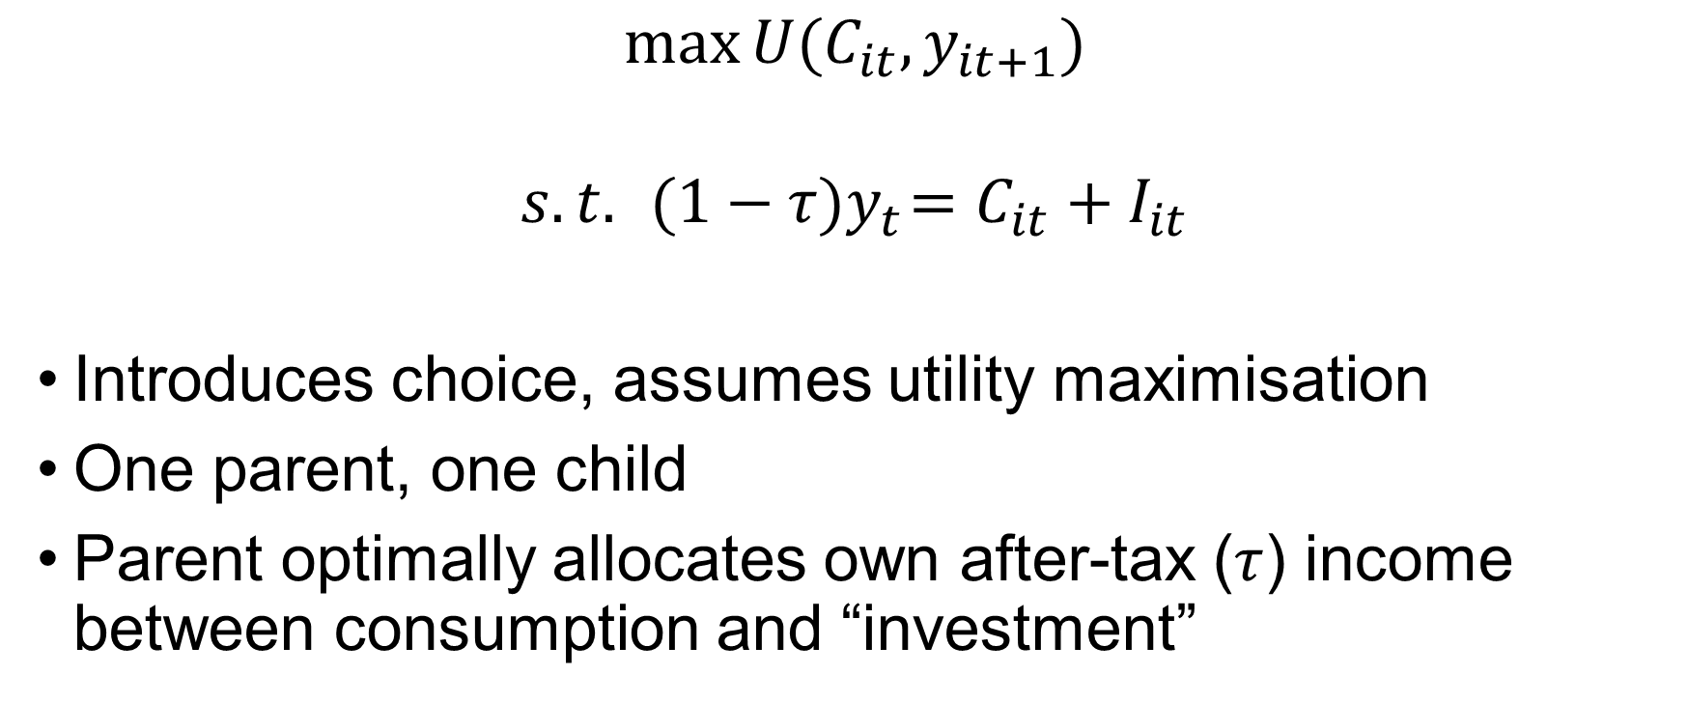
Becker’s microeconomic model (Solon 2004)
$$\max{U(C_{it},y_{it+1})}$$
$$s.t. { (1−τ)y}_{t}=C_{it}+I_{it}$$
Introduces choice, assumes utility maximisation
One parent, one child
Parent optimally allocates own after-tax ($τ$) income between consumption and “investment”

Slide 9
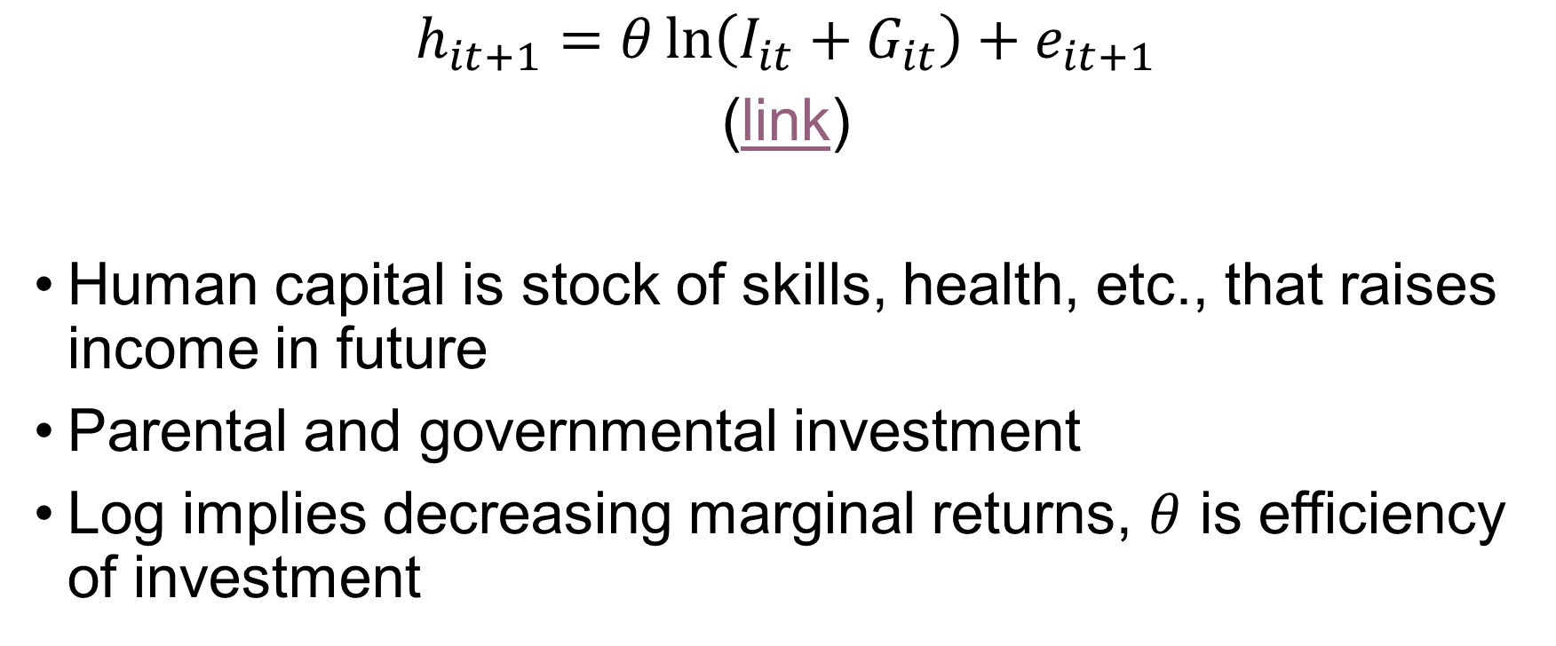
Human capital
$$h_{it+1}=θ\ln\left(I_{it}+G_{it}\right)+e_{it+1}$$
(link)
Human capital is stock of skills, health, etc., that raises income in future
Parental and governmental investment
Log implies decreasing marginal returns, $θ$ is efficiency of investment

Slide 10
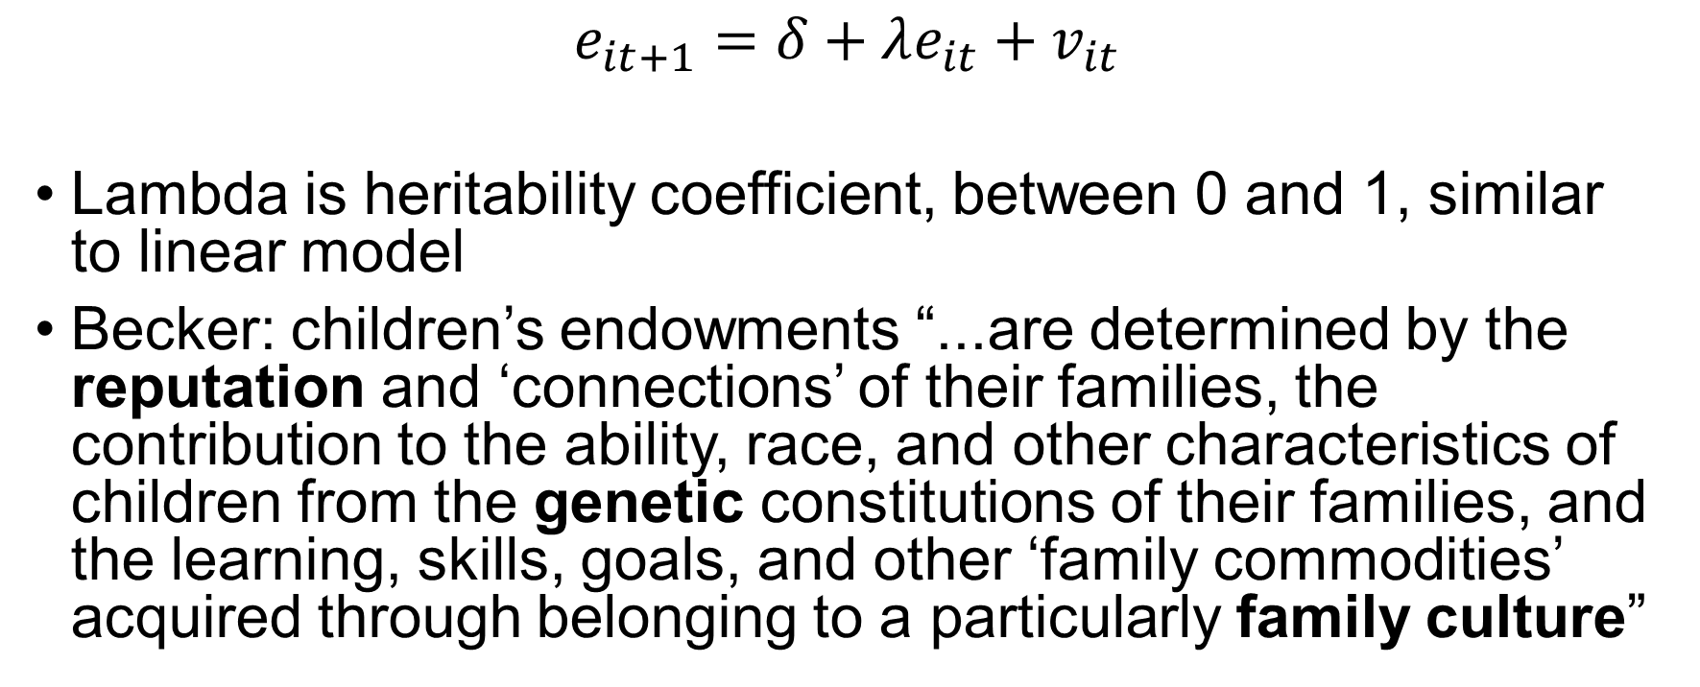
Endowed traits
$$e_{it+1}=δ+λe_{it}+v_{it}$$
Lambda is heritability coefficient, between 0 and 1, similar to linear model
Becker: children’s endowments “...are determined by the reputation and ‘connections’ of their families, the contribution to the ability, race, and other characteristics of children from the genetic constitutions of their families, and the learning, skills, goals, and other ‘family commodities’ acquired through belonging to a particularly family culture”

Slide 11
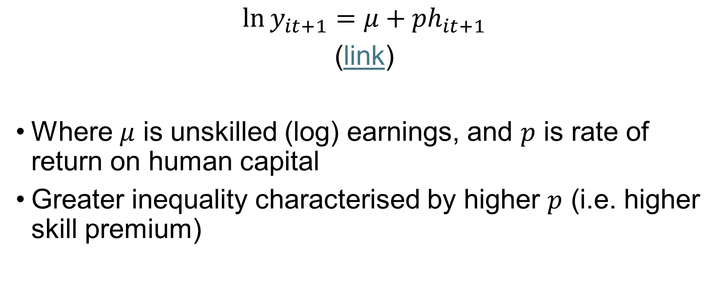
Earnings of child
$$\ln{y_{it+1}}=μ+{ph}_{it+1}$$
(link)
Where $μ$ is unskilled (log) earnings, and $p$ is rate of return on human capital
Greater inequality characterised by higher $p$ (i.e. higher skill premium)

Slide 12
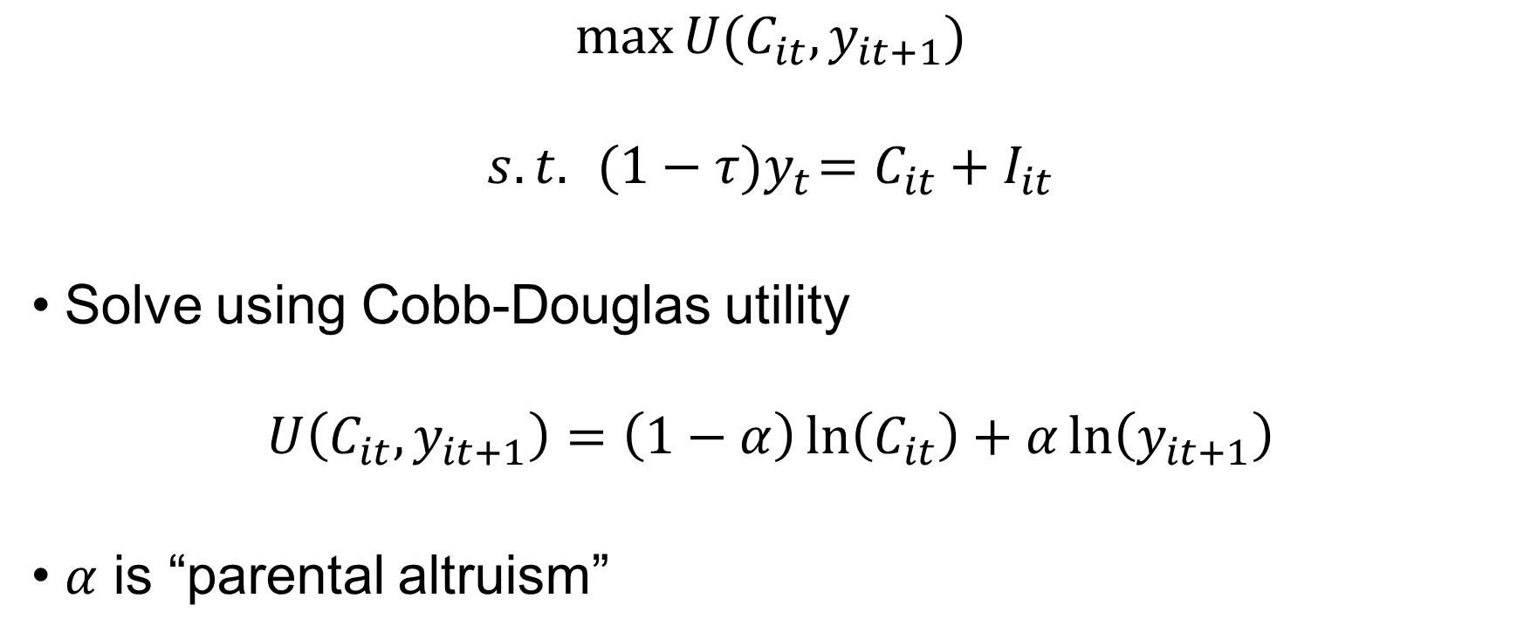
Solution
$$\max{U(C_{it},y_{it+1})}$$
$$s.t. { (1−τ)y}_{t}=C_{it}+I_{it}$$
Solve using Cobb-Douglas utility
$$U\left(C_{it},y_{it+1}\right)=\left(1−α\right)\ln\left(C_{it}\right)+α\ln\left(y_{it+1}\right)$$
$α$ is “parental altruism”

Slide 13
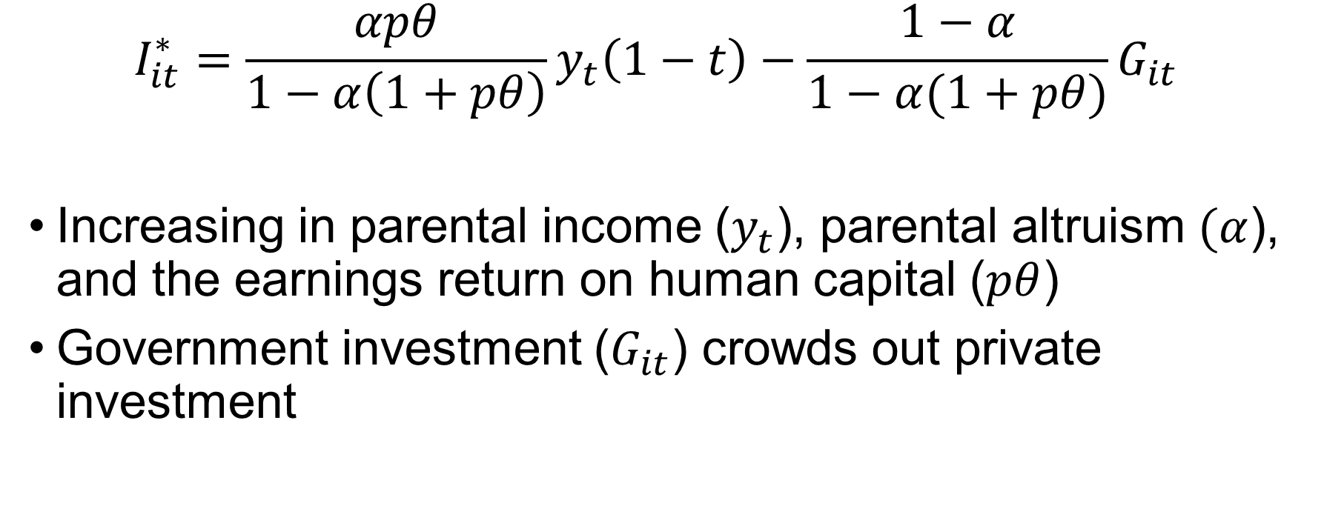
Solution
$$I_{it}^{∗}=\frac{αpθ}{1−α\left(1+pθ\right)}y_{t}\left(1−t\right)−\frac{1−α}{1−α(1+pθ)}G_{it}$$
Increasing in parental income ($y_{t}$), parental altruism $(α$), and the earnings return on human capital ($pθ$)
Government investment ($G_{it}$) crowds out private investment

Slide 14

Deriving intergenerational mobility
From
$$\ln{y_{it+1}=μ+ph_{it+1}}$$
to
$$\ln{y_{it+1}=μ+p[θ\ln{(I_{it}+}G_{it})}+e_{it+1}]$$
Substitute $I_{it}^{∗}$ for $I_{it}$

Slide 15
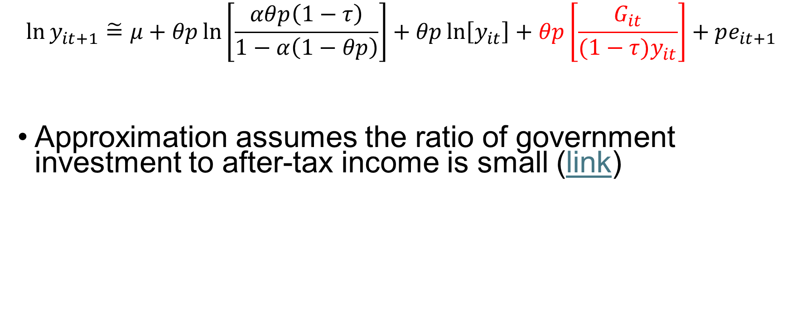
Deriving intergenerational mobility
$$\ln{y_{it+1}\tilde{=}μ+θp\ln\left[\frac{αθp\left(1−τ\right)}{1−α\left(1−θp\right)}\right]+θp\ln\left[y_{it}\right]+θp\left[\frac{G_{it}}{(1−τ)y_{it}}\right]+pe_{it+1}}$$
Approximation assumes the ratio of government investment to after-tax income is small (link)

Slide 16
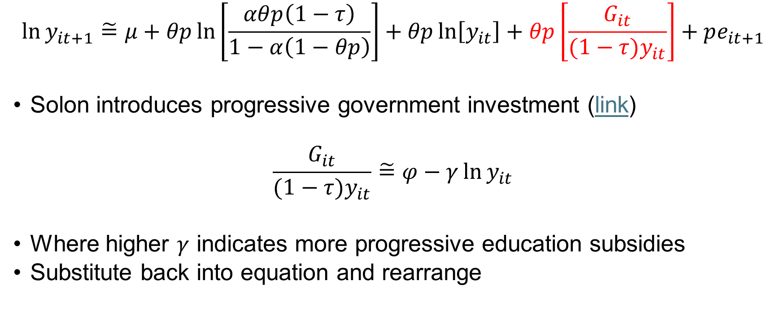
Introducing progressive education
$$\ln{y_{it+1}\tilde{=}μ+θp\ln\left[\frac{αθp\left(1−τ\right)}{1−α\left(1−θp\right)}\right]+θp\ln\left[y_{it}\right]+θp\left[\frac{G_{it}}{(1−τ)y_{it}}\right]+pe_{it+1}}$$
Solon introduces progressive government investment (link)
$$\frac{G_{it}}{(1−τ)y_{it}}\tilde{=}φ−γ\ln{y_{it}}$$
Where higher $γ$ indicates more progressive education subsidies
Substitute back into equation and rearrange

Slide 17
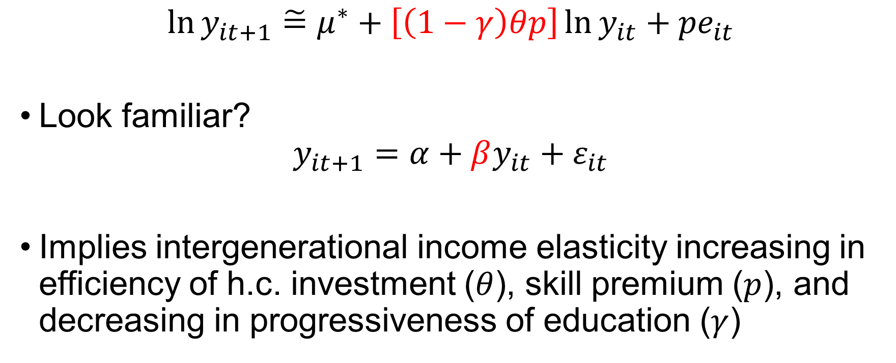
Deriving intergenerational mobility
$$\ln{y_{it+1}\tilde{=}μ^{∗}+\left[\left(1−γ\right)θp\right]\ln{y_{it}+{pe}_{it}}}$$
Look familiar?
$$y_{it+1}=α+βy_{it}+ε_{it}$$
Implies intergenerational income elasticity increasing in efficiency of h.c. investment ($θ$), skill premium ($p$), and decreasing in progressiveness of education ($γ$)

Slide 18
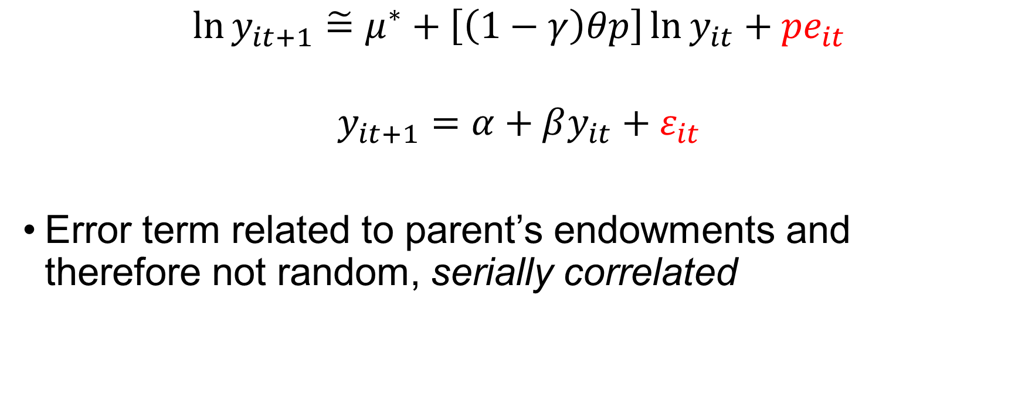
Deriving intergenerational mobility
$$\ln{y_{it+1}\tilde{=}μ^{∗}+\left[\left(1−γ\right)θp\right]\ln{y_{it}+{pe}_{it}}}$$
$$y_{it+1}=α+βy_{it}+ε_{it}$$
Error term related to parent’s endowments and therefore not random, serially correlated

Slide 19
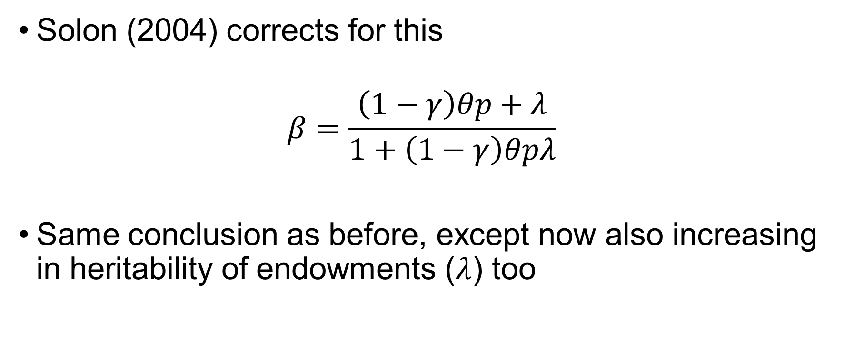
Deriving intergenerational mobility
Solon (2004) corrects for this
$$β=\frac{\left(1−γ\right)θp+λ}{1+\left(1−γ\right)θpλ}$$
Same conclusion as before, except now also increasing in heritability of endowments ($λ$) too

Slide 20
Deriving intergenerational mobility
Utility maximisation approach predicts social mobility will be lower (ceteris paribus) if:
skill premium is higher
human capital investment is more efficient
heritability of endowments is greater
education policy is less progressive
Solon (2004) shows in dynamic model that social mobility declines in response to rising inequality and increases in response to more progressive education

Slide 21
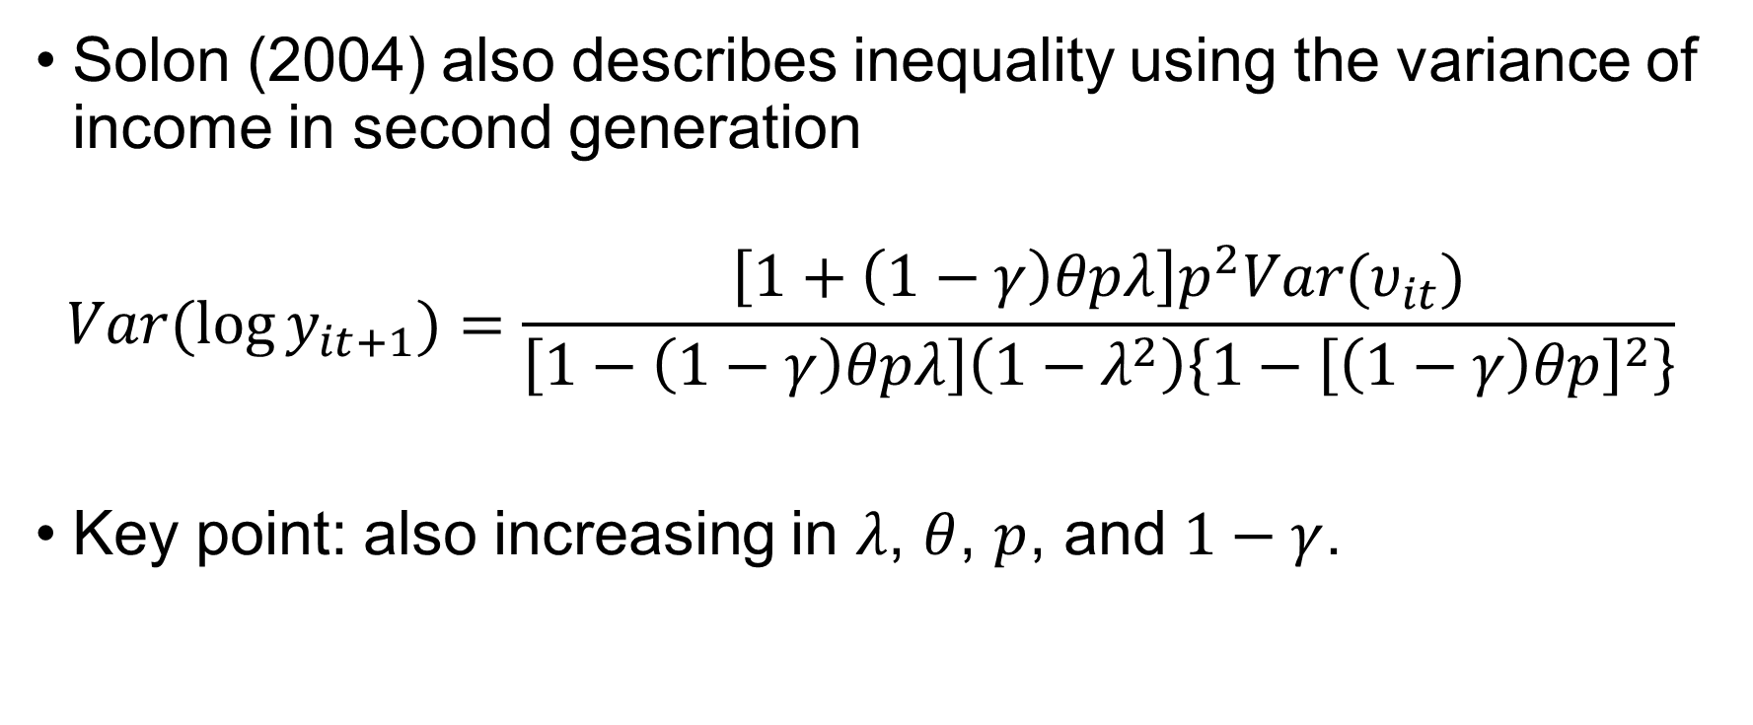
Mobility and inequality
Solon (2004) also describes inequality using the variance of income in second generation
$$Var(\log{y_{it+1})=\frac{\left[1+\left(1−γ\right)θpλ\right]p^{2}Var(υ_{it})}{\left[1−\left(1−γ\right)θpλ\right]\left(1−λ^{2}\right)\left\{1−{\left[\left(1−γ\right)θp\right]}^{2}\right\}}}$$
Key point: also increasing in $λ$, $θ$, $p$, and $1−γ$.

Slide 22
Mobility and inequality
Solon argues inequality and social immobility likely correlated because determined by same factors.
What should we expect to observe if...?
skill premium is higher
human capital investment is more efficient
heritability of endowments is greater
education policy is less progressive

Slide 23
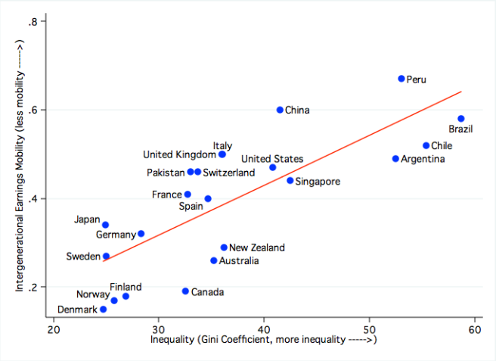
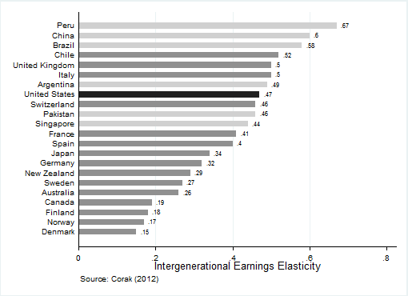
Great Gatsby Curve (Corak 2016)

Slide 24
Mobility and educational reform
Evidence from reforms in Sweden (Meghir and Palme 2005; Holmund 2007) and Finland (Pekkarinen et al. 2006) suggest progressive education reduces intergenerational income elasticities
Greater state-level school expenditure in U.S. associated with more social mobility (Mayer and Lopoo (2008)

Slide 25
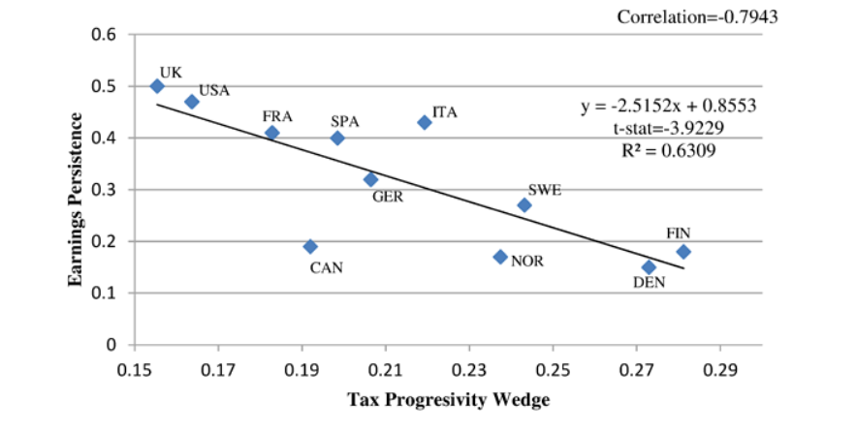
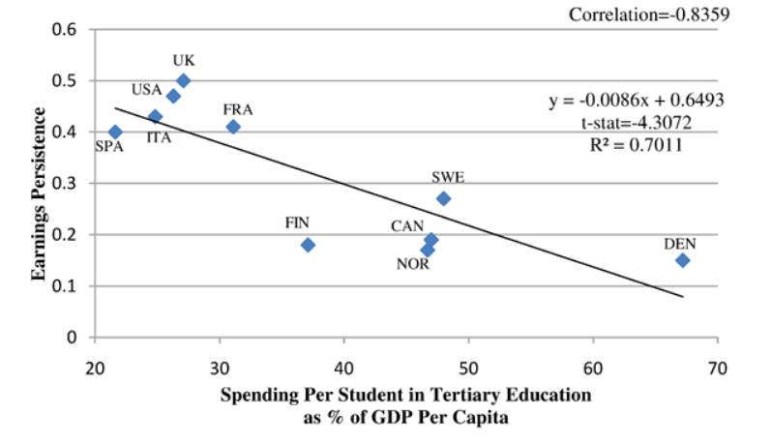
Mobility and education
(Holter 2015)

Slide 26
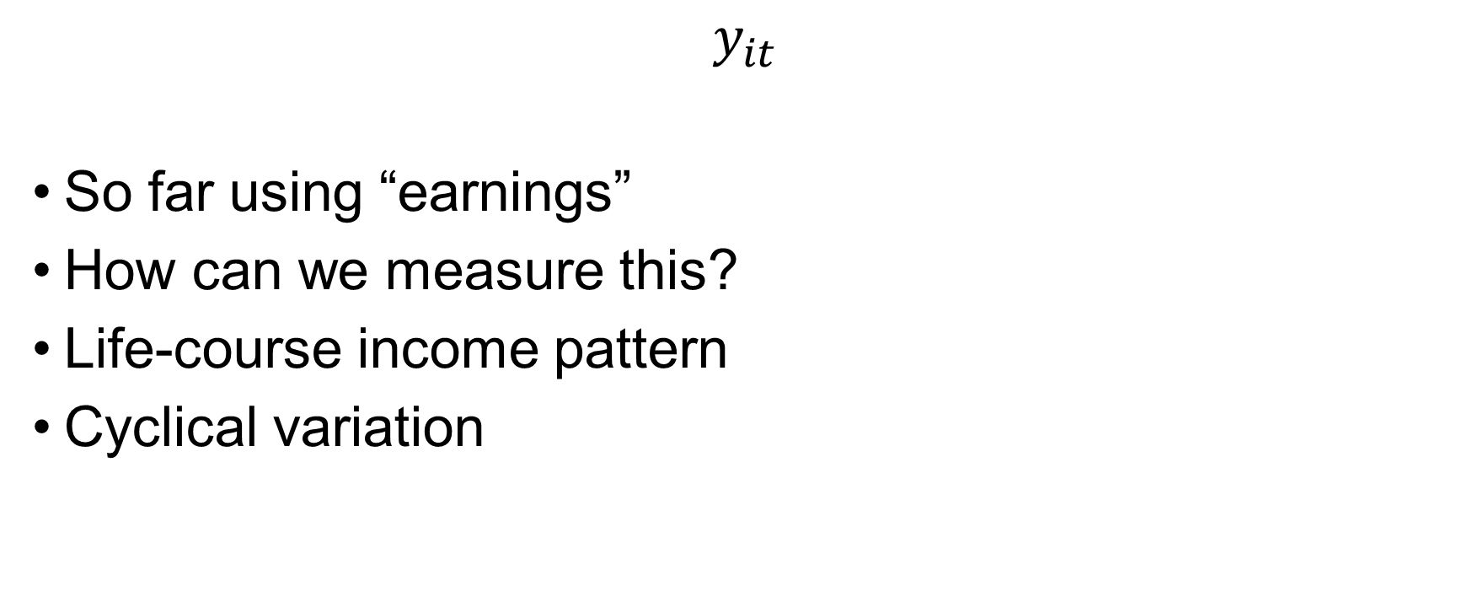
Note: measuring earnings
$$y_{it}$$
So far using “earnings”
How can we measure this?
Life-course income pattern
Cyclical variation

Slide 27
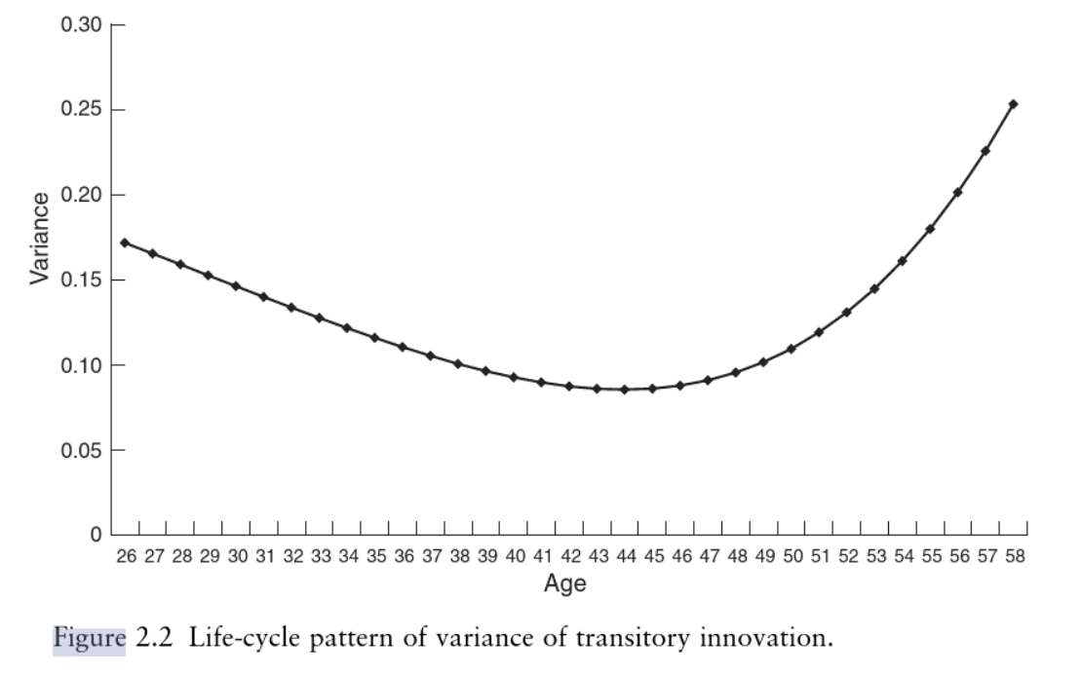
Note: measuring earnings
Earnings variation over life-cycle (Mazumder 2005)

Slide 28
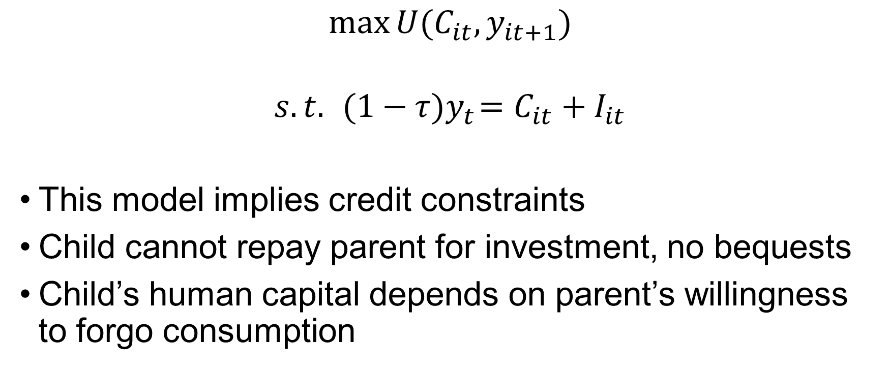
Note: credit constraints
$$\max{U(C_{it},y_{it+1})}$$
$$s.t. { (1−τ)y}_{t}=C_{it}+I_{it}$$
This model implies credit constraints
Child cannot repay parent for investment, no bequests
Child’s human capital depends on parent’s willingness to forgo consumption

Slide 29
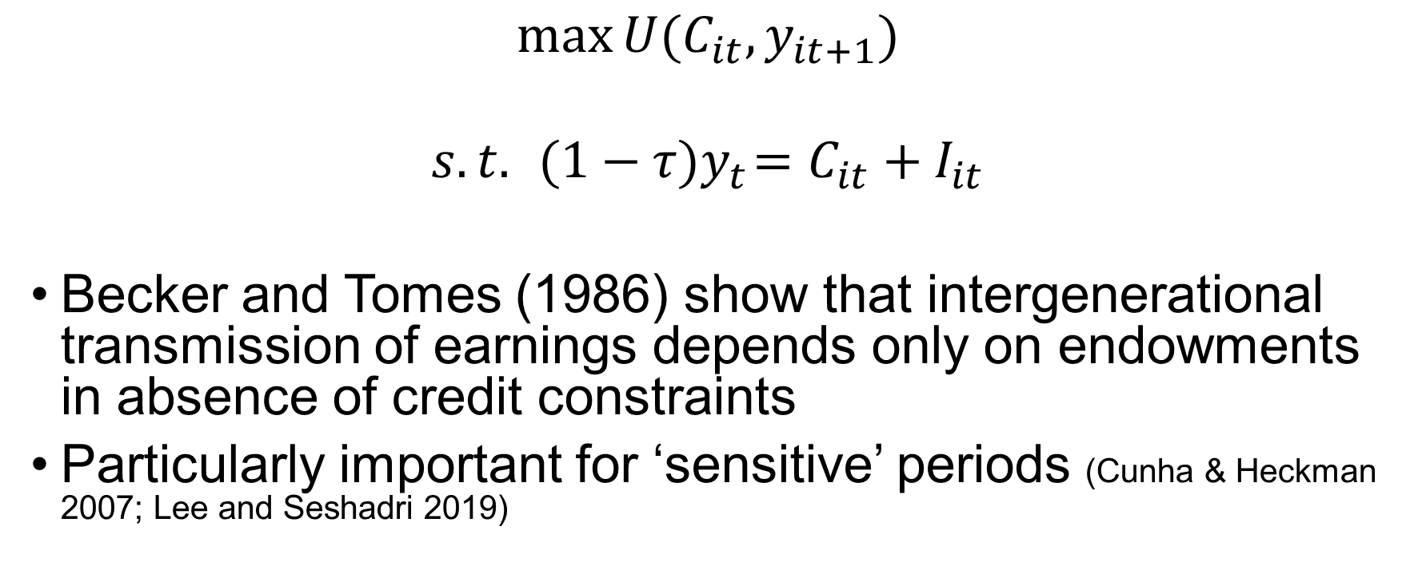
Note: credit constraints
$$\max{U(C_{it},y_{it+1})}$$
$$s.t. { (1−τ)y}_{t}=C_{it}+I_{it}$$
Becker and Tomes (1986) show that intergenerational transmission of earnings depends only on endowments in absence of credit constraints
Particularly important for ‘sensitive’ periods (Cunha & Heckman 2007; Lee and Seshadri 2019)

Slide 30
Microeconomic approach
Is this a good model?
Strongly parameterised
Some conclusions are sensitive to the particular formal assumptions (Björklund & Jäntti 2012)
Predictions derived from behaviour of single representative family. What about market clearing?
General equilibrium model (Hassler 2007) reaches a similar conclusion: progressive education ↑ skill premium ↓

Slide 31
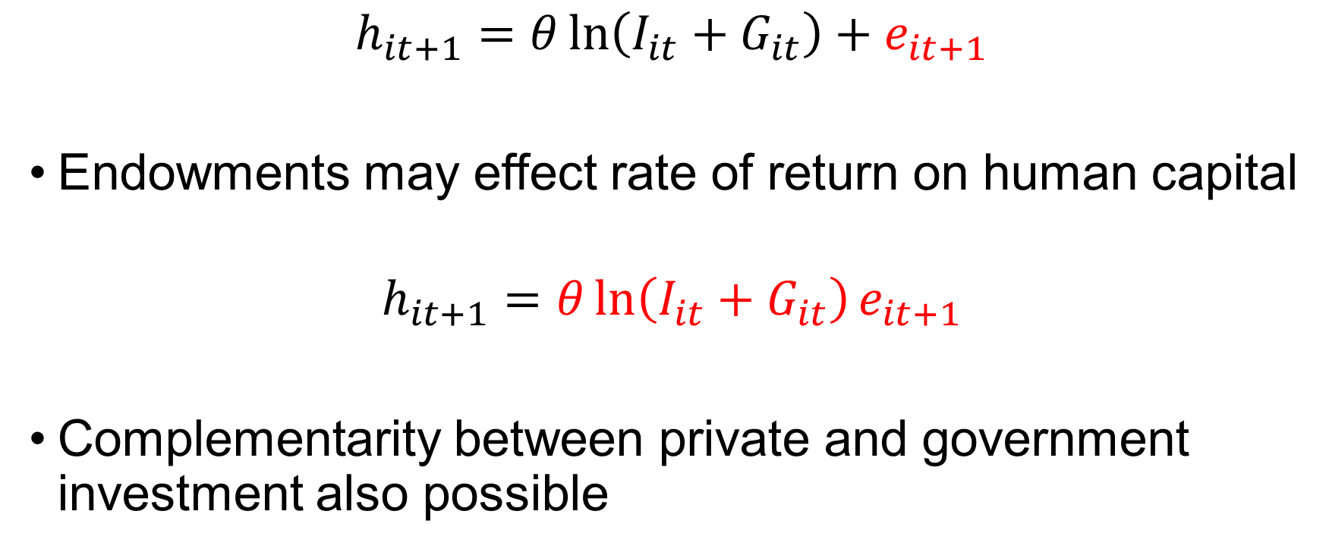
Human capital
$$h_{it+1}=θ\ln\left(I_{it}+G_{it}\right)+e_{it+1}$$
Endowments may effect rate of return on human capital
$$h_{it+1}=θ\ln\left(I_{it}+G_{it}\right)e_{it+1}$$
Complementarity between private and government investment also possible

Slide 32
Extensions
Model does a good job of explaining empirical phenomena in simplest possible terms
Is it convincing?
Extensions may add greater realism
See (Durlauf, Kortellos, & Tan 2022)

Slide 33
Social models
Human capital depends on others’ behaviours
Neighbourhoods (The Opportunity Atlas)
Political economy

