Slide 1

Climbing ahead, falling behind: social mobility across time and space
Week 3
April 29, 2024
Dr. Louis Henderson

Slide 2
Where to download the data
https://louis-henderson.web.app/dataset1.xls

Slide 3
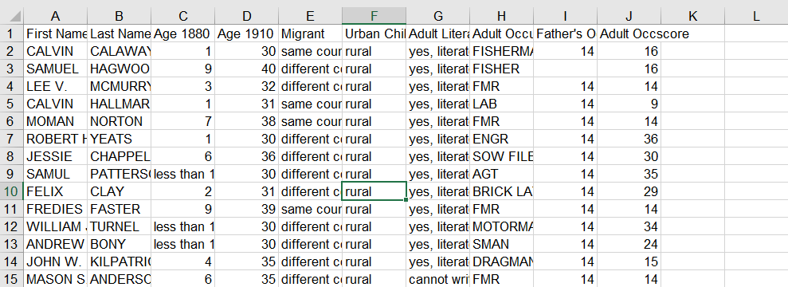
Explore the dataset

Slide 4
Explore the dataset
What do you think the different variables mean?
Income measure: “occscore”
OCCSCORE assigns each occupation in all years a value representing the median total income (in hundreds of 1950 dollars) of all persons with that particular occupation in 1950. OCCSCORE thus provides a continuous measure of occupations, according to the economic returns received by people working at them in 1950. (IPUMS 2024)
Link to 1880 census form

Slide 5
Explore the dataset
Some father-son links fail, resulting in missing values
Excel treats missing values as zeros
Fathers we fail to link did not necessarily earn 0 income
We need to filter out missing values

Slide 6
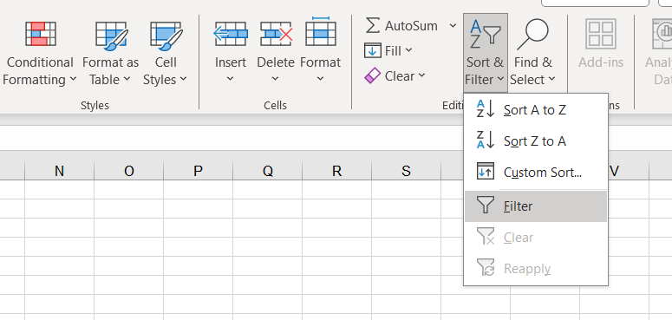
Excel’s “filter” feature
Select your data (ctrl + a)
Turn on filters

Slide 7
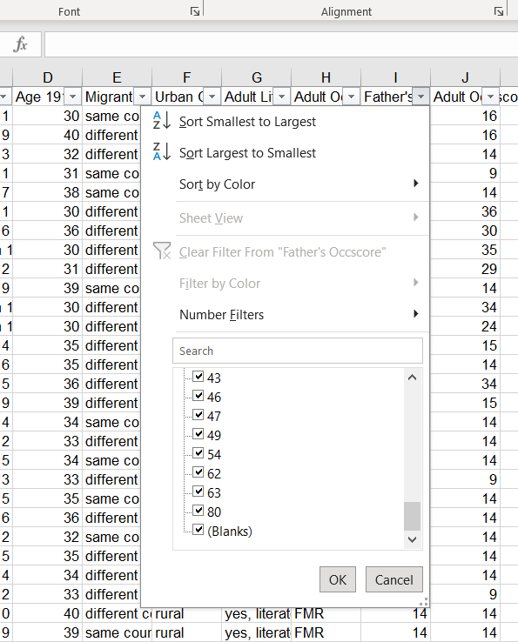
Excel’s “filter” feature
Apply a filter to Father’s occupation
Uncheck “blanks”

Slide 8

Line-of-best-fit
Fitting a line through data points
Use method of ordinary least squares
R² as a measure of goodness-of-fit:
$R^{2}=1−\frac{RSS}{TSS}$

Slide 9
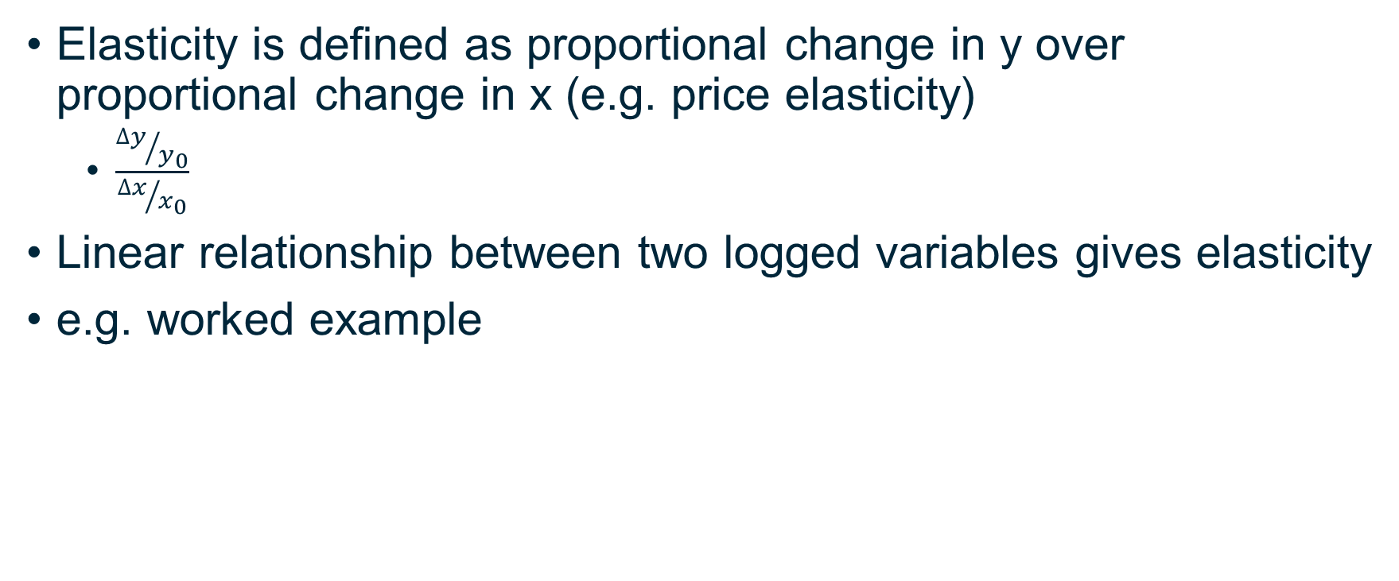
Intergenerational income elasticity
Elasticity is defined as proportional change in y over proportional change in x (e.g. price elasticity)
$\frac{{∆y}/{y_{0}}}{{∆x}/{x_{0}}}$
Linear relationship between two logged variables gives elasticity
e.g. worked example

Slide 10
Adding random noise
Excel: “=NORM.INV(RAND(),0,5)”
Gives the inverse of cumulative standard normal distribution
Generates a random number between 0 and 1
Mean of the distribution
Standard deviation, how “wide” the random noise is
Excel: “=NORM.INV(ZUFALLSZAHL(),0,5)”

