Slide 1

Climbing ahead, falling behind: social mobility across time and space
Week 3
May 6, 2024
Dr. Louis Henderson

Slide 2
Sociological approaches to social mobility
Empirical differences
Theoretical differences
Example of sociology in practice
...but keep in mind sociological and economic approaches to studying social mobility are converging.

Slide 3
Sociological approaches to social mobility
We have so far considered economic approaches to social mobility
These consider individual households’ optimal resource allocation between investment and consumption
Common measure is intergenerational income elasticity
How might sociologists differ? What is the sociological approach?

Slide 4
Sociological approaches to social mobility
First research committee of the ISA on social mobility (1950)
We will adopt a pragmatic definition:
Sociology is what sociologists do
Economics is what economists do
Sociologists tend to focus more on class mobility than income mobility

Slide 5
What is social class?
Many theories:
Asset ownership (Marx, Sørensen);
Power, status, life-chances (Weber, Bourdieu);
Employment relations (Goldthorpe);
In practice, it is a system of categorizing occupational titles.

Slide 6
Classifying occupations
E.g. NS-Sec, E-Sec, based on employment relation (Goldthorpe).
Contract type:
How closed or open is the contract?
What Goldthorpe calls “service” contract is open-ended, incomplete
Difficult to specify contract in advance, employment contract is structured to incentivise long-term relationships
Versus spot market/piece rates

Slide 7
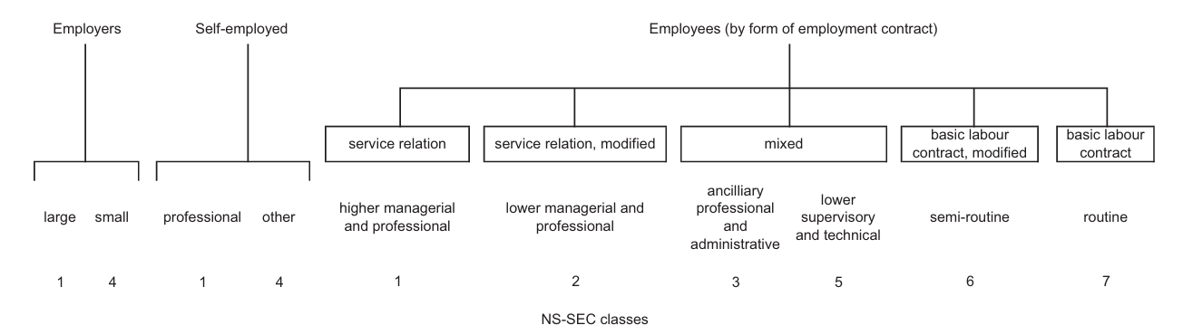
Classifying occupations (NS-SEC)
E.g. Goldthorpe schema.
(Bukodi and Goldthorpe 2018)

Slide 8
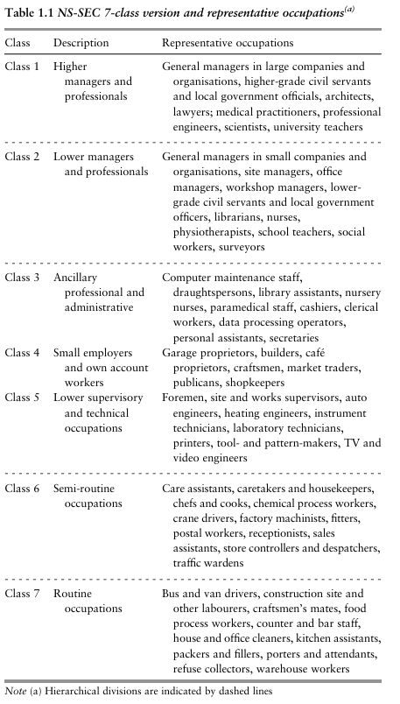
Classifying occupations (NS-SEC)
(Bukodi and Goldthorpe 2018)

Slide 9
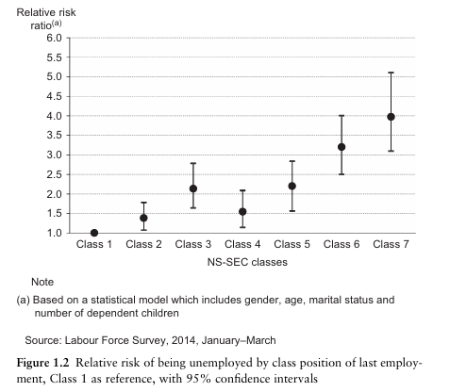
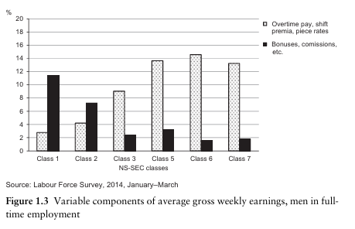
Classifying occupations (NS-SEC)
(Bukodi and Goldthorpe 2018)

Slide 10
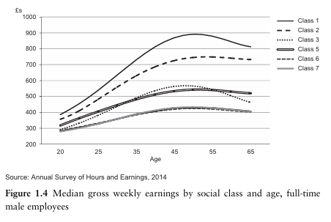
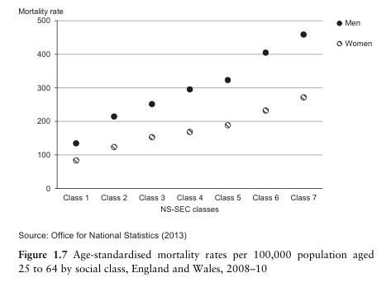
Classifying occupations (NS-SEC)
(Bukodi and Goldthorpe 2018)

Slide 11
Advantages of class-based mobility measures
Occupation less affected by income fluctuations
We saw that measurement error of father’s income will lead to attenuation bias (i.e. higher estimates of social mobility)
Class possibly a more accurate measure of long-run income

Slide 12
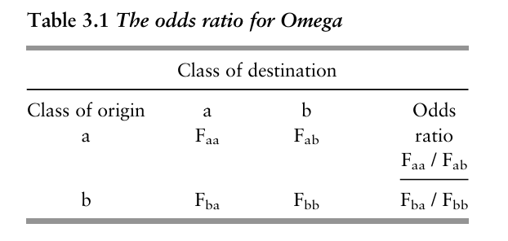
Odds ratios
Relative versus absolute mobility
(Bukodi and Goldthorpe 2018)

Slide 13
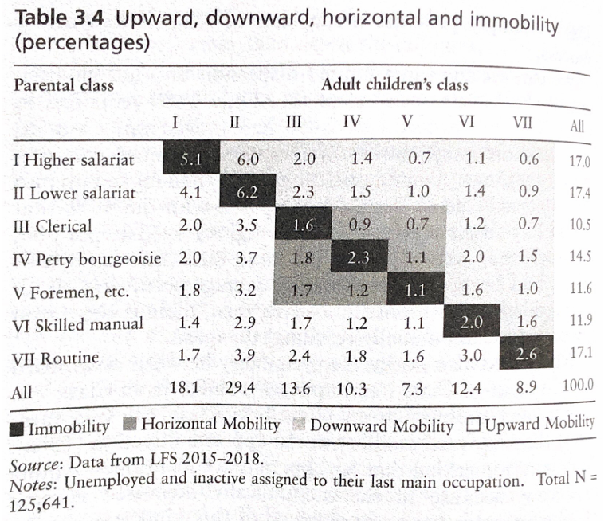
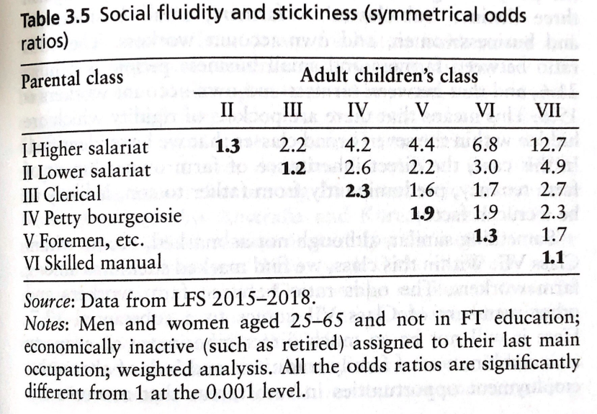
Odds ratios
(Heath and Li 2024)

Slide 14
What is social class mobility?
Attributional inequality, relational inequality (Bukodi and Goldthorpe 2018)
Attributional: inequality of valued attributes, e.g., wealth, health, or income
Relational: inequality embedded in social relationships, e.g., employer/employee

Slide 15
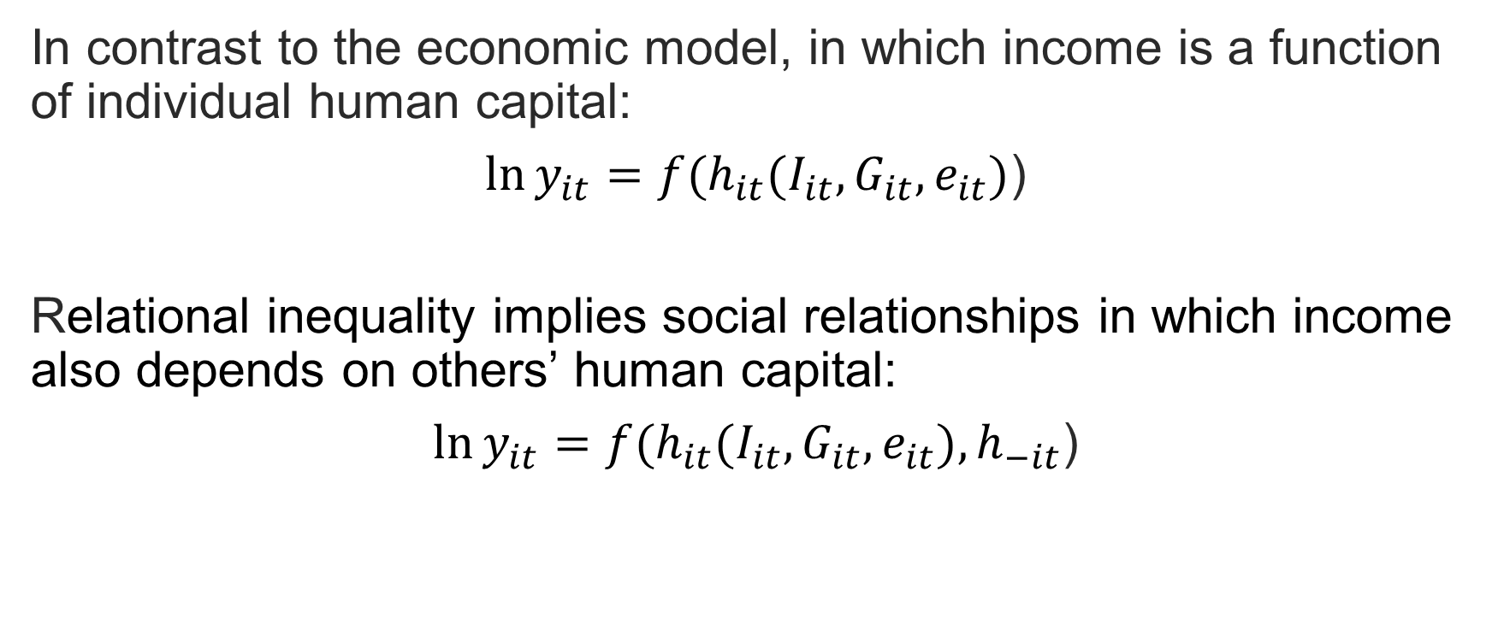
What is social class mobility?
In contrast to the economic model, in which income is a function of individual human capital:
$\ln{y_{it}=f(h_{it}(I_{it},G_{it},}e_{it})$)
Relational inequality implies social relationships in which income also depends on others’ human capital:
$\ln{y_{it}=f(h_{it}(I_{it},G_{it},}e_{it}),h_{−it}$)

Slide 16
Examples of social models
Value of human capital depends on others
Efficiency of human capital investment depends on others
Neighbourhoods and sorting (The Opportunity Atlas)
Political economy

Slide 17
Examples of social models
Value of human capital depends on others
Efficiency of human capital investment depends on others
Neighbourhoods and sorting (The Opportunity Atlas)
Political economy

Slide 18
Markets
Value of human capital depends on supply
Human capital may nonetheless be productive
Signalling, or education as “positional” good
Education not directly productive but provides information to employers
Use this signal to assign positions

Slide 19
Examples of social models
Value of human capital depends on others
Efficiency of human capital investment depends on others
Neighbourhoods and sorting (The Opportunity Atlas)
Political economy

Slide 20
Social learning, peers, motivation, norms, social networks (Coleman 1988)

Slide 21
Examples of social models
Value of human capital depends on others
Efficiency of human capital investment depends on others
Neighbourhoods and sorting (The Opportunity Atlas)
Political economy

Slide 22
Income determines position on housing market
Houses of similar value cluster in neighbourhoods
May affect education quality through local taxes
May also affect rates of crime and violence, which may affect learning

Slide 23
Examples of social models
Value of human capital depends on others
Efficiency of human capital investment depends on others
Neighbourhoods and sorting (The Opportunity Atlas)
Political economy

Slide 24
Income affects voters’ preferences over redistributive policy, including the progressiveness of education
Income distribution determines which policies will be preferred and win democratic contests

Slide 25
Bernardi, F. and Gil-Hernández (2021)
“The Social-Origins Gap in Labour Market Outcomes: Compensatory and Boosting Advantages Using a Micro-Class Approach”
Study comparing income and occupational outcomes

Slide 26
Background & Data
Spain, Feb. 2013 to May 2018, where intergenerational inequality is high compared to other European countries
Study considers “direct effect of social origins” (DESO) after controlling for years of education*

Slide 27
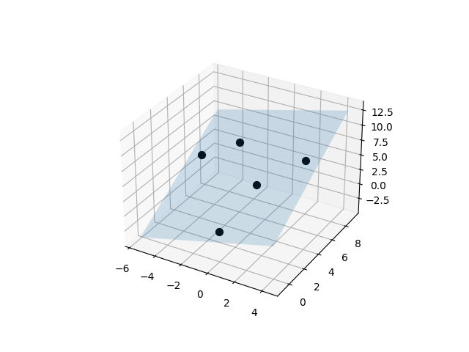
*Intuition on multivariable regression
Like linear regression but in three dimensions: a plane
Outcome variable on Z axis
One dimension is education
How much is still explained by parent’s occupation?
(Hynes 2019)

Slide 28
Background & Data
Spain, where intergenerational inequality is high compared to other European countries
Survey data between Feb. 2013 to May 2018, representative sample
Study considers “direct effect of social origins” (DESO) after controlling for years of education*
Calculates DESO separately for children’s class destination (occupation) and income
Compares degree-holders and non-degree-holders, and different “micro-class” occupations.

Slide 29
Background & Data
Class measure based on average income and education of occupation
International socio-economic index of occupational status (ISEI)
Income measure based on reported monthly earnings

Slide 30
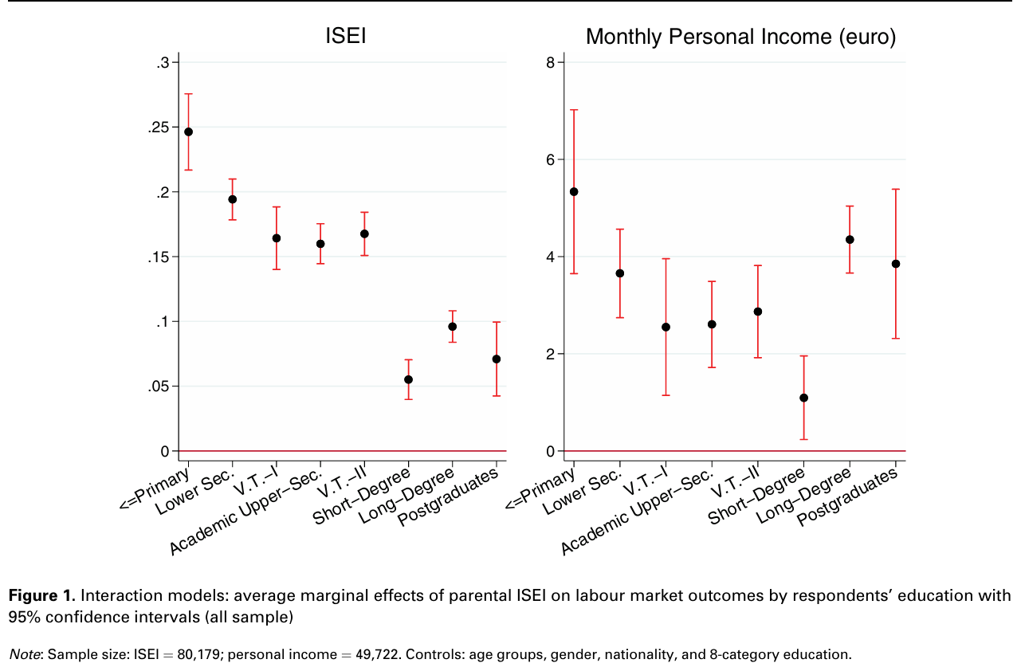
Results 1

Slide 31
Results 1
Compensatory advantage:
Despite poor educational performance, children of higher-status households nonetheless acquire relatively high-status occupations
Employment in family business, family connections, start-up funds
Boosting advantage:
High-status households better able to take advantage of income inequality within occupations
Identify high-performing firms, elite schools and high-paying majors
May also impart complementary traits, cultural capital.

Slide 32
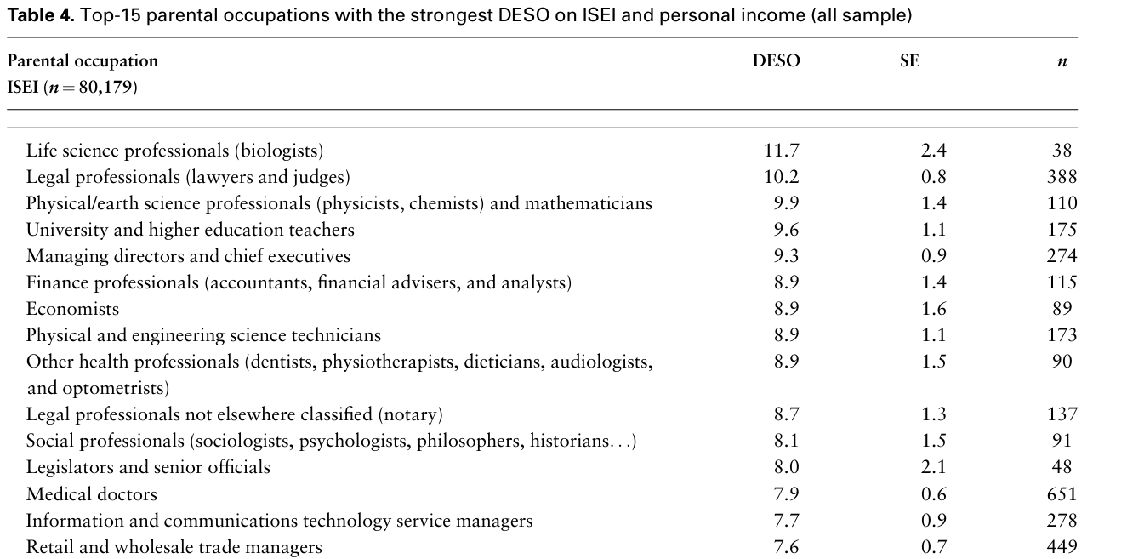
Results 2

Slide 33
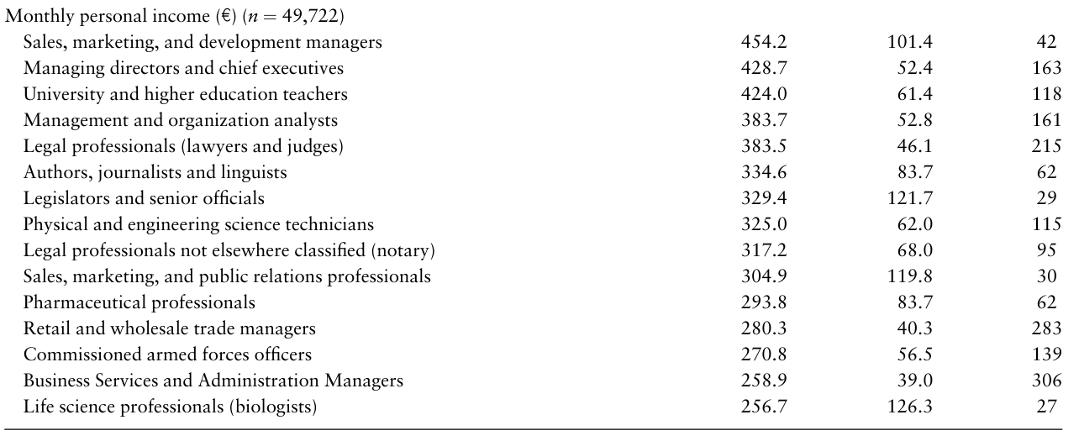
Results 2

Slide 34
Results 2
Liberal professions:
“…legal professionals whose parents themselves are legal professionals are expected to make about € 700 per month more than legal professionals whose parents are construction workers.”
Compensatory advantage:
Shop salesperson most common occupation for those without upper-secondary education and highest DESO

