Slide 1

Climbing ahead, falling behind: social mobility across time and space
Week 5
May 13, 2024
Dr. Louis Henderson

Slide 2
Where to download the data
https://louis-henderson.web.app/coventry.csv

Slide 3
Introducing the dataset
To vote in the city of Coventry, men needed to have served a seven-year apprenticeship in the city.
Following allegations of voter fraud in 1780, legislation was introduced to require registration of all apprenticeships
These persisted into the late 20th century.

Slide 4
Introducing the dataset
Dataset contains boy’s father’s occupation, “PJOB”
Also contains the occupation of the master to which the boy was apprenticed, “OCC”.
Apprenticeship was a system of occupational training, usually begun at age 14.
Dataset contains other interesting details.

Slide 5
Question
Inspect the dataset. What do you notice?
What do you think the variables mean?
What do we need to do or know before we begin?

Slide 6
HISCO/HISCLASS
A historical class scheme intended for international comparisons of 18th, 19th and 20th centuries.
Occupation as written > HISCO (c. 1000) > HISCLASS (12)
HISCO fairly specific occupational categories

Slide 7
HISCO/HISCLASS
HISCO code | Description
75400 | Weaver, Specialisation Unknown
75710 | Rope Maker, General
79100 | Tailor, Specialisation Unknown
95120 | Bricklayer (Construction)
75622 | Yarn, Fabric or Garment Dyer
94220 | Basket Maker
45220 | Street Vendor
58300 | Military
72500 | Metal Moulder or Coremaker, Specialisation Unknown
99910 | Labourer

Slide 8
HISCO/HISCLASS
HISCLASS general classification system based on four dimensions:
Manual/non-manual
Physical aptitude required for job?
Skill
Number of years general education and specific training?
Supervision
Position requires holder to delegate and plan tasks
Sector
Primary or non-primary

Slide 9
HISCO/HISCLASS
Information about these dimensions taken from Dictionary of Occupational Titles
In 1930s, U.S. employment offices needed a way to match unemployed workers to prospective employers
Massive survey effort cataloguing requirements of different jobs
Resulting classifications validated/challenged by seven historians of work

Slide 10
Class number | Class label | Manual/non-manual | Skill level | Supervision | Sector
1 | Higher managers | Non-manual | High | Y
2 | Higher professionals | Non-manual | High | N
3 | Lower managers | Non-manual | Medium | Y
4 | Lower professionals | Non-manual | Medium | N
5 | Lower clerical and sales | Non-manual | Low | N
6 | Foremen | Manual | Medium | Y
7 | Medium skilled | Manual | Medium | N
8 | Farmers and fishermen | Manual | Medium | N | Primary
9 | Lower skilled | Manual | Low | N
10 | Lower skilled farm | Manual | Low | N | Primary
11 | Unskilled | Manual | Unskilled | N
12 | Unskilled farm | Manual | Unskilled | N | Primary

Slide 11
Class number | Class label | Manual/non-manual | Skill level | Supervision | Sector
1 | Higher managers | Non-manual | High | Y
2 | Higher professionals | Non-manual | High | N
3 | Lower managers | Non-manual | Medium | Y
4 | Lower professionals | Non-manual | Medium | N
5 | Lower clerical and sales | Non-manual | Low | N
6 | Foremen | Manual | Medium | Y
7 | Medium skilled | Manual | Medium | N
8 | Farmers and fishermen | Manual | Medium | N | Primary
9 | Lower skilled | Manual | Low | N
10 | Lower skilled farm | Manual | Low | N | Primary
11 | Unskilled | Manual | Unskilled | N
12 | Unskilled farm | Manual | Unskilled | N | Primary

Slide 12
Question
Using Excel’s pivot table function, create a transition matrix with the frequency of father-son class pairings in each cell.
What do you notice?

Slide 13
Question
Calculate the proportion of the sample who are socially immobile.
Calculate the proportion who are upwardly and downwardly mobile.
Using the filter feature of the pivot table, calculate this proportion for different time periods.
Does this suggest social mobility increased or decreased over time?

Slide 14
Question
Calculate symmetric likelihood ratios from the table.
Where there are two classes, A and B, this is the that odds a child whose parents are in class A also ends up in class A and not class B, divided by the odds that a child whose parents are in class B ends up in class A and not class B.
What does this suggest about relative social mobility in this sample?

Slide 15
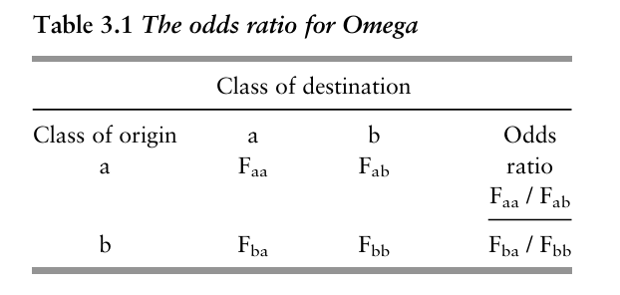
Odds ratios
Relative versus absolute mobility
(Bukodi and Goldthorpe 2018)

Slide 16
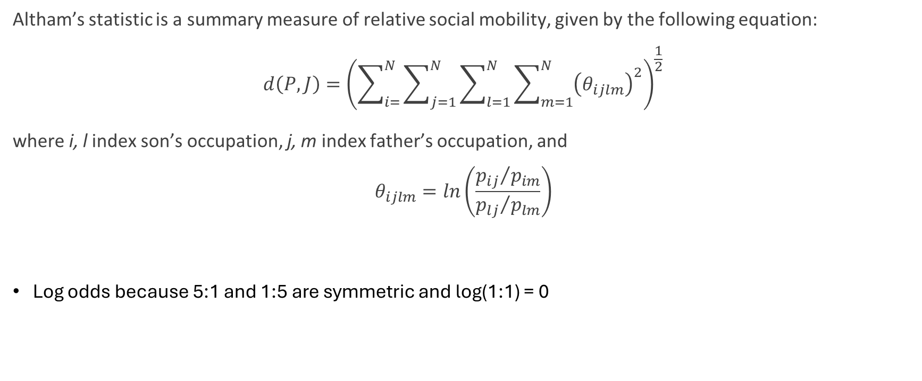
Altham Statistic
Altham’s statistic is a summary measure of relative social mobility, given by the following equation:
$$d\left(P,J\right)={\left(\sum_{i=}^{N}{\sum_{j=1}^{N}{\sum_{l=1}^{N}{\sum_{m=1}^{N}{{\left(θ_{ijlm}\right)}^{2}}}}}\right)}^{\frac{1}{2}}$$
where i, l index son’s occupation, j, m index father’s occupation, and
$$θ_{ijlm}=ln\left(\frac{{p_{ij}}/{p_{im}}}{{p_{lj}}/{p_{lm}}}\right)$$
Log odds because 5:1 and 1:5 are symmetric and log(1:1) = 0

Slide 17
Question
Calculate Altham’s statistic for the whole sample.
Does relative social mobility change much over time?

Slide 18
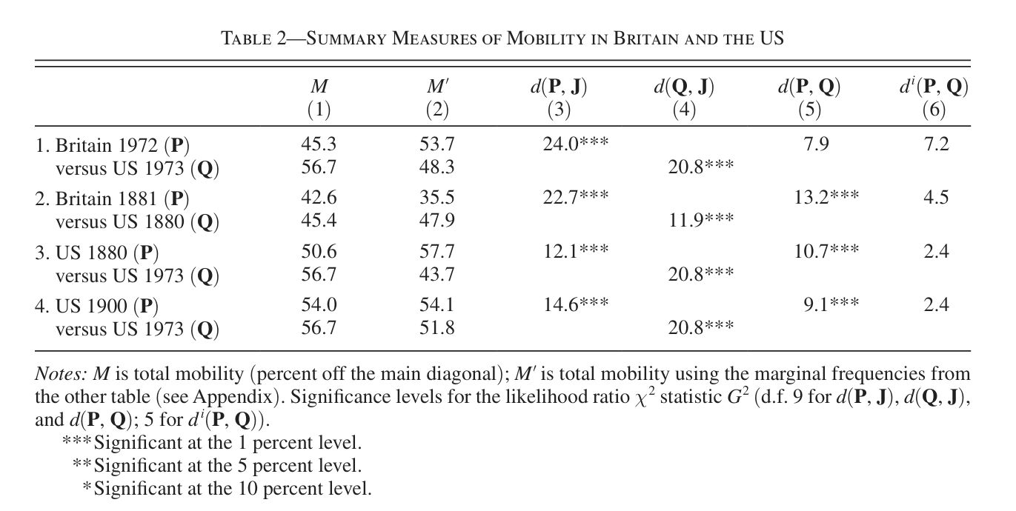
Using Excel’s pivot table function, create a transition matrix with the frequency of father-son class pairings in each cell.
What do you notice?
(Long & Ferrie 2013)

