Slide 1

Climbing ahead, falling behind: social mobility across time and space
Week 7
June 3, 2024
Dr. Louis Henderson

Slide 2
Surname frequency method
Persistence of rare surnames in “elite” status
Advantage: minimal data requirements

Slide 3
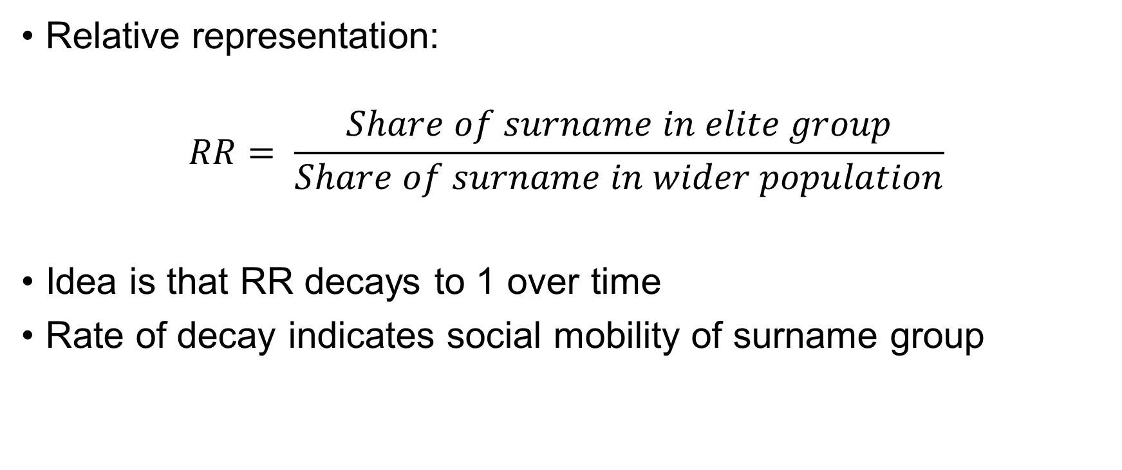
Surname frequency method
Relative representation:
$$RR= \frac{Share of surname in elite group}{Share of surname in wider population}$$
Idea is that RR decays to 1 over time
Rate of decay indicates social mobility of surname group

Slide 4
From RR to “social status”
Standardize RR to allow for comparisons
Adjust for how “selective” the elite status is
Three key assumptions:
Elite group represents the top of the status distribution
Social status is normally distributed with constant variance
Variance of social status is the same in the surname group and in the whole population

Slide 5
Example: Oxbridge membership
Generation | Relative representation | Oxbridge elite share % | Implied mean status | Implied beta
1800-29 | 19.06 | 0.64 | ??? | ???
1830-59 | 10.57 | 0.62 | ??? | ???
1860-89 | 7.59 | 0.53 | ??? | ???

Slide 6
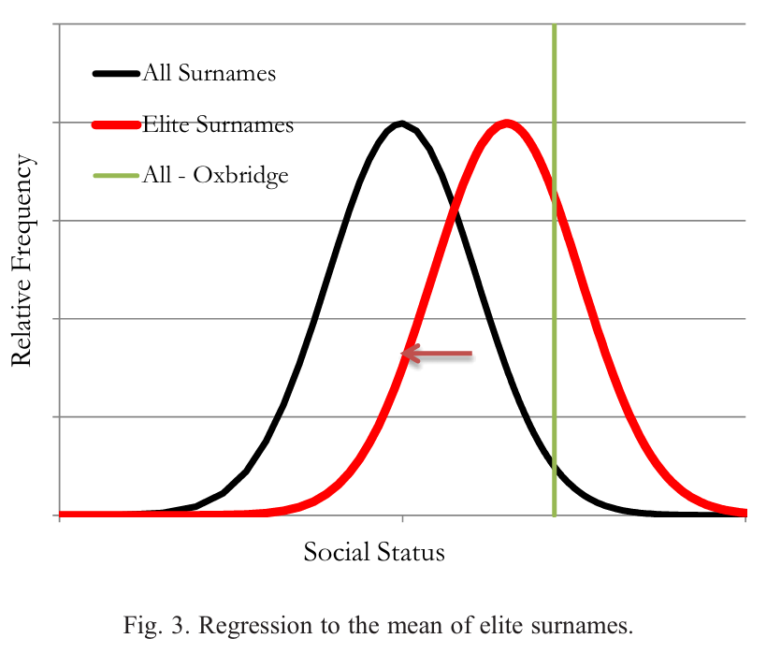
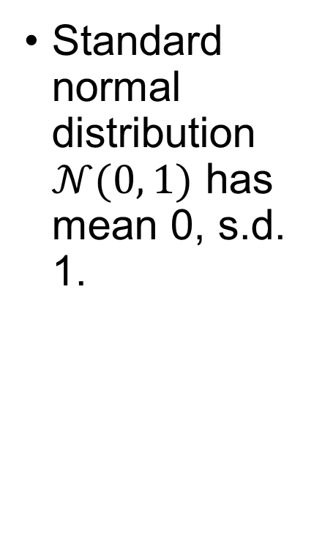
The standard normal distribution (z-score)
Standard normal distribution $𝒩(0, 1)$ has mean 0, s.d. 1.

Slide 7
The standard normal distribution (z-score)
Excel: “=NORM.S.INV(___)”
Input probability, output z-score

Slide 8
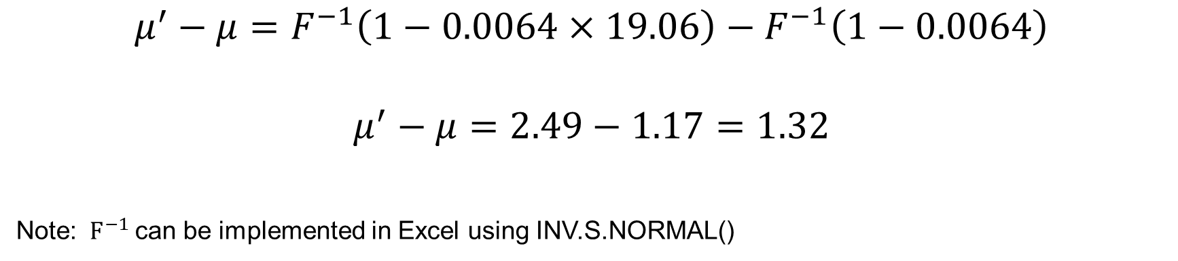
Example: Oxbridge membership
Generation | Relative representation | Oxbridge elite share % | Implied mean status | Implied beta
1800-29 | 19.06 | 0.64 | 1.32σ | ???
1830-59 | 10.57 | 0.62 | 0.99σ | ???
1860-89 | 7.59 | 0.53 | ??? | ???
$$μ^{′}−μ=F^{−1}\left(1−0.0064×19.06\right)−F^{−1}\left(1−0.0064\right)$$
$$μ^{′}−μ=2.49−1.17=1.32$$
Note: $F^{−1}$can be implemented in Excel using INV.S.NORMAL()

Slide 9
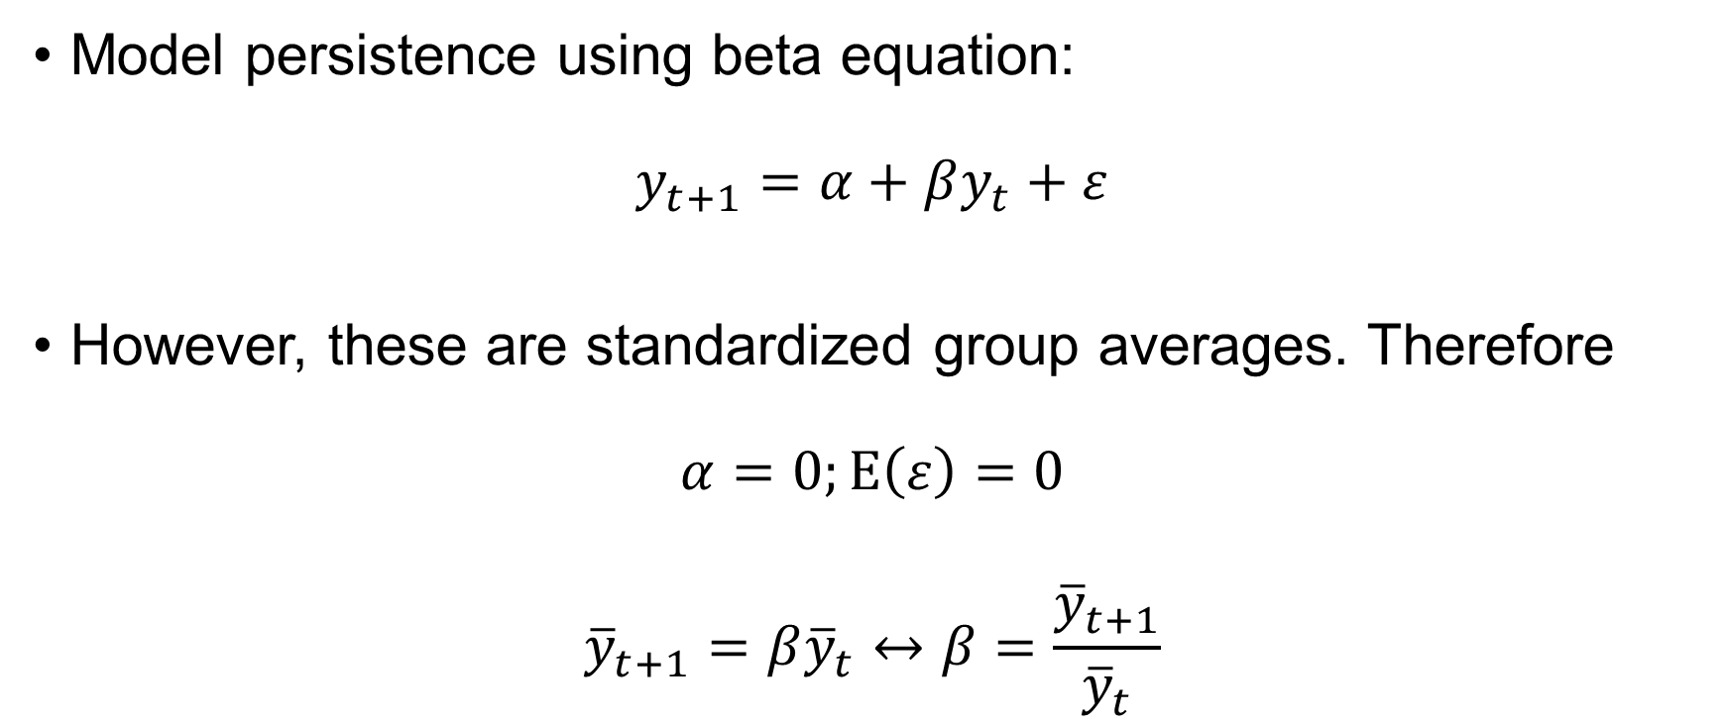
From sigmas to betas
Model persistence using beta equation:
$$y_{t+1}=α+βy_{t}+ε$$
However, these are standardized group averages. Therefore
$$α=0;E\left(ε\right)=0$$
$${\overline{y}}_{t+1}=β{\overline{y}}_{t}↔β=\frac{{\overline{y}}_{t+1}}{{\overline{y}}_{t}}$$

Slide 10

Example: Oxbridge membership
Generation | Relative representation | Oxbridge elite share % | Implied mean status | Implied beta
1800-29 | 19.06 | 0.64 | 1.32 | -
1830-59 | 10.57 | 0.62 | 0.99 | 0.75
1860-89 | 7.59 | 0.53 | 0.81 | ???
$$β=\frac{{\overline{y}}_{t+1}}{{\overline{y}}_{t}}=\frac{0.99}{1.32}=0.75$$

Slide 11
Boulazac 1836-1876
Census data from Mosaic project
French census usually carried out every 5 years
Boulazac, a small settlement in Dordogne département, southwest France
1836 and 1876 are digitized

Slide 12
Data set
Two datasets today:
https://louis-henderson.web.app/france1836.xls
https://louis-henderson.web.app/france1876.xls

Slide 13

Boulazac 1836-1876

Slide 14
Elite surnames in France
“De” or “Du” may indicate nobility
Nobility was abolished in French Revolution (citizenship revoked, some property sold), restored under Napoleon, property indemnified, nobility abolished in 1848, revived in 1852, and finally ended in 1870
No obligation to change name
In 1840s, titled nobles paid mean land tax 2,050 francs, those with “de” or “du” paid 871 francs, electors paid 380 francs (Higgs 1987)

Slide 15
Identifying an elite group
Inspect the data from both 1836 and 1876
Can you think of a way to identify an elite group in the census?

Slide 16
Identifying an elite group
Agricultural, rural society
“Propriétaire” implies land-ownership
“Cultivateur” and “Metayer” likely imply tenancy
“Journalier” is a day labourer
“Domestique” does not in France in this period necessarily mean domestic servant
Live-in agricultural service, yearly

Slide 17
Identifying an elite group
“Servants” identified as members of the household in census
Relationship lists servants in household
Take those hiring more than one servant as sign of relative high status

Slide 18
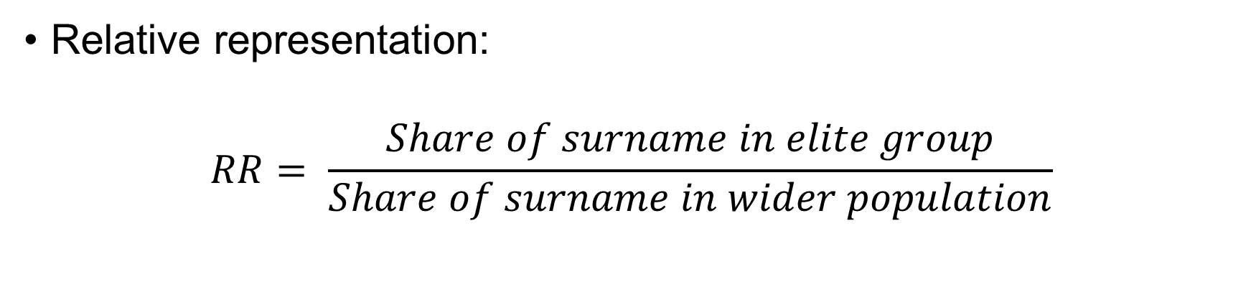
Boulazac
Generation | Relative representation | Elite share % | Implied mean status | Implied beta
1836
1876
Relative representation:
$$RR= \frac{Share of surname in elite group}{Share of surname in wider population}$$

Slide 19
Problems with the method
Begs the question
Method assumes what they are trying to demonstrate
There is an “underlying” social status, normally distributed, and top of the distribution get elite positions
This is at odds with most theory we have discussed so far

Slide 20
Problems with the method

Slide 21
Problems with the method
Torche and Corvalan (2018) mount important critique of Clark’s approach in two ways
They first point out that Clark is not measuring individual-level persistence
Individual persistence (individual father-son pairs) can be decomposed into “between-group” persistence and “within-group” persistence
Clark’s is a measure of “between-group” persistence, with groups defined by surnames

Slide 22
Problems with the method
Clark claims that this “between group” estimate gives a more accurate measure of individual persistence
Further, Clark claims that the higher level of “true” persistence at the group level indicates the importance of genetics in intergenerational mobility, but it does not

Slide 23
Problems with the method
Torche and Corvalan (2018) show that the presence of “within group” persistence means taking group-level averages does not solve the measurement-error problem
In fact, it may introduce new problems that are not present at the individual level.
While genes link biological fathers and sons, the relationship is likely weaker at the group level, and groups may exhibit emergent properties that individuals do not
Possibly more confounders, not fewer

Slide 24
Problems with the method
Additionally, the finding that surname (between-group) persistence is higher than individual persistence appears to be an artefact of the groups Clark selects for analysis
Torche and Corvalan (2018) show that individual persistence measures will be higher than between-group measures if within-group persistence is greater than between-group persistence
Taking only sample of white Americans, they find the reverse of Clark → individual persistence estimate larger than group persistence of ethnic origin
Explanation is significant within-group persistence, little difference between groups

Slide 25
Surname method
Nonetheless, between-group measures of social mobility are meaningful if interpreted carefully
Surnames do not give cleaner measure of individual-level persistence
This evidence suggests that elite-group social status mobility was not much affected by institutional and structural change in the long run

Slide 26
Thank you!

