Slide 1

Climbing ahead, falling behind: social mobility across time and space
Week 9
June 17, 2024
Dr. Louis Henderson

Slide 2
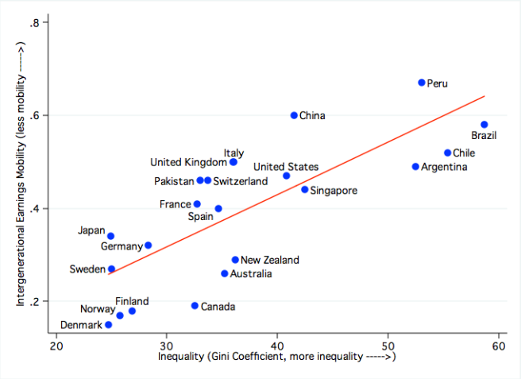
Europe: social mobility and labour-market institutions

Slide 3
Europe: social mobility and labour-market institutions
Solon (2004) claims two important features of labour market will affect social mobility: human capital and earnings inequality
How do labour markets work?
Can we identify differences in labour markets that may explain differences in social mobility across European countries?
Why would such closely integrated labour markets exhibit these different characteristics?
Can we explain how these differences emerge?

Slide 4
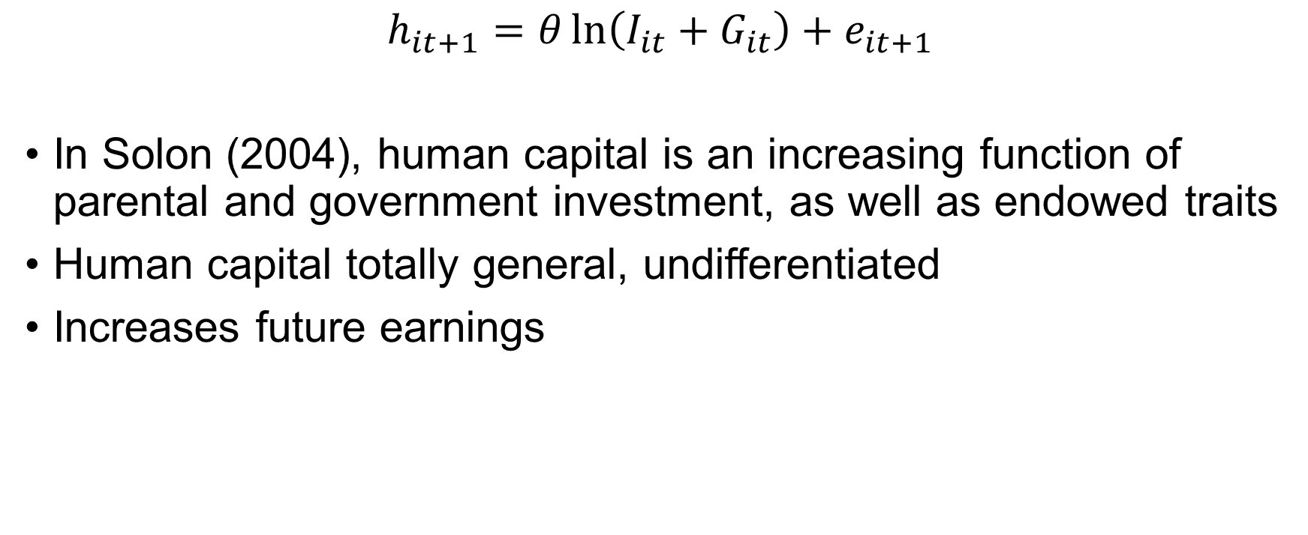
Human capital investment
$$h_{it+1}=θ\ln\left(I_{it}+G_{it}\right)+e_{it+1}$$
In Solon (2004), human capital is an increasing function of parental and government investment, as well as endowed traits
Human capital totally general, undifferentiated
Increases future earnings

Slide 5
Human capital investment
General | Industry-specific | Firm-specific
Valuable in any task/occupation Basic education E.g., literacy, theoretical knowledge, mathematics, skills with wide applications. | Valuable skills in a given industry Apprenticeship Not transferable to other industry E.g., skilled labour, ceramicist, car mechanic | Valuable only to a specific firm Learning-by-doing E.g., knowledge of specific software, proprietary technology

Slide 6
“Varieties of capitalism”
Estevez-Abe et al. (2001) propose that different product-market strategies are linked to different inputs of specific and general skills
Specific skills introduce different kinds of risks and coordination failures
Labour-market institutions complement these different product-market strategies

Slide 7
Human capital and product markets
General | Industry-specific | Firm-specific
Fordist mass-production Extreme division of labour Automobiles, consumer durables Radical product innovation | High-quality, low volume products | Hybrid models Diversified mass production (general and firm-specific) Diversified quality production (industry-specific and firm-specific)

Slide 8
Skill and coordination failure
Honest Co. agrees to pay lower wages for a period to recoup training costs
Freeriders Inc. has not paid costs of training and can therefore offer a higher wage to attract trained workers
Honest Co. loses its investment. Stops training.
No-training equilibrium: prisoner’s dilemma.

Slide 9
Specific skills and risk
General skills less risky than specific skills for employees
Workers with general skills can change jobs if unemployed and receive similar wage
Those with specific skills will not earn higher wages outside of industry or firm
Risk-averse workers will be reluctant to invest in specific skills, and firms may need to pay a risk premium
Exacerbates coordination problems by raising cost of training

Slide 10
Specific skills and risk
More generous welfare regimes can reduce the risks of investing in specific skills
Reduces costs of specific-skill training, firms in these states more competitive on international markets
In contrast, firms in product markets pursuing general-skills strategies may find that generous welfare discourages general human capital accumulation

Slide 11
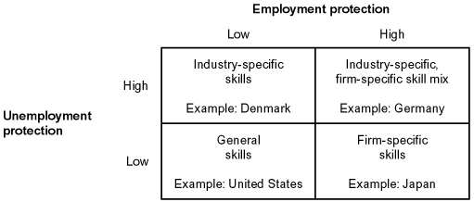
Specific skills and risk
(Estevez-Abe et al. 2001)

Slide 12
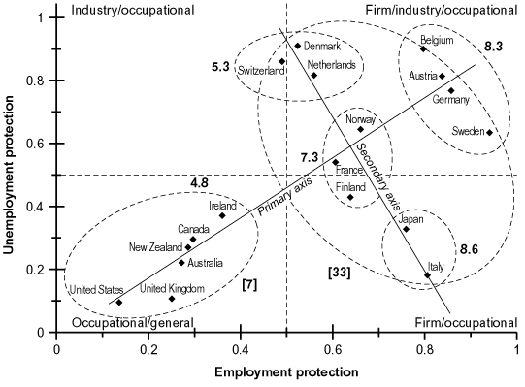
Specific skills and risk
(Estevez-Abe et al. 2001)

Slide 13
Specific skills and risk
(Estevez-Abe et al. 2001)

Slide 14
Country | Tenure | Vocational Training | Apprenticeship model | Upper Secondary | Tertiary
Austria | 6.9 | 22 | Dual apprenticeship | 71 | 6
Germany | 10.7 | 34 | Dual apprenticeship | 81 | 13
Sweden | 7.8 | 36 | Vocational colleges | 74 | 13
Norway | 6.5 | 37 | Vocational colleges | 82 | 16
Belgium | 8.4 | 53 | Mixed | 53 | 11
Japan | 8.3 | 16 | Company‐based
Finland | 7.8 | 32 | Vocational colleges | 67 | 12
Italy | 8.9 | 35 | Company‐based | 38 | 8
France | 7.7 | 28 | Company‐based | 60 | 10
Ireland | 5.3 | 6 | Weak | 50 | 11
The Netherlands | 5.5 | 43 | Mixed | 62 | 22
Switzerland | 6 | 23 | Dual apprenticeship | 80 | 10
Denmark | 4.4 | 31 | Mixed | 66 | 15
Canada | 5.9 | 5 | Weak | 76 | 17
Australia | 3.4 | 9 | Weak | 57 | 15
New Zealand |  | 7 | Weak | 60 | 11
United Kingdom | 5 | 11 | Weak | 76 | 13
United States | 4.2 | 3 | Weak | 86 | 26
(Estevez-Abe et al. 2001)

Slide 15
Poverty traps
Estevez-Abe et al. (2001) argue general skills regimes lead to lower mobility for academically underperforming children
Where there is greater demand for vocational training and specific skills, academic performance in school offers opportunities to compete for these positions
Closer relationships between employers and local education system
Where firms rely more on general skills, there are fewer of these medium-skill opportunities. Return on education is less linear in these labour markets.

Slide 16
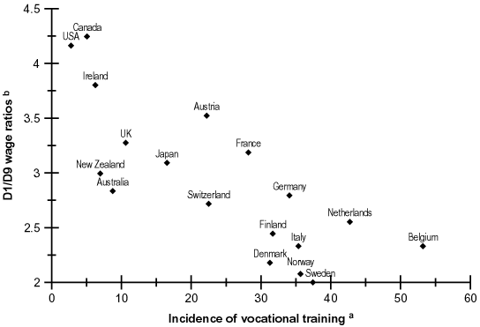
Poverty traps

Slide 17
Country | Scientific Citation Ratio | Service sector employment
Ireland | 1.514 | —
United States | 1.31 | 23
New Zealand | 1.267 | —
Canada | 1.032 | 20
United Kingdom | 0.837 | 16
Australia | 0.804 | 26
Sweden | 0.757 | 14
The Netherlands | 0.754 | 14
Norway | 0.69 | 17
Switzerland | 0.639 | —
France | 0.601 | 11
Belgium | 0.598 | 13
Germany | 0.592 | 14
Japan | 0.586 | —
Austria | 0.575 | —
Finland | 0.552 | 11
Denmark | 0.536 | 11
Italy | 0.491 | 9
(Estevez-Abe et al. 2001)

Slide 18
Gender inequality
In contrast, women face additional challenges in specific-skill demanding labour markets because of maternity and caring
Job guarantee for women returning from maternity leave makes firm-specific investments less risky
These are costly for employers, difficult to replace specific workers if relying on internal labour markets
Men cheaper to employ, and workforce may be more segregated by gender to avoid competition where specific skills predominate
General skills less risky for women

Slide 19
Share of occupation by women %
 | (1) Professional, technical, and related workers | (2) Administrative and managerial workers | (3) Clerical and related workers | (4) Sales workers | (5) Service workers | (6) Production and related workers
USA (1989) | 22 | 26 | 70 | 33 | 30 | 30
Japan (1988) | 10 | 7 | 58 | 11 | 40 | 39
Germany (1986) | 15 | 11 | 59 | 52 | 67 | 21
The Netherlands (1993) | 14 | 0 | 55 | 32 | 45 | 12
Sweden (1989) | 15 |  | 57 | 25 | 72 | 24
Australia (1987) | 8 | 18 | 20 | 43 | 76 | 31
(Estevez-Abe et al. 2001)

Slide 20
Institutional evolution
These differences may not emerge because of preferences, rather because of path dependence
Early differences, because of increasing returns, may become “locked in”
Institutions sometimes change dramatically, and are sometimes very resilient
Two case studies, Thelen (2004), illustrate

Slide 21
Institutional evolution
Thelen (2001) argues that existing institutions in early phase of industrialisation set-up long-run differences between labour-market institutions in U.K. and Germany
In brief, industrial unions in the U.K. were trapped in a two-way conflict with employers over supply of skills
In Germany, artisans granted monopoly powers over training, led industrial unions and employers to cooperate over skill development
More specific skills in Germany in the long run, thicker “middle” of the skill distribution

Slide 22
Institutional evolution: U.K. case study
Statute of artificers (1562), law governing labour in England until repeal in 1813
Necessary to serve an apprenticeship before practicing a recognized trade
Does not cover new occupations arising through technological change
Steady erosion of apprenticeship rates over time

Slide 23
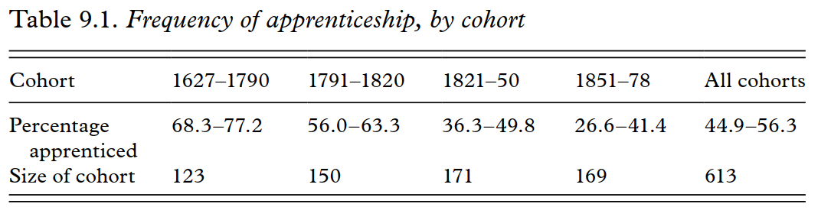
Institutional evolution: case study UK
(Humphries 2010)

Slide 24
Institutional evolution: case study UK
State involvement in labour markets
Early on, bans industrial unions but promotes “friendly societies”
Craft organizations offering sick leave, funeral costs, insurance, etc.
These eventually develop unemployment and strike benefits
Unites masters, journeymen and apprentices in one organization with shared interests

Slide 25
Institutional evolution: case study UK
Industrial relations develop around issue of limiting skilled labour
Craft unions aim to maintain high wages through scarcity
Leads to unemployed resources, conflict, particularly during economic downturns or shocks
Employers press for total control over apprenticeship, which is largely unregulated

Slide 26
Institutional evolution: case study UK
“Race to the bottom” competition over skills
Poaching skilled labour, poor-quality training and low pay for apprentices
Failure to establish credentialing system for apprenticeship until very late
Reluctance to impose compulsory vocational training (e.g. evening schools, mechanics’ institutes) as firms pursue low-skill equilibrium

Slide 27
Institutional evolution: case study Germany
In contrast, industrial employers and unions develop a more collaborative approach to skill formation
Imperial Germany grants monopoly on skill certification and training to master artisans (Handwerk)
Motives were conservative, to preserve artisan as political counterweight to Social Democrats popular among industrial workers

Slide 28
Institutional evolution: case study Germany
Handwerkergesetz/Handicraft Protection Law (1897)
Defined master artisan as someone over 24 years, passed journeyman’s examination or worked independently in artisanal sector for five years
Established local councils of artisans (Handwerkskammern) to regulate training
Participation compulsory
Solves coordination problem described above

Slide 29
Institutional evolution: case study Germany
Training does not formally occur in industry, industrial relations separate from control of skill supply
Unions instead focus on quality of training, wage structure

Slide 30
Institutional evolution: case study Germany
Industry largely happy with supply of skill from handwerk sector
In 1925, late in the game, 55% of apprentices trained in handwerk firms
Discontent arises from machine and metalworking firms
Supply and quality of skills from handwerk not sufficient
Began own training programmes (DATSCH), but these were not certified or recognized
Want to emulate and supplant training model

Slide 31
Institutional evolution: case study Germany
Weimar-era hyperinflation, post-war radicalism
State responds by recognizing industrial unions, which include unskilled workers
Unions press for wage compression
Skilled wages kept below marginal product encourages specific skill investment (Acemoglu and Pischke 1998)
Unskilled wages above marginal product leads to unemployment, encourages investment in specific skills

Slide 32
Institutional evolution: case study Germany
Industry faces limited domestic demand, has to compete internationally
Competitive advantage is in high-skill, high-quality segment
Leads to cooperation with unions over skill training, oversight
Elements of heavy industry (rural, few competitors) preferred firm-specific training and opposed reforms
Partial reform of training (new schools and standards), direction fairly clear

Slide 33
Institutional evolution
“Hollowing out” effect of radical change in liberal market economies
Shocks tend to erode training in Britain, consolidate it in Germany
Product-market specialisation in coordinated economies

Slide 34
Thank you!

