Slide 1
Resume Extractor
Zongdao Wen
Email: zongdaow@usc.edu

Slide 2
Introduction: Welcome to the "Resume Extractor" project presentation. In this project, I aim to automate the process of extracting key information from resumes using Named Entity Recognition (NER) model in Natural Language Processing (NLP).

Slide 3
Description
The model is trained with 200 resumes with entity annotations. The resume extractor could extract information that belongs to one of the following 10 entity categories.:
Years of Experience
Graduation Year
Companies worked at
College Name
Name
Designation
Location
Degree
Email Address
Skills
Data Preprocessing: Before training the model, I performed data preprocessing steps, including cleaning, tokenization, and normalization.

Slide 4
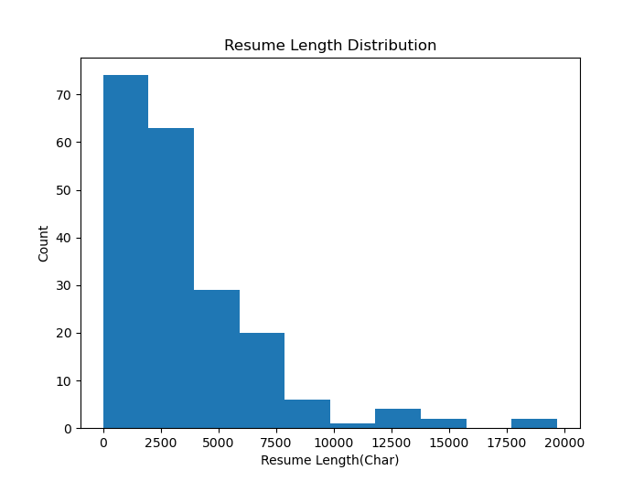
Resume Length (Avg. 3582 Char)

Slide 5
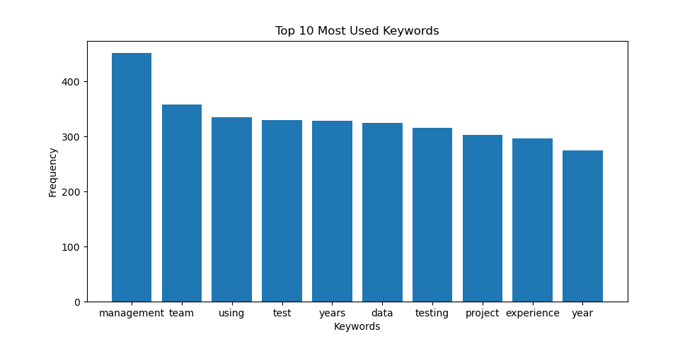
Top 10 Frequent Words

Slide 6
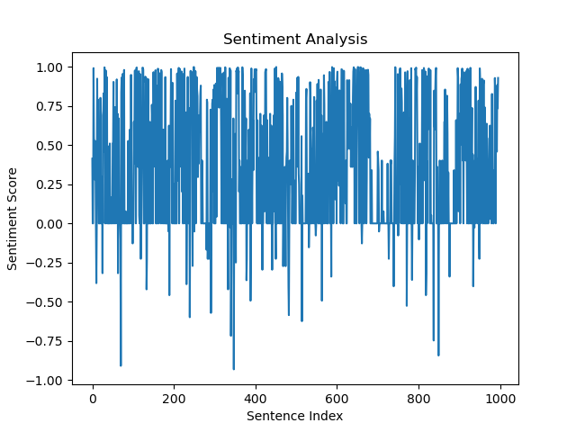
Sentiment Analysis (1 positive, -1 negative)

Slide 7
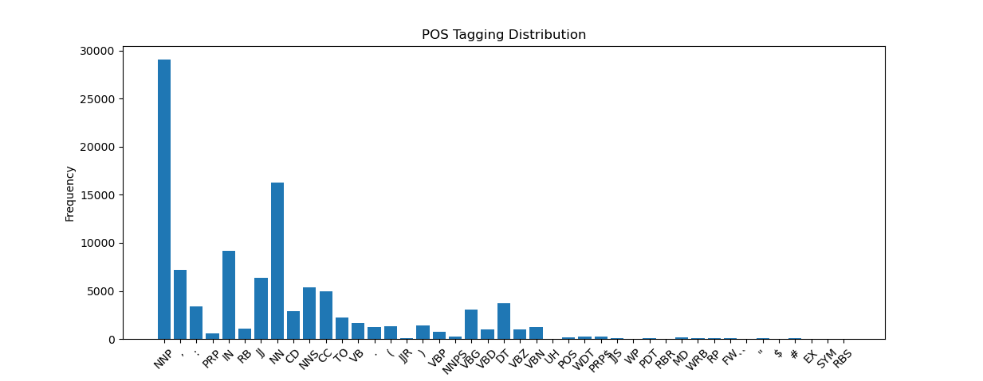
POS Tag Distribution
The data is predominantly with nouns.

Slide 8
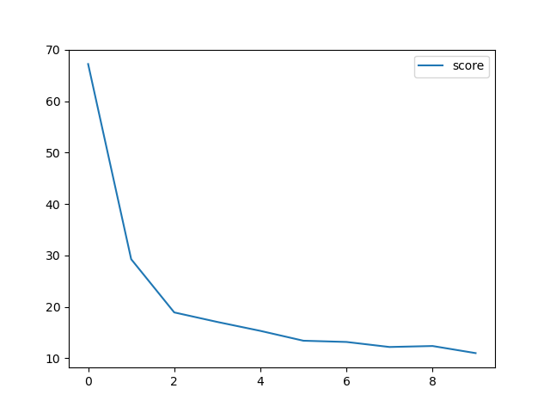
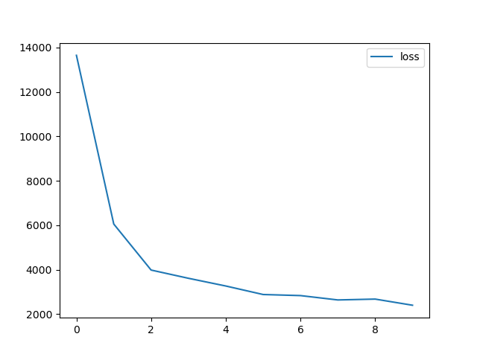
Training
NER Model: I employed a state-of-the-art NER model based on deep learning techniques.
Training Process: The model was trained on the annotated dataset using the popular Adam optimizer with a learning rate of 0.001.
Loss and Score: Throughout the training process, we plotted the loss and score to monitor the model's performance.

Slide 9
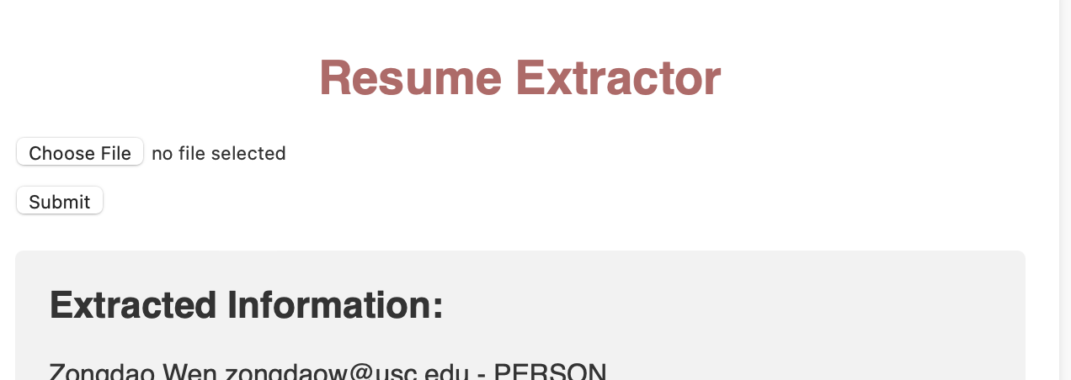
Flask App Integration
I successfully integrated the NER model into a user-friendly Flask app.
The app allows users to upload their PDF resumes and receive detailed information about their qualifications, skills, and experiences.

Slide 10
Conclusion
The spaCy NER (Named Entity Recognition) model is a powerful tool for extracting entities such as names, organizations, locations, and other predefined categories from text data like resumes. By training the NER model on a labeled dataset of resumes, it can learn to recognize and classify specific entities within new resume texts.
The project's success highlights its potential to significantly improve the efficiency of the recruitment process for companies and enhance candidates' chances of securing their dream jobs.
Future Enhancements: Going forward, I plan to enhance the model's performance by incorporating more labeled data and exploring advanced NLP techniques.

Slide 11
Thank You
Github: https://github.com/louiswenz

