Slide 1

Exploratory Data Analysis
Cab Investment Firm
May 20, 2023
Zongdao Wen

Slide 2
Background
XYZ, a private company based in the US, intends to invest in the Cab industry due to its notable expansion over the past few years and the presence of numerous significant competitors in the market.
Objective: Identify the right company for making investment.

Slide 3

Data
1/31/2016 - 12/31/2018

Slide 4
Approach
The 4 CSV files are combined using pd.merge. First, Transcation_ID and Cab_Data are merged based on Transactio ID column. The resulting data frame is then merged with Customer_ID based on Customer ID column. Finally, the resulting data frame is merged with City based of City column. Rows with n/a values are dropped.
The date column of the final combined data frame is then being separated into two columns: Year and Month. In addition, profit per km column is created and added to the data frame for every observation. The resulting data frame contains 359392 rows and 17 columns

Slide 5
Assumptions
Profits are calculated strictly by finding the difference between Price_charged and Cost_of_Trip.
Rows with n/a values are dropped. The resulting data has no outliers. Every ride has a Customer ID and Transaction ID.

Slide 6
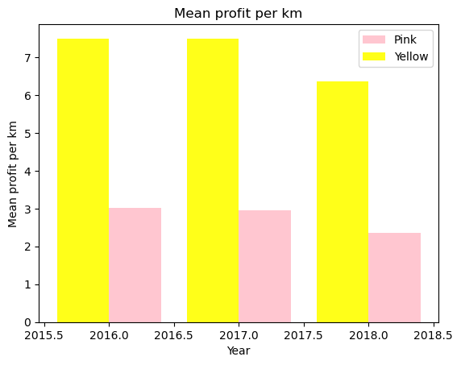
Average Profit /KM
The graph shows the average profit per km for the two cab companies.
Yellow cab makes almost double the profit per km compared to pink cab.

Slide 7
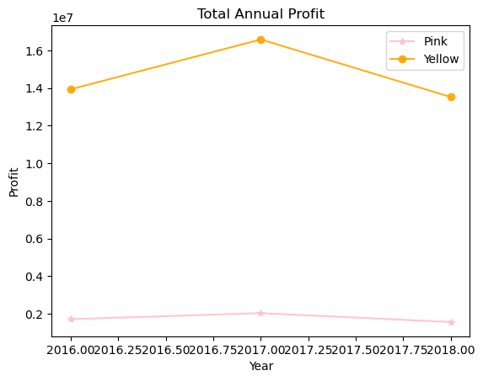
Annual Profit
The graph shows the annual total profit for the two cab companies.
Yellow cab makes significantly more profit than pink cab.

Slide 8
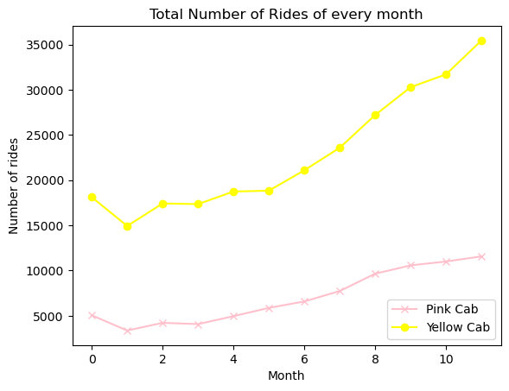
Total Monthly Rides
The graph shows the total monthly number of rides for the two companies from 2016-2018.
Yellow cab has triple the amount of rides compare to pink cab.
They behaves similarly over the months.

Slide 9
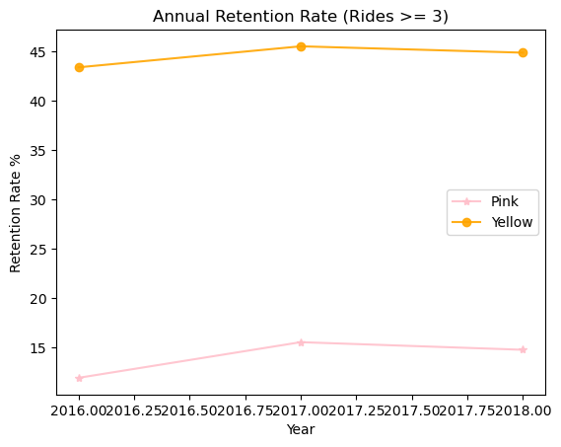
Annual Customer Retention
The graph shows the annual customer retention rate. A customer is considered ‘loyal’ if this individual takes >= 3 rides.
Yellow cab has a higher customer retention rate than pink cab.

Slide 10
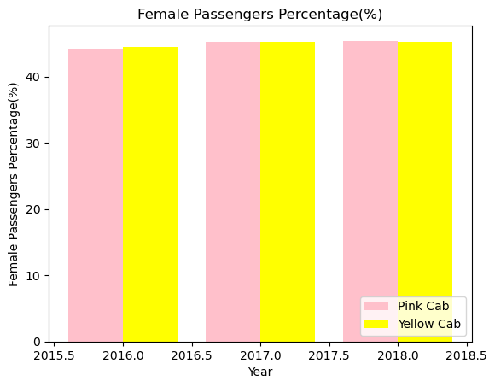
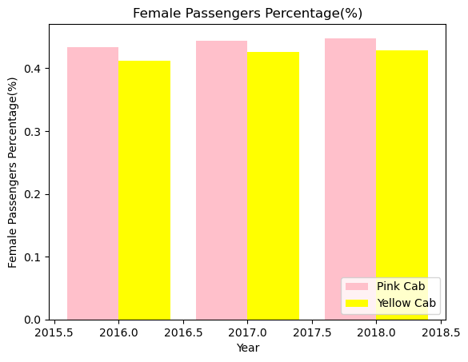
Female Passenger %
Female user %
Female rides %
Yellow cab and the pink cab have almost the same percentage of female users.
Pink cab have more female rides than yellow cab which indicates the female users use pink cab more often compared to yellow cab

Slide 11
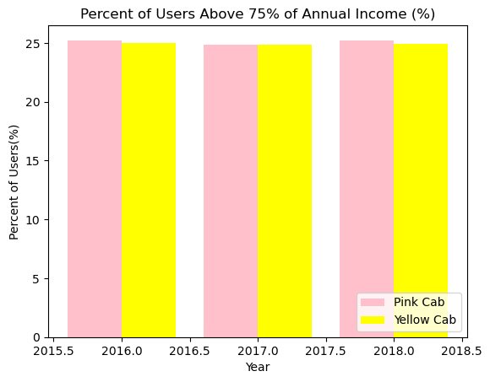
Income
The graph shows the percent of users that are in the 75th percentile of national average income.
Yellow cab and pink cab has the same income demographic percentage.

Slide 12
Observations
Profit: Yellow Cab is a larger company compared to Pink Cab. Yellow Cab is more profitable per KM travelled and its annual profit is nearly 7 times more than pink cab.
Seasonality: The number of Yellow Cab and Pink Cab rides experience the same trend throughout the months.
Customer retention: If we considered at least 3 rides as loyal customer. Yellow Cab can retain customers better than Pink Cab.
Income Demographic: Both cab companies have approximately the same demographic oh customers in terms of income.
Gender Demographic: Pink Cab has a larger portion of rides that are female compared to Yellow Cab.

Slide 13
Recommendation
Yellow Cab is recommended for investment if the goal of investment is to generate more profit.
Pink Cab is recommended for investment if the goal is to expand female market.

Slide 14
Thank You

